Slide 1

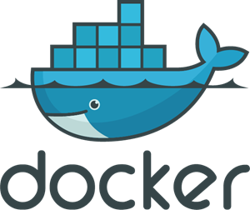





Slide 2




Trigger
ECS Container
1
5
Response Metrics
AWS CLI
startTest
DynamoDB
Response
metrics
4
test files
3
response
Rebuild
test files
2
S3

Slide 3
