Slide 1

YOUR
BUSINESS
Here is where your presentation begins

Slide 2
TABLE OF CONTENTS
01
MARS
02
MERCURY
03
VENUS
04
JUPITER
Here you can describe the topic of the section
Here you can describe the topic of the section
Here you can describe the topic of the section
Here you can describe the topic of the section

Slide 3
WHOA!
This could be the part of the presentation where you can introduce yourself, write your email...

Slide 4
“This is a quote, words full of wisdom that someone important said and can make the reader get inspired.”
—SOMEONE FAMOUS

Slide 5
01
COMPANY
You can enter a subtitle here if you need it

Slide 6
THE SLIDE TITLE GOES HERE!
Do you know what helps you make your point clear? Lists like this one:
● They’re simple
● You can organize your ideas clearly
● You’ll never forget to buy milk!
And the most important thing: the audience won’t miss the point of your presentation

Slide 7
MAYBE YOU NEED TO DIVIDE THE CONTENT
Mercury
Venus
Mercury is the closest planet to the Sun and the smallest one in the Solar System
Venus has a beautiful name and is the second planet from the Sun

Slide 8
YOU COULD USE THREE COLUMNS, WHY NOT?
MARS
JUPITER
SATURN
Despite being red, Mars is a cold place
It’s a gas giant and the
biggest planet
It’s composed of hydrogen and helium

Slide 9

A PICTURE ALWAYS
REINFORCES THE
CONCEPT
Images reveal large amounts
of data, so remember: use an
image instead of long texts

Slide 10
PROCESS
STEP 2
STEP 3
Saturn is the
ringed one and a gas giant
Neptune is the
farthest planet
from the Sun
STEP 1
STEP 4
Mercury is the
closest planet to the Sun
It’s the biggest
planet in the Solar System

Slide 11
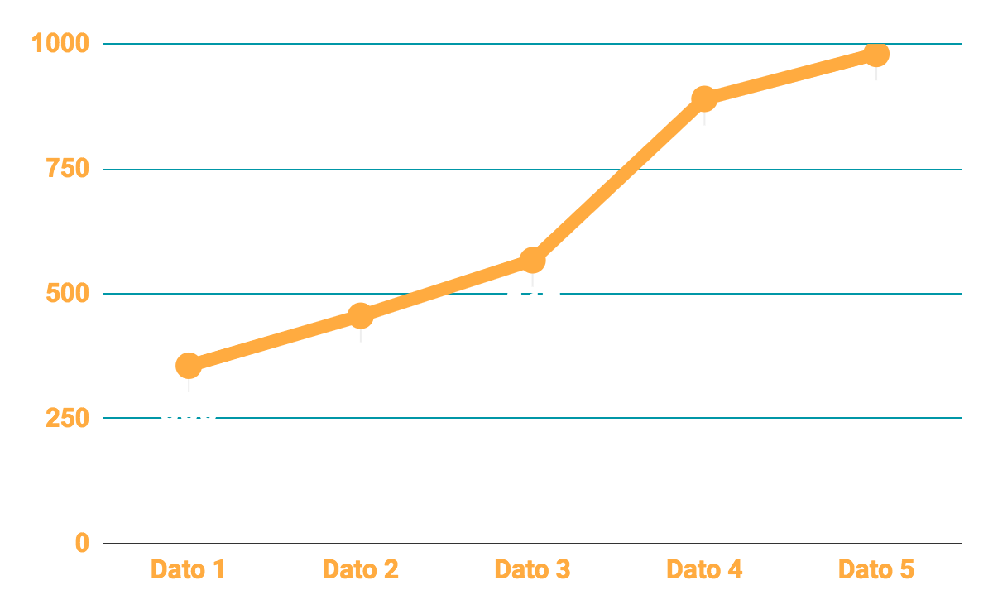
YOUR GRAPH
To modify this graph, click on it, follow the link, change the data and replace it here

Slide 12
SOMETIMES, REVIEWING
CONCEPTS IS A GOOD IDEA
01
02
03
04
05
06
Mercury is the
closest planet to
the Sun
Venus has a
beautiful name,
but it’s terribly hot
Despite being red,
Mars is actually a cold
place
It’s the biggest
planet in the Solar
System
Saturn is the
ringed one and a
gas giant
Neptune is the
farthest planet
from the Sun

Slide 13

A PICTURE IS WORTH A THOUSAND WORDS

Slide 14
GROWTH
35%
45%
64%
YEAR 1
YEAR 2
YEAR 3
Mercury is the
closest planet to
the Sun
Venus has a
beautiful name,
but it’s terribly hot
It’s the biggest
planet in the Solar
System

Slide 15
THIS IS A TABLE
 | MASS (earths) | DIAMETER (earths) | SURFACE GRAVITY (earths)
MERCURY | 0.06 | 0.06 | 0.06
MARS | 0.06 | 0.06 | 0.06
SATURN | 0.06 | 0.06 | 0.06

Slide 16
INFOGRAPHICS MAKE YOUR IDEA
UNDERSTANDABLE
Despite being red, Mars is a cold place
Mercury is the smallest planet
Jupiter is the biggest planet
Venus has a beautiful name

Slide 17
MAYBE FOUR COLUMNS
Mercury
Venus
Mars
Jupiter
Mercury is the
Smallest planet
Venus has a
beautiful name
Despite being red,
Mars is a cold
It’s the biggest
planet of them all

Slide 18
THIS IS A MAP
01
02
03
04
05
03
Mercury
01
Mars
04
Saturn
Jupiter
02
05
Venus

Slide 19
A TIMELINE ALWAYS WORKS WELL
Venus has a
beautiful name
Saturn is the ringed one and a gas giant
DAY 1
DAY 3
DAY 5
DAY 2
DAY 4
Mercury is the closest
planet to the Sun
Despite being red,
Mars is a cold place
Neptune is the farthest planet

Slide 20
234,000
Big numbers catch your audience’s attention!

Slide 21
24h 37m
$234,000
234
earths is the Sun’s mass
is Jupiter’s rotation period
is a very high temperature

Slide 22


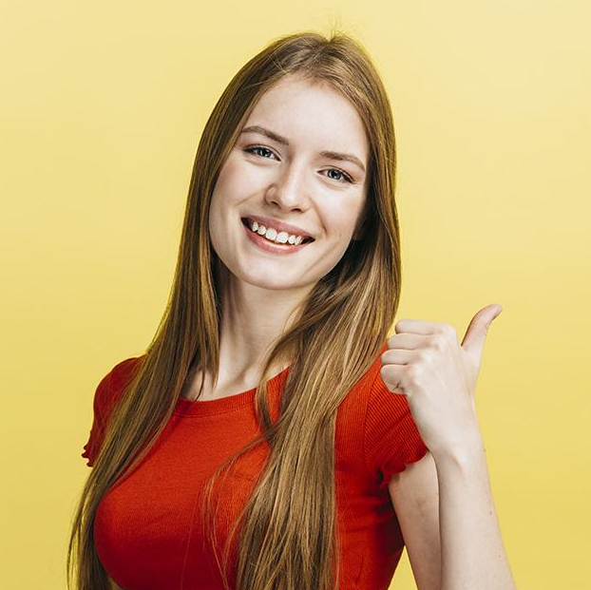
OUR TEAM
VENUS
MARS
SATURN
Venus has a
beautiful name,
but it’s terribly hot
Despite being red,
Mars is actually a cold
place
Saturn is the
ringed one and a
gas giant

Slide 23

DESKTOP SOFTWARE
You can replace the image on
the screen with your own
work. Just delete this one,
add yours and center it properly

Slide 24
TABLET APP
You can replace the image on the screen with your own work. Just delete this one, add yours and center it properly

Slide 25
MOBILE WEB
You can replace the image
on the screen with your
own work. Just delete this
one, add yours and center it properly

Slide 26
MORE INFORMATION
VENUS
MARS
224K
110M

Slide 27
AWESOME
WORDS
AWESOME
WORDS
AWESOME
WORDS
Because key words are great for
catching your audience’s attention
Because key words are great for
catching your audience’s attention
Because key words are great for
catching your audience’s attention

Slide 28
PRICE LIST
$55,200
$67,200
$90,500
MARS
VENUS
JUPITER
Benefit 1
Benefit 2
Benefit 3
Benefit 1
Benefit 2
Benefit 3
Benefit 1
Benefit 2
Benefit 3

Slide 29
STRATEGIC ALLIES
MARS
JUPITER
SATURN
129,000
349,000
178,000
Mars is a cold place
Jupiter is the biggest
Saturn has several rings

Slide 30
TESTIMONIALS
—JOHN DOE
—HELENA PATTERSON
“Jupiter is the biggest planet in the Solar System and the fourth-brightest object in the night sky”
“Saturn, the ringed planet, is a gas giant and is composed mostly of hydrogen and also helium”

Slide 31
ALTERNATIVE RESOURCES
PHOTOS
Massage what makes you unique over dartboard background
Man making the call me sign
Low angle woman wearing suit on balcony
Group of business people in a meeting
Man holding a cup
Medium shot man holding frame
Joyful business team waving on office stairway
Group of male architect using laptop while looking at blueprint

Slide 32
RESOURCES
Did you like the resources on this template? Get them for free at our other websites.
PHOTOS
Group of young business people analyzing graph over wooden desk
Man with binoculars
Group of young male architect analyzing blueprint
Smiley girl with yellow background
Happy young woman gesturing thumb up against bright yellow surface
Portrait of positive man with retro camera standing isolated
Multiracial group of cheerful coworkers
VECTORS
Geometric logo collection
Abstract infographics options number workflow template design
Colorful step business infographic with numbers
Concept of flat computer engineering
Modern tiktok interface on smartphone
Digital device mockup

