Slide 1
SOFTWARE DEVELOPMENT PROJECT

Slide 2
THE ULTIMATE JOURNEY
SUBMITTED BY: TARIQUL ISLAM 15-01-04-081 MASHRUR TAJWAR 15-01-04-062

Slide 3
about
SINGLE PLAYER GAME
SOFTWARES USED: ANDROID STUDIO,PHOTOSHPO
PROGRAMMING LANGUAGE :JAVA

Slide 4
features
THE MAIN CHARACTER HAS TO COMPLETE A PATH TO REACH THE DESTINATION.
THERE WILL BE SEVEREL OBSTACLES IN THE PATH.
THERE WILL BE 5 LIFELINES FOR THE GAMER.
EACH TIME THE CHARACTER GET COLLUDED WITH THE OBSTACLE ,THE CHARACTER WILL LOST LIFELINE.

Slide 5
features
THE TIME TO COMPLETE THE DISTANCE WILL BE COUNTED.
THE GAMER WHO WILL TAKE MINIMUM TIME TO COMPLETE THE PATH WILL BE THE TOP SCORER.
THE GAMER CAN CONTROL THE CHARACTER BY TAPPING ON THE SCREEN.

Slide 6
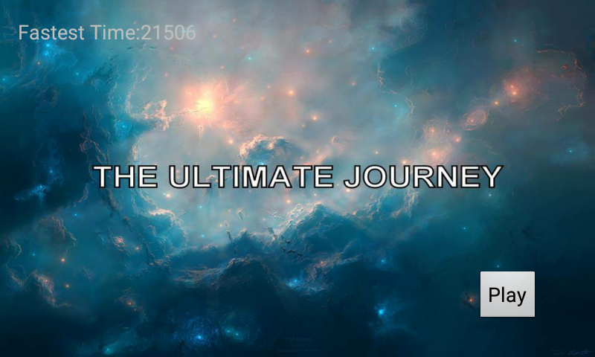
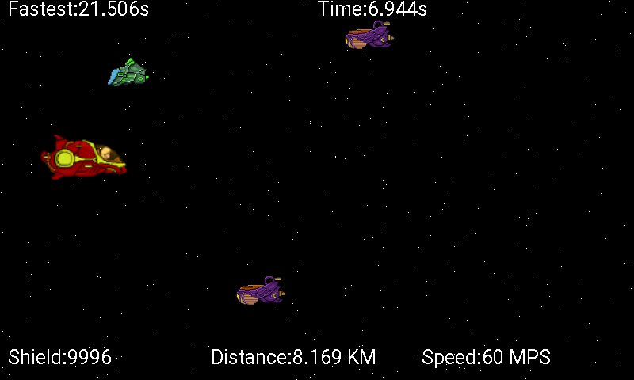
SNAP SHOTS

Slide 7
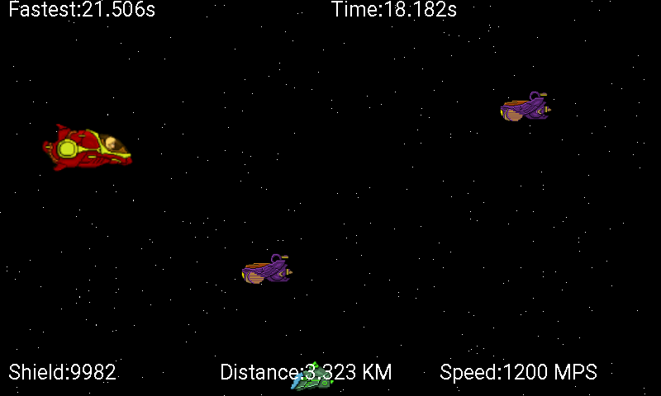
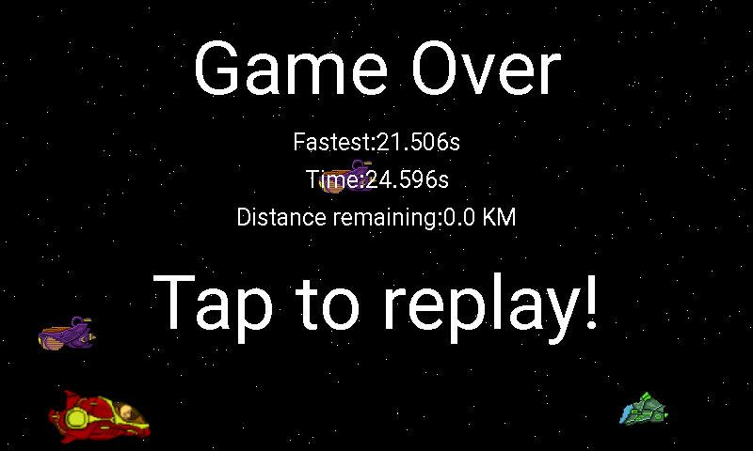
Snap shots

Slide 8


