Slide 1
EECE680C
Homework #1 Solutions

Slide 3
1.

Slide 4
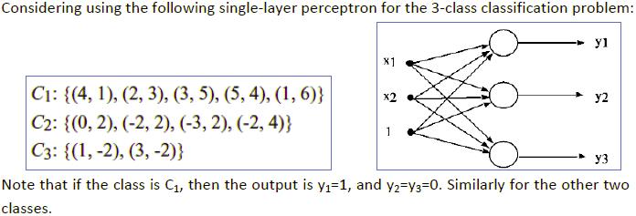

2.
Solution:
(a) yes. The three classes are linearly separable. The first neuron y1 can be used to separate C1 from C2&C3. The second neuron y2 can be used to separate C2 from C1&C3. The third neuron y3 can be used to separate C3 from C1&C2.
(b)No. After adding (-1,6) to C1, then there is no way to separate C2 from C1&C3 with a linear line (i.e., a single neuron).

Slide 5

3.
(a)
For AND gate, let y=(w1*x1+w2*x2+b), where w1=w2=1, and b=-1.5.
For OR gate, let y=(w1*x1+w2*x2+b), where w1=w2=1, and b=-0.5.
For complement, let y=(w*x+b), where w=-1, and b=0.5.
(b)
XOR is not linearly separable.

Slide 6

4.
No standard solution needed.

