Slide 1
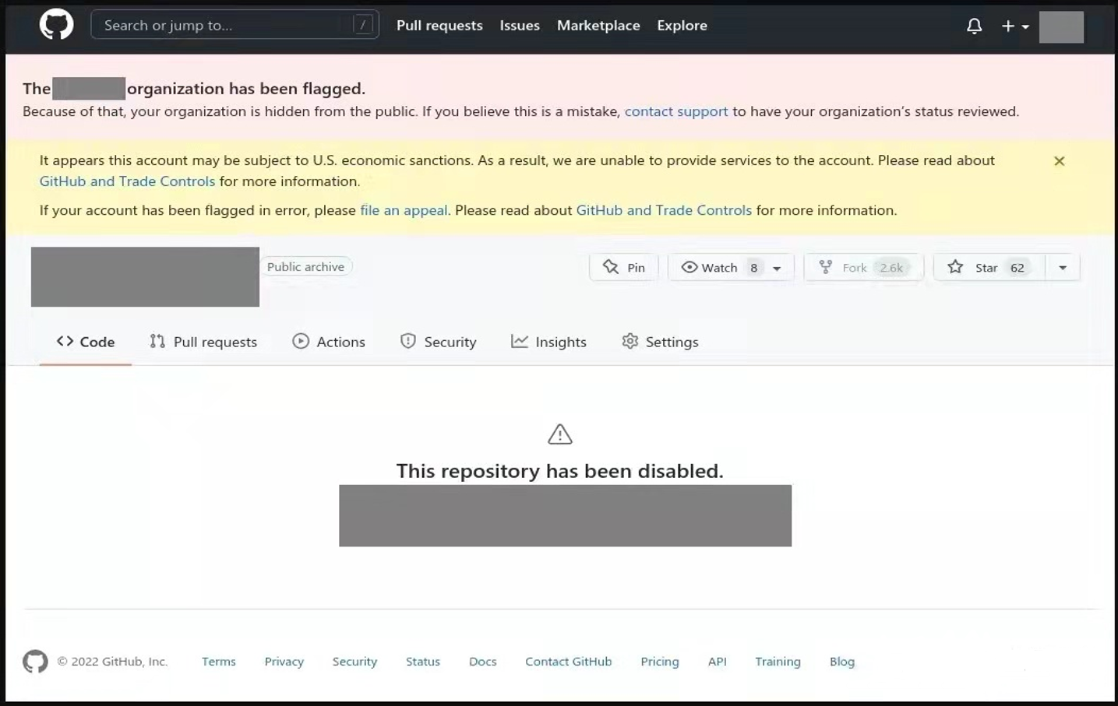
According to Russian software developers, if they work for companies sanctioned by the United States, their GitHub accounts will be blocked without prior warning.

Slide 2
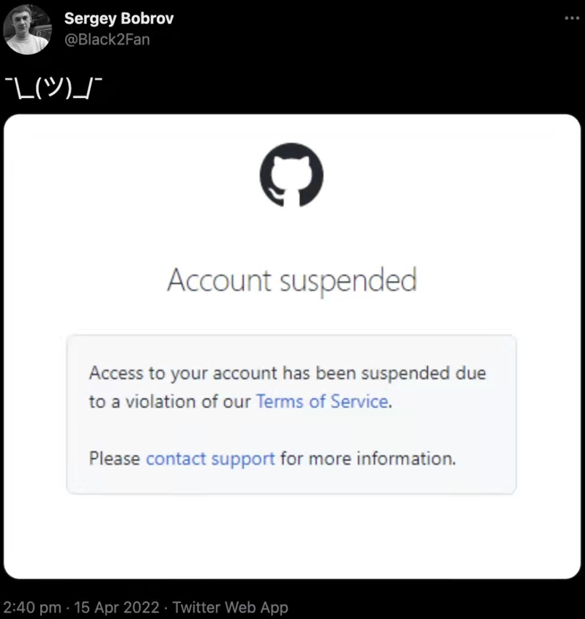
The GitHub accounts of many Russian companies, first code hosting projects were disabled and then deleted entirely from the platform.

Slide 3
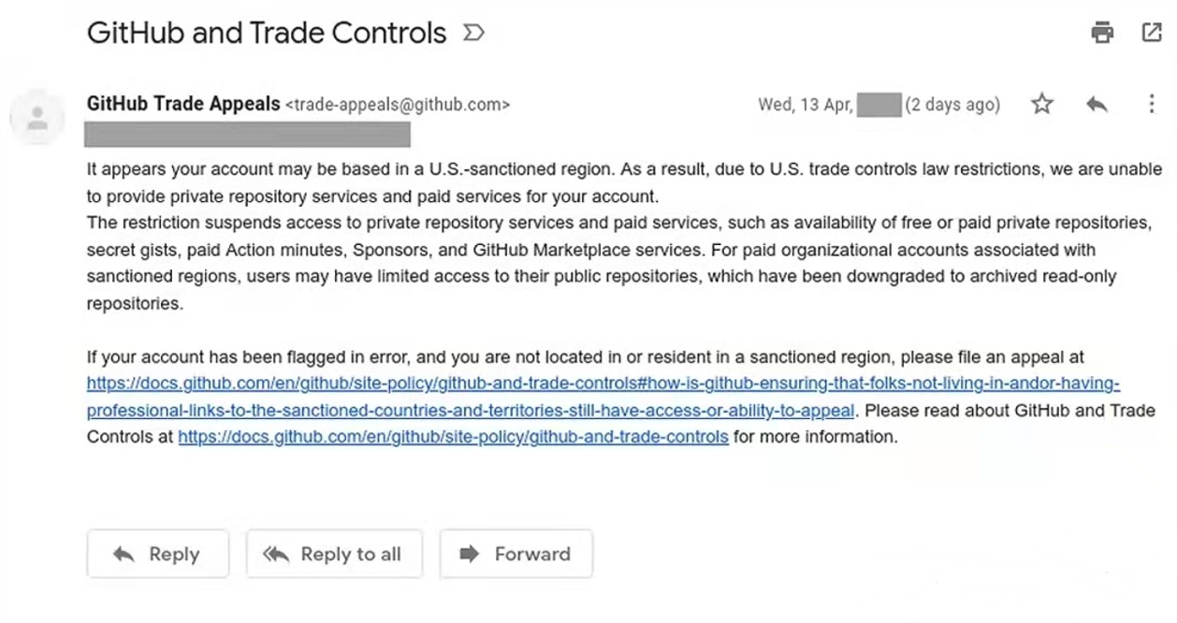
GitHub explained that their account was banned because of the government's economic sanctions. The move is not particularly surprising given that these companies are on the U.S. Treasury's sanctions list, and GitHub is owned by Microsoft of the United States.

Slide 4
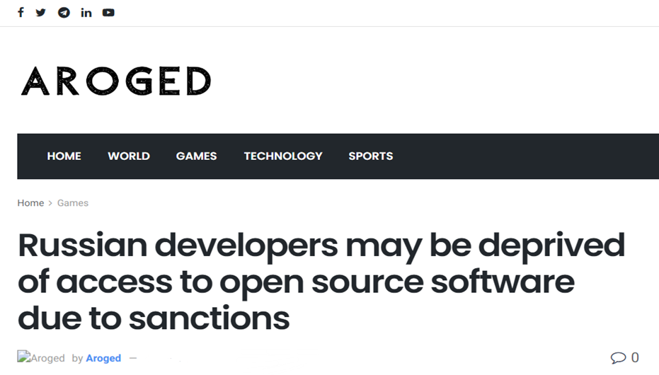

In response to the news, the Russian government announced plans to create a domestic alternative to GitHub by the end of 2022. One of the tasks of the project is to develop state-owned open source software.

Slide 5
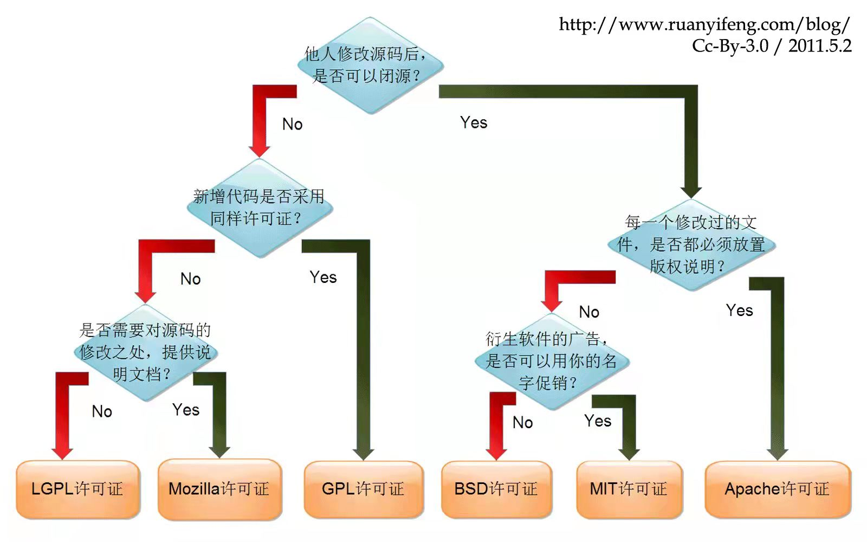
Open source knows no national boundaries?
but people who write code have national boundaries
In order to prevent monopoly, we must develop our own core products
Thanks for your listening!

