Slide 1







Key
 | Birds
 | Plants
 | Mammals
 | Fish
 | Invertebrates
 | Benthos
 | Plankton

Slide 2
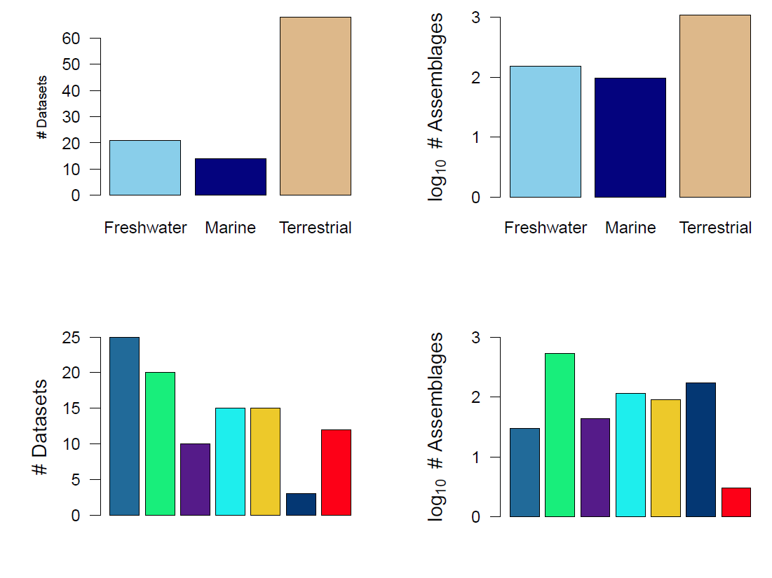

Slide 3
