Slide 1







Key
 | Birds
 | Plants
 | Mammals
 | Fish
 | Invertebrates
 | Benthos
 | Plankton
Notes:
Bird – created by parkjisun
Tree – created by Delwar Hossain,
Deer – created by Francisca Arévalo
Fish – created by Iconic
Butterfly – created by Jacqueline Fernandes
Shell – created by B Barrett Noun project
Bacteria – created by Boris Belov

Slide 2
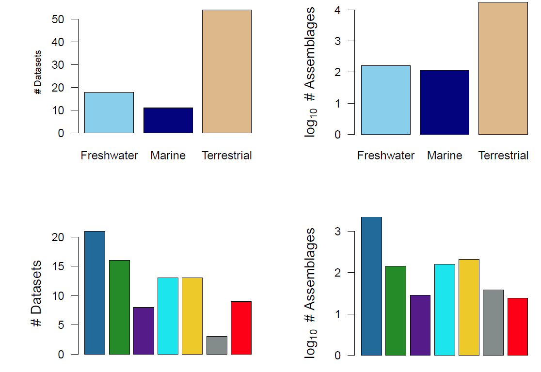
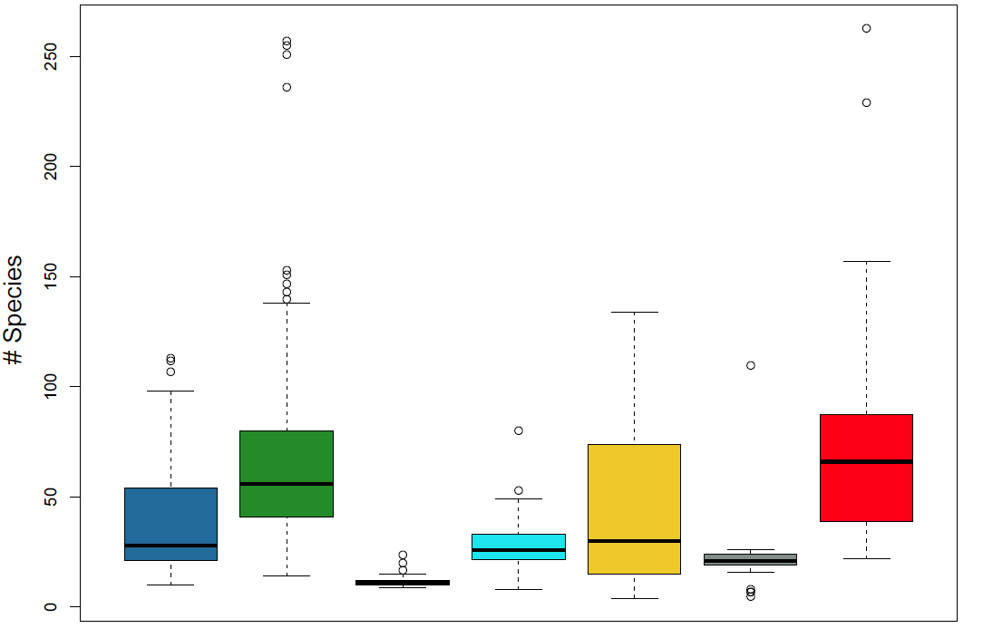
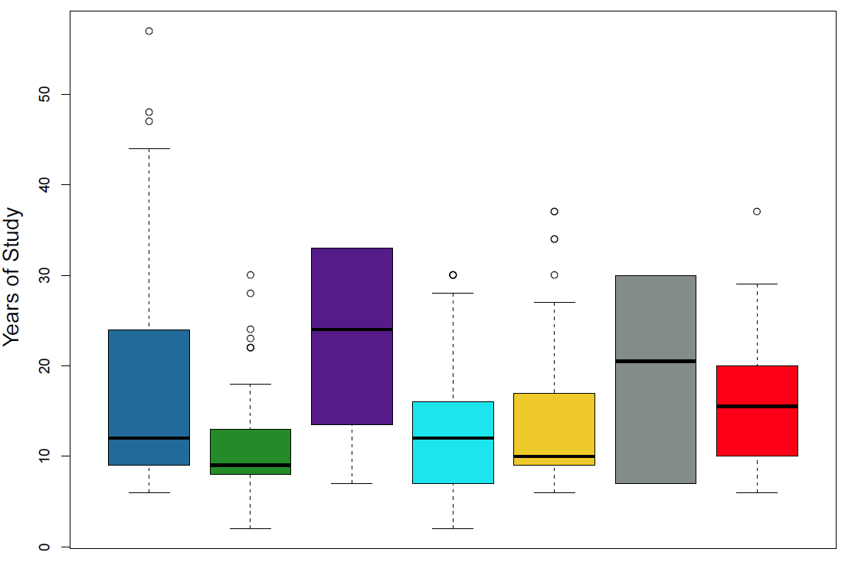
Fig 1a-1f

Slide 3
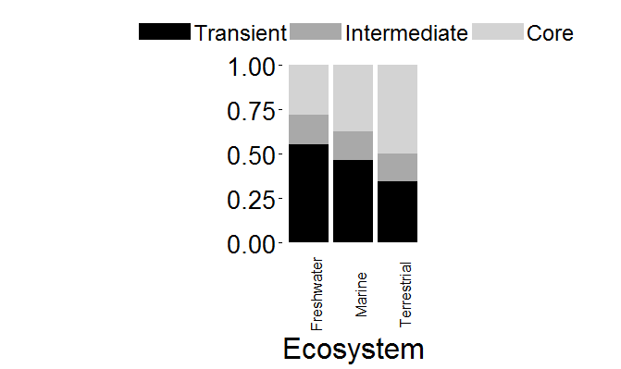
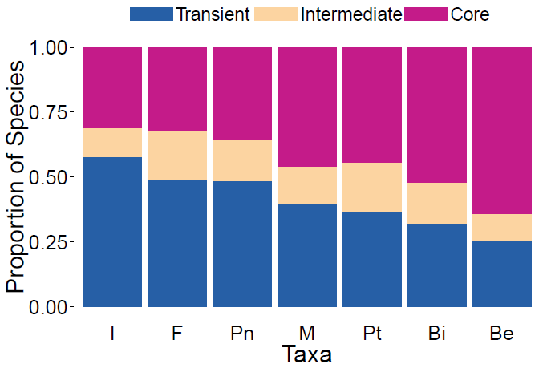
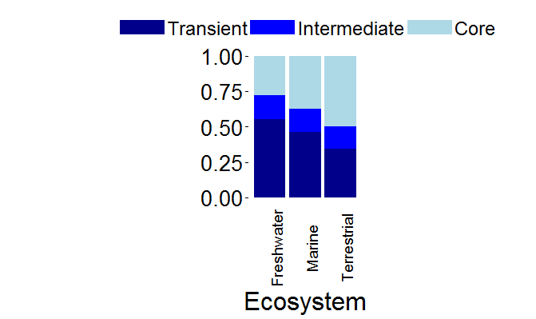
Fig 2a-2b
Check colors, grid print?

Slide 4
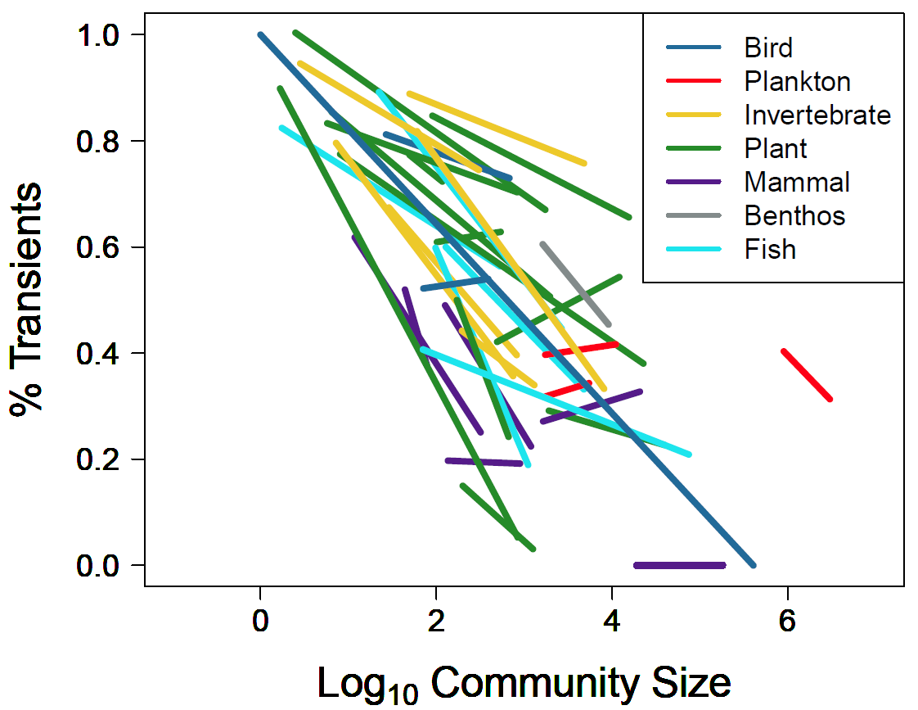
% area
Currently only have smallest sampling grain
Figures 3a, 3b. Proportion of transient and core species by log of community size (number of individuals), colored by taxa, using the hierarchically scaled datasets.

Slide 5
Fig 4a – 4d

Slide 6
