Slide 1







Key
 | Birds
 | Plants
 | Mammals
 | Fish
 | Invertebrates
 | Benthos
 | Plankton
Notes:
Bird – created by parkjisun
Tree – created by Delwar Hossain,
Deer – created by Francisca Arévalo
Fish – created by Iconic
Butterfly – created by Jacqueline Fernandes
Shell – created by B Barrett Noun project
Bacteria – created by Boris Belov

Slide 2
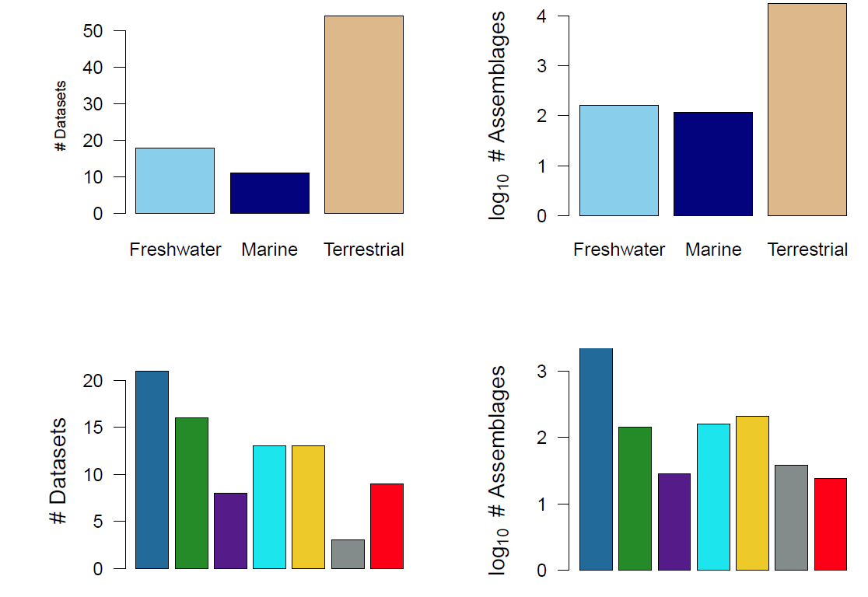

Slide 3
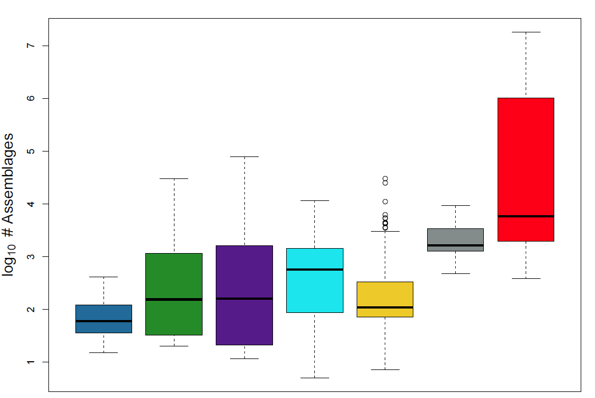
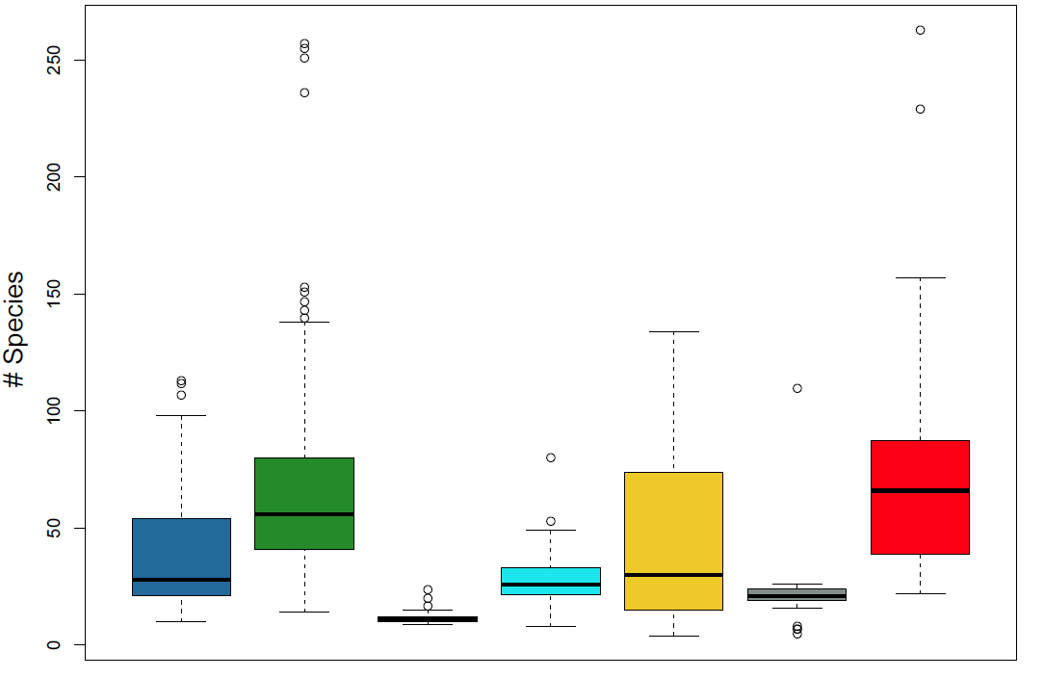

Slide 4
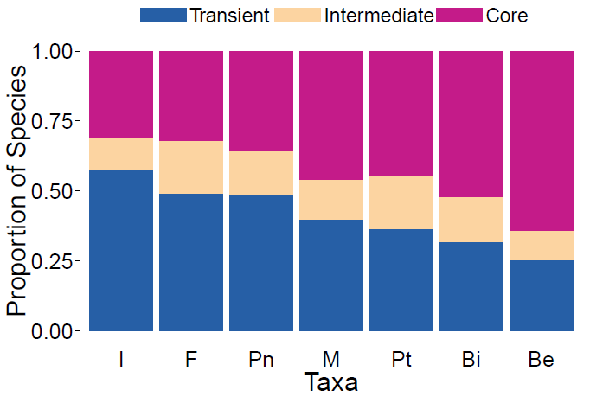

Slide 5
