Slide 1











Key
 | Birds
 | Plants
 | Mammals
 | Fish
 | Invertebrates
 | Benthos
 | Plankton
Notes:
Bird – created by parkjisun
Tree – created by Delwar Hossain,
Deer – created by Francisca Arévalo
Fish – created by Iconic
Butterfly – created by Jacqueline Fernandes
Shell – created by B Barrett Noun project
Bacteria – created by Boris Belov
Mountains by alice noir, ocean by alex muravev, lake by Pieter smits

Slide 2
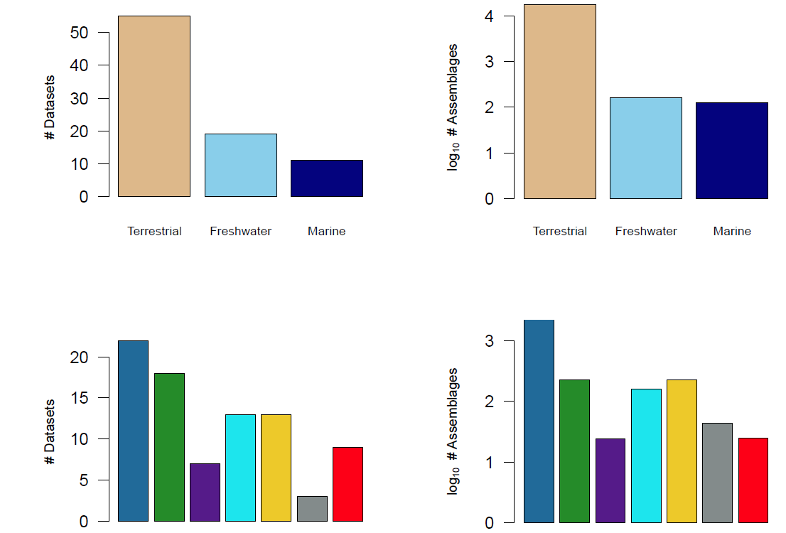
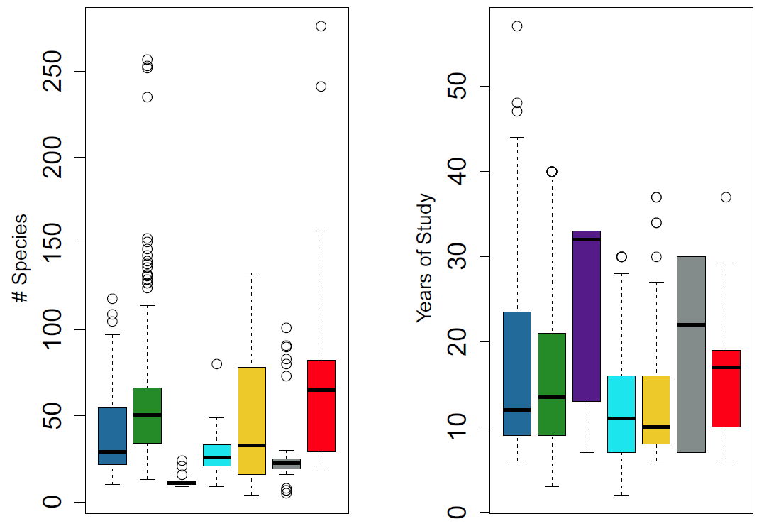
Fig 1a-1f

Slide 3
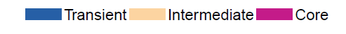
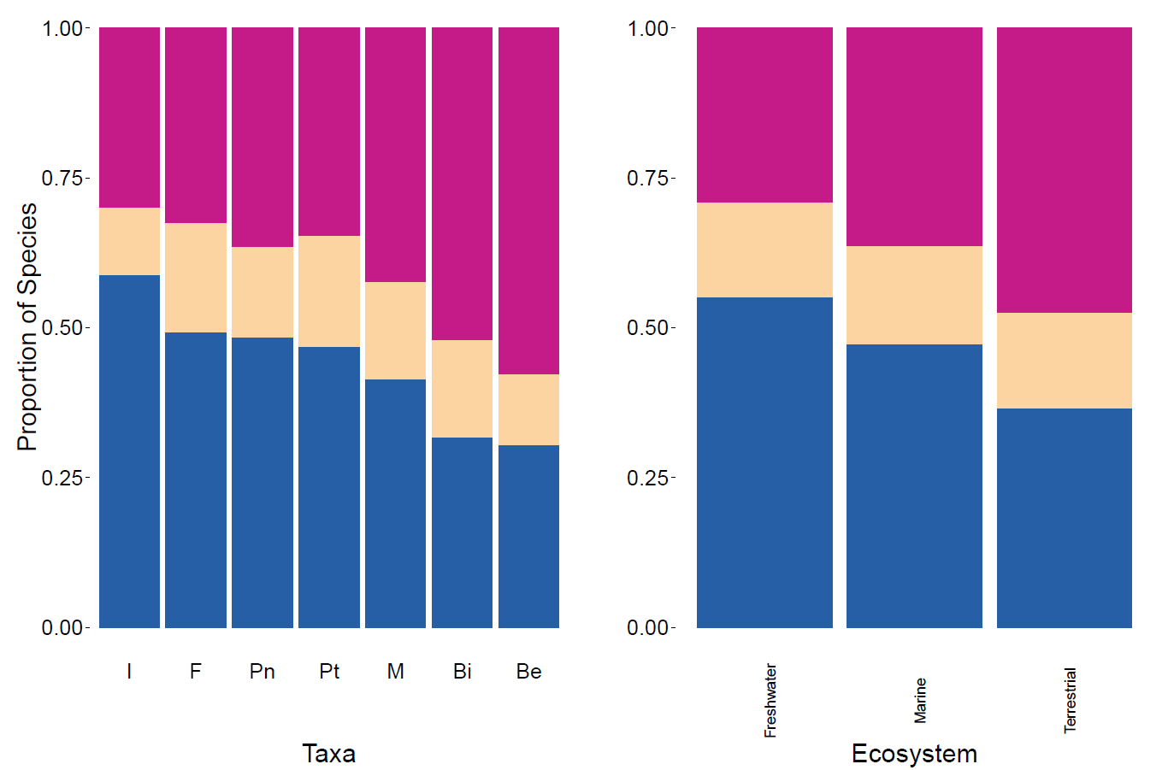
Fig 2a-2b

Slide 4
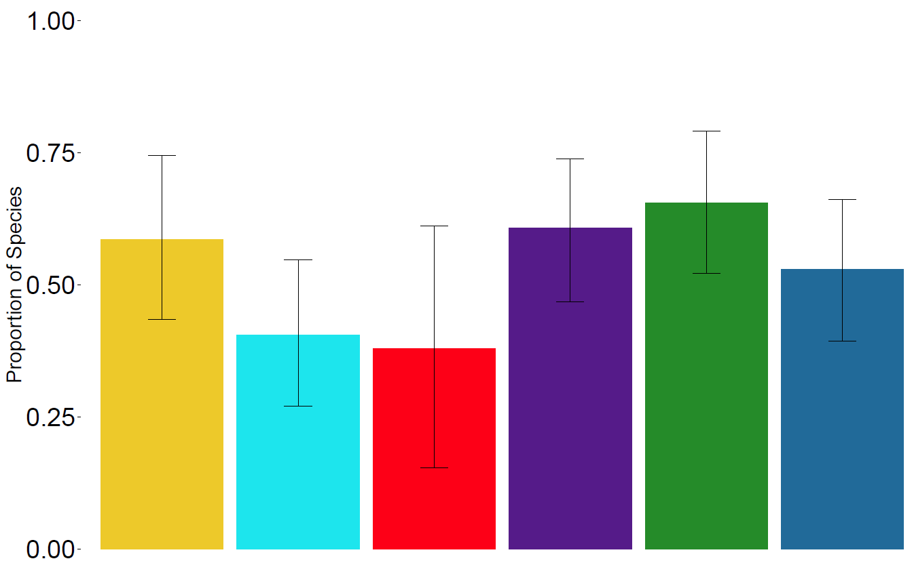
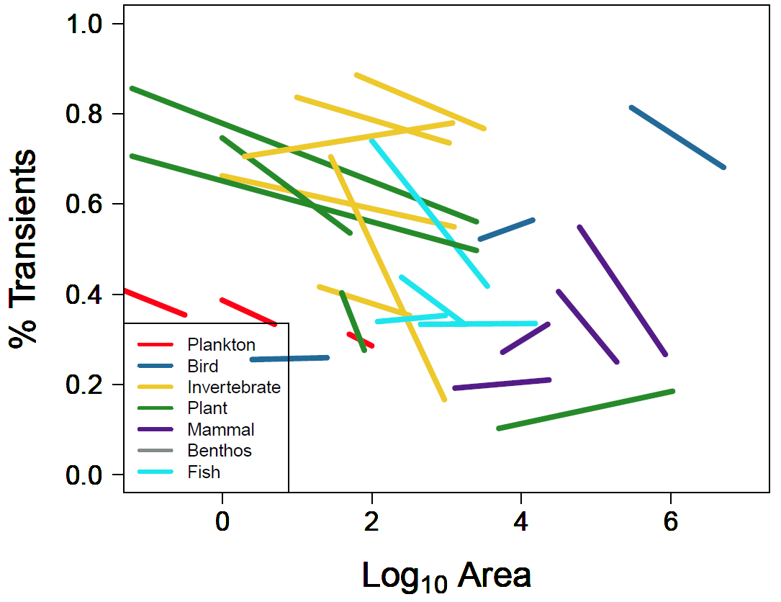
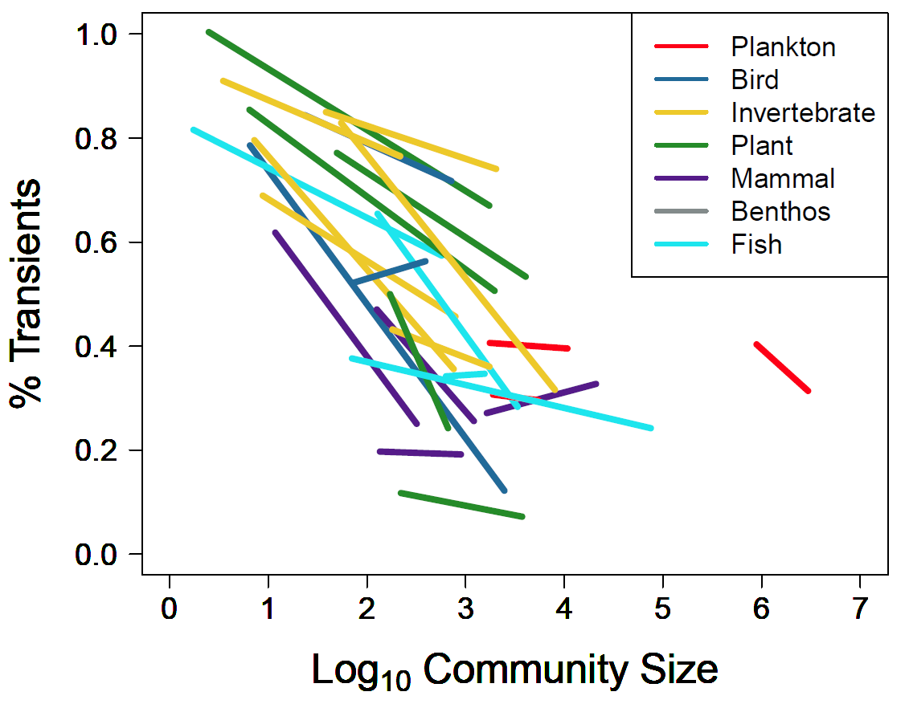
Fig 3a-3c
Figure3a. Proportion of transient species by log of area, colored by taxa, using the hierarchically scaled count datasets.
Figure3b. Proportion of transient species by log of community size (number of individuals), colored by taxa, using the hierarchically scaled count datasets.
Figure3c. Predicted values of hierarchically scaled count datasets by taxa.

Slide 5
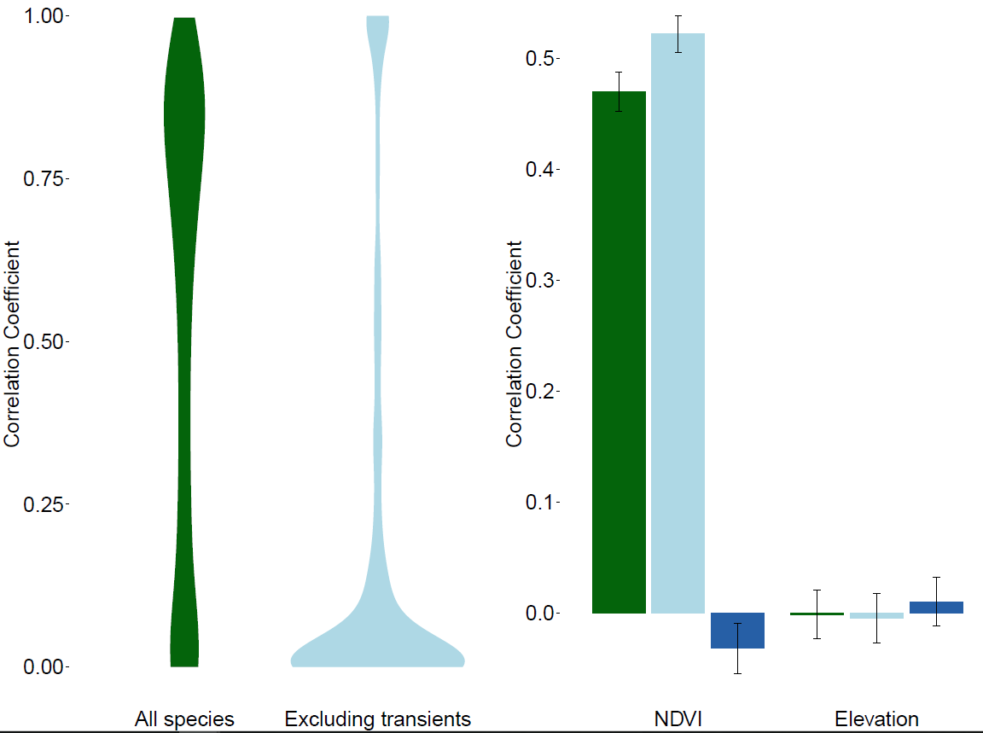
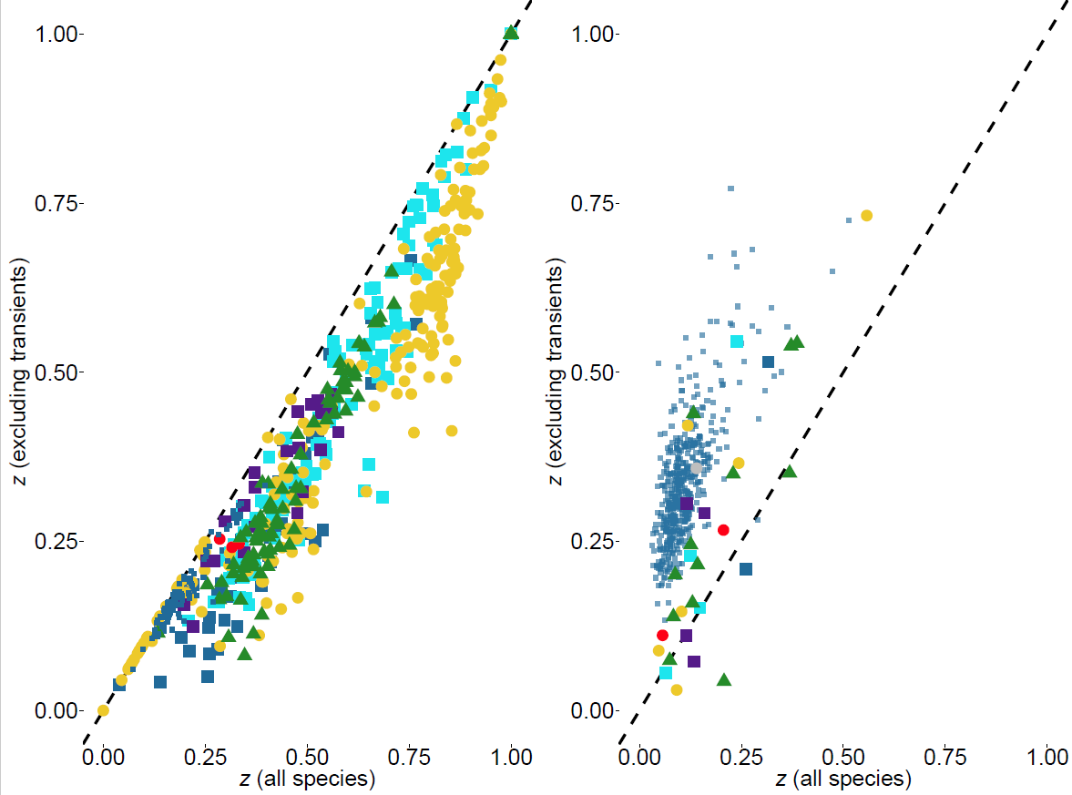
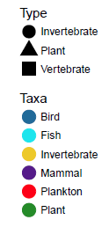
Fig 4a-4d

Slide 6
