Slide 1










Key
 | Birds
 | Plants
 | Mammals
 | Fish
 | Invertebrates
 | Benthos
 | Plankton
 | Birds |  | Invertebrates
 | Plants |  | Benthos
 | Mammals |  | Plankton
 | Fish
Terrestrial
Marine
Freshwater
Notes:
Bird – created by parkjisun
Tree – created by Delwar Hossain,
Deer – created by Francisca Arévalo
Fish – created by Iconic
Butterfly – created by Jacqueline Fernandes
Shell – created by B Barrett Noun project
Bacteria – created by Boris Belov
Mountains by alice noir, ocean by alex muravev, lake by By Anton Gajdosik

Slide 2
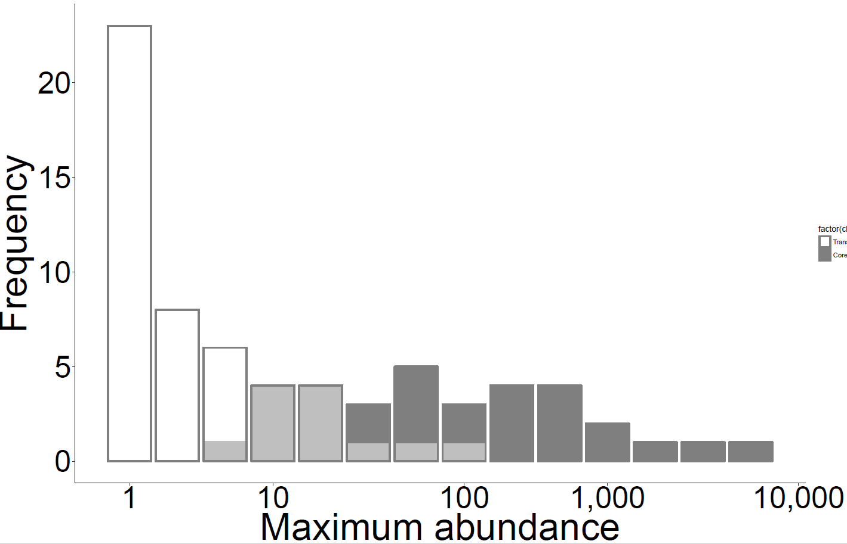
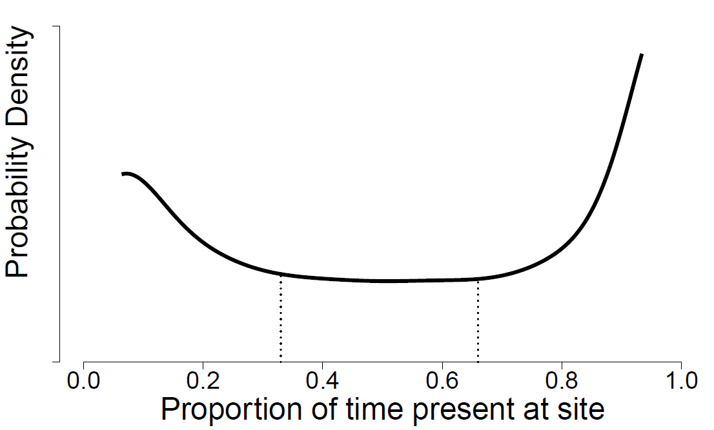
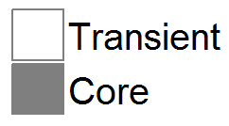
6 panel conceptual figure
A
B
Transient
Core
Figure 1. (A) Bimodal distribution of temporal occupancy for North American birds from Coyle et al. (2013). (B) Core and transient species exhibit different species abundance distributions for the Hinkley Point fish assemblage (Magurran and Henderson 2003). (C) Four contiguous quadrats in which species (different shapes) may be core (shaded) or transient (open). (D) The species-area relationships for (C) depending on whether transient species are excluded or not, using the lower right panel to represent the smallest area. Because every species is core in at least one quadrat, species richness at the largest scale is the same for the two relationships. (E) Temporal turnover (using one minus the Jaccard index of similarity) is much lower when transient species are excluded from the calculation, since they are the species most driving turnover.
C
D
All species
log(Species)
Excluding transients
log(area)
E
All species:
= 50%
Excluding
transients:
0
= 0%
time $t_{1}$
time $t_{2}$
Turnover

Slide 3







Species temporal occupancy strongly determined by environment
Species temporal occupancy strongly determined by competition

Slide 4
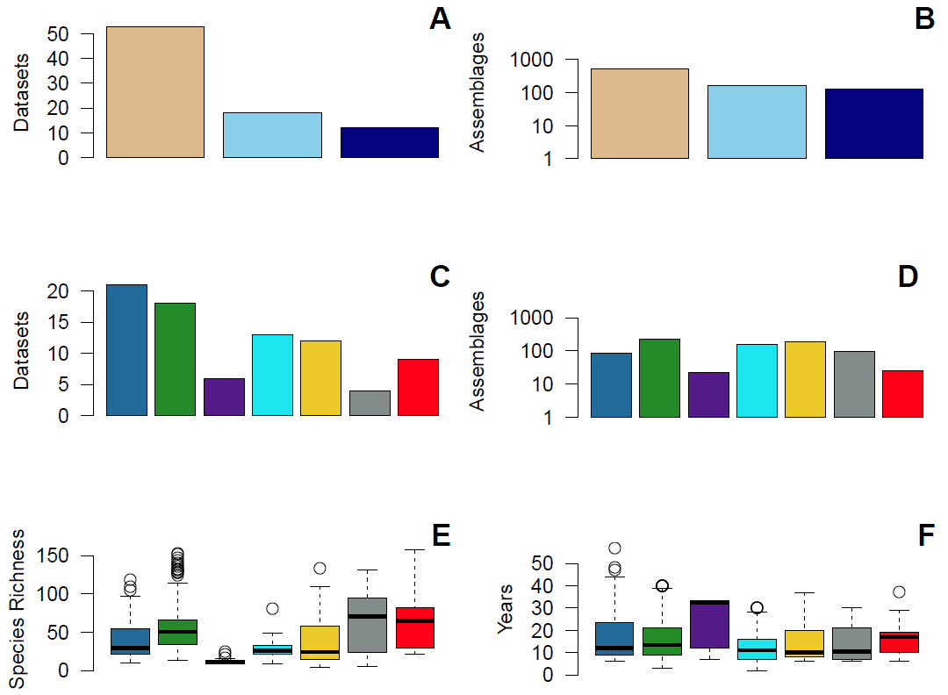
Fig 1a-1f
Birds
Invertebrates
Terrestrial
Benthos
Marine
Plants
Freshwater
Fish
Plankton
Mammals
Notes:
Not fixed

Slide 5
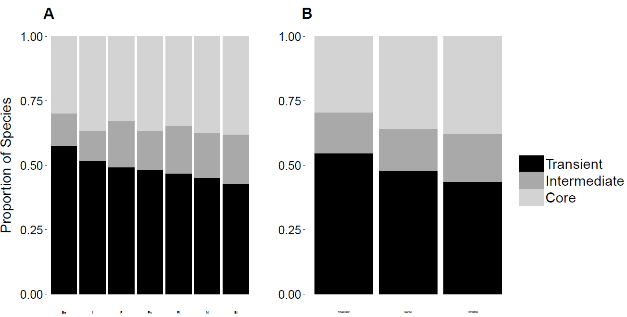
Fig 3a-3b
Notes:
FIXED

Slide 6
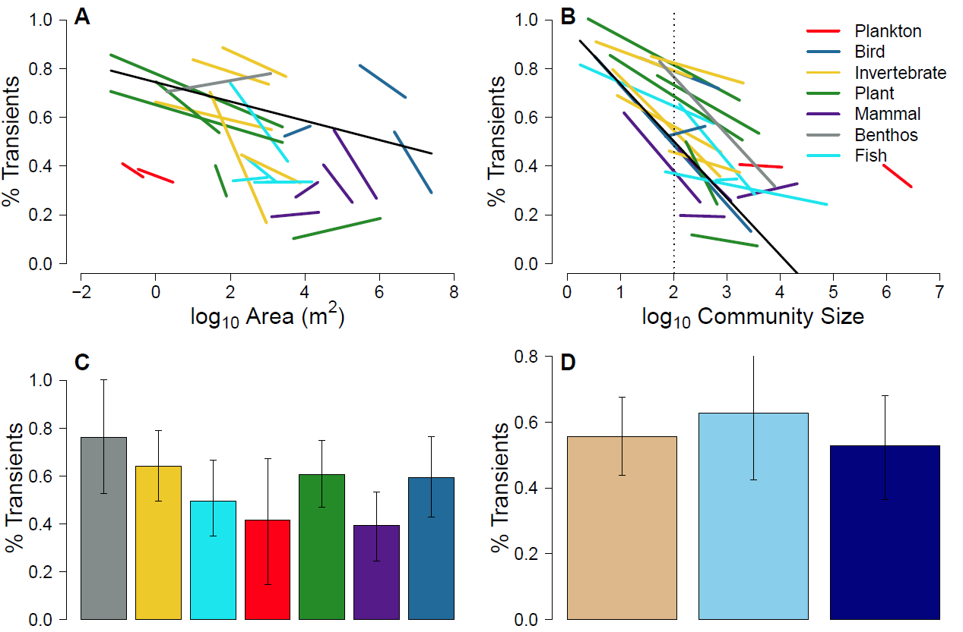

Fig 3a-3c
Simple R² = 0.43
Marginal R² = 0.12
Simple R² = 0.28
Marginal R² = 0.06

Slide 7
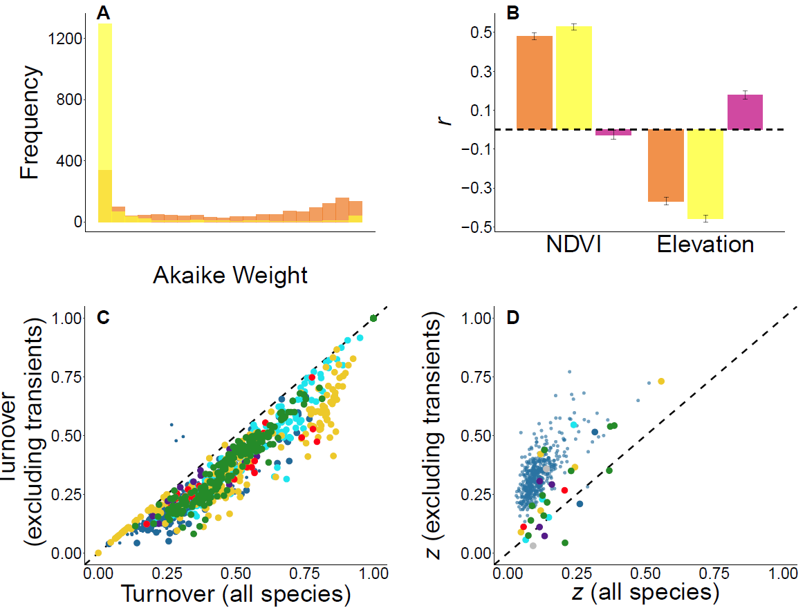


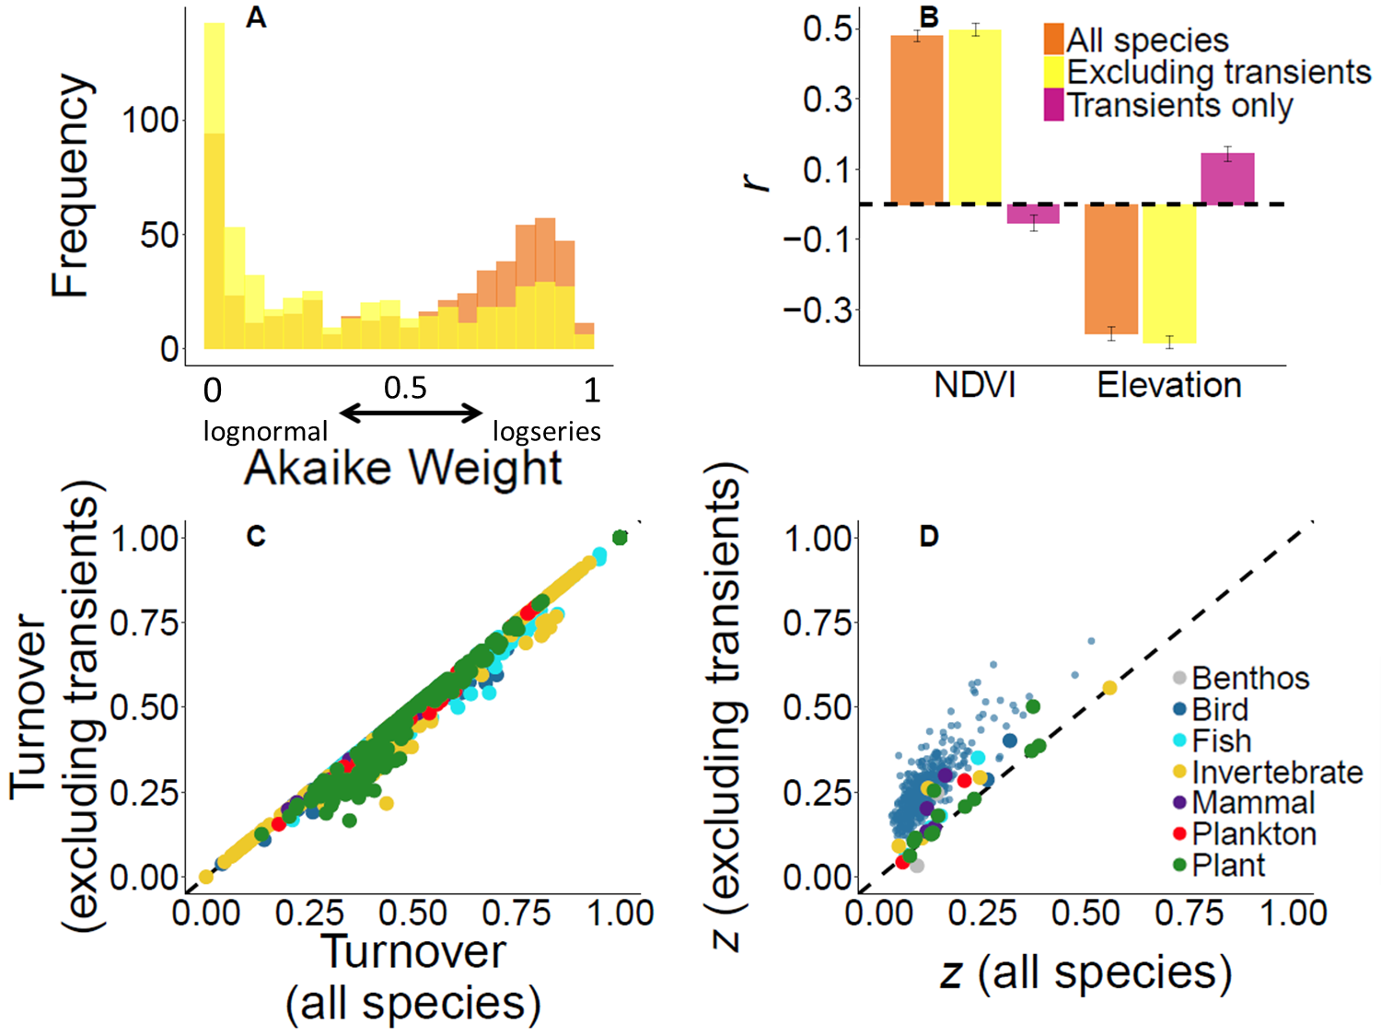
0
lognormal
0.5
1
logseries

Slide 8
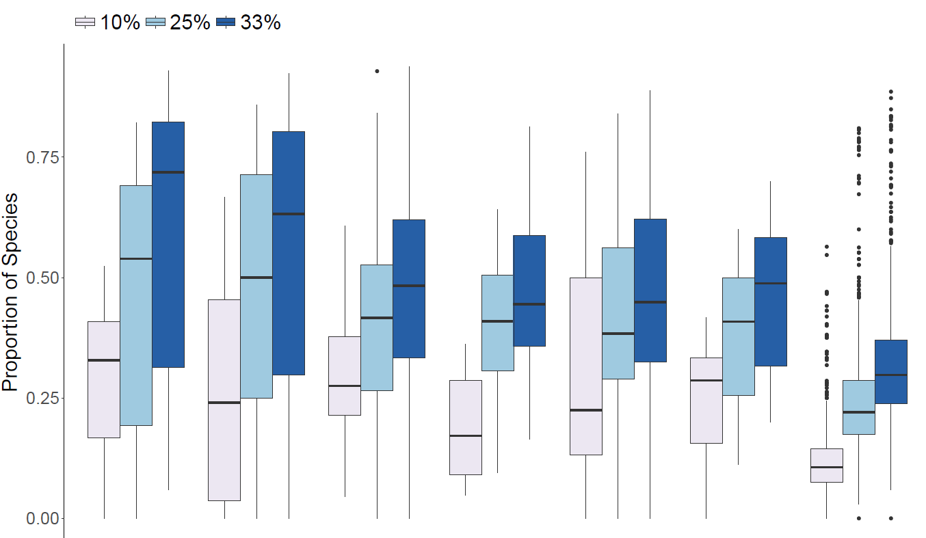

Slide 9
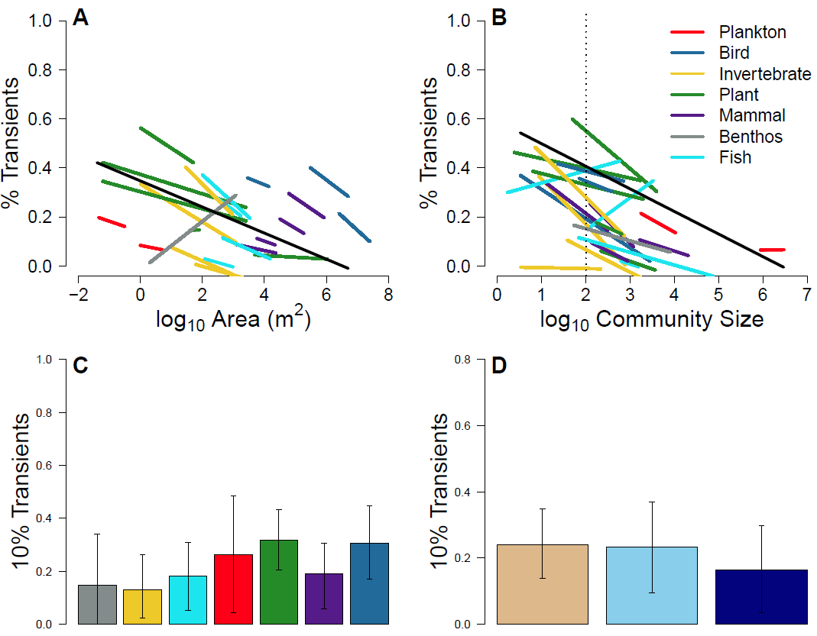


Supp10
Simple R² = 0.17
Marginal R² = 0.11
Simple R² = 0.21
Marginal R² = 0.08

Slide 10
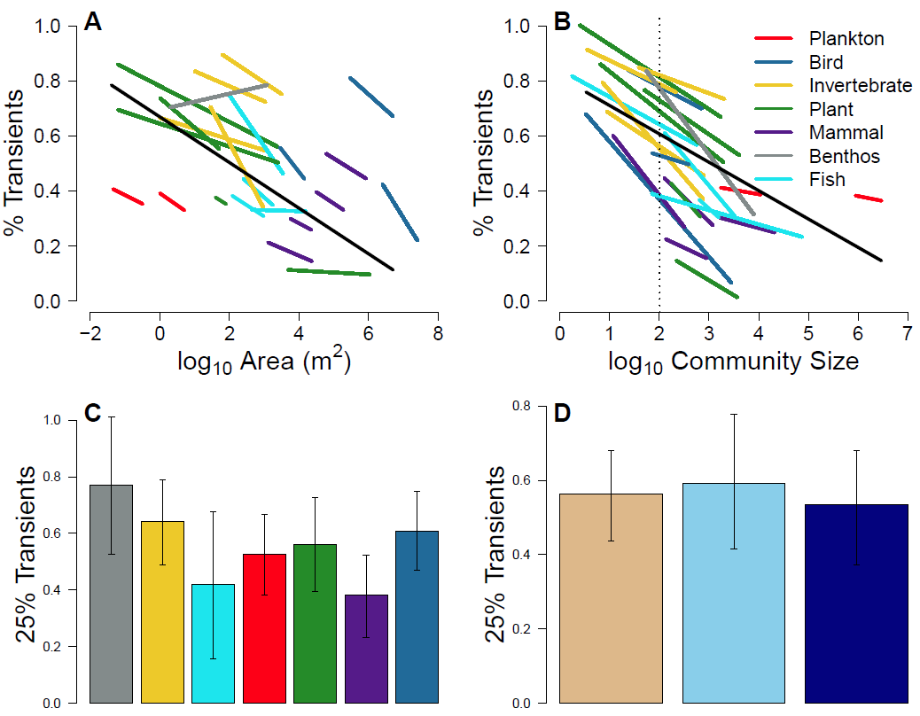

Supp 25
Simple R² = 0.32
Marginal R² = 0.09
Simple R² = 0.53
Marginal R² = 0.08

Slide 11
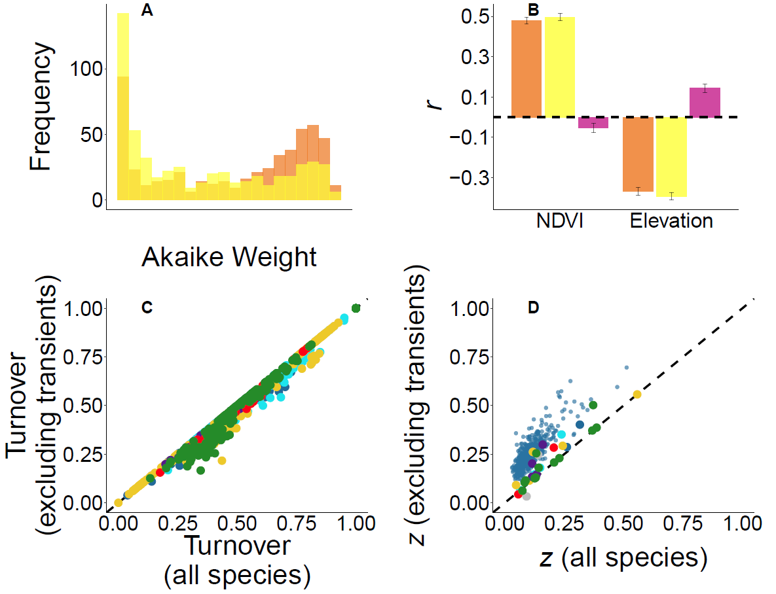
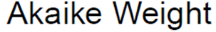
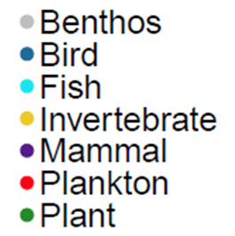
Supp 10
0
lognormal
0.5
1
logseries

Slide 12
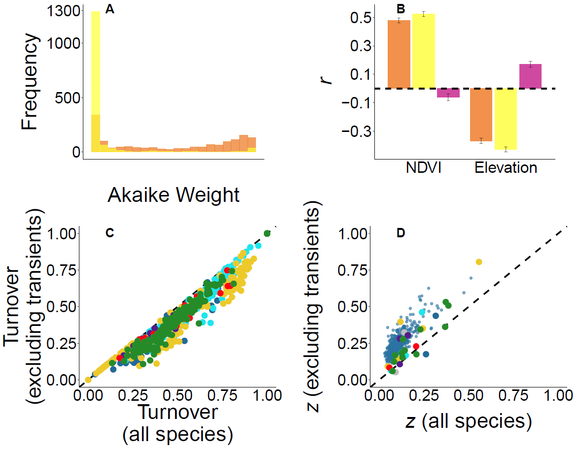

Supp 25
0
lognormal
0.5
1
logseries

Slide 13
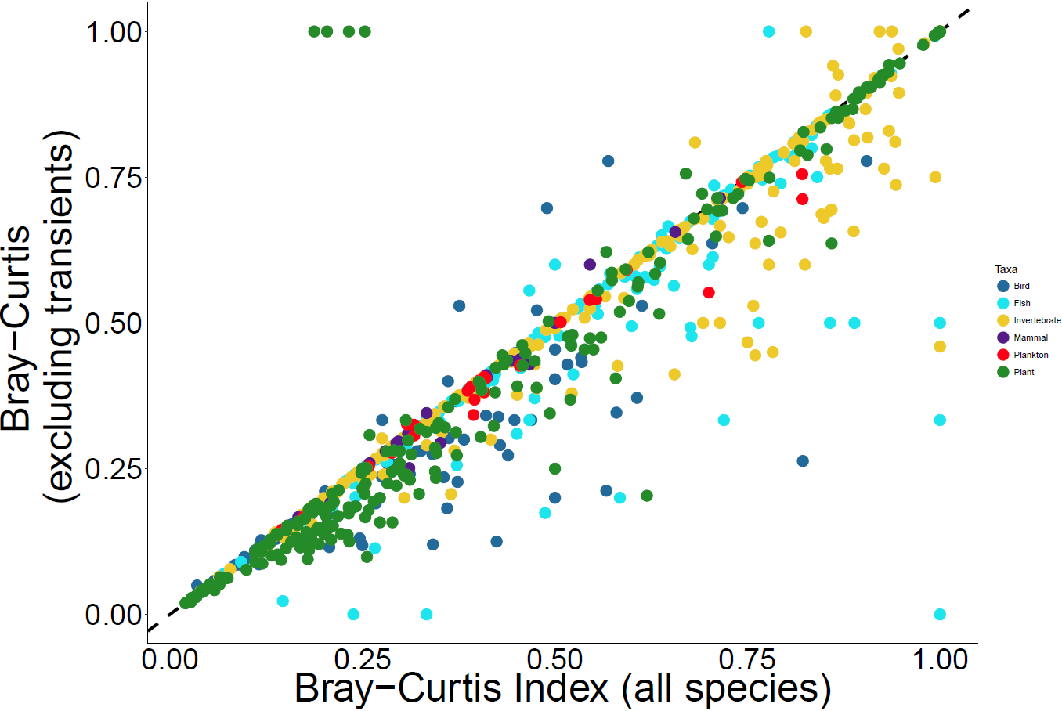

Slide 14
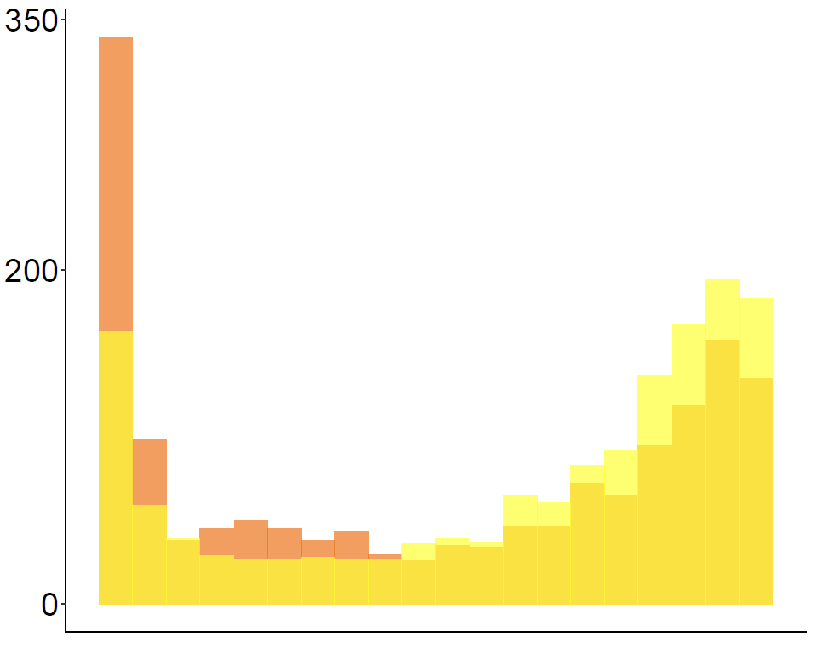
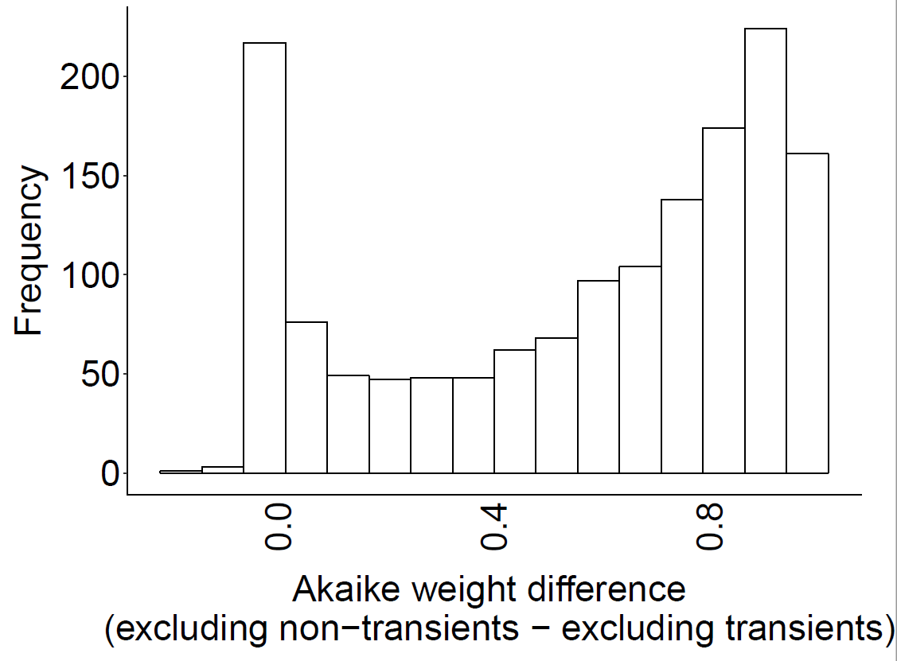
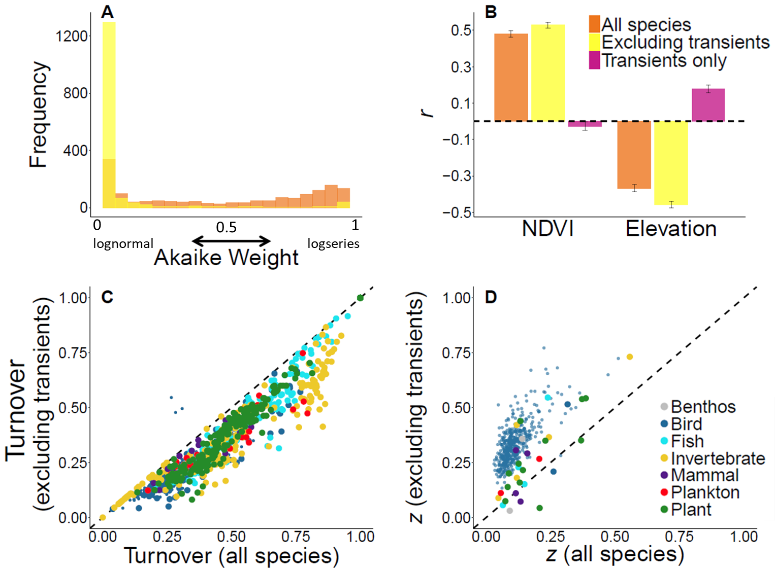
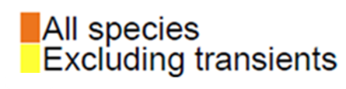
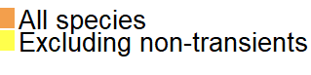
1a null
A
B
C
Frequency
Frequency
0
lognormal
1
logseries
0.5
Akaike Weight

Slide 15
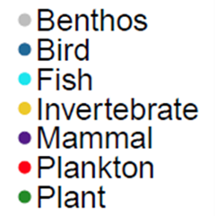
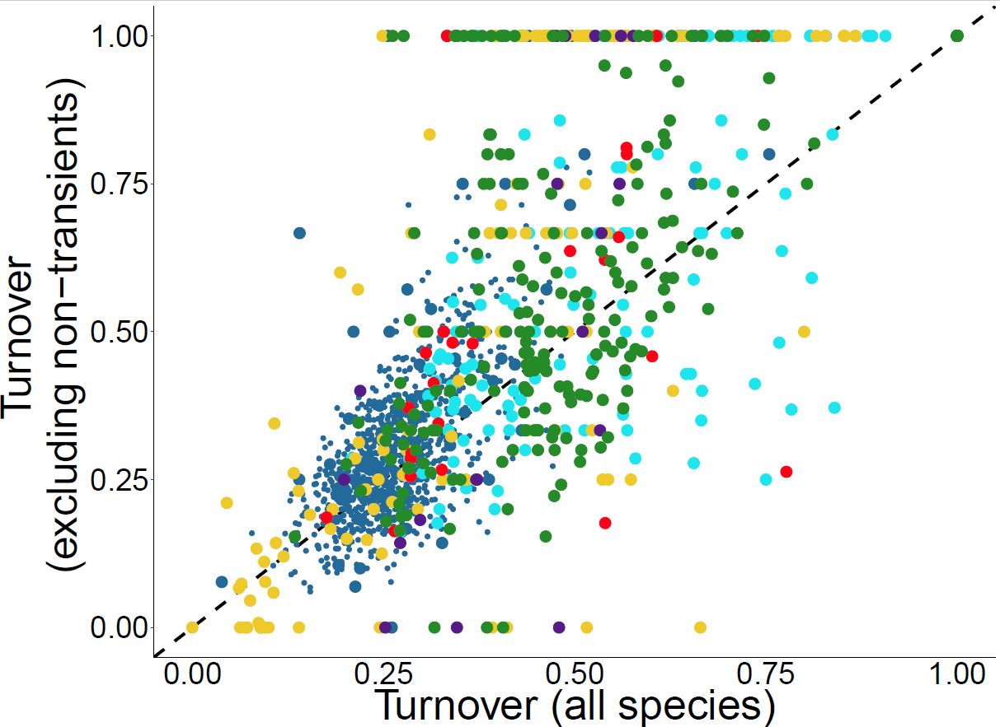
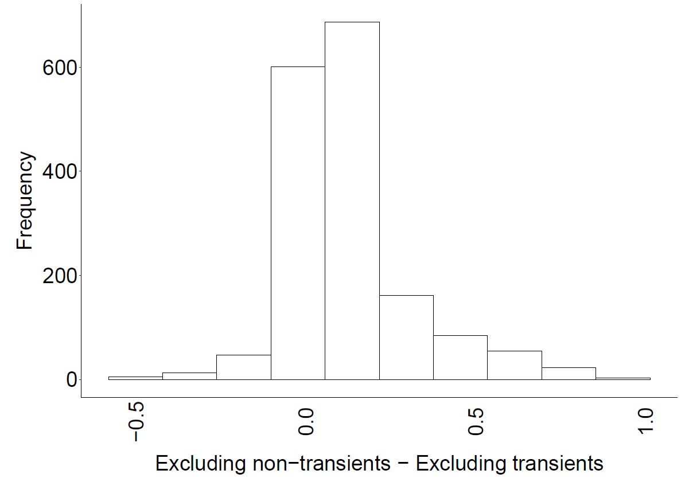
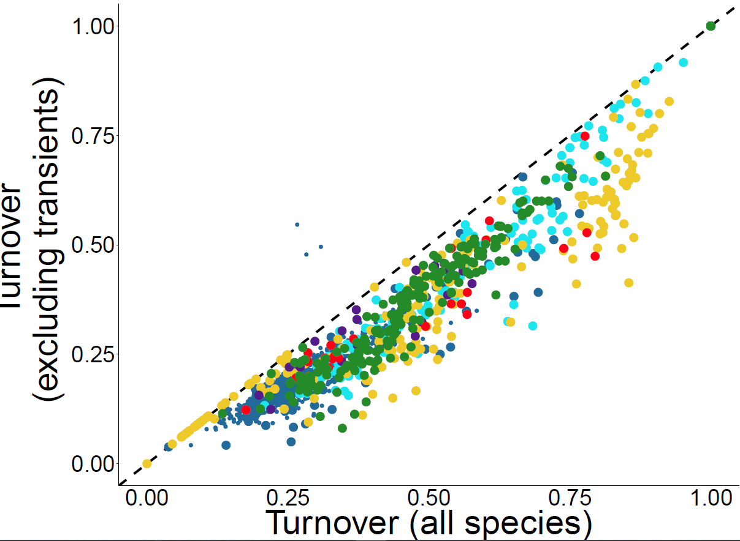
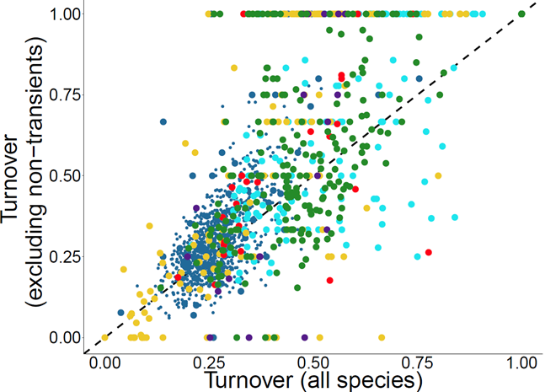
Null turnover
Frequency

Slide 16
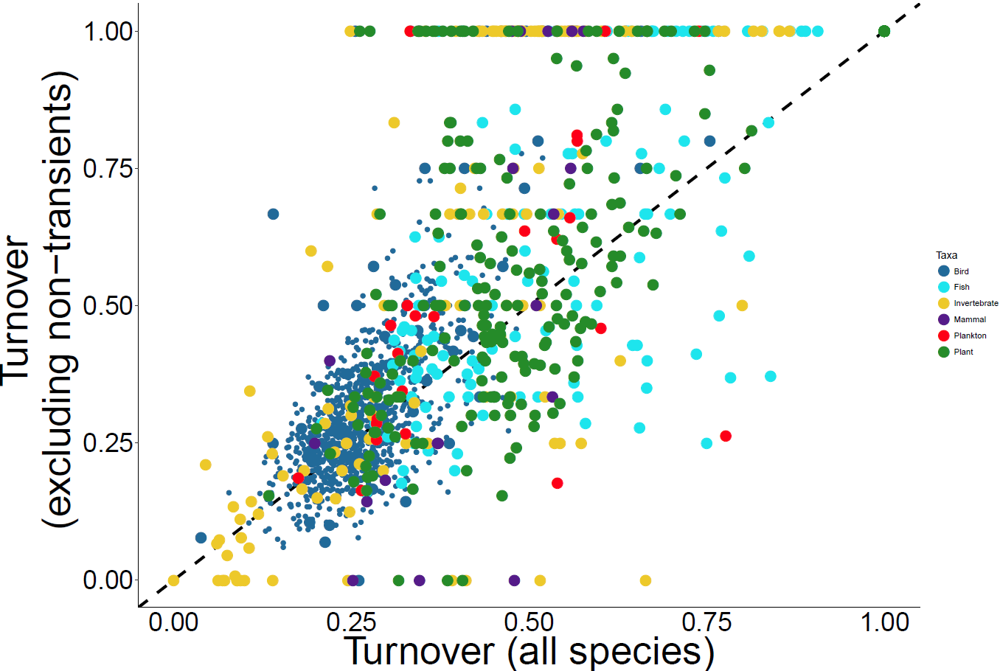
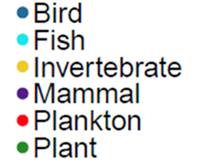
Null turnover

Slide 17
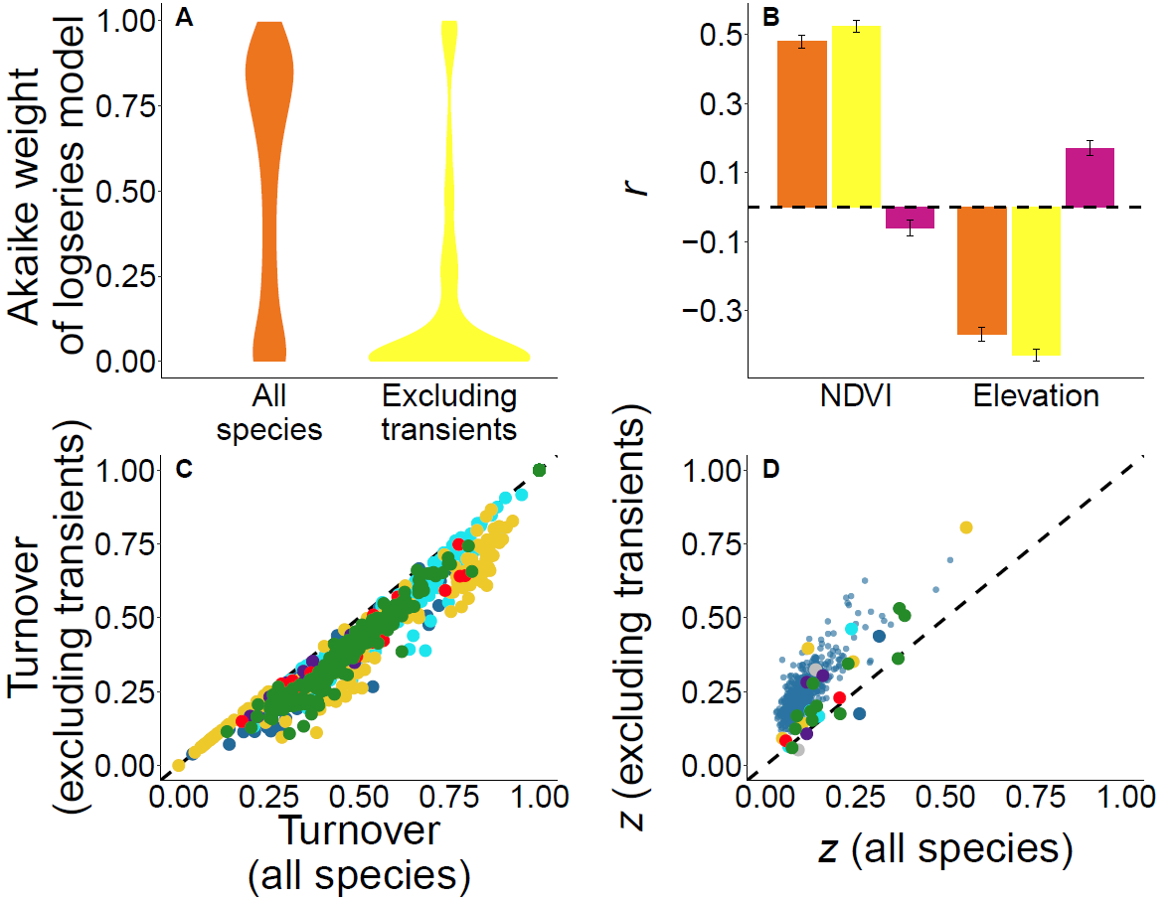
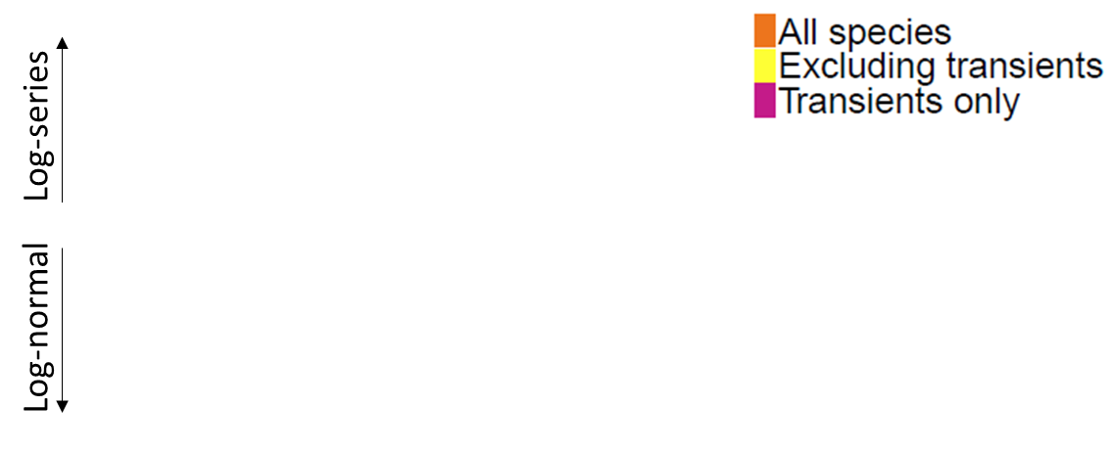
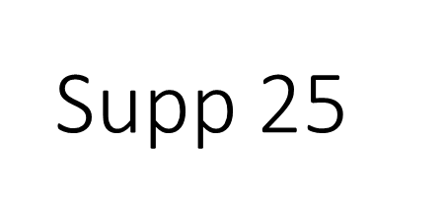

Slide 18
