Slide 1










Key
 | Birds
 | Plants
 | Mammals
 | Fish
 | Invertebrates
 | Benthos
 | Plankton
 | Birds |  | Invertebrates
 | Plants |  | Benthos
 | Mammals |  | Plankton
 | Fish
Terrestrial
Marine
Freshwater
Notes:
Bird – created by parkjisun
Tree – created by Delwar Hossain,
Deer – created by Francisca Arévalo
Fish – created by Iconic
Butterfly – created by Jacqueline Fernandes
Shell – created by B Barrett Noun project
Bacteria – created by Boris Belov
Mountains by alice noir, ocean by alex muravev, lake by By Anton Gajdosik

Slide 2
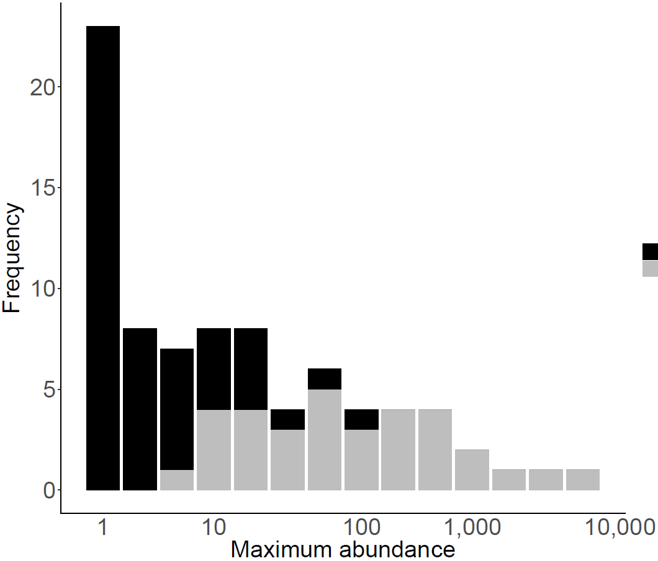
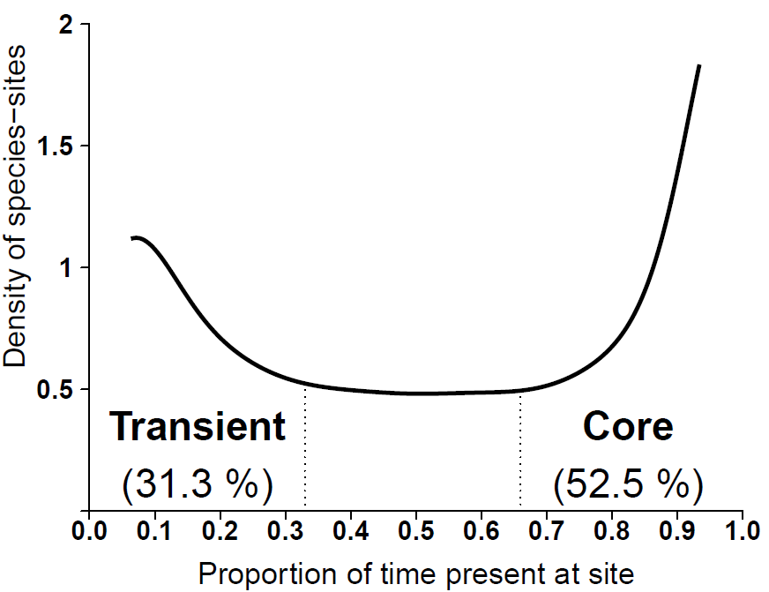



6 panel conceptual figure
A
B
C
D
All species
Excluding transients
Log(Species)
Log(area)
E time $t_{1}$
time $t_{2}$
Turnover = # of spp unique to t_{i} / total # spp
All species: 6/11 = 55%
Excluding transients: 0/5 = 0%

Slide 3
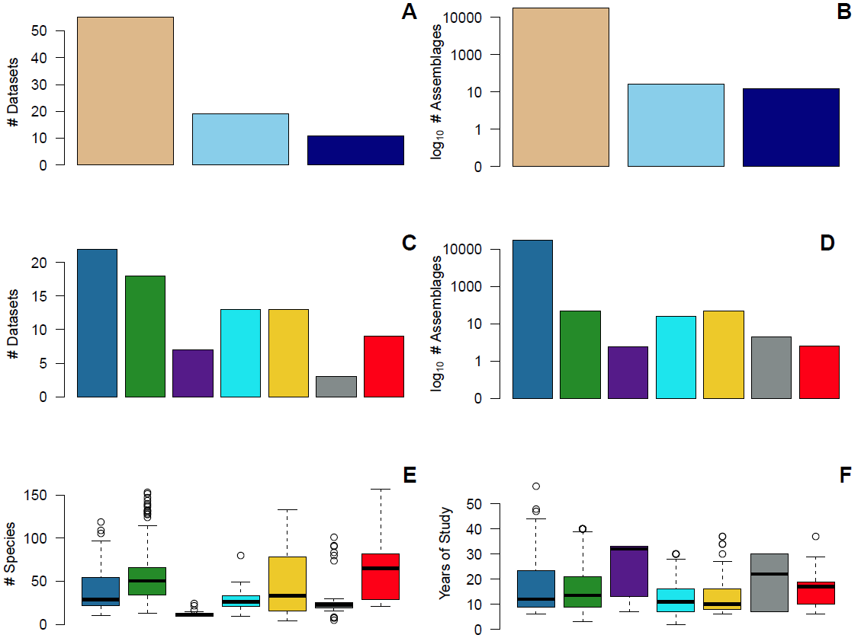
Fig 1a-1f
Birds
Invertebrates
Terrestrial
Plants
Benthos
Marine
Fish
Plankton
Freshwater
Mammals
*
*
Notes:
Not fixed

Slide 4
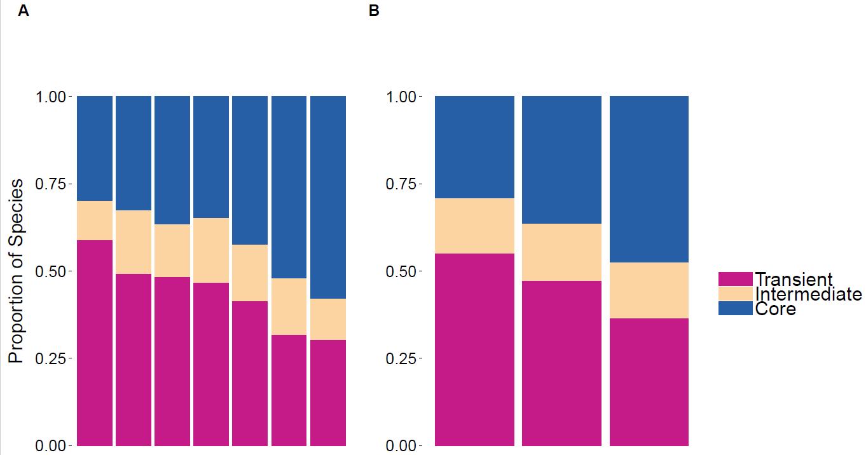
Fig 3a-3b
Notes:
FIXED

Slide 5
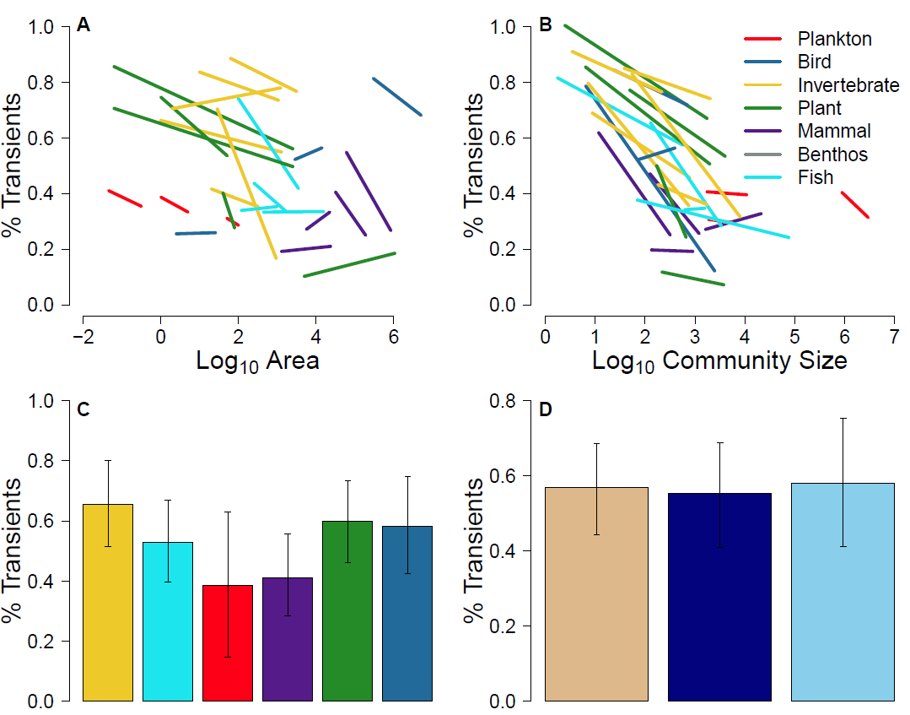
Fig 3a-3c
Figure3a. Proportion of transient species by log of area, colored by taxa, using the hierarchically scaled count datasets.
Figure3b. Proportion of transient species by log of community size (number of individuals), colored by taxa, using the hierarchically scaled count datasets.
Figure3c. Predicted values of hierarchically scaled count datasets by taxa using average community size XXX.

Slide 6
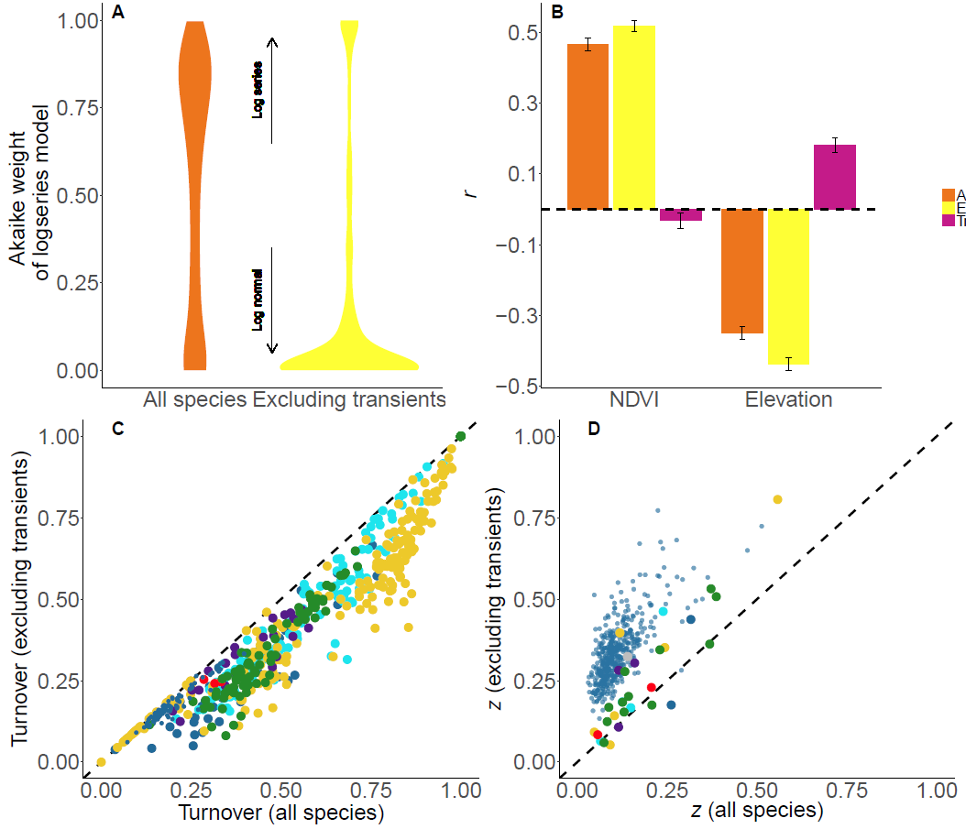

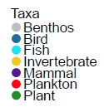
Log-series
Log-normal

Slide 7
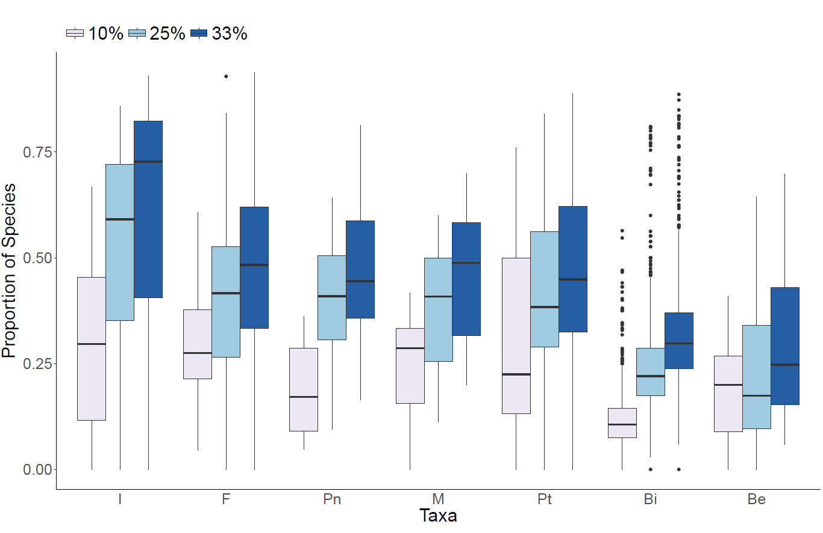

Slide 8
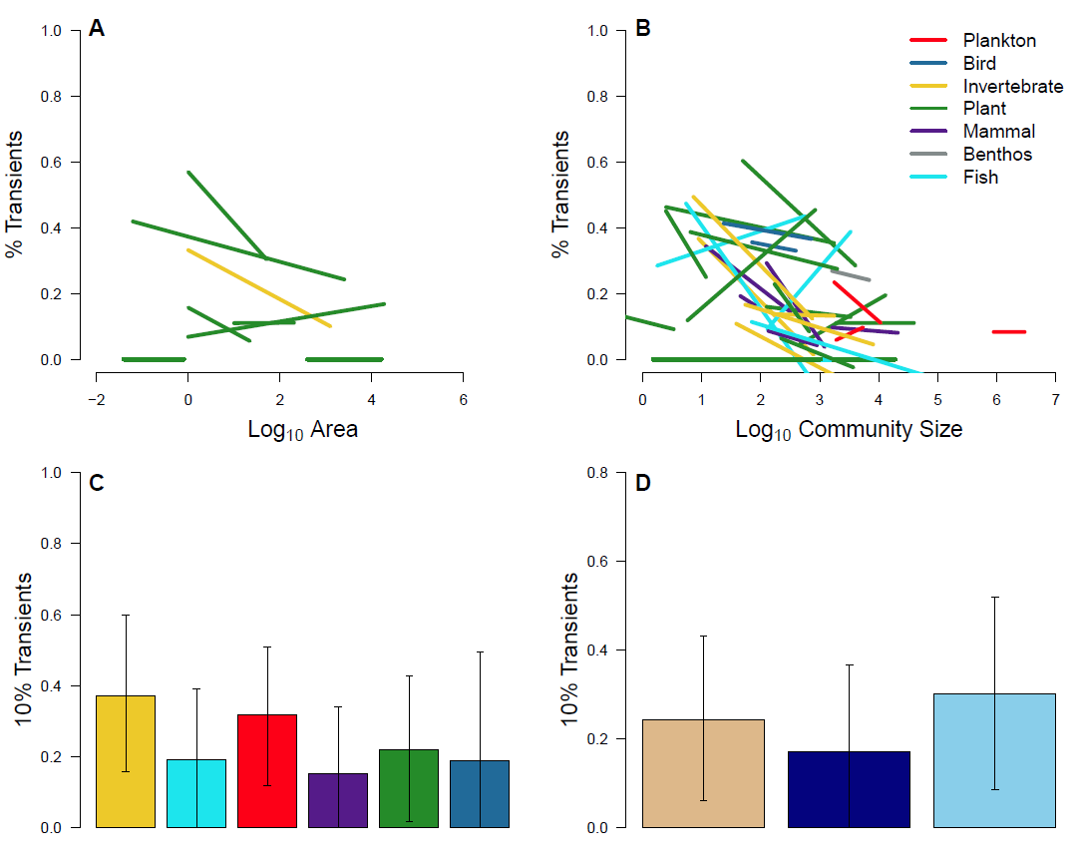
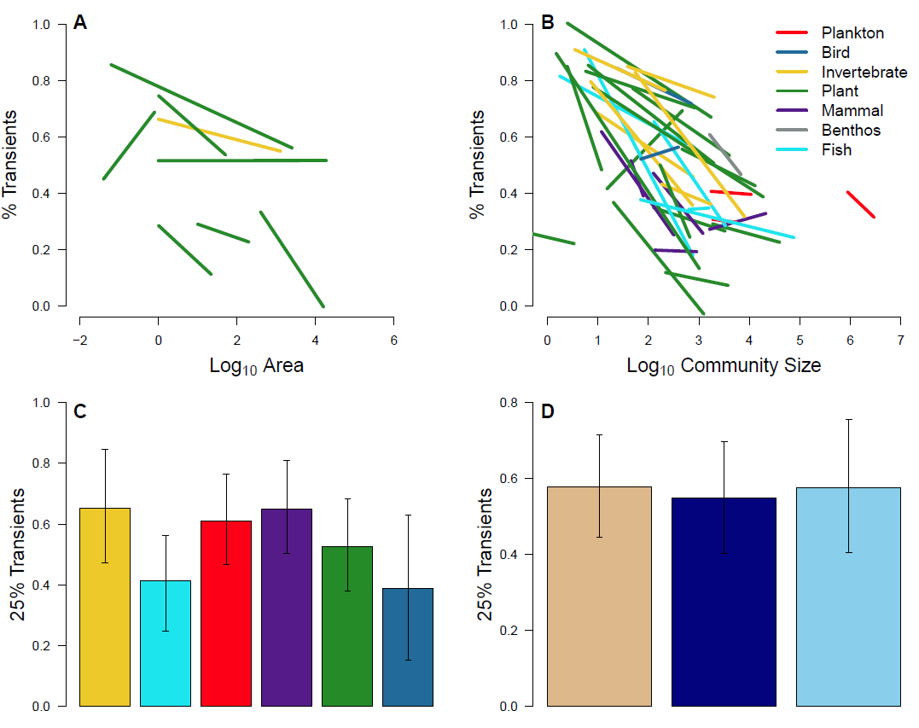
FIG 3 SUPP 10 FIG 3 SUPP 25

Slide 9
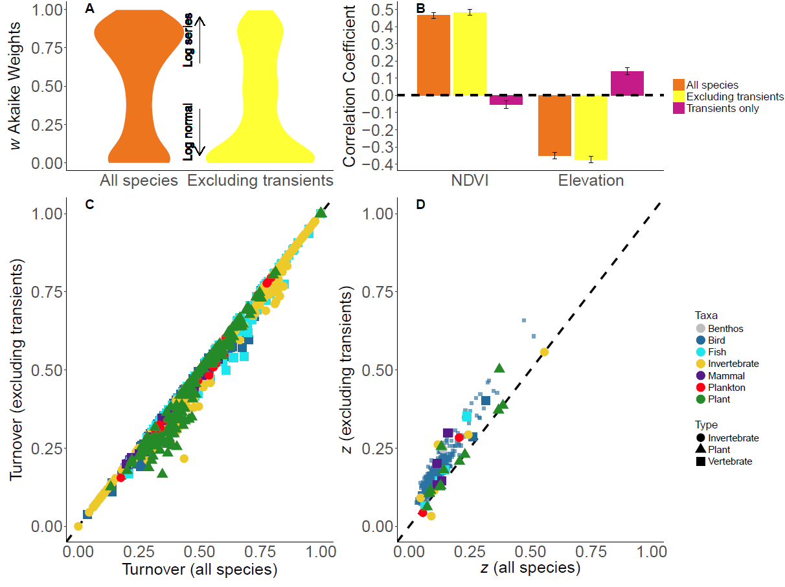
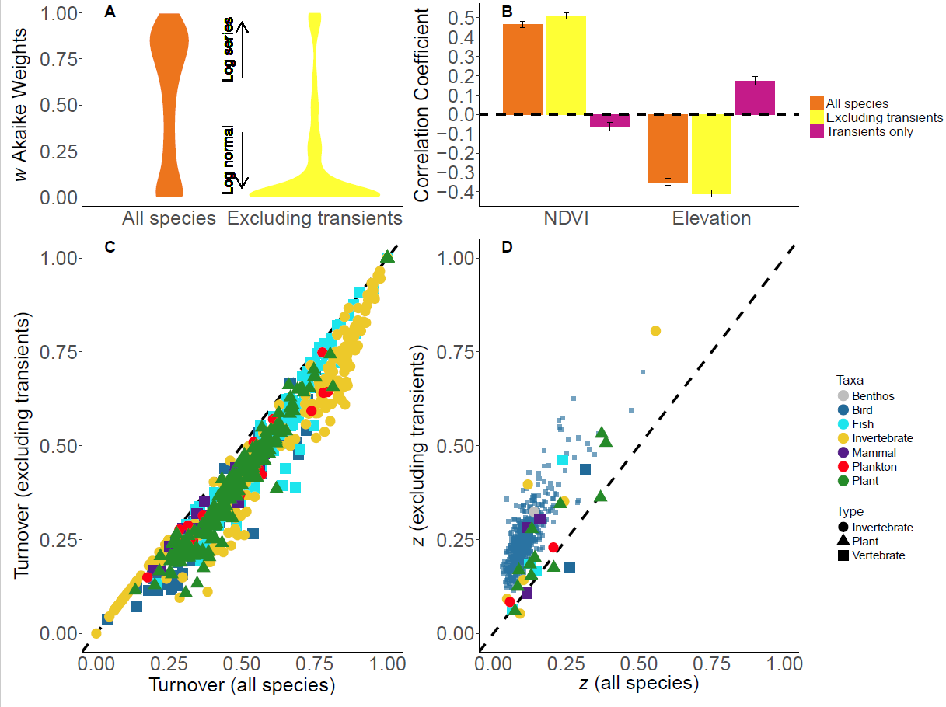
FIG 4 SUPP 10 FIG 4 SUPP 25

