Slide 1







Key
 | Birds
 | Plants
 | Mammals
 | Fish
 | Invertebrates
 | Benthos
 | Plankton
Notes:
Bird – created by parkjisun
Tree – created by Delwar Hossain,
Deer – created by Francisca Arévalo
Fish – created by Iconic
Butterfly – created by Jacqueline Fernandes
Shell – created by B Barrett Noun project
Bacteria – created by Boris Belov

Slide 2
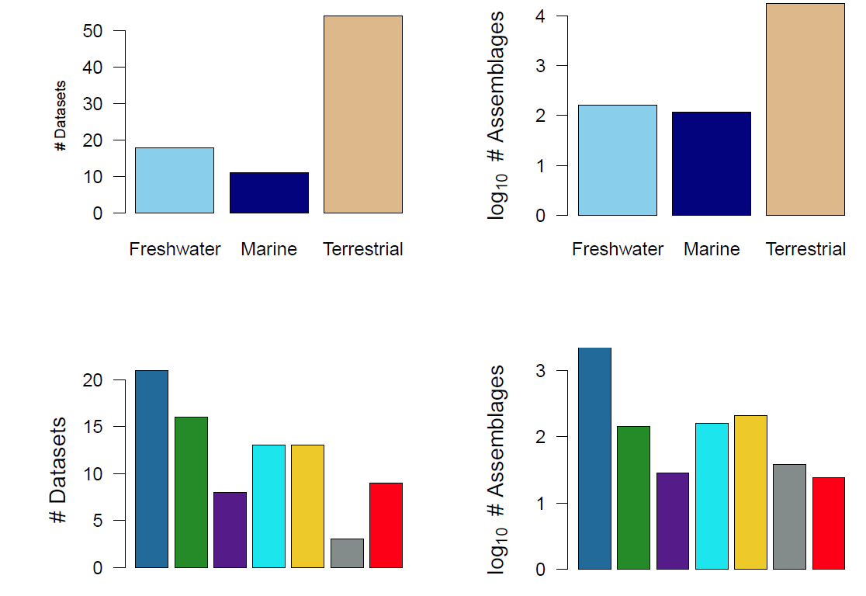
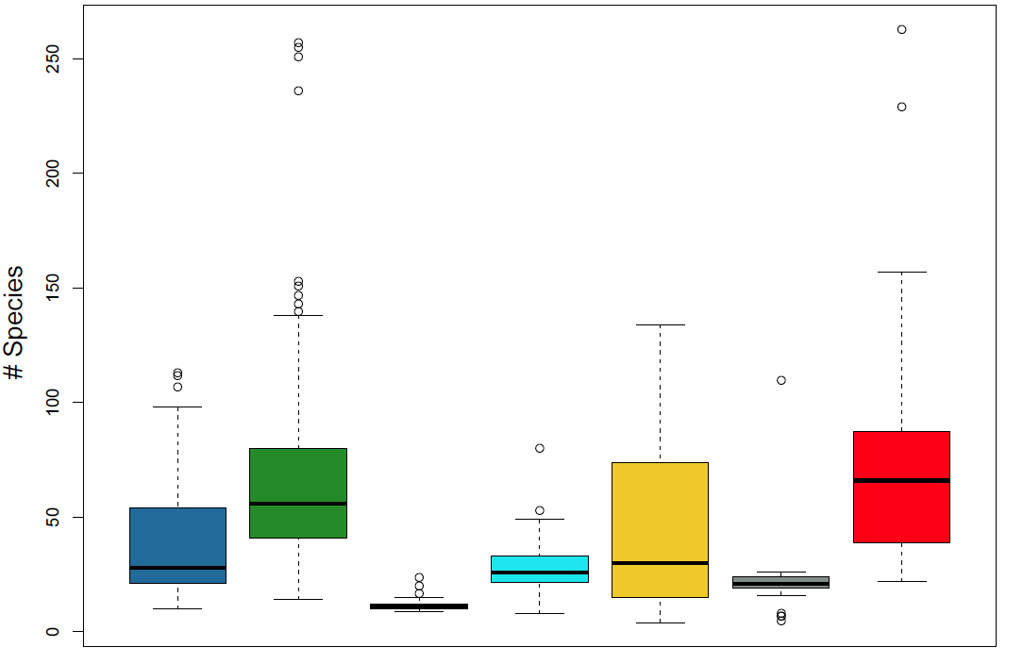
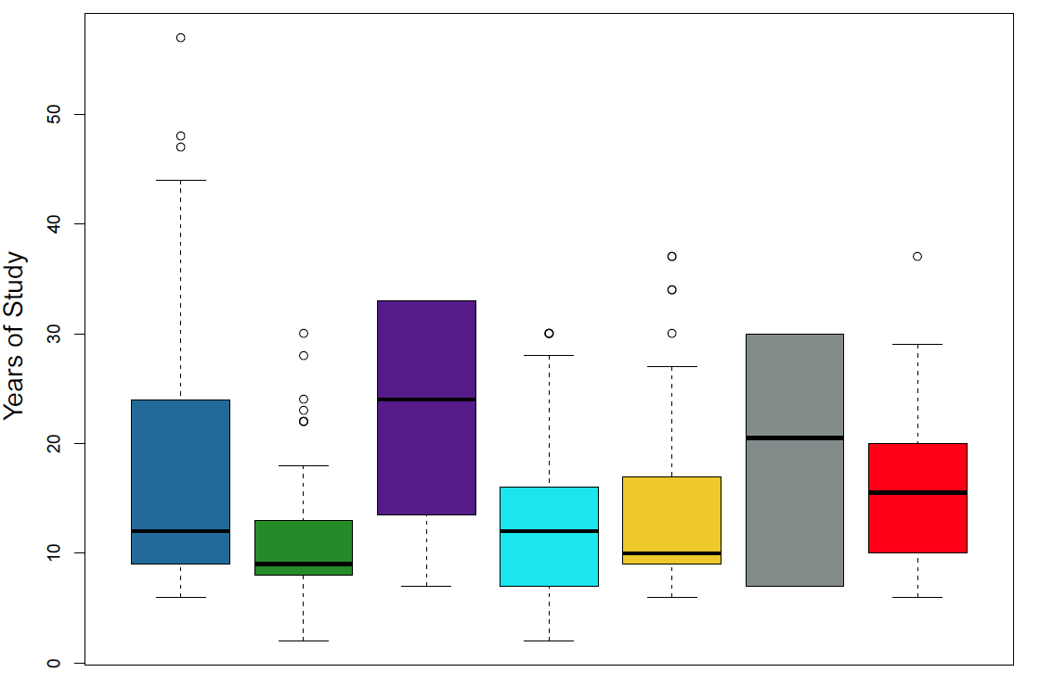
Fig 1a-1f
Need to order better

Slide 3
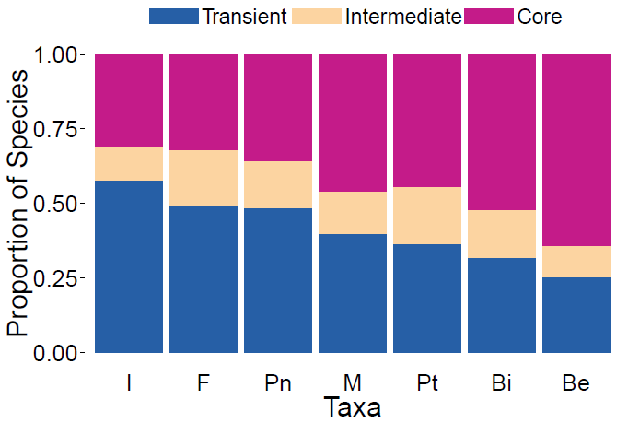
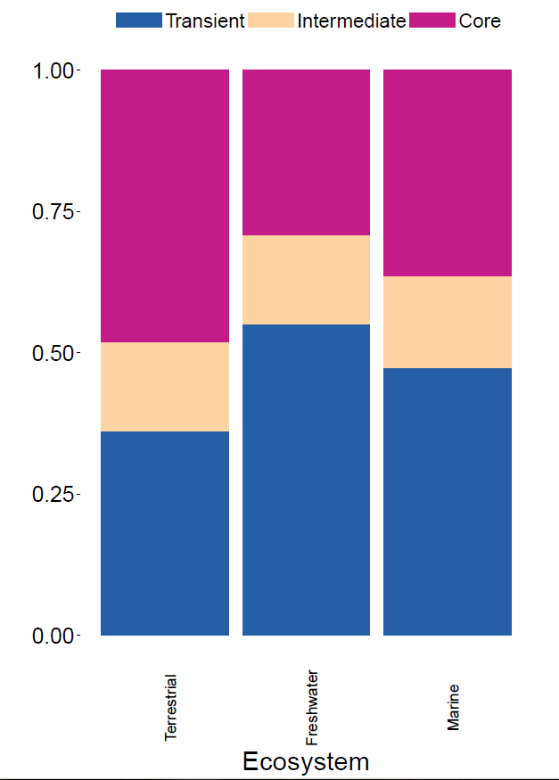
Fig 2a-2b

Slide 4
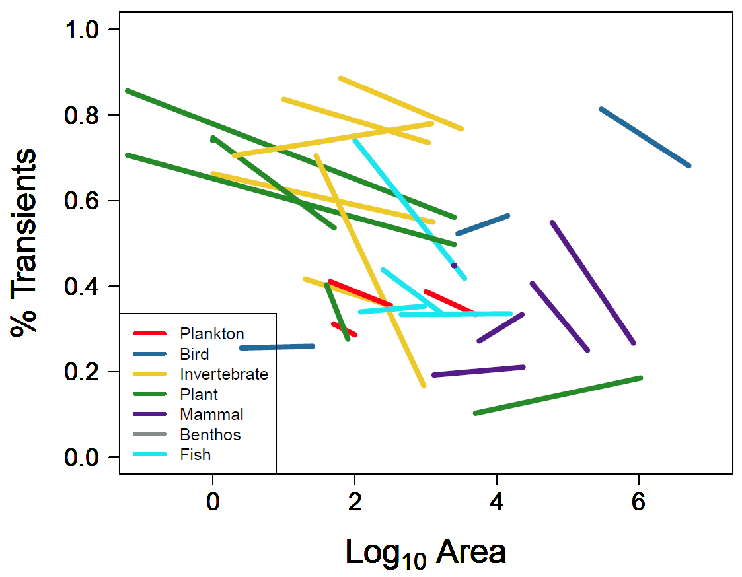
Figure3a. Proportion of transient species by log of area, colored by taxa, using the hierarchically scaled count datasets.

Slide 5
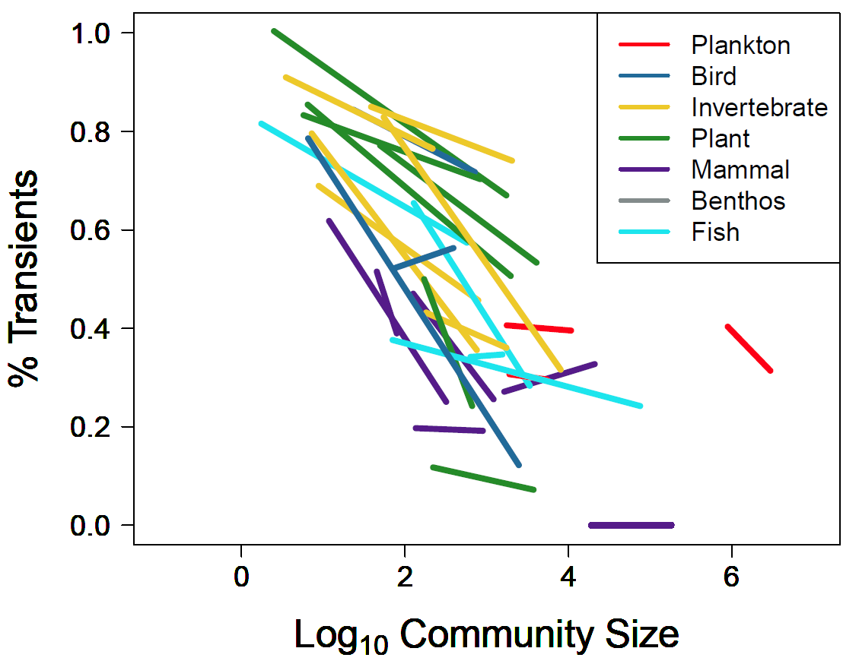
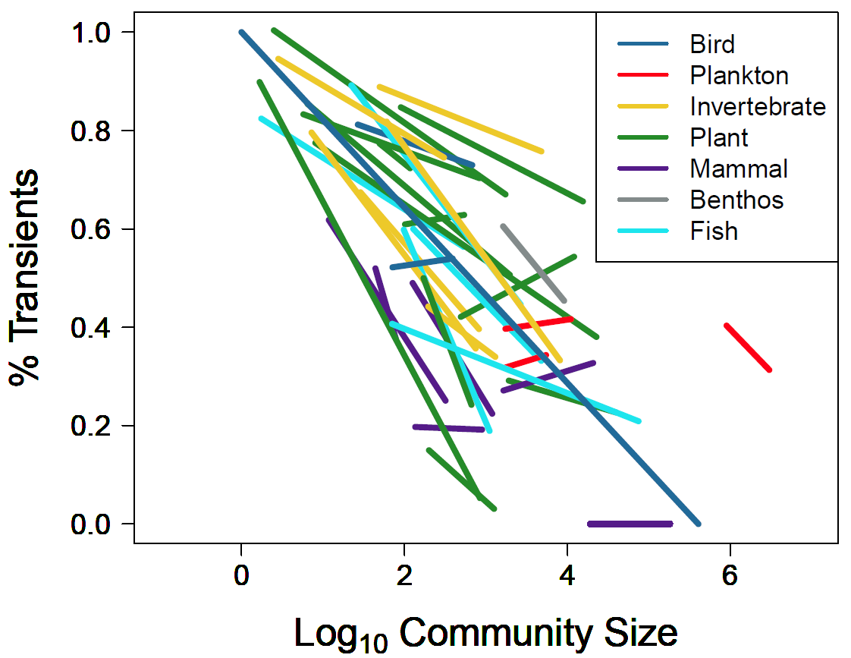
Count data ONLY
Figure3b. Proportion of transient species by log of community size (number of individuals), colored by taxa, using the hierarchically scaled count datasets.

Slide 6
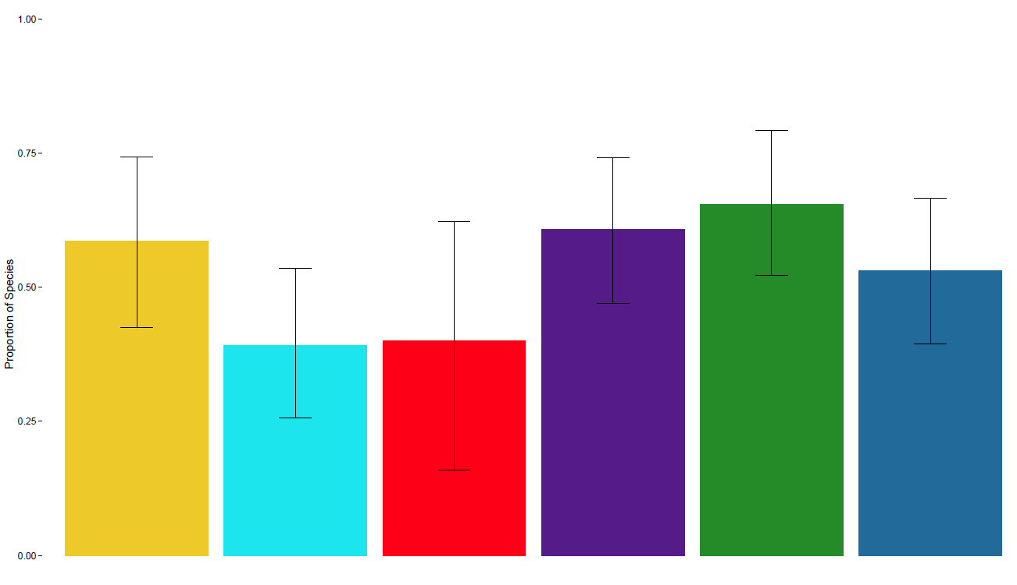

Figure3c. Predicted values of hierarchically scaled count datasets by taxa.

Slide 7
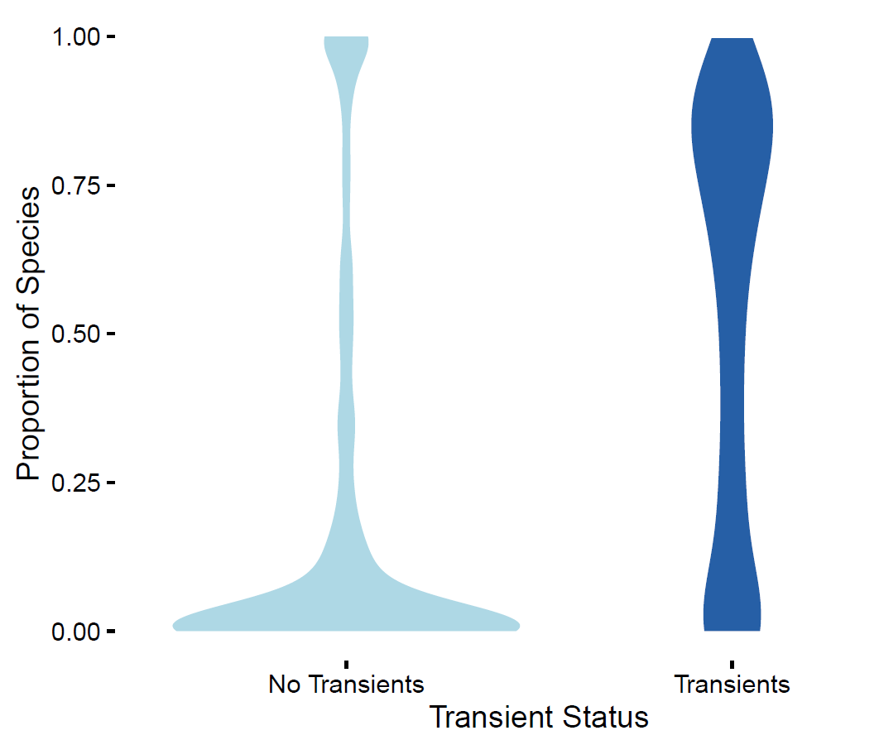
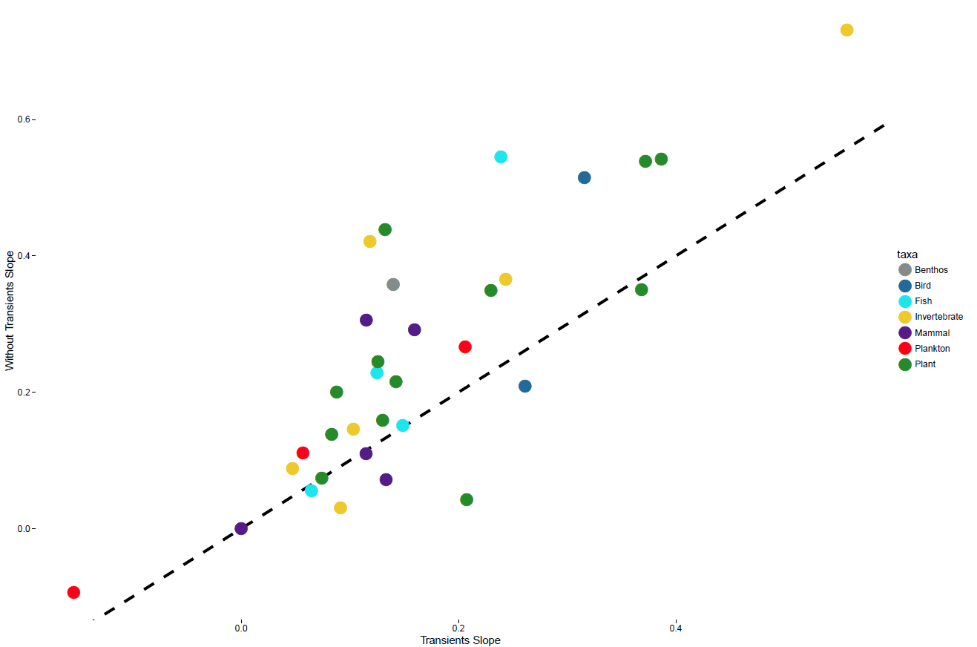
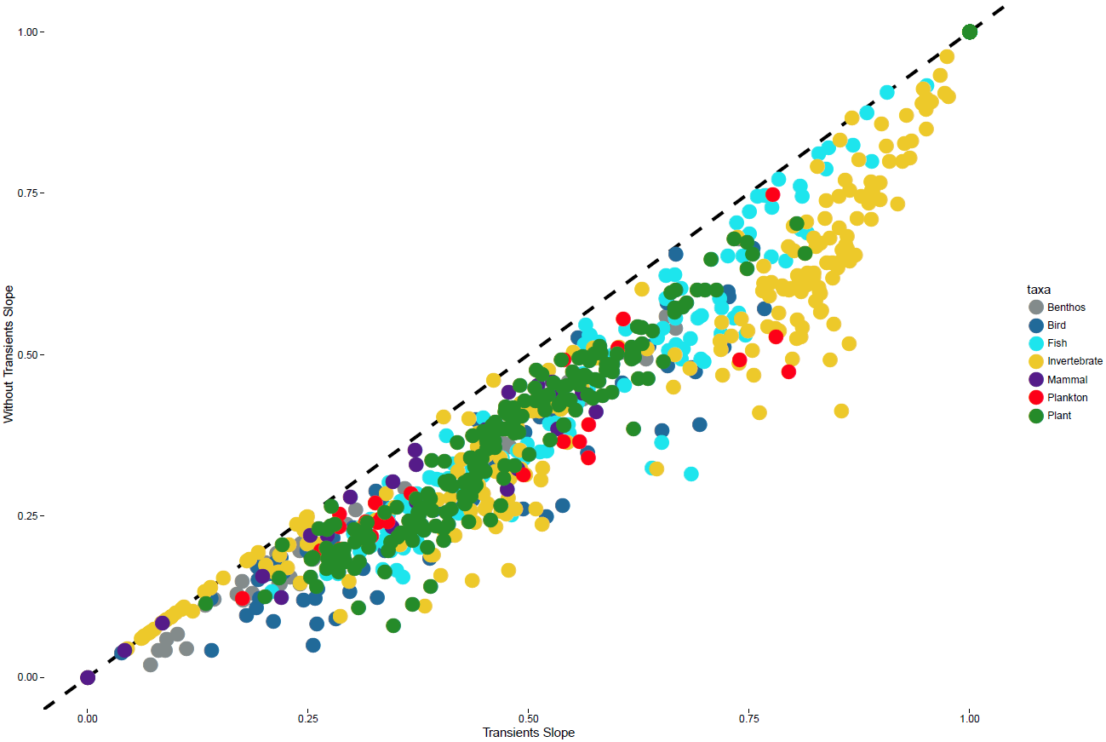

Slide 8
