Slide 1
Contemporary Problems of Indian Society
12th Grade General Studies Project
Based on Public Opinion Survey

Slide 2
Introduction :
This project analyzes contemporary issues in Indian society using public survey data. We covered topics such as reservation, education, gender inequality, safety, child welfare, and juvenile delinquency.
The Group members are:
Atiksh K
Ruhi K
Ayush B
Avani P
Aditi J
Arnav S
Vedashree K
Shrawan D

Slide 3
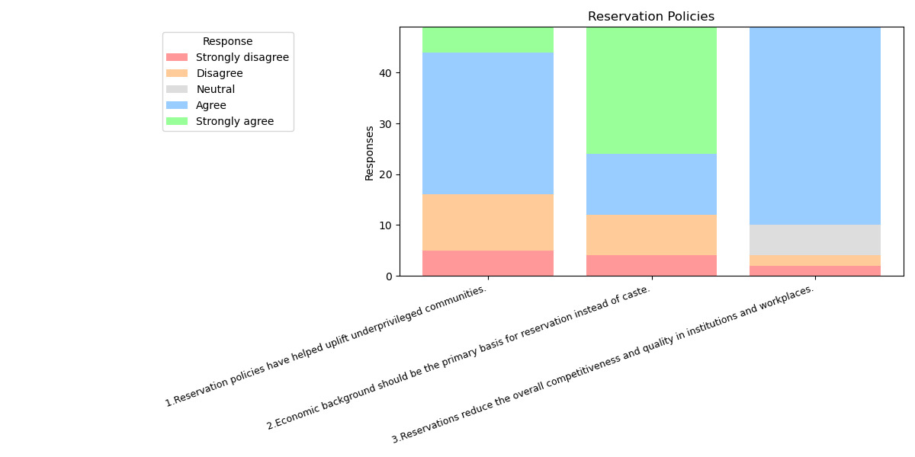
RESERVATION POLICIES
Most people support reservation based on economic status rather than caste.
While many agree that reservation helps uplift underprivileged groups, they also feel it can reduce fair competition.
Opinions are divided — some see reservation as necessary and fair, while others believe it's outdated and needs reform.

Slide 4
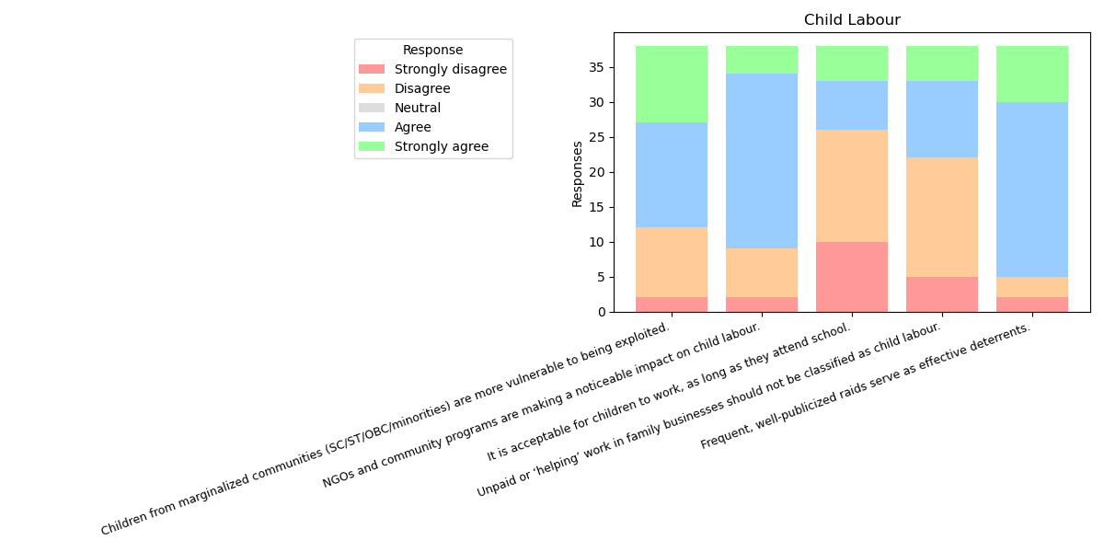
CHILD LABOUR AND EDUCATION
The current education system is seen as too theoretical and disconnected from real-life skills.
Lack of practical training is viewed as a major cause of unemployment.
Many believe children from poor backgrounds work out of necessity, often at the cost of education.
Some respondents feel it’s acceptable for children to work as long as they also attend school, revealing gaps in awareness.

Slide 5
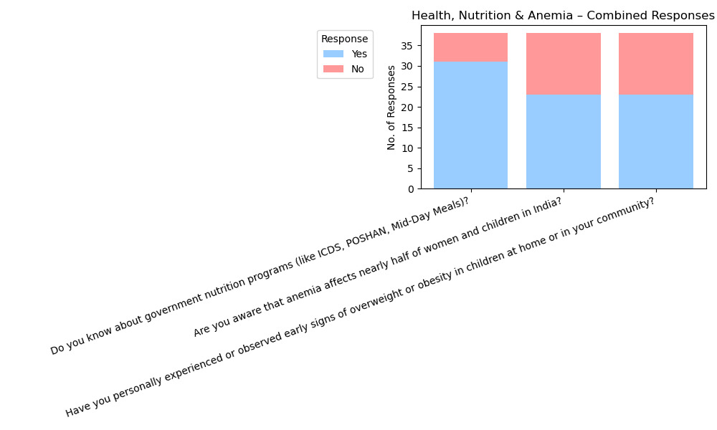
NUTRITION AND HEALTH
People are aware of common health problems like anemia, obesity, and malnutrition.
Many believe these issues are caused by poverty, poor hygiene, and unhealthy lifestyles. Urban respondents talked about an increase in childhood obesity, while rural areas still struggle with undernutrition.
There is strong support for better health education and preventive care.

Slide 6

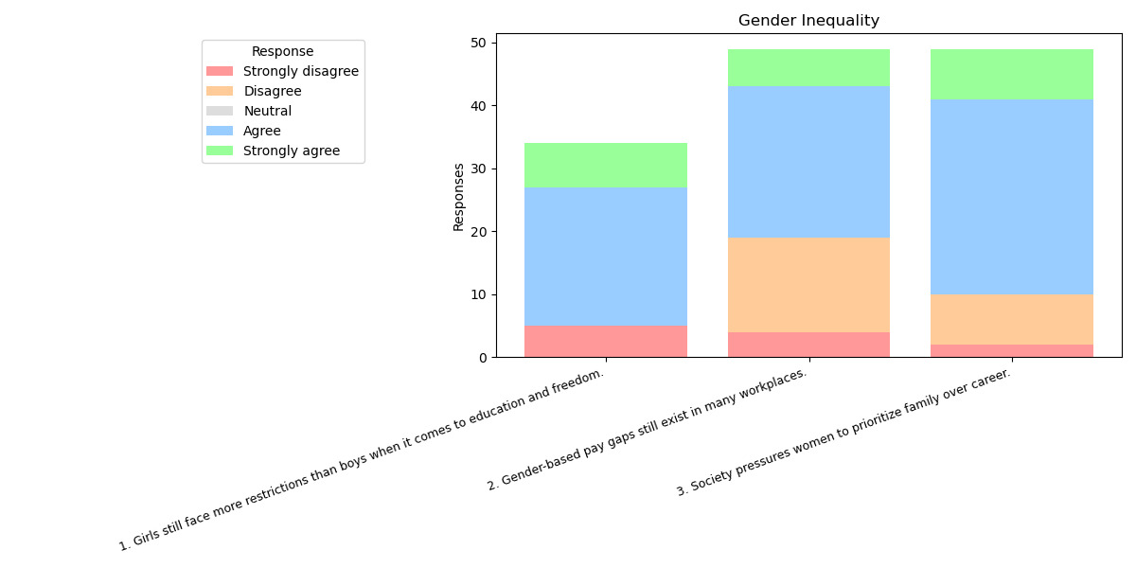
GENDER INEQUALITY
Gender bias is still common, especially in rural areas, where women face unequal treatment due to traditional roles and social expectations at home and work.
People recognize
that achieving true gender equality requires not just policy changes, but also a shift in mindsets, attitudes , and everyday behavior.

Slide 7
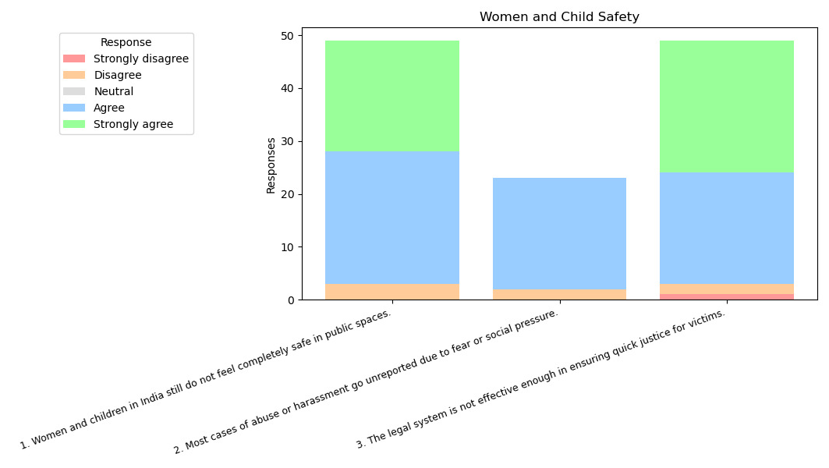
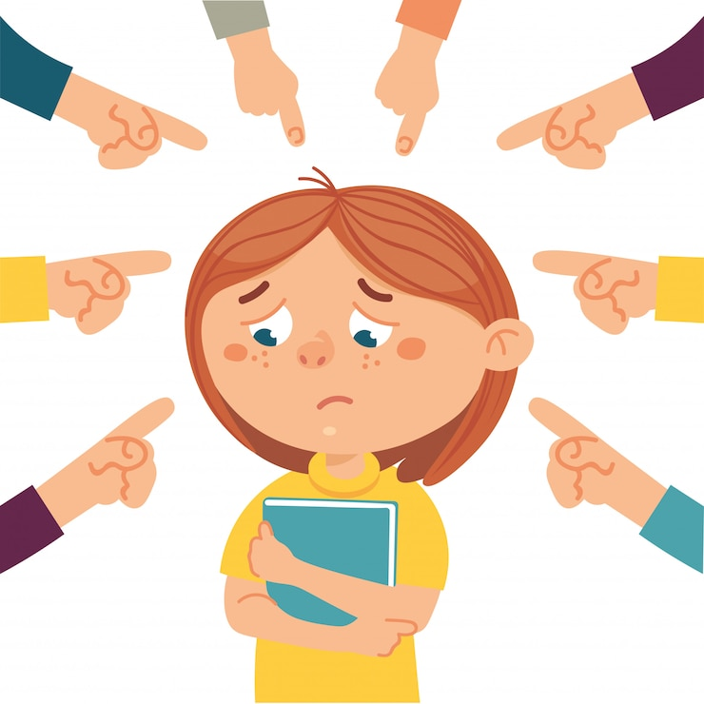
WOMEN AND CHILD SAFETY
Many feel that harassment and abuse go unreported due to fear, shame, or lack of trust in the system. Walking alone feels unsafe for many, especially at night.
Delayed justice discourages victims, and though awareness has grown, people still lack confidence in getting protection or support. Safety is seen as a societal issue , not just a legal one.

Slide 8
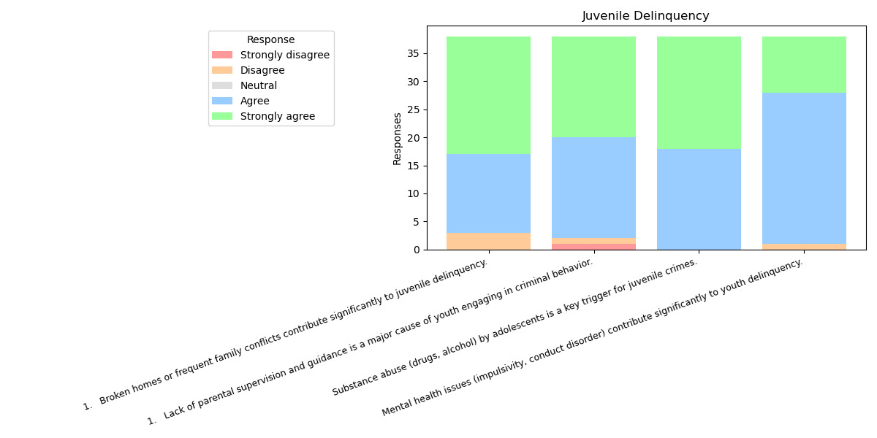
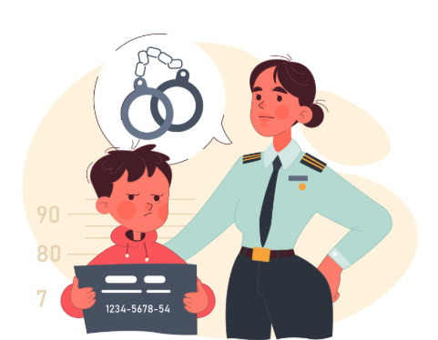
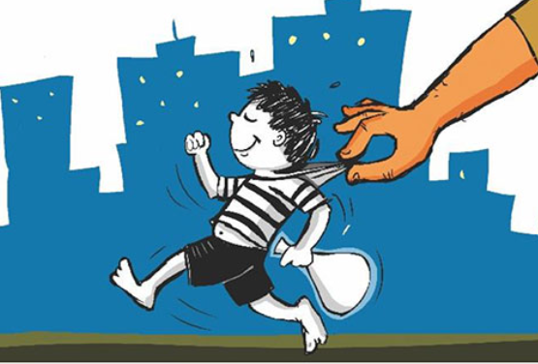
Juvenile Delinquency
Most respondents believe poor parenting, peer pressure, and media exposure are major contributors to youth crime.
There is strong support for counseling and rehabilitation over punishment.
The data suggests people view juvenile crime as a result of the environment, not character.
A lack of guidance, discipline, and support systems is commonly highlighted.

Slide 9
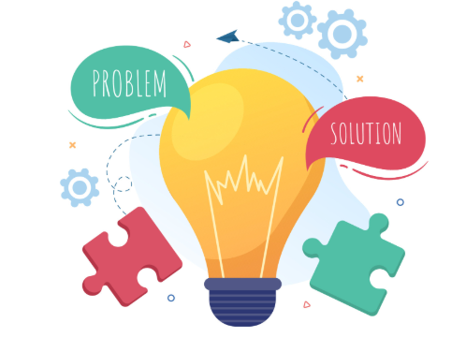
Suggestions & Solutions
Reservation:
Reform policy to prioritize economic criteria.
Raise awareness about fairness and merit-based support.
Education & Employment:
Integrate skill-based learning and vocational training.
Strengthen career counselling in schools.
Gender Inequality:
Promote gender sensitization programs in schools and workplaces.
Enforce stricter penalties for gender discrimination.
Women & Child Safety:
Improve reporting mechanisms and fast-track legal processes.
Launch awareness campaigns and self-defense training programs.
Nutrition:
Monitor mid-day meal quality in schools
Conduct health screening and awareness drives.
Juvenile Delinquency:
Offer parenting workshops and mentorship programs.
Provide mental health support in schools and communities.

Slide 10
Conclusion and Summary
This survey reflects an India that is aware of its deep-rooted social challenges—from outdated education and unemployment to gender inequality, child labor, and juvenile crime. People are not only identifying problems but also suggesting solutions, such as skill-based learning, early intervention, and improved systems for safety and justice.
Across topics, a key pattern emerges: while awareness has grown, trust in systems remains low, and many feel real change needs both action and accountability.
What’s particularly ironic is that many respondents who acknowledge issues like harassment, bullying, and gender discrimination also seem to perpetuate them in their behavior—a reminder that societal change needs more than just awareness.
India is ready for progress. However, a lasting impact will only come when mindsets evolve alongside policies.

Slide 11
Thank you

