Slide 1
GoLang
Long Le
Ahiho – 2021/06

Slide 2
Agenda
GoLang Introduction
Documentation
From JS to GoLang
Example
Summary

Slide 3

Introduction
Created by Google and release first version in 2009
Basically, it’s C + Memory Managagement + String + Concurrencies
Advantages
High performance
Concurrencies
Cross-Platform with very light weight build file
Notes:
Golang là ngôn ngữ được tạo ra bởi google, với mục đích tạo ra 1 ngôn ngữ đơn giản, dễ học, dễ sử dụng, hiệu năng tốt.
Nguyên nhân: để giải quyết vấn đề performance của Python và việc compile lâu & khó debug của C/C++

Slide 4
Introduction
What’s GoLang can do
Docker
Kubernetes
Gitea
Traefik
https://github.com/avelino/awesome-go

Slide 5
Introduction
It’s struct programming language
No class, no generic type
https://tour.golang.org/

Slide 6
From JS to GoLang
Getting started
Static Typed
Struct & Pointer
No try/catch
No async/await
Goroutines & Channel

Slide 7
From JS to GoLang
Getting Started
Download and install https://golang.org/doc/install
Install Go extensions for VS Code
Play with https://tour.golang.org

Slide 8
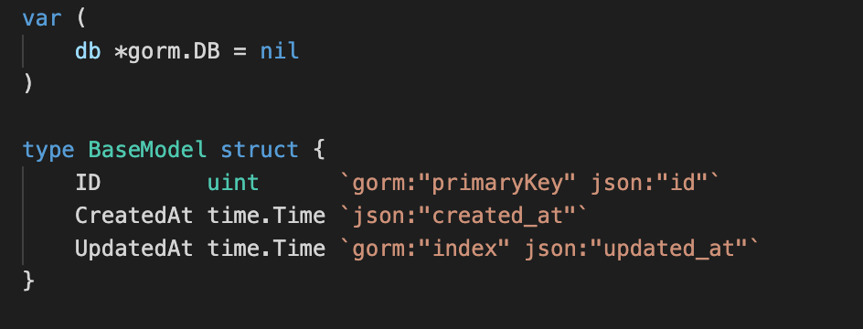
From JS to GoLang
Static typed

Slide 9
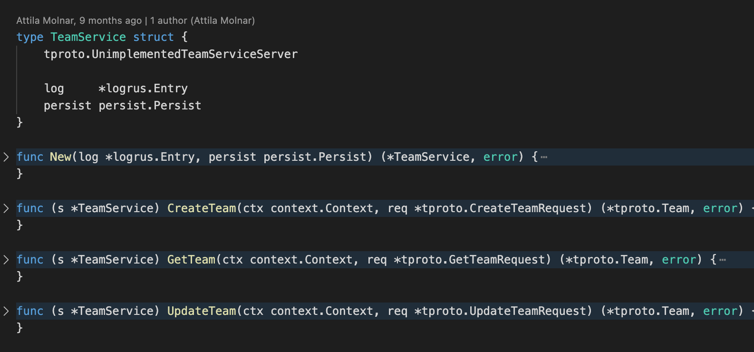
From JS to GoLang
Struct and Pointer

Slide 10
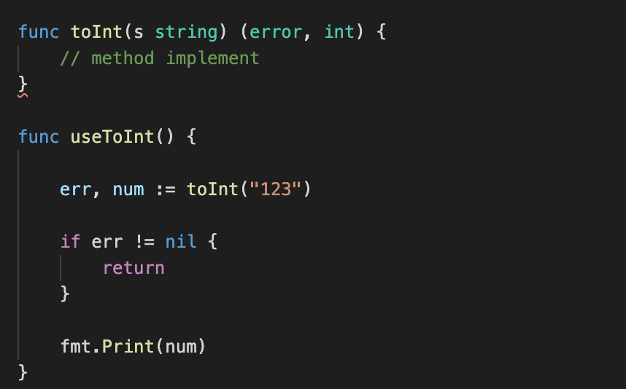
From JS to GoLang
No try/cacth

Slide 11
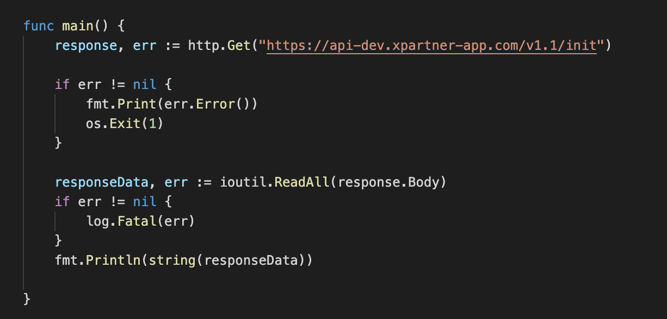
From JS to GoLang
No async/await

Slide 12
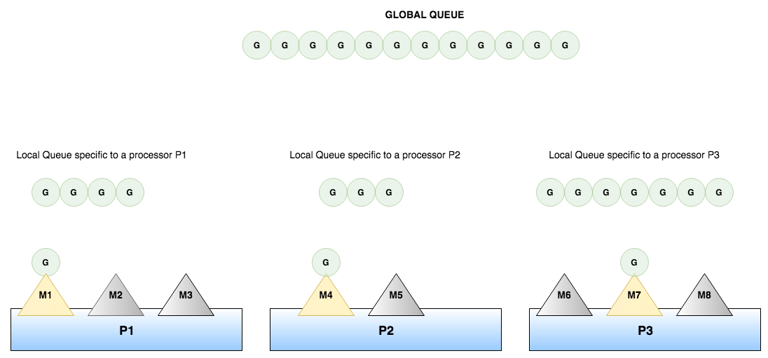
From JS to GoLang
Goroutine & Channel

Slide 13
Example
Simple API
Goroutine & channel

Slide 14

Thankyou

