Slide 1

WELCOME TO
LABCORP
LDD Dashboard - 2022

Slide 2
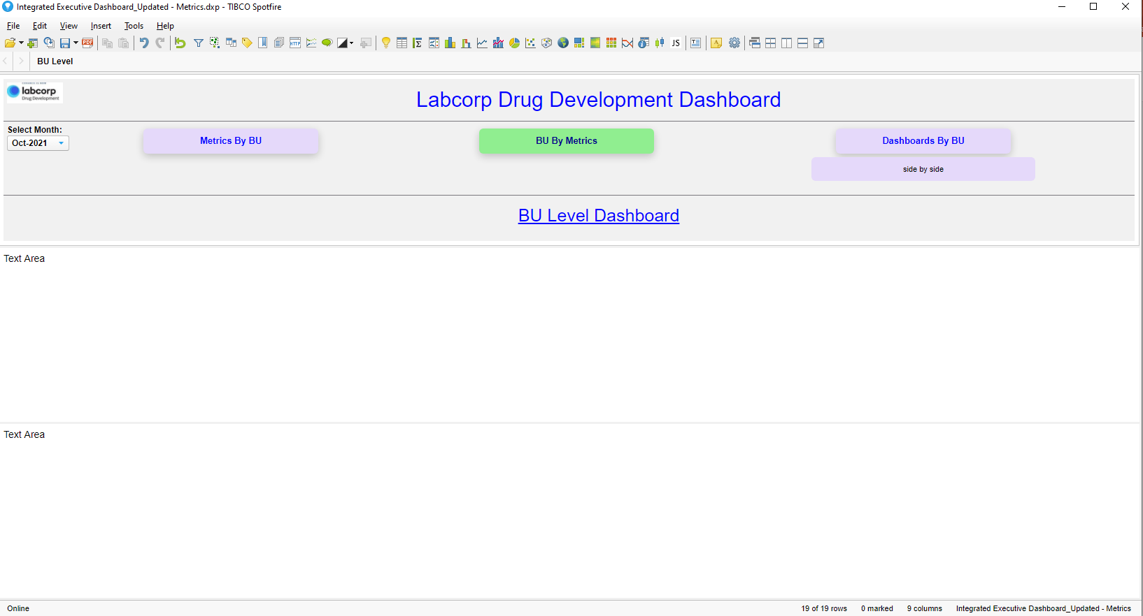
Note – Available design in Spotfire

Slide 3
Proposal design for LDD dashboard #01

Slide 4





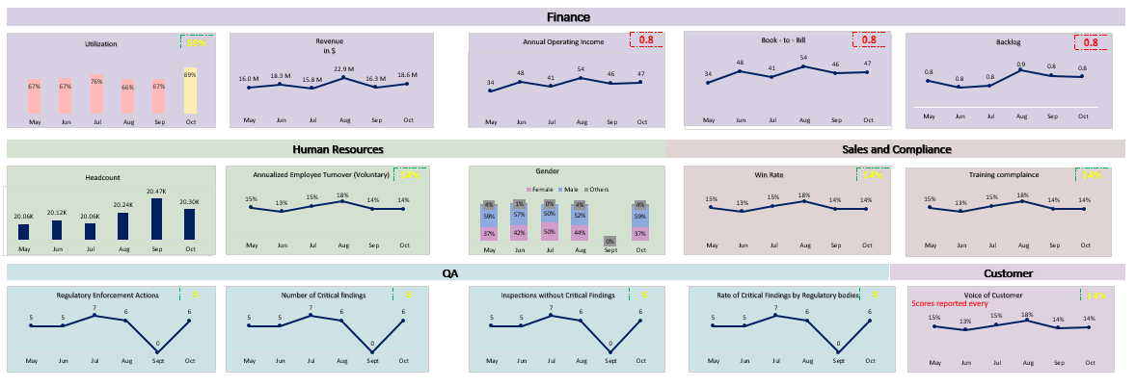
Labcorp Drug Development Dashboard
BU by Metrics
Select Month
Metrics by BU
Dashboards Links
Demo Visualizations, View only
Note – Landing page and filters are not applied. Switch provides change Bu by Metrics to Metrics by BU

Slide 5
Labcorp Drug Development Dashboard
BU by Metrics
Select Month
Metrics by BU
Dashboards Links
Oct 2021
CDCS
CTTS
ES
CDCS
CTTS
ES
Nov 2021
Dec 2021
Demo Visualizations, View only
Note – Landing page and filters are applied. Switch provides change Bu by Metrics to Metrics by BU

Slide 6
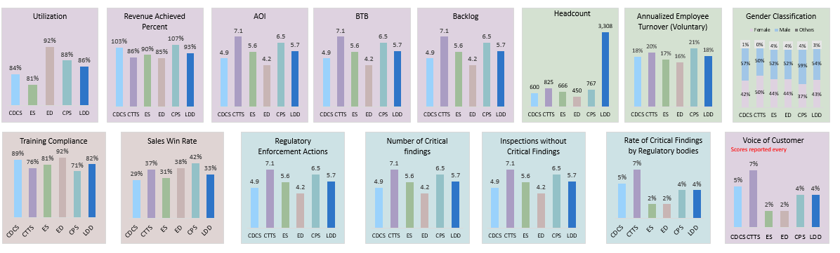
Labcorp Drug Development Dashboard
Metrics by BU
Select Month
Dashboards Links
Demo Visualizations, View only
Note – Landing page and filters are not applied. Switch provides change Bu by Metrics to Metrics by BU

Slide 7
Labcorp Drug Development Dashboard
Metrics by BU
Select Month
Dashboards Links
Oct 2021
CDCS
CTTS
ES
Nov 2021
Dec 2021
Demo Visualizations, View only
Note – Landing page and filters are applied. Switch provides change Bu by Metrics to Metrics by BU

Slide 8
Proposal design for LDD dashboard #02

Slide 9
Labcorp Drug Development Dashboard
BU by Metrics
Select Month
Metrics by BU
Dashboards Links
Demo Visualizations, View only
Note – Landing page and filters are not applied. Switch provides change Bu by Metrics to Metrics by BU

Slide 10
Labcorp Drug Development Dashboard
BU by Metrics
Select Month
Title On Demand
Oct 2021
Nov 2021
Dec 2021
Metrics by BU
CDCS
CTTS
ES
Dashboards Links
CDCS
CTTS
ES
Demo Visualizations, View only
Note – Landing page and filters are applied. Switch provides change Bu by Metrics to Metrics by BU

Slide 11
Labcorp Drug Development Dashboard
Metrics by BU
Select Month
Title On Demand
Dashboards Links
Demo Visualizations, View only
Note – After using the switch from BU by Metrics to Metrics by BU and Filters are not applied

Slide 12
Labcorp Drug Development Dashboard
Metrics by BU
Select Month
Title On Demand
Oct 2021
Nov 2021
Dec 2021
Dashboards Links
CDCS
CTTS
ES
Demo Visualizations, View only
Note – After using the switch from BU by Metrics to Metrics by BU and Filters are applied

