Slide 1
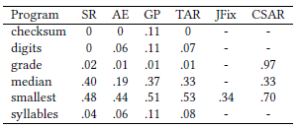

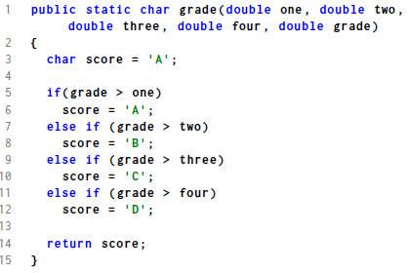
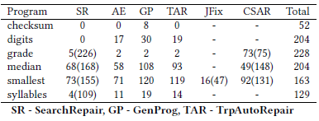

Canonical Search And Repair
Andrew Hill¹, Kathryn Stolee¹, Corina Pasareanu²
¹North Carolina State University, ²Ames Research Center and Carnegie Mellon Silicon Valley
PROBLEM
CSAR seeks to automatically repair buggy programs by leveraging code reuse. Search for compatible repair templates is accomplished via string metrics on canonical-form path conditions from symbolic execution. For speed, a machine learning algorithm can be used to identify incorrect patches without running a test suite. Our learner achieved XX% YY.
X gives the process of transforming PCs into canonical form, and Y gives an example.
Once all potential code is represented by this logical summary of its path flow, we can compare the canonical form using simple string metrics, as shown in XX.
RESULTS
We show an XX% overall improvement in number of correct patches, even though we were not able to attempt three of the six methods due to limitations in effective encoding of their PCs. Additionally, we showed an improvement of XX% over previous state of the art on XX and YY, suggesting that at minimum CSAR is a powerful supplement for problem types which are difficult for existing methods.
We also introduce the idea of an intentional non-patch. This is to say that an ideal repair technique should not only give correct patches to bugs, but also be able to inform the user if the patch provided is unlikely to be correct (i.e. provide not only a patch, but also a confidence this patch is correct). The emphasis on number of correct patches produced in repair literature is analogous to considering only true and false positives; without considering true/false negatives.
CSAR Algorithm
Consider the buggy code above. Each of the < should be <=, and the program does not have a case for the grade “F”.
Symbolic execution runs on the buggy method (could be semantic region, but for this initial work and these small problems the two are usually identical). This yields path conditions (a logical record of what variable values will cause execution of each branch of if statements).
Both search \cite{} and synthesis \cite{} approaches make use of symbolic execution. Our contribution is to use a standard/canonical form to transform all program information into a single intermediate representation; then compare the representations. This is similar to transforming all quadratic equations into the standard form ax^2 + bx + c = 0 prior to attempting analysis.
SETUP
For this work, we used a transformation of the IntroClass dataset into Java, and the Java Symbolic Pathfinder (SPF) symbolic execution engine.
XX gives our numbers of CORRECT patches (explain difference and how they are calculated). YY gives the percentage of attempted patches which resulted in a successful patch.

Slide 2

Canonical Search And Repair
Andrew Hill¹, Kathryn Stolee¹, Corina Pasareanu²
¹North Carolina State University, ²Ames Research Center and Carnegie Mellon Silicon Valley
Problem
Results
CSAR seeks to automatically repair buggy programs by leveraging code reuse. Search for compatible repair templates is accomplished via string metrics on canonical-form path conditions from symbolic execution. For speed, a machine learning algorithm can be used to identify incorrect patches without running a test suite. Our learner achieved XX% YY.
We show an XX% overall improvement in number of correct patches, even though we were not able to attempt three of the six methods due to limitations in effective encoding of their PCs. Additionally, we showed an improvement of XX% over previous state of the art on XX and YY, suggesting that at minimum CSAR is a powerful supplement for problem types which are difficult for existing methods.
CSAR Algorithm
Setup
1) Localize Fault, expand to buggy region (here, method)
2) Run symbolic execution on buggy region and GET Path Conditions
3) Path Conditions to Canonical Form
a) all inequalities to < or <=
b) solve for zero
c) make <= 0 by adding minimum amount to left if needed
d) left to right, replace variables with generic vis
4) Search DB for matches based on string metrics between canonical representations (here Edit distance and Longest Common Substring)
5) Use string metric values and a Decision Tree to weed out matches which are unlikely to be correct. Discard these matches without running unit tests.
6) For high-probability matches, transform source code for matches to match variable names.
7) Check whether patched code passes unit tests
8) Verify correctness of patched code using heldout tests
For this work, we used a transformation of the IntroClass dataset into Java, and the Java Symbolic Pathfinder (SPF) symbolic execution engine.
XX gives our numbers of CORRECT patches (explain difference and how they are calculated). YY gives the percentage of attempted patches which resulted in a successful patch.

Slide 3
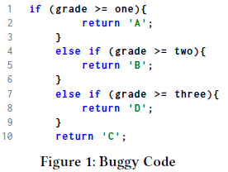
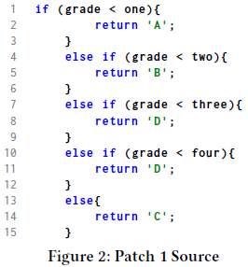
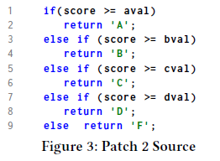
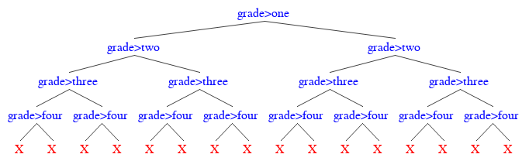
Canonical Search And Repair
Andrew Hill¹, Kathryn Stolee¹, Corina Pasareanu²
¹North Carolina State University, ²Ames Research Center and Carnegie Mellon Silicon Valley
Problem
Results
CSAR seeks to automatically repair buggy programs by leveraging code reuse. Search for repair templates is accomplished via string metrics on canonical-form path conditions from symbolic execution. For speed, a machine learning algorithm can be used to identify likely incorrect patches without running a test suite. Our learner achieved over 95% precision.
We show an 8% overall improvement in number of correct patches over state of the art, even though we were not able to attempt three of the six methods due to limitations in effective encoding of their PCs. Additionally, only CSAR can consistently repair grade bugs suggesting that at minimum CSAR is a powerful supplement for problem types which are difficult for existing methods.
CSAR Algorithm
1) Localize fault, expand to buggy region
2) Run symbolic execution on buggy region and get path conditions
3) Path conditions to canonical form a la Green
4) Search DB for matches based on string metrics between canonical representations (Edit distance and Longest Common Substring)
5) Use string metrics and a Decision Tree to remove likely incorrect patches
6) For remaining matches, transform source code to fit code under repair
7) Run unit tests
8) Verify correctness of patched code using heldout tests
Setup
Results
For this work, we used a Java version of the IntroClass dataset, and the Java Symbolic Pathfinder (SPF) symbolic execution engine.
Table 1 gives our numbers of CORRECT patches (explain difference and how they are calculated). Table 2 gives the percentage of attempted patches which resulted in a successful patch.
8% improvement in correct patches over state of the art, even though only 3/6 program groups were attempted.
47.6% improvement over previous state in reuse-based approaches
Only technique which consistently repairs grade
Use of metrics allows finer-grained control than unit tests

