Slide 1
Title slide

Slide 2
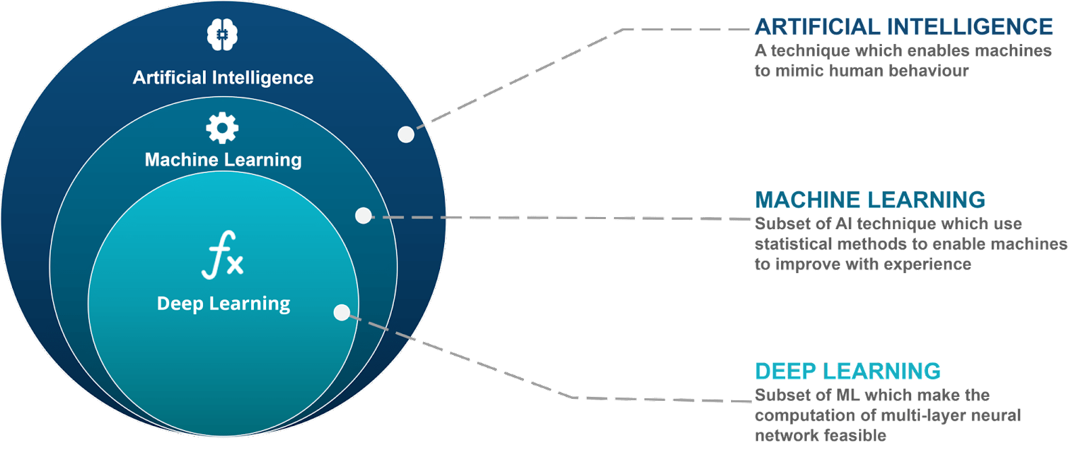
What is Machine Learning (ML)?

Slide 3
Why Choose ML?
Do it better
e.g. Models do not specifically forecast convection hazards, use ML to make explicit forecasts
Do it faster
e.g. Radiation code in models is very slow (but we know the right answer) - use ML methods to speed things up
Do something new
e.g. Go looking for non-linear relationships you didn’t know were there
Credit: CSU Machine Learning Workshop

Slide 4
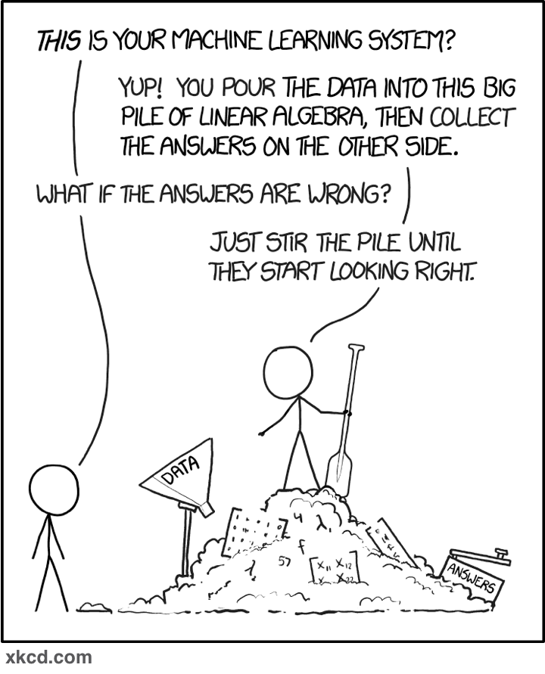
The ML “Black Box”
ML is not a futuristic, black-box idea anymore within
geophysical applications…
data
prediction
The box is configurable and interpretable
MOS is a ”primitive” example: Predict Y from records of X(s)
Recommended reading: McGovern et al. (2019), “Making the Black Box More Transparent: Understanding the Physical Implications of Machine Learning”, BAMS

Slide 5
Applications of ML for atmospheric science
Relevance prioritized for operations

