Slide 1


M.Tech Program
Advanced Industry Integrated Programs
Jointly offered by University and LTIMindTree
FactoryCAPA – AI Quality Intelligence Platform
Ahilya Chauhan
VIT,Vellore
Knowledge partner | Implementation partner

Slide 2
FactoryCAPA – AI Quality Intelligence Platform
Introduction
Manual defect detection in pharma manufacturing is slow and inconsistent
Root-cause analysis often relies on inspector experience alone
FactoryCAPA combines Computer Vision, ML, and LLMs to analyze tablet defects
Investigates visual, production, and batch evidence together
Recommends explainable corrective and preventive actions (CAPA)

Slide 3
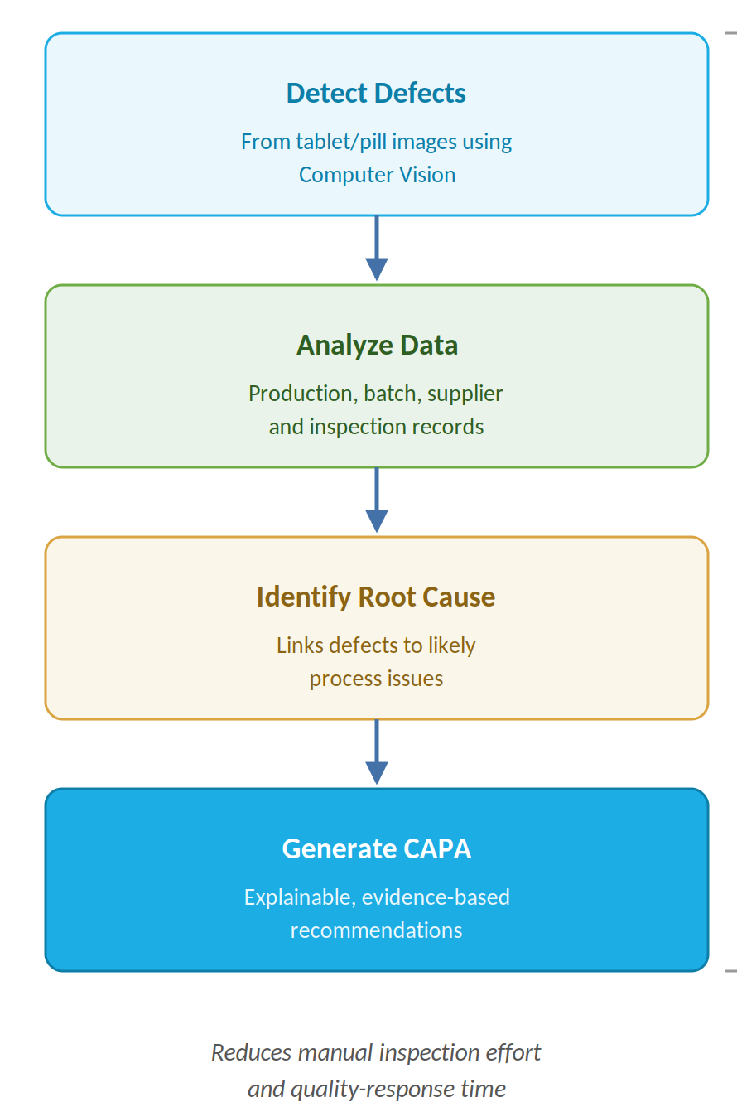
FactoryCAPA – AI Quality Intelligence Platform
Objective
Automatically detect tablet/pill defects from images
Analyze production, batch, supplier, and inspection data
Identify probable root causes behind detected defects
Generate explainable, evidence-based CAPA recommendations
Reduce manual inspection effort and quality-response time

Slide 4
FactoryCAPA – AI Quality Intelligence Platform
Scope
Covers visual defect detection for pharmaceutical tablets/pills
Uses production, batch, supplier, and inspection records as supporting context
Performs root-cause analysis and CAPA recommendation generation
Final CAPA approval remains with the quality team

Slide 5
FactoryCAPA – AI Quality Intelligence Platform
Literature Review
Bergmann et al. (2019) – MVTec AD: benchmark dataset for industrial anomaly detection
An et al. (2026) – EMN-Net: lightweight YOLOv8 model for tablet defect detection
ScienceDirect (2025) – CNN-based defect detection in film-coated tablets
Lundberg & Lee (2017) – SHAP framework for explainable predictions

Slide 6
FactoryCAPA – AI Quality Intelligence Platform
Summary of Literature
Most tablet-defect research focuses on vision-only detection
Few models combine visual evidence with production/batch context
Root-cause reasoning is rarely integrated with defect detection
Explainability (SHAP) is underused in pharma quality systems
FactoryCAPA combines vision + multimodal data + explainable CAPA generation

Slide 7
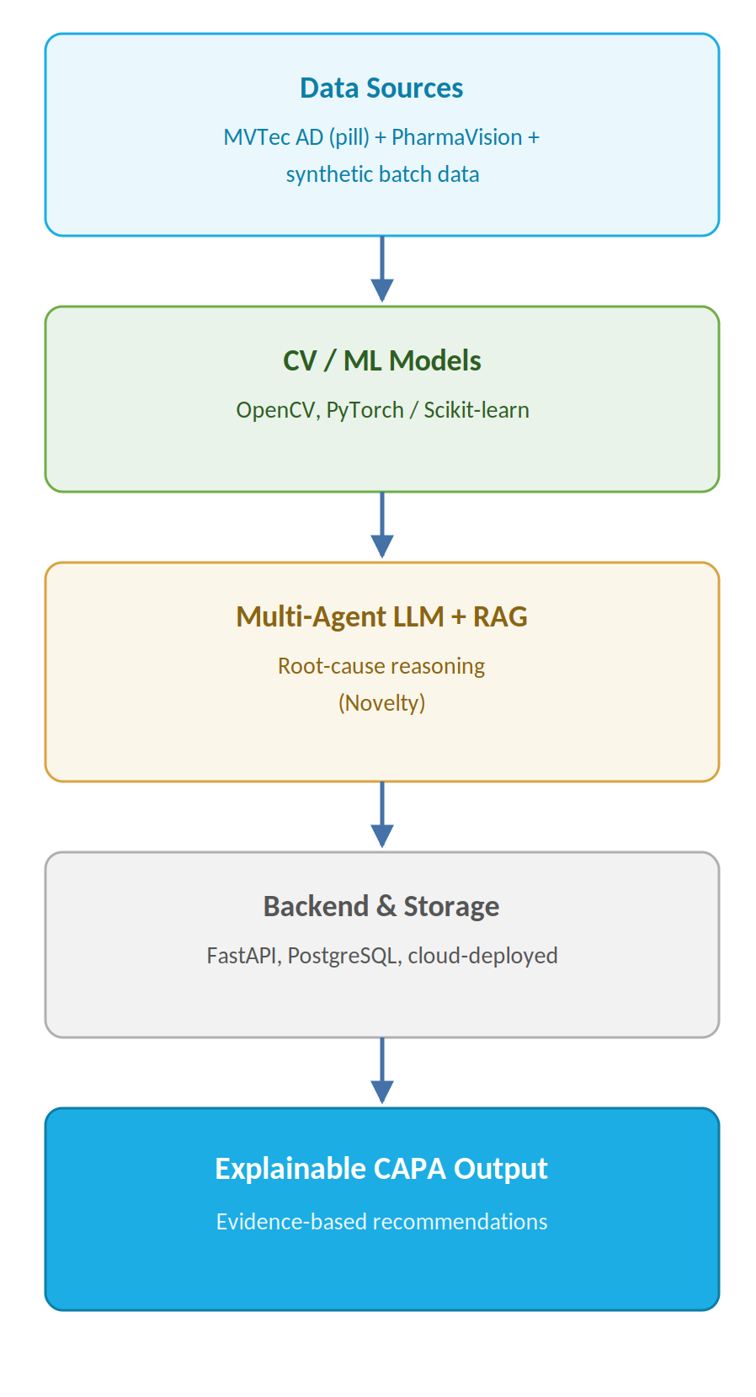
FactoryCAPA – AI Quality Intelligence Platform
Additional Information
Tech stack: Python, OpenCV, PyTorch/Scikit-learn
Backend: FastAPI, Database: PostgreSQL, cloud-deployed
Data: MVTec AD (pill) + PharmaVision blister-pack dataset; synthetic batch/supplier data
Novelty: multi-agent LLM + RAG pipeline for evidence-based, explainable CAPA recommendations

Slide 8
FactoryCAPA – AI Quality Intelligence Platform
Modules to cover
M1: Defect Detection (Computer Vision)
Detects and localizes visible defects on tablets from image data
Flags cracks, contamination, color and imprint faults
M2: Production & Batch Data Analysis
Correlates detected defects with production, batch, and supplier records
Builds contextual evidence for root-cause investigation

Slide 9
FactoryCAPA – AI Quality Intelligence Platform
Modules
M3: Root-Cause Investigation (Multi-Agent)
Specialized agents analyze visual and historical evidence together
Identify probable causes such as supplier, process, or equipment issues
M4: CAPA Recommendation & Explainability
LLM + RAG generates evidence-based corrective and preventive actions
Presents transparent, auditable reasoning behind each recommendation

