Slide 1


M.Tech Program
Advanced Industry Integrated Programs
Jointly offered by University and LTIMindTree
TenderBid AI – AI-Powered Bid/No-Bid Decision Platform
Ahilya Chauhan
VIT, Vellore
Knowledge partner | Implementation partner

Slide 2
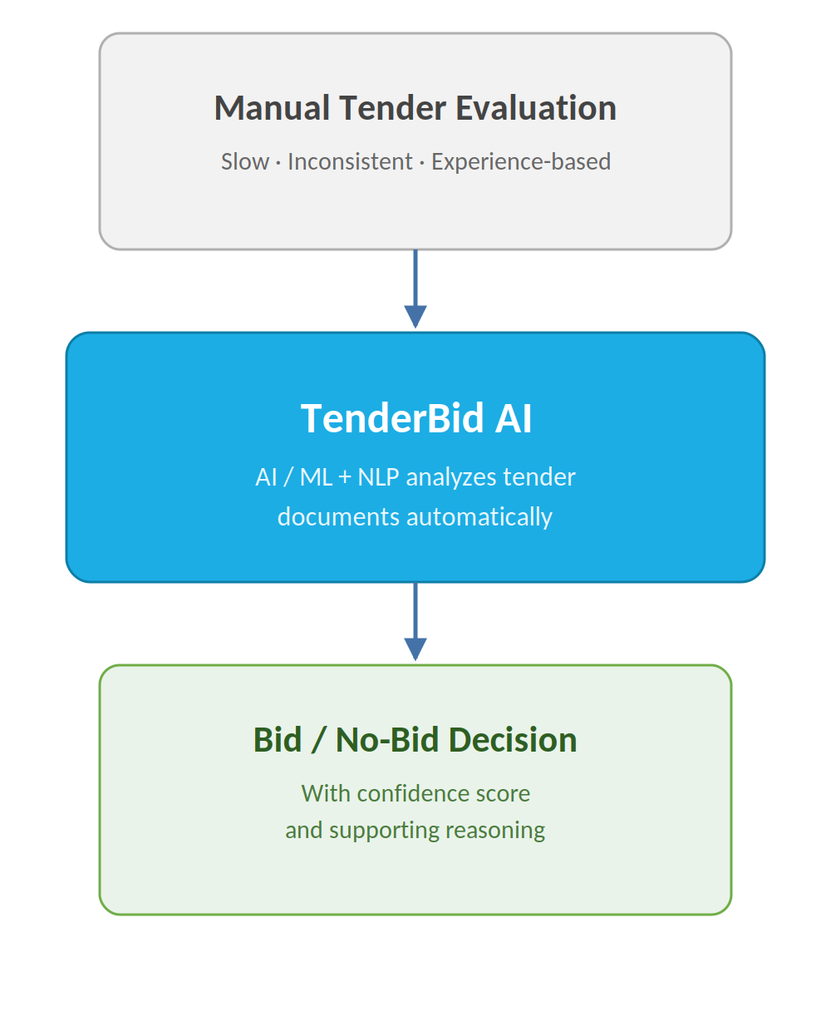
Project Title - Calibri body 18
Introduction
Manual tender evaluation is slow, inconsistent,
resource-heavy
Decisions often based on experience, not data
TenderBid AI applies AI/ML + NLP to tender documents
Recommends Bid/No-Bid with a confidence score
Adds explainable reasoning behind each decision

Slide 3
Project Title - Calibri body 18
Objectives
Automate evaluation of tender documents — reduces dependency on manual review
Extract key parameters using NLP — pulls structured data from unstructured PDFs/DOCX
Predict bid-win probability from historical data — scores new tenders using past outcomes
Generate explainable, not black-box, recommendations — shows the "why" behind each score
Reduce manual effort and decision turnaround time — speeds up go/no-go calls from days to minutes

Slide 4
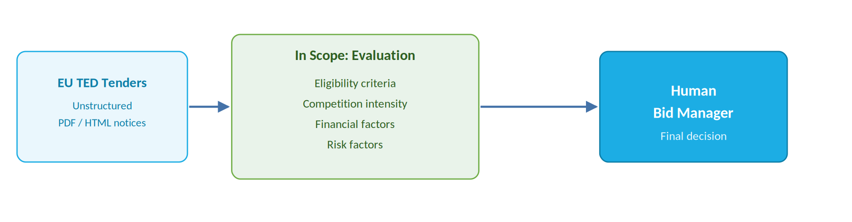
Project Title - Calibri body 18
Scope
Tenders sourced from the EU's TED (Tenders Electronic Daily) portal
Accepts unstructured PDF/HTML tender notices as input
Evaluates eligibility, competition, financial and risk factors
Excludes proposal writing and contract negotiation stages
Final bidding decision remains with the human bid manager

Slide 5
Project Title - Calibri body 18
Literature Review
Sonmez & Sözgen (2017) – SVM-based bid/no-bid decision making
Xu & Yan (2016) – rough sets + neural network bid/no-bid prediction model
Onyekaonwu et al. (2024) – ML algorithm for tender evaluation & contractor selection
Lundberg & Lee (2017) – SHAP framework for explainable predictions

Slide 6
Project Title - Calibri body 18
Summary of Literature
Most bid/no-bid research is rooted in construction industry.
ML/SVM models outperform manual, subjective scoring methods
Very few models combine tender-document NLP with prediction
Explainability (SHAP) remains rarely applied in bid/no-bid literature
TenderBid AI extends this into e-procurement with NLP + ML + explainability

Slide 7
Project Title - Calibri body 18
Additional Information
Tech stack: LLM, Hybrid RAG, Multi-Agent AI, LangGraph
Backend built with FastAPI, database: PostgreSQL, containerized with Docker
Data: EU TED public tender/RFP PDFs, procurement documents
Output: explainable Bid/No-Bid recommendation with confidence score
Novelty: Multi-agent LLM + RAG pipeline delivering evidence-based recommendations over real EU tender/award data

Slide 8
Project Title - Calibri body 18
Modules to cover
M1: Document Ingestion & Preprocessing
Accepts tender/RFP PDFs from EU TED portal and chunks them for retrieval
M2: Requirement & Risk Extraction (RAG-based)
Hybrid RAG + LLM extract requirements, eligibility, and risk clauses from tender text
M3: Eligibility & Capability Matching (Multi-Agent)
Compares requirements with company capability data to flag gaps and score eligibility

Slide 9
Project Title - Calibri body 18
Modules
M4: Risk Analysis Agent
Analyzes financial, legal, and delivery risk factors
Uses historical EU award data for risk scoring
M5: Bid/No-Bid Recommendation & Explainability
LangGraph orchestrates agent outputs into final decision
Generates evidence-based recommendation with supporting reasoning on dashboard

