Slide 1

Kabita Live
The value we created
Our work, its value and the creative possibilities ahead
Presented by
Ahimanikya Satapathy
Redesign, design system
& project direction
AHIMANIKYA SATAPATHY | KABITA LIVE REDESIGN
01
Notes:
Sources: kb/TEAM-CHARTER.md; kb/artifacts/design/brand-guide/DESIGN-SYSTEM.md; kb/registers/activity.jsonl. Design direction: Ahimanikya Satapathy, with AI assistance. Existing journal illustrations include AI-assisted artwork; preserved originals remain in the project KB. The presentation balances the effort behind the redesign, value already available, and possibilities for editorial development. Artwork: projects/site/assets/home/life-after-rain.webp.

Slide 2
Our project timeline
29 September - 2 October 2026
29 SEP
Study, design and preservation
Design proposal and visual direction; 47 editions and 801 poem records captured.
30 SEP
Reader experiments and editorial preparation
Typography, artwork and reading controls; translation drafts and Facebook presence.
01 OCT
Poet research and page review
All 427 enriched narratives applied; poem, profile and archive refinements.
02 OCT
Final refinements and hosted preview
Reader and credit checks; writer audit; verified hosting and materials to share.
AHIMANIKYA SATAPATHY | KABITA LIVE REDESIGN
02
Notes:
Sources: kb/TEAM-CHARTER.md; kb/artifacts/design/brand-guide/DESIGN-SYSTEM.md; kb/registers/activity.jsonl. Design direction: Ahimanikya Satapathy, with AI assistance. Existing journal illustrations include AI-assisted artwork; preserved originals remain in the project KB. Dates use America/Los_Angeles (Pacific Time). The original design proposal is dated 29 September 2026. Activity evidence: KBL-EVT-011/012/013 for profile and poem capture on 29 September; 030/032/040 for Facebook on 30 September; 272 for completion of 427 narratives on 1 October; 310/313/328/343/351 for reader refinements, credits, audit and hosted preview on 2 October. This is a milestone chronology, not a timesheet or claim of measured hours.

Slide 3
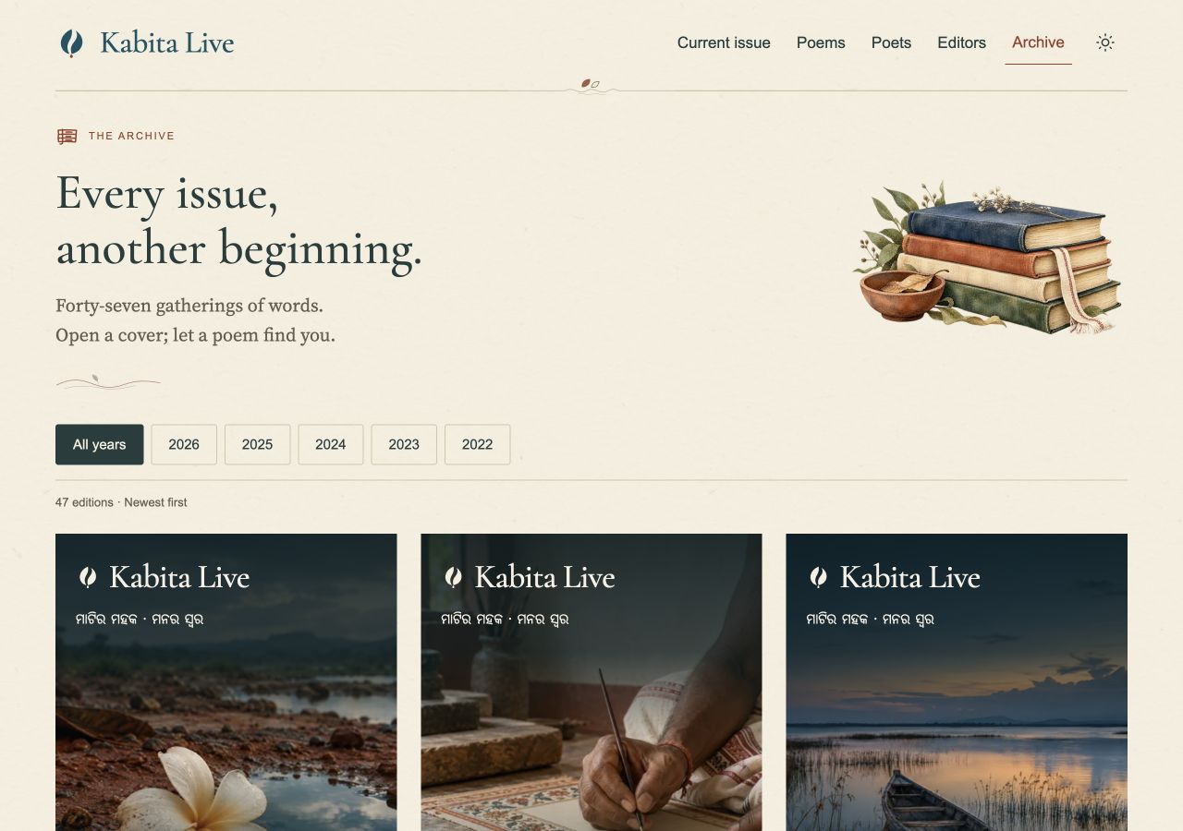
An archive readers can explore
47
799
editions
active poems
Poems connect to their editions and contributors.
Earlier writing has more ways to find a new reader.
AHIMANIKYA SATAPATHY | KABITA LIVE REDESIGN
03
Notes:
Sources: kb/TEAM-CHARTER.md; kb/artifacts/design/brand-guide/DESIGN-SYSTEM.md; kb/registers/activity.jsonl. Design direction: Ahimanikya Satapathy, with AI assistance. Existing journal illustrations include AI-assisted artwork; preserved originals remain in the project KB. Sources: README.md; kb/research/edition-content-import.md; kb/records/github-pages-preview-deployment.json. 801 records captured; 2 unavailable records preserved outside active editions; 799 active poem records. This is not a claim that unresolved editorial questions are closed. Screenshot: hosted archive captured 2 October 2026 in project-story-2026-10-02/screenshots/archive.png.

Slide 4
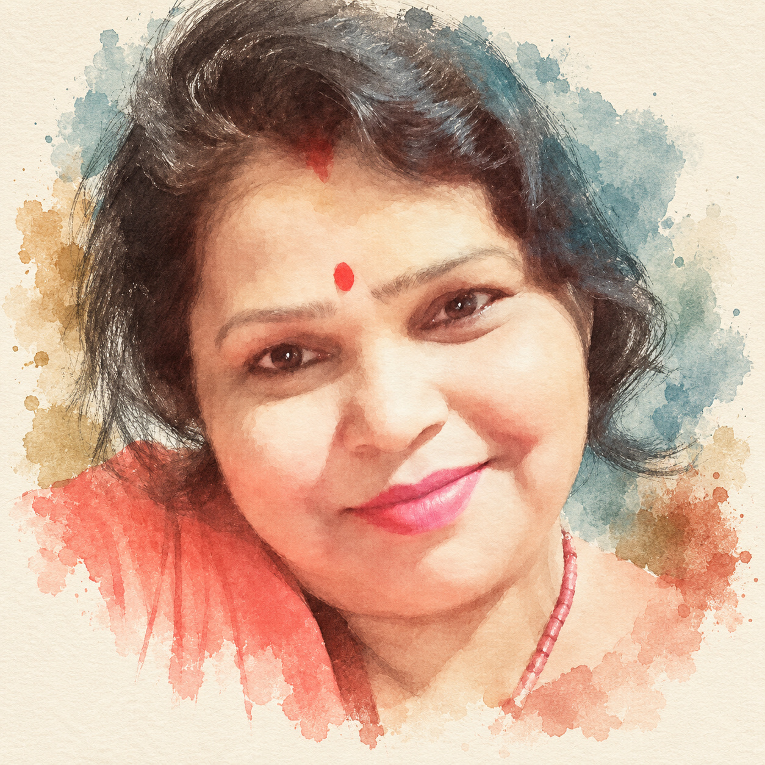
A fuller presence for each poet
427
enriched poet narratives
Literary backgrounds and contribution histories give readers context.
Careful identity checks and faithful quotations support that recognition.
Narmada Nilotpala
AHIMANIKYA SATAPATHY | KABITA LIVE REDESIGN
04
Notes:
Sources: kb/TEAM-CHARTER.md; kb/artifacts/design/brand-guide/DESIGN-SYSTEM.md; kb/registers/activity.jsonl. Design direction: Ahimanikya Satapathy, with AI assistance. Existing journal illustrations include AI-assisted artwork; preserved originals remain in the project KB. Sources: kb/registers/activity.jsonl KBL-EVT-272, 343; README.md. All 427 enriched narratives applied. Source-limited profiles remain modest; a few identity and credit questions need editor confirmation. Narmada Nilotpala artistic portrait derives from an existing photograph: projects/site/assets/writers/82-earth-voice-v1.png. Wider portrait rollout remains under review.

Slide 5
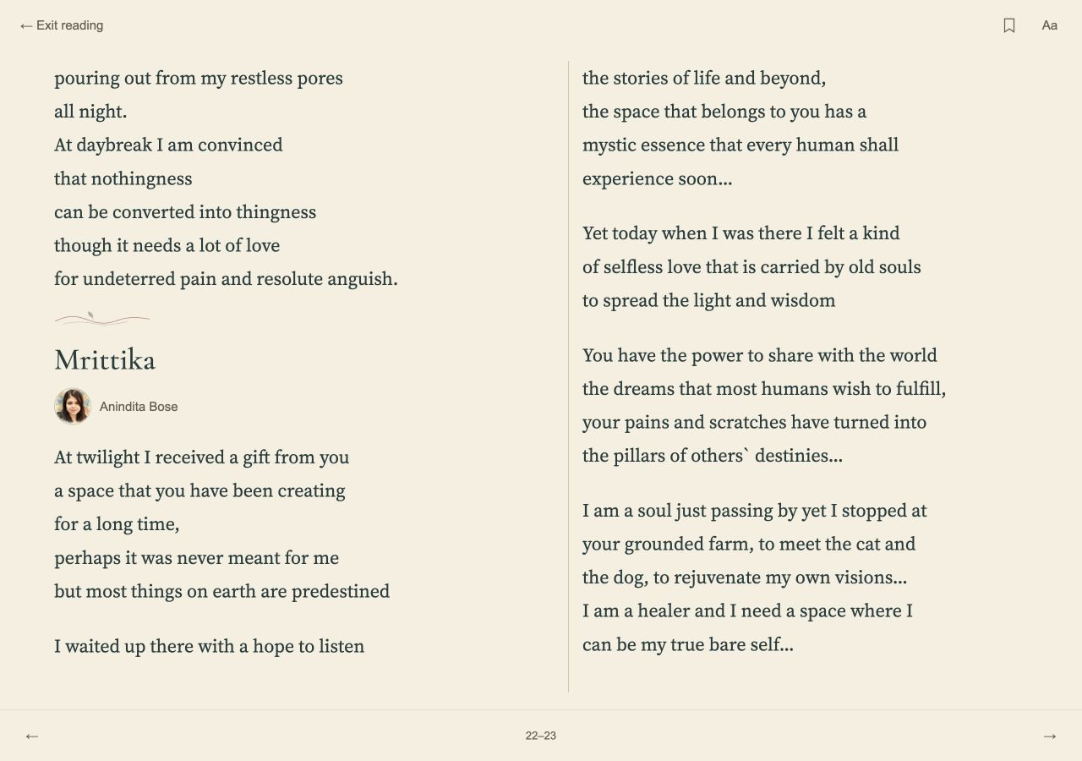
More room for attention
Quiet reading brings the poem into focus.
Adjustable text and appearance support different reading preferences.
Search and bookmarks help readers discover and return.
AHIMANIKYA SATAPATHY | KABITA LIVE REDESIGN
05
Notes:
Sources: kb/TEAM-CHARTER.md; kb/artifacts/design/brand-guide/DESIGN-SYSTEM.md; kb/registers/activity.jsonl. Design direction: Ahimanikya Satapathy, with AI assistance. Existing journal illustrations include AI-assisted artwork; preserved originals remain in the project KB. Sources: kb/artifacts/design/brand-guide/DESIGN-SYSTEM.md reading rules; quiet-reader implementation and checks in activity ledger. Bookmarks and marks stay on the reader’s device. Screenshot: hosted quiet reader captured 2 October 2026. Visible poem: Mrittika by Anindita Bose, Issue 47; poetry rights remain with the author. Better conditions for reading are an intended benefit, not measured engagement uplift.

Slide 6
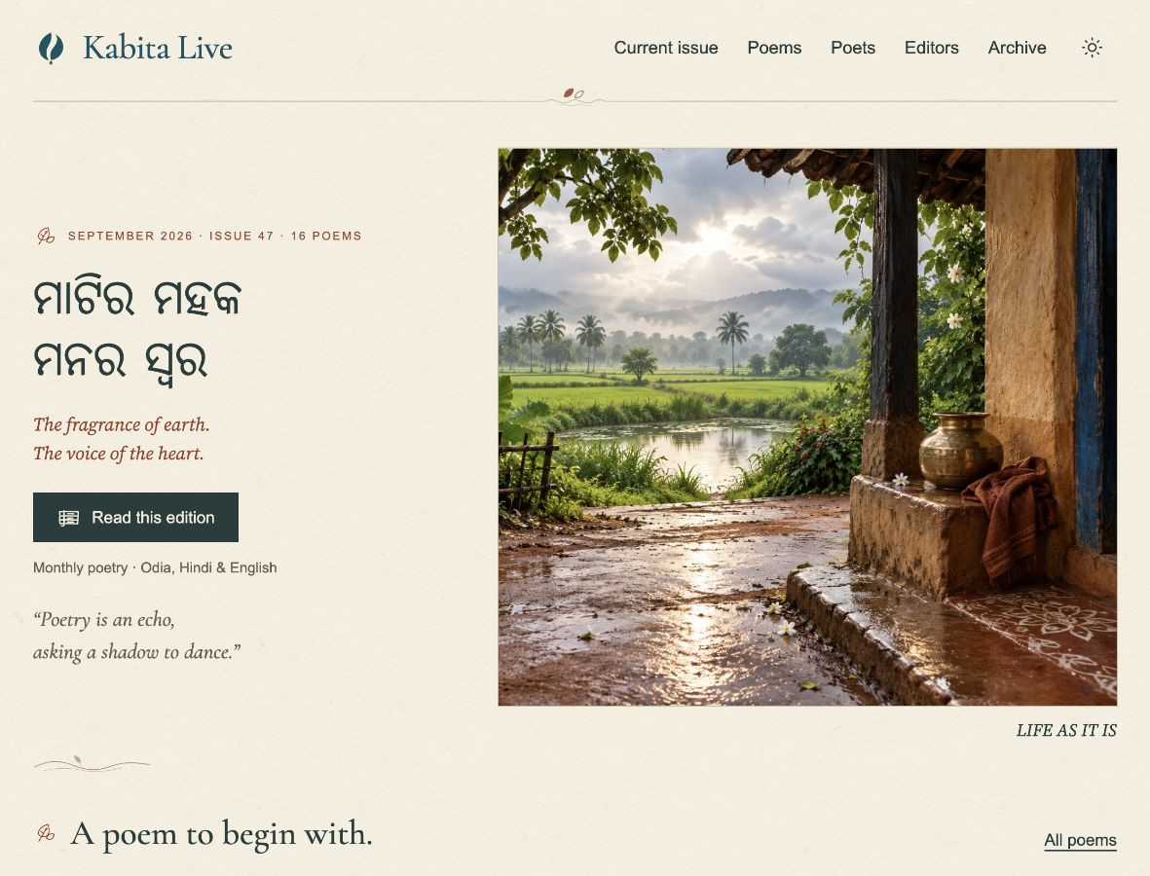
A recognisable literary character
Rooted in Odisha
Artwork, warm paper and deep ink give the journal a sense of place.
Open to three languages
Typography gives Odia, Hindi and English space to read comfortably.
AHIMANIKYA SATAPATHY | KABITA LIVE REDESIGN
06
Notes:
Sources: kb/TEAM-CHARTER.md; kb/artifacts/design/brand-guide/DESIGN-SYSTEM.md; kb/registers/activity.jsonl. Design direction: Ahimanikya Satapathy, with AI assistance. Existing journal illustrations include AI-assisted artwork; preserved originals remain in the project KB. Source: approved brand guide. English display uses Cormorant Garamond; reading uses Source Serif 4; Odia uses Noto Serif Oriya; Hindi uses Tiro Devanagari Hindi. Screenshot from the hosted homepage, captured 2 October 2026. Cultural presence describes the design intent, not a measured audience response.

Slide 7

A shared foundation for editors
Less reinvention
Reusable layouts and editor guidance give routine decisions a common reference.
Continuity
Preserved originals and research help future changes respect the magazine’s history.
More room for editorial ideas
That foundation supports attention to poems, contributors and the shape of an edition.
AHIMANIKYA SATAPATHY | KABITA LIVE REDESIGN
07
Notes:
Sources: kb/TEAM-CHARTER.md; kb/artifacts/design/brand-guide/DESIGN-SYSTEM.md; kb/registers/activity.jsonl. Design direction: Ahimanikya Satapathy, with AI assistance. Existing journal illustrations include AI-assisted artwork; preserved originals remain in the project KB. Sources: KBL-WORK-018 editor guide and proposal; kb/reference/storage-layout.md; approved brand guide. The expected reduction in routine rework has not been quantified. Editorial desk artwork: projects/site/assets/section-art/editorial-desk.webp.

Slide 8
Creative possibilities for the magazine
Curated conversations
The poet behind the poem
Bring poems across editions and languages together around a theme.
Invite a short reflection on a poem’s beginning or a creative choice.
Collaboration across forms
Thoughtful reader participation
Explore reviewed translations, commissioned art or carefully produced readings.
Let private feedback reveal questions and interests worth exploring.
AHIMANIKYA SATAPATHY | KABITA LIVE REDESIGN
08
Notes:
Sources: kb/TEAM-CHARTER.md; kb/artifacts/design/brand-guide/DESIGN-SYSTEM.md; kb/registers/activity.jsonl. Design direction: Ahimanikya Satapathy, with AI assistance. Existing journal illustrations include AI-assisted artwork; preserved originals remain in the project KB. These are proposals for editorial exploration, not implemented features or scheduled commitments. Translation drafts need editorial/linguistic review; recited audio remains deferred. New artwork, readings and translations require appropriate contributor involvement and permissions. Private feedback is the agreed engagement model; public comments are not proposed.

Slide 9

One possibility: a collection on rain
A theme can make new connections within the existing archive.
An editor could select poems from different issues, introduce their shared theme and invite a poet to reflect on one work.
A new way to encounter poems readers may have missed.
AHIMANIKYA SATAPATHY | KABITA LIVE REDESIGN
09
Notes:
Sources: kb/TEAM-CHARTER.md; kb/artifacts/design/brand-guide/DESIGN-SYSTEM.md; kb/registers/activity.jsonl. Design direction: Ahimanikya Satapathy, with AI assistance. Existing journal illustrations include AI-assisted artwork; preserved originals remain in the project KB. Illustrative editorial concept only. No poems have been selected and no collection is published or scheduled. Original language and author credits should remain beside each poem; translations only after review. Artwork: projects/site/assets/section-art/gatherings.webp, existing journal illustration.

Slide 10
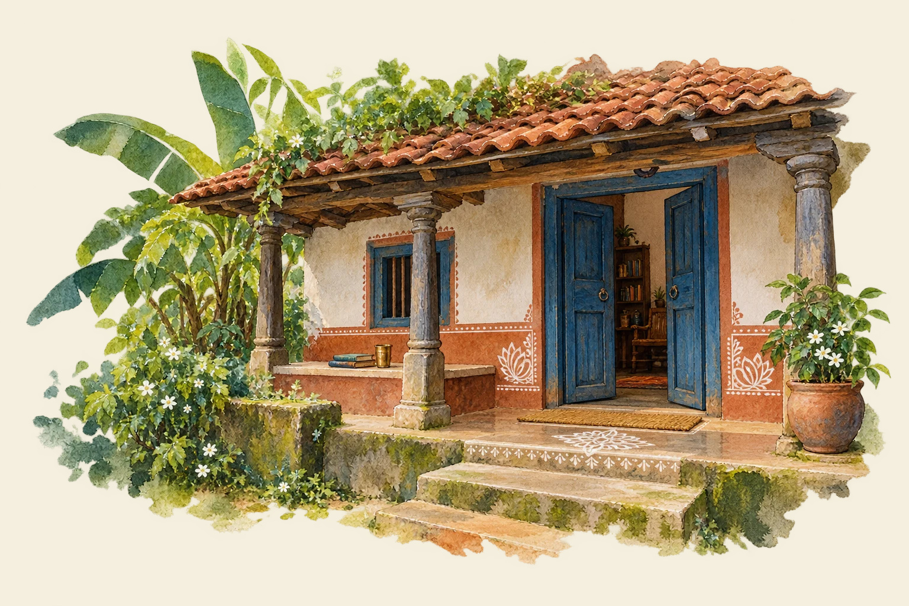
A literary home to grow together
Editors shape the direction.
Poets bring their voices.
Readers bring their attention.
The hosted preview is ready to explore and share.
ahimanikya.github.io/kabita-live
Presented by Ahimanikya Satapathy
AHIMANIKYA SATAPATHY | KABITA LIVE REDESIGN
10
Notes:
Sources: kb/TEAM-CHARTER.md; kb/artifacts/design/brand-guide/DESIGN-SYSTEM.md; kb/registers/activity.jsonl. Design direction: Ahimanikya Satapathy, with AI assistance. Existing journal illustrations include AI-assisted artwork; preserved originals remain in the project KB. Hosted preview: https://ahimanikya.github.io/kabita-live/ . Source: kb/records/github-pages-preview-deployment.json. Existing domain unchanged; DNS transition is separate. Translation/identity review and portrait work continue. No measured traffic, engagement or productivity uplift is claimed. Acknowledgements: editors, contributors, Sonu Swayin and Versatile IT Services Pvt. Ltd. for hosting and managing Kabita Live since inception. Artwork: projects/site/assets/section-art/our-story.webp.

