Slide 1
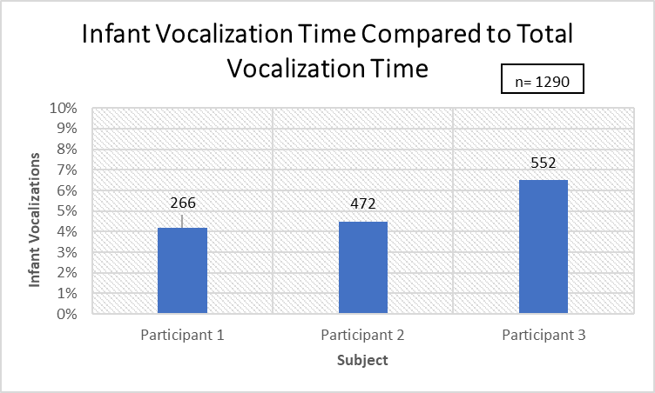
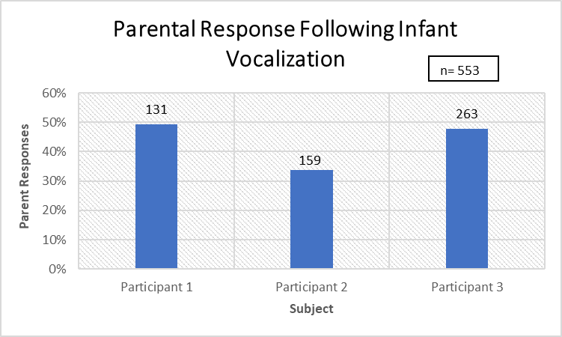
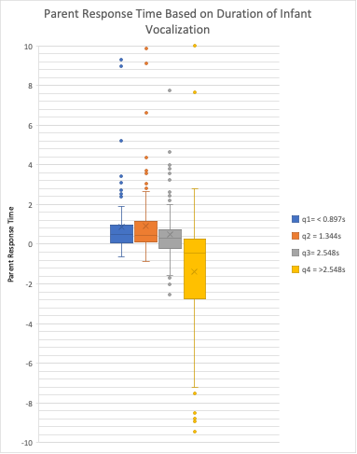
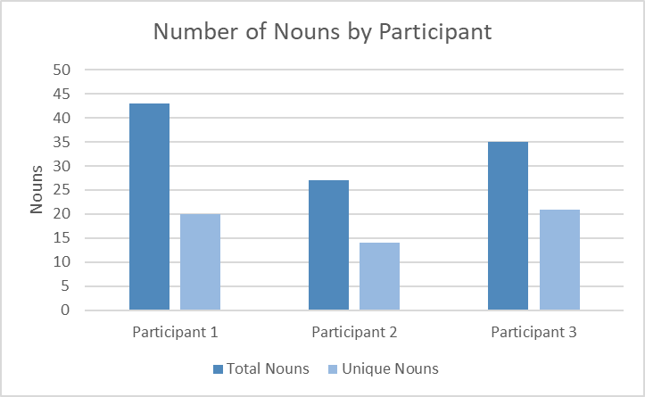
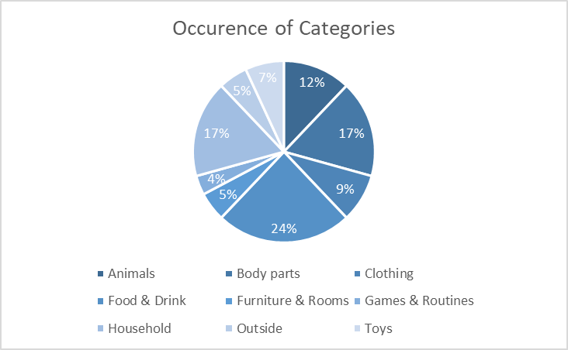
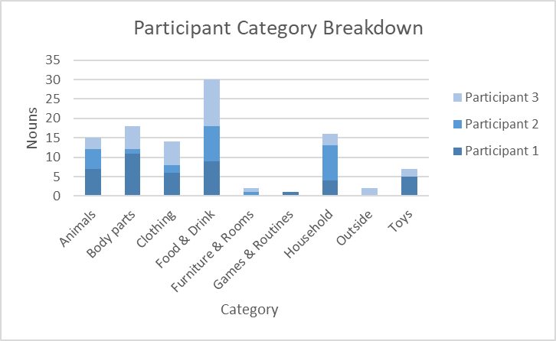
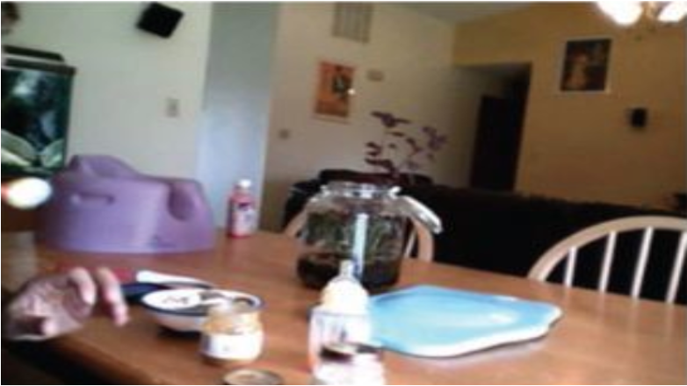
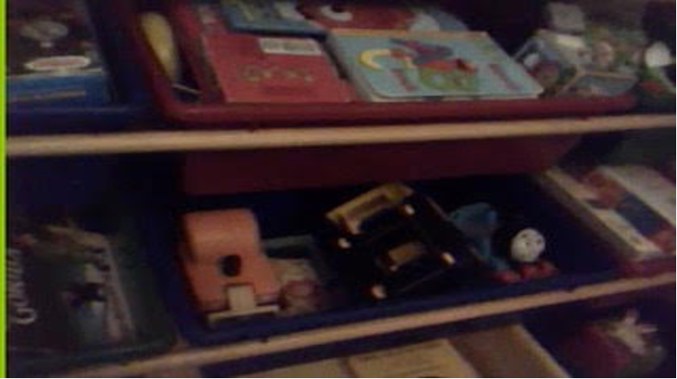

Temporal and linguistic properties of infant-parent communication
in the home environment
Austin Himebaugh, AJ Humbert, Angelena Lara, Sara Benham, Elizabeth Clerkin, & Linda B. Smith
Indiana University, Department of Psychological & Brain Sciences
Parents respond to infant communication in a variety of ways. Research suggests that the type of input and temporal contingency of the response lays critical groundwork for language development and is directly linked to later vocabulary development (Tamis-LeMonda, Bornstein, Kahana-Kalman, Baumwell, & Cyphers, 1998).
Infants change the quality (e.g., phonetic/phonological structure) of their vocalization based on the verbal response from the parent (Bloom et al., 1987; Goldstein & Schwade, 2008), suggesting that the parent response may shape aspects of the vocalization.
Our objective is to characterize the temporal and linguistic properties of infant-parent communication in the home environment.
Research Questions:
1. How often do infants vocalize?
2. How often parents respond?
3. Does the length of an infant vocalization affect parental response time?
4. When parents respond to the infant vocalization, how often do they label objects?
Summary
Introduction
Question 1: How often do infants vocalize?
Methods: Created a datavyu column that contained every audible sound that the infant produced
-IV: Subject
-DV: Number of vocalizations produced
Question 1:
Infants vocalized 5.06% of the time
Question 2:
Parents responded to infant vocalizations 42.87% of the time
Question 3:
Shorter response time as duration gets longer
Question 4:
Parental responses contain a noun 18.98% of the time.
Most labeling occurs in relation to food & drink. There’s significant repetition of words, but also diversity in the number of semantic categories infants hear.
Question 2: How often do parents respond to infant vocalizations?
Methods: Created a datavyu column that contained every contextually relevant parental response to infant vocalization
-IV: Subject
-DV: Number of parental responses/non-responses
Question 3: Does the length of the infant’s vocalization affect the response time from the parents?
Methods: Used datavyu columns and onset and offset tools to measure the duration of vocalizations and the start of the response
-IV: The length of the vocalization (grouped)
-DV: The time it takes the parent to respond (response time)
Conclusion
Although infant vocalizations make up a minimal portion of home environment speech, it has a strong impact on non-infant conversation, eliciting parent response and noun labels
Limitations & Future Directions
 | <0.897 sec | >.897 and <1.344 sec | > 1.344 & <2.548 sec | > 2.548 & < 18.227 sec
Mean | 0.9178 | 0.9293 | 0.4399 | -1.700
Median | 0.4825 | 0.444 | 0.31 | -0.465
SD | 1.73357109 | 1.70969403 | 1.34198398 | 3.84334976
How rate of vocalization and parent response change as infants age
Extending analyses to other home scenes beyond mealtime, playtime, and book reading
Other phonetic/acoustic properties of the vocalization (e.g., pitch, loudness)
Other aspects of infant communication (e.g., gestures, facial reactions) and parent response (e.g., touch, eye gaze)
General Methods
Participants n = 3; (all 11 months, 2 M; 1F)
Home videos were acquired using a head camera sent home with families. Videos were only coded for mealtime, playtime, and book reading scenes, then parsed into 5-second segments.
Coding:
Adult speech transcription
Presence and duration of infant vocalizations
Adult response time to the vocalization (within 6 sec., but longer responses accepted if it was clearly related to infant vocalization)
Question 4: What is the content of parental response? What noun labeling or noun usage occurs in a response?
Methods: Used datavyu to code for nouns and noun categories on the MCDI (vocabulary checklist) in the adult responses
-IV: Subject
-DV: Nouns and noun categories used during response
References
Bloom, K., Russell, A., & Wassenberg, K. (1987). Turn taking affects the quality of infant vocalizations. Journal of Child Language, 14(2), 211–227.
Bornstein, M. H., Putnick, D. L., Cote, L. R., Haynes, O. M., & Suwalsky, J. T. (2015). Mother-infant contingent vocalizations in 11 countries. Psychological Science, 26(8), 1272-1284
Goldstein, M. H., & Schwade, J. A. (2008). Social feedback to infants’ babbling facilitates rapid phonological learning. Psychological Science, 19(5), 515–523.
Smith, P. B., & Pederson, D. R. (1988). Maternal sensitivity and patterns of infant-mother attachment. Child development, 1097-1101
Acknowledgements
National Science Foundation Grant BCS-15233982
NIH Grant R01HD 074601; 028675
T32 NICHD HD007475

