Slide 1

A Recommendation System for Movies
By: Alec Hing

Slide 2
Outline
Overview
Data Involved
Approach
Methods
Results
Improvements
Recommendations
Conclusion

Slide 3

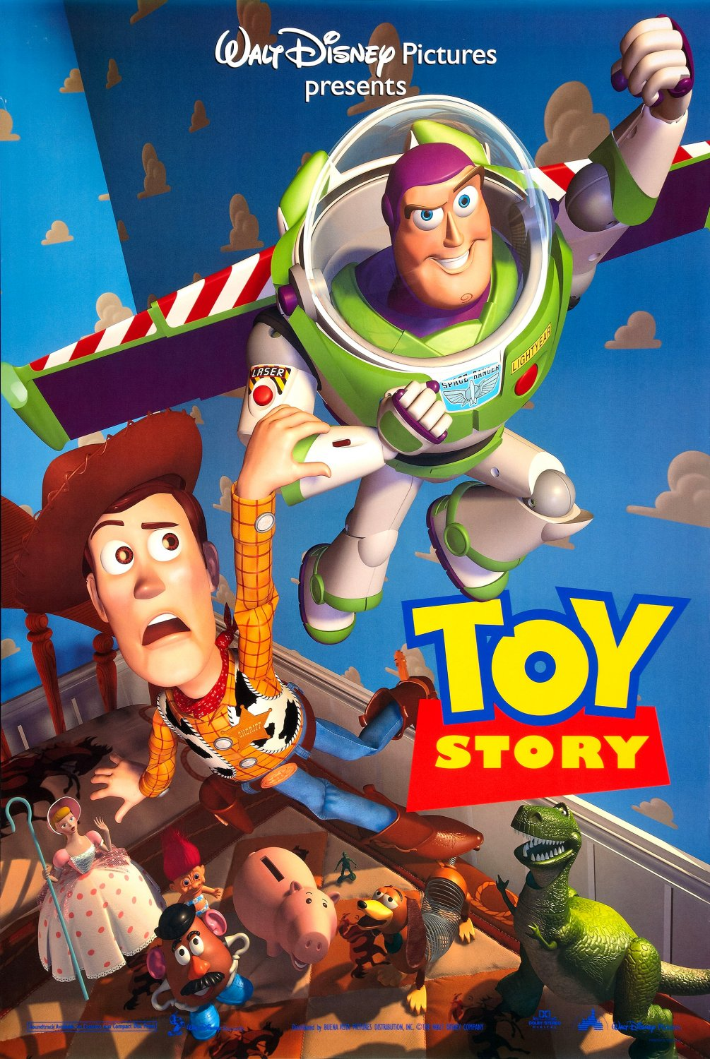




Overview
Provide Netflix user’s meaningful recommendations they may like
How do we know what movies a user may like based on prior likes?
What about no information?
Notes:
100,000 considered a small dataset. A big one would be a dataset of 27,000,000 or 58,000 movies by 280,000 users.
New user is called the cold start problem

Slide 4


Data Involved
The datasets used in this project are from the MovieLens research lab at the University of Minnesota
Main categories analyzed were Movie Id, Title, Genre, User Id, and Rating
Ratings were on a scale of 0 to 5
100,836 total movies rated
610 users
9724 movies

Slide 5
Approach
Questions:
What have they not seen?
Quantity of movies
Total ratings per movie
2 systems will be used to create a proper recommendation system
First – Collaborative Filtering: Users with similar interests will probably like the same thing
Second - Content based filtering: If a user likes an item, they may like similar items
Notes:
Content based filtering was used to solve the cold start problem
Ask user which of the top 10 movies they liked
If user A likes items 5, 6, 7, and 8 and user B likes items 5, 6, and 7, then it is highly likely that user B will also like item 8

Slide 6


Methods
Models:
The ALS and matrix factorization models used for massive datasets
Memory based methods used for simplicity
Because this is a “smaller” dataset, computing time was not a priority
Notes:
There were more movies than users, so using a user-user similarity would have been quicker but the more accurate result was with item-item

Slide 7





Methods – Collaborative Filtering
Movies both users have seen
Similar users
Recommended by user to another user

Slide 8

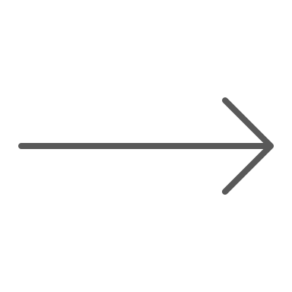

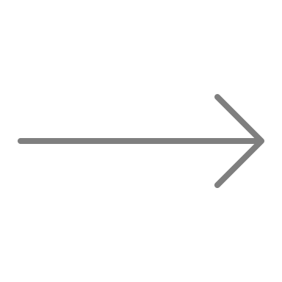
Methods – Solution to Cold start Problem
Movie watched by user
Similar Movies
Content Based Filtering
Recommended to user
Notes:
Content based recommendations
Main Idea: If you like an item, you will also like "similar" items.

Slide 9
Results
Out of the 6 methods used, the most accurate one was KNNBaseline
This is a more advanced model than the rest that accounts for other variables
Its accuracy was calculated to be about 0.55 off while the rest were around 0.80
Notes:
Other variables are bias and a minimized cost function
On a scale of 0 to 5 our best model is only about 0.55 off while the rest are closer to being 1 whole rating off
This RMSE is important for the cold start problem. Gave slightly different results than when another method was used (SVD)

Slide 10


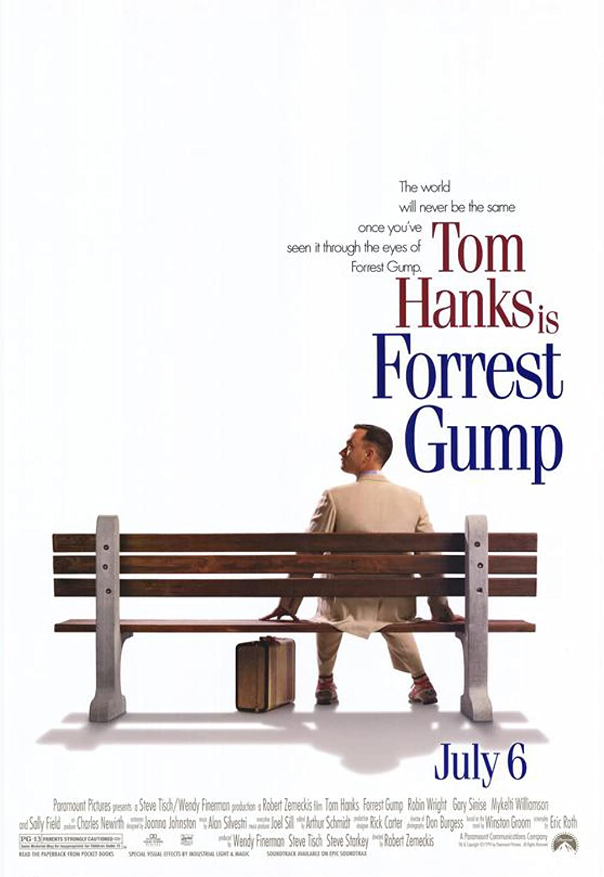
Improvements
Fine tuning the parameters
Ask about Genres, Length, Actors
Number of ratings per movie (See next slide)
Notes:
If only a handful of people rated a certain movie, the rating on that movie may be fair. Ex: if only 5 people rated and superhero movie and gave it a 1/5 just because they don’t like action, then that’s not representative of variety of people
More info can be obtained from a new user, do they like long or short movies, do they like movies with sequels, or do they like a certain genre only

Slide 11
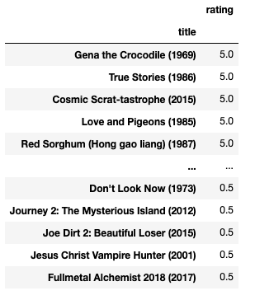
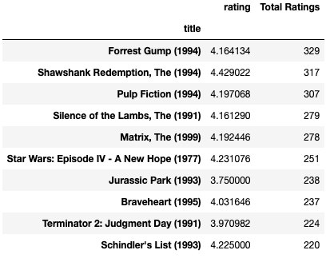
Improvements
VS
Notes:
- NOTE THE TOTAL RATINGS

Slide 12
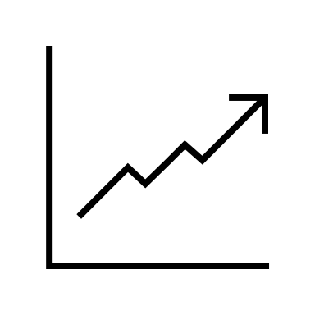
Recommendations
Compute time – Small dataset vs. Big dataset
Recommend movies similar users would like
Ask users about their interests
Consider number of ratings
Computer time
Size of Data

Slide 13
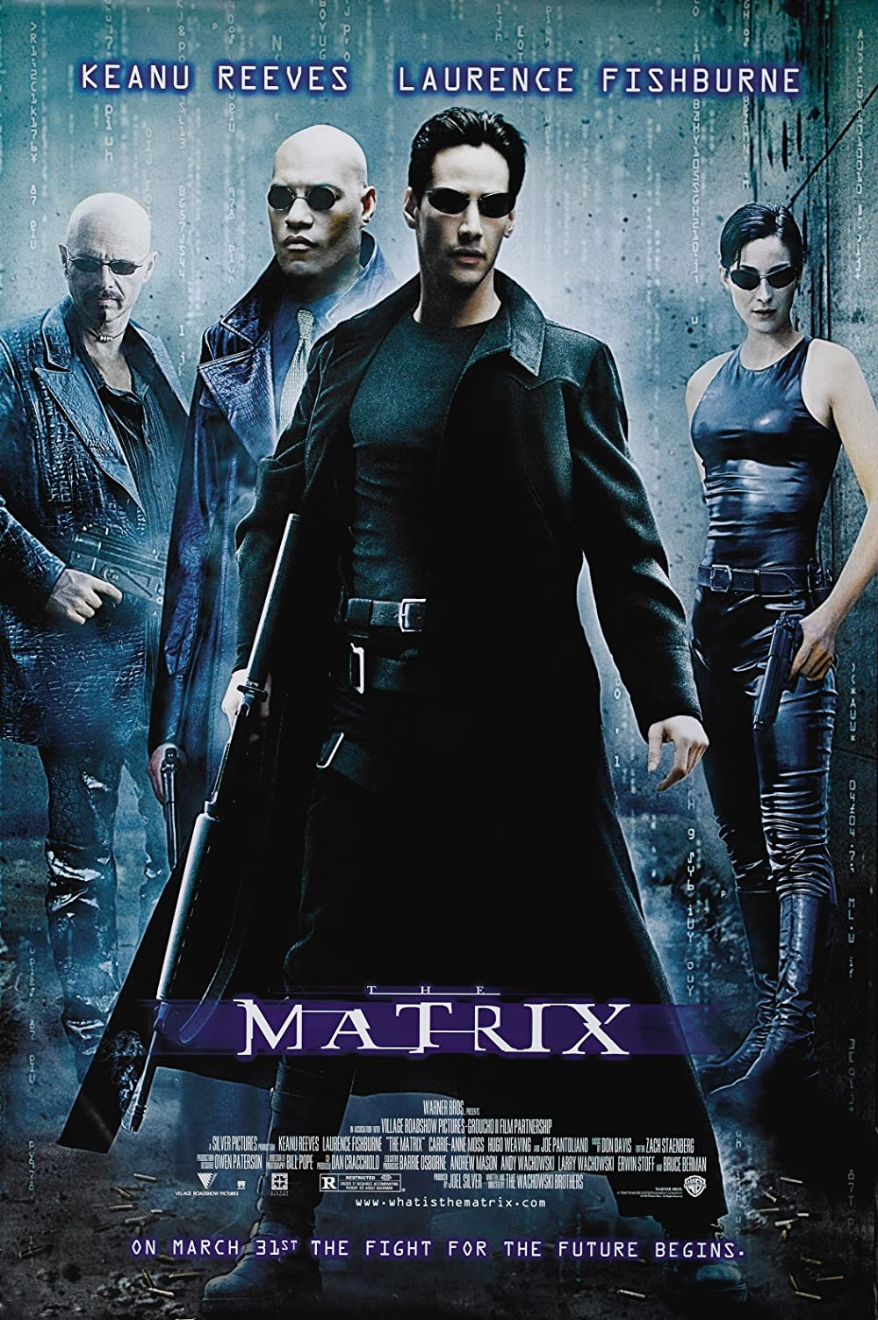
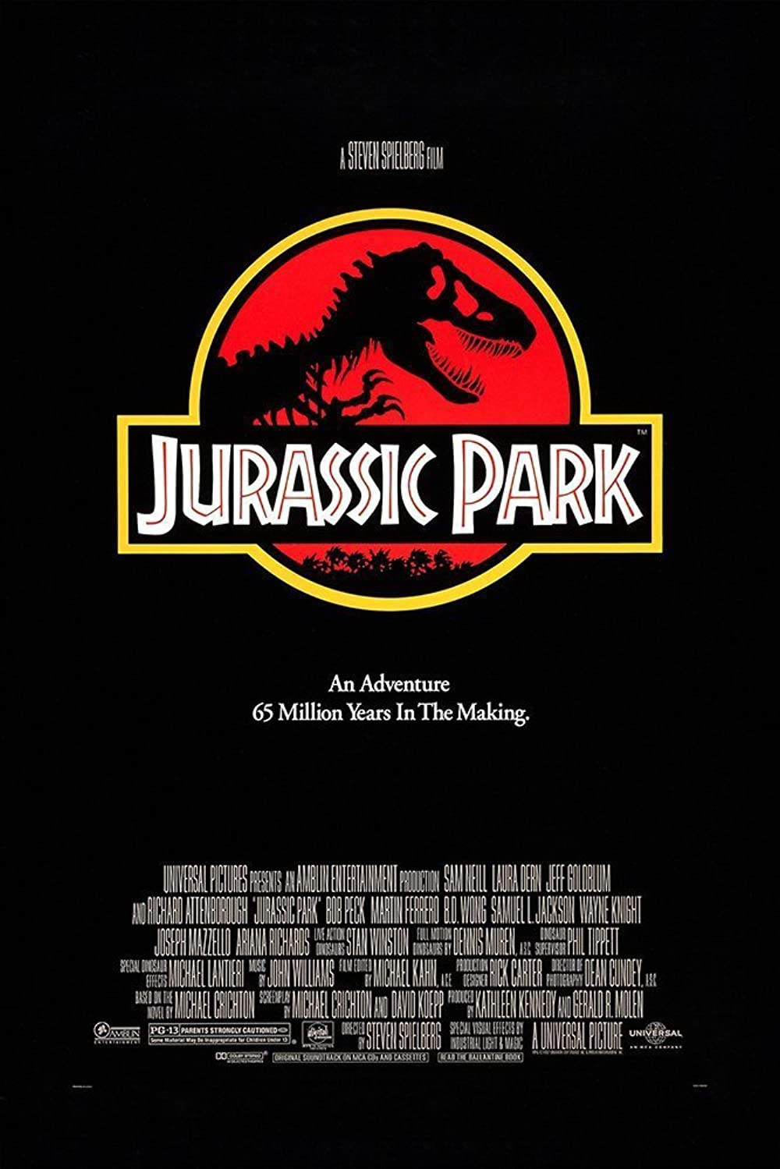

Conclusion
Most rated -> Some of the most popular
More ratings for a movie = More accurate
Need a baseline of user’s interests
Notes:
Collaborative filtering – multiple people feel a certain way
Content based filtering – need that baseline

Slide 14
Thank You
Email: ahing619@gmail.com
GitHub: @ahing
LinkedIn: https://www.linkedin.com/in/alec-hing

