Slide 1
The pandas Library: Cutting, Sorting, and Analyzing Data

Slide 2
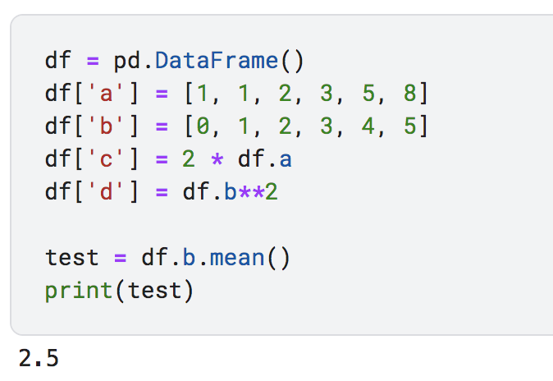
Reminder: the pandas DataFrame
A pandas DataFrame is similar to a table in Excel.
Each column can hold a different piece of information, like First Name, Last Name, Student ID number, and GPA.
In this example, each row holds data for a unique student.

Slide 3
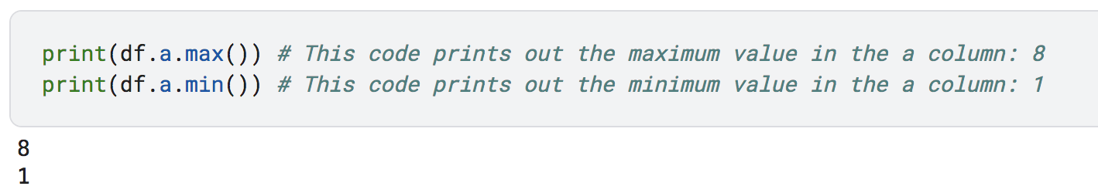
Methods for Column Stats
Mean (average): .mean()
Returns the average of a column.
Minimum: .min()
Returns the minimum value in a column.
Maximum: .max()
Returns the maximum value in a column.

Slide 4
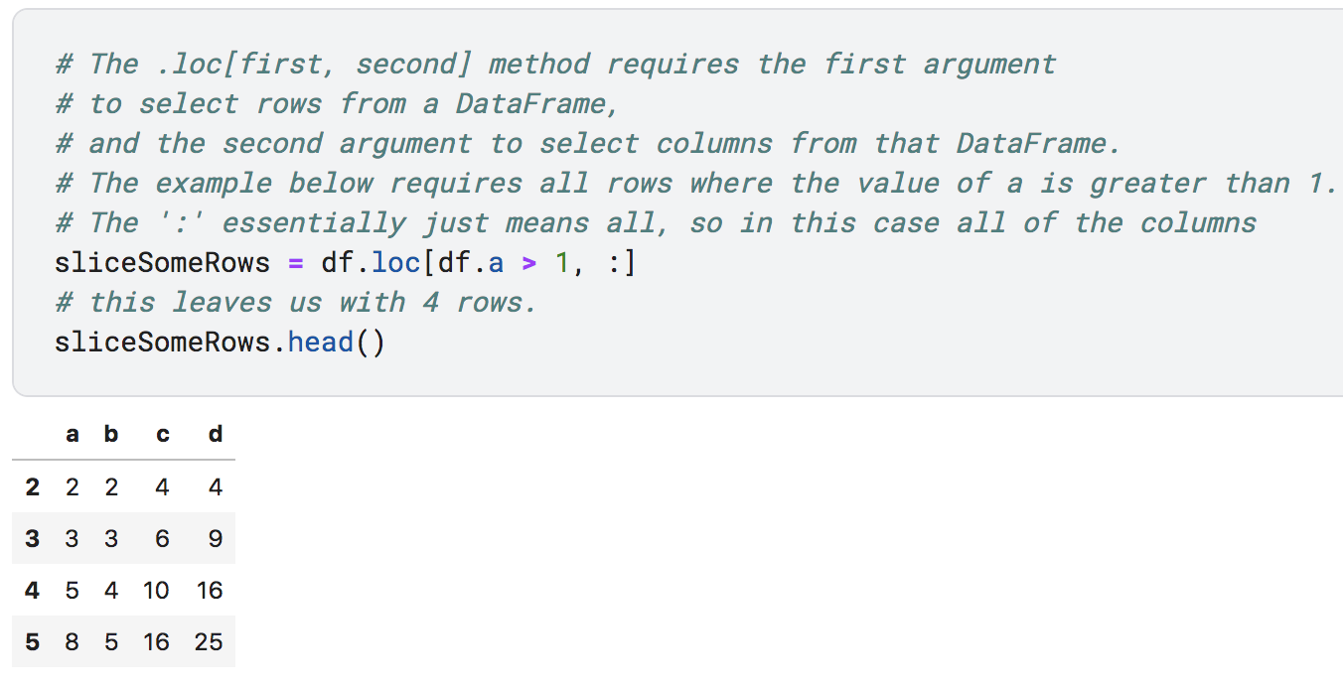
The .loc[] command
The .loc[] command allows one to access a subset of rows and/or columns in a DataFrame.
The first argument selects rows
The second argument selects columns

Slide 5
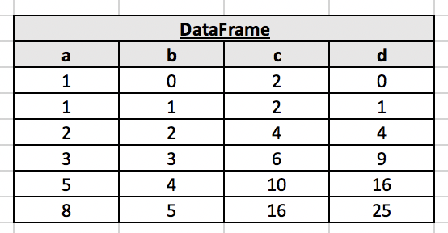
The .loc[] command
You can visualize the .loc[] command as filtering out unwanted rows (e.g.) in an Excel table:
Think of this command as
keeping only rows with a > 1

Slide 6
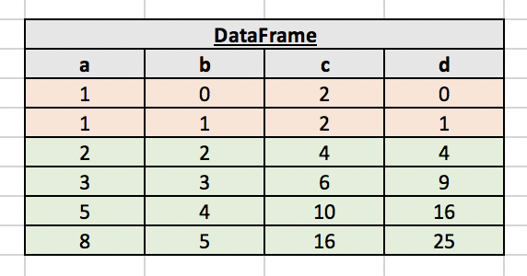
The .loc[] command
You can visualize the .loc[] command as filtering out unwanted rows (e.g.) in an Excel table:
The red rows do not satisfy the condition,
while the green rows do satisfy the condition
The .loc[] command returns only the
green rows from our illustration

Slide 7
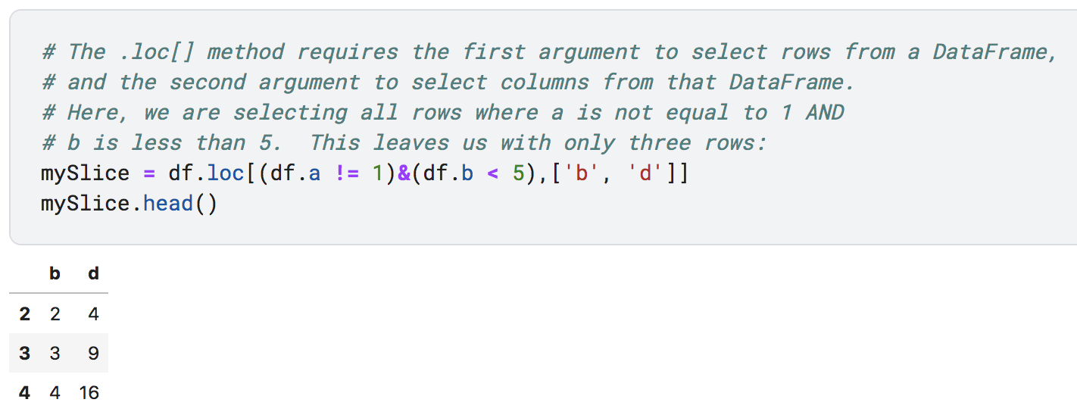
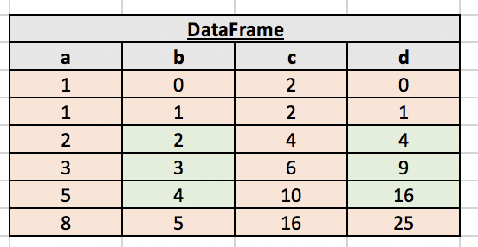
The .loc[] command
Multiple conditions can be required simultaneously by using the & symbol.

Slide 8
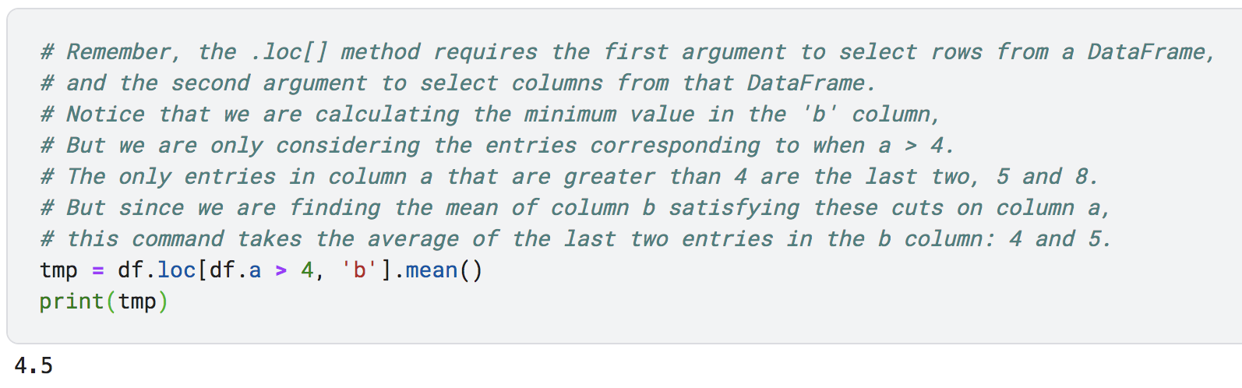
Method Chaining
The result of one method can be the input of another method
Think of these as acting “from the inside-out”
This example first requires that all entries have an ‘a’ greater than 4, and then takes the mean of column ‘b’.

Slide 9
Card Question
Which of the following examples of method chaining will return the average of the Score column only for rows with the Year column set to sophomores? Assume the DataFrame is named data.
A) data.loc[“Score”, “Year”].mean()
B) data.loc[data.Score, data.Year == ‘Sophomore’].mean()
C) data.loc[data.Year == ’Sophomore’, ‘Score’ ].mean()
D) data.Score.mean()
E) None of the above.

Slide 10
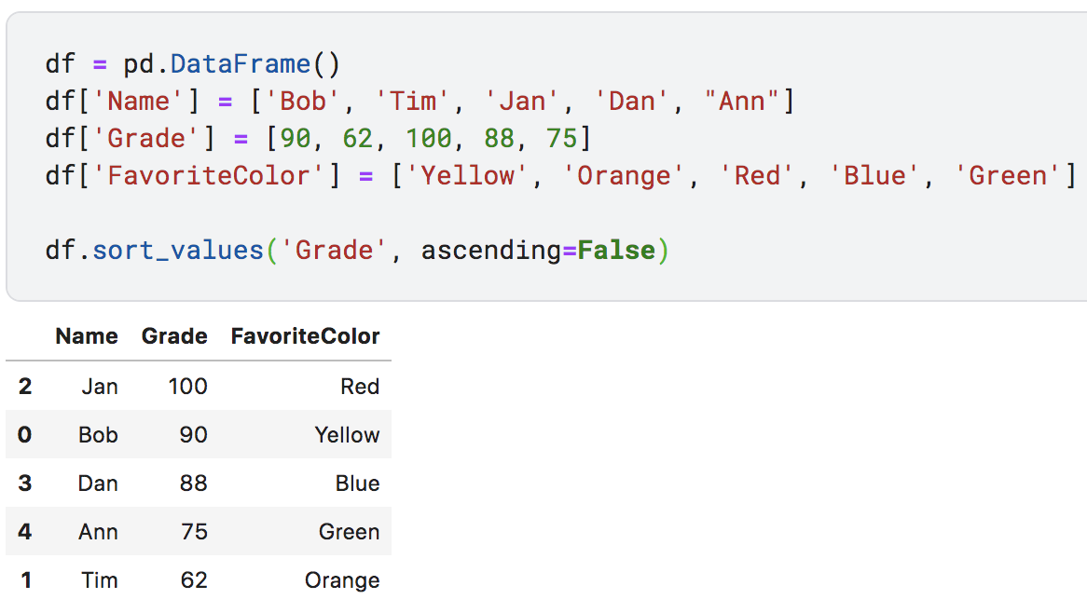
Sorting Data
The .sort_values() method enables the sorting of DataFrames in ascending or descending order.
The .sort_values() method does not change the order of the data in a DataFrame, it merely returns the sorted values for display or other uses.

Slide 11
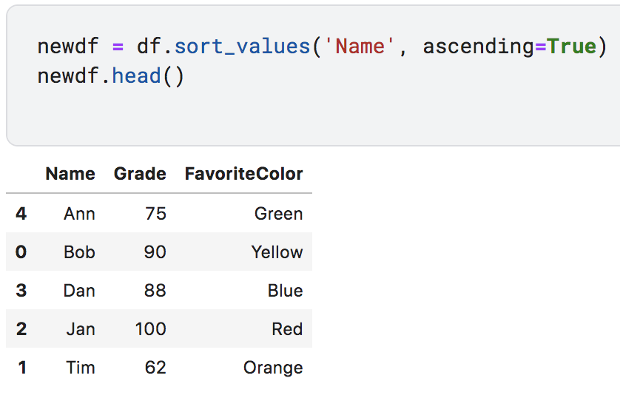
Sorting Data
The sorted values can be stored in a new DataFrame object by using the assignment operator (=).
Note that sorting a column of string type data alphabetizes the column.

