Slide 1
An Introduction to Microsoft Excel

Slide 2
Microsoft Excel
Microsoft Excel is a spreadsheet software capable of analyzing and visualizing data.
Excel is extremely useful tool that can save you an enormous amount of time by performing calculations at scale.
Here is a rough rule of thumb:
If anything in Excel (apart from typing a formula) takes longer than a second, there’s probably a faster method.
Understanding tabular data and Excel formulae will help when we start programming in python.

Slide 3
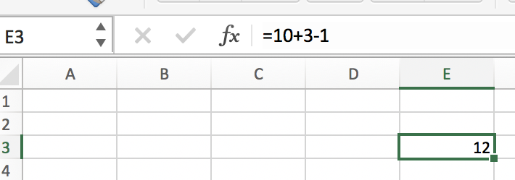
Excel Formulae
An Excel formula is an equation that will automatically perform calculations for you.
A formula can be initiated by beginning your entry with the equal sign.

Slide 4
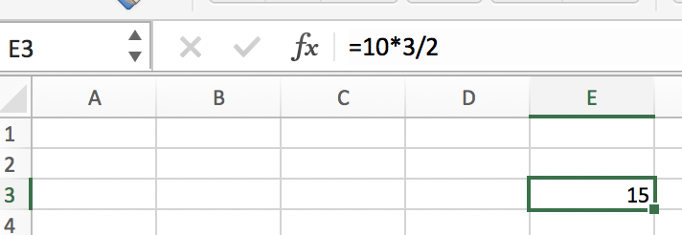
Mathematics in Excel
+, addition
-, subtraction
*, multiplication
/, division
^, exponentiation
There are also useful, built-in functions like SUM(), AVERAGE(), etc.

Slide 5
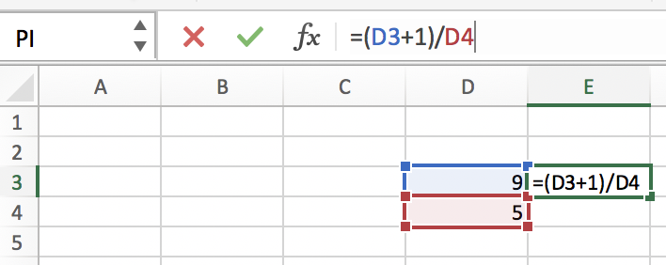
Cell References
A formula can reference another cell by name, and will automatically update when the cells referenced are changed.

Slide 6
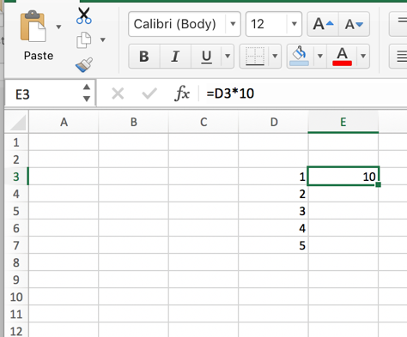
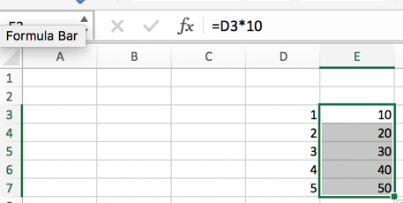
The “Fill Handle”
Once a formula is entered at the top of a column, the formula can be ‘copied’ down the column by double clicking the fill handle.
If there is a reference to a cell, that reference will also move down its column.

Slide 7
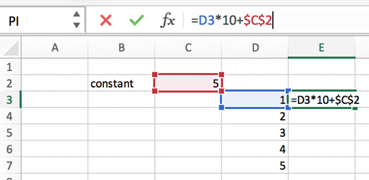
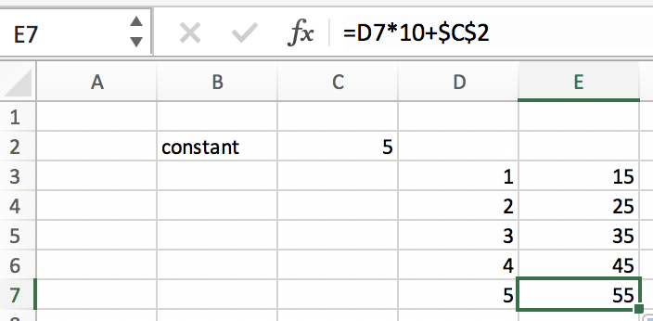
Freezing Cell References
If, on the other hand, you do NOT want a cell reference to change, you can ‘freeze’ the cell reference in the formula with the dollar sign symbol.
Place a $ in front of the column name to prevent the column from changing.
Place a $ in front of the row number to prevent the row from changing.

