Slide 1
The Pandas Library

Slide 2
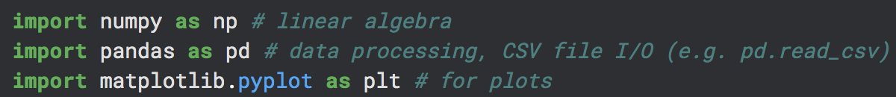
pandas
The pandas library contains useful tools for data analysis in python.
We will often use pd as shorthand for pandas
With pandas, you can:
Store data in a similar format to a table in Excel
Quickly analyze and process data
Quickly sort data
Cut away data that does not meet some criterion
And much more!

Slide 3
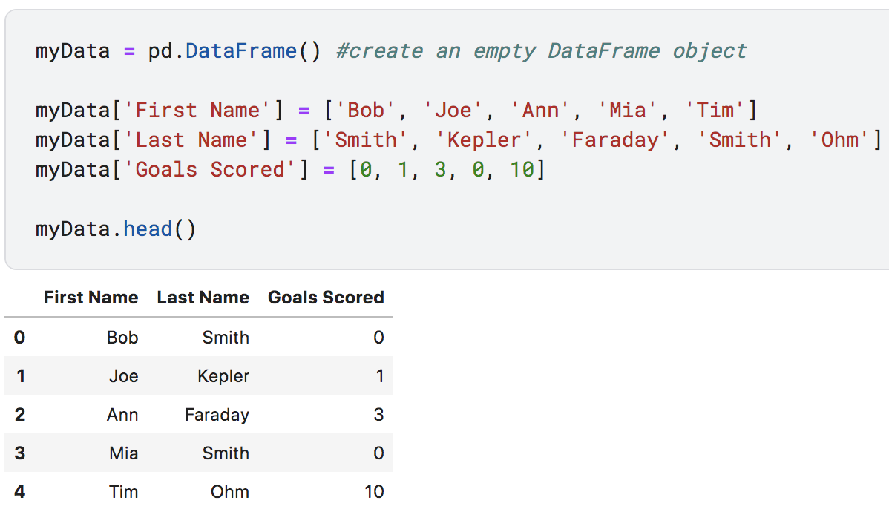
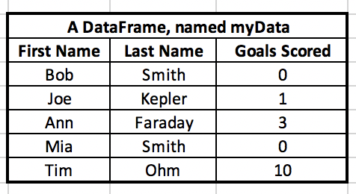
DataFrames
A DataFrame is an object that stores data in rows and columns, similar to a database.
You can think of a DataFrame as kind of like an Excel table.

Slide 4
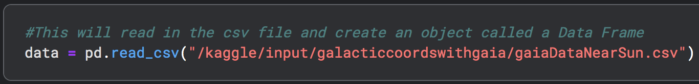
Reading in data from a .csv file
The pandas library makes reading in data from a .csv file into a DataFrame object very simple.
If the .csv data has a header row (i.e., column names), the read_csv() function automatically names the columns in the DataFrame.

Slide 5
Methods
Methods are like functions, but are specifically tied to an object, like a DataFrame.
len() is a function, as it can be applied to a list or a DataFrame or other data types.
.head() is a method, as it can only be called from a DataFrame object: myData.head()

Slide 6
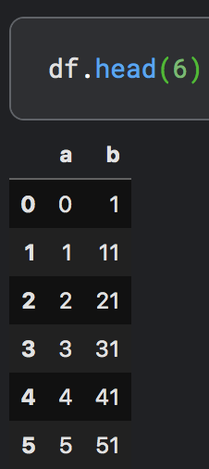
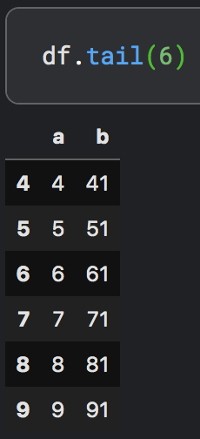
Exploring the data
Here are a few useful methods for exploring your data once it is stored in a DataFrame:
.head()– This displays the first 5 rows of data in a DataFrame. Alternatively, you can choose the number of rows displayed by including a different number as an argument.
.tail()– this displays the last 5 rows of data if no argument is included. Otherwise, the number included as an argument will be the number of rows shown.

Slide 7
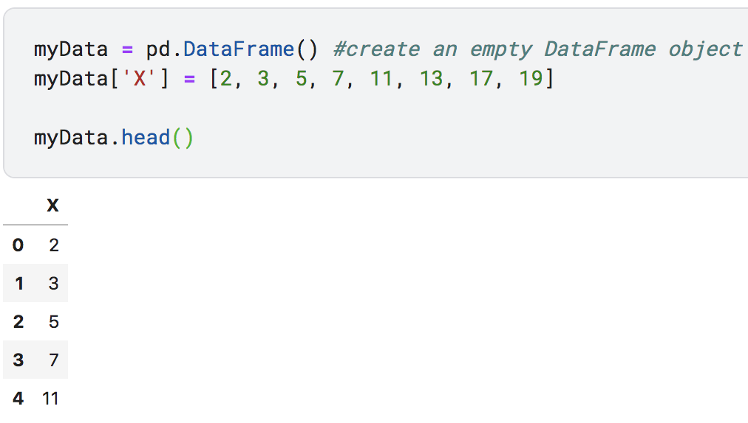
Creating, Referencing Columns in a DataFrame
To create a new column in a DataFrame:
Use square brackets and single quotes to name the new column, and use the assignment operator to assign new data to the column.

Slide 8
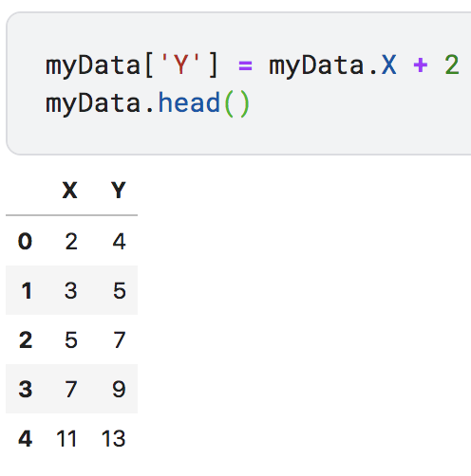
Creating, Referencing Columns in a DataFrame
To reference an existing column:
Type the DataFrame’s name followed by a period and then the column name you’d like to reference.

Slide 9
Visualizing Math with DataFrames:
Adding a number and a column:
myData.a
1
4
1
4
3
+
2
=
5
3
6
5
8

Slide 10
Visualizing Math with DataFrames:
Adding two columns:
myData.x
myData.y
1
2
3
0
3
3
2
+
5
=
7
1
7
8
0
11
11

Slide 11
Visualizing Math with DataFrames:
Subtracting a number and a column:
myData.a
1
0
1
0
2
-
1
=
1
3
2
5
4

Slide 12
Visualizing Math with DataFrames:
Subtracting two columns:
myData.x
myData.y
1
2
-1
0
3
-3
2
-
5
=
-3
1
7
-6
0
11
-11

Slide 13
Visualizing Math with DataFrames:
Multiplying a number and a column:
myData.a
1
3
1
3
3
*
2
=
6
3
9
5
15

Slide 14
Visualizing Math with DataFrames:
Multiplying two columns:
myData.x
myData.y
1
2
2
0
3
0
2
*
5
=
10
1
7
7
0
11
0

Slide 15
Visualizing Math with DataFrames:
Dividing a column by a number:
myData.c
2
1
4
2
6
/
2
=
3
7
3.5
8
4

Slide 16
Visualizing Math with DataFrames:
Dividing a column by another column:
myData.x
myData.y
8
2
4
6
3
2
2
/
2
=
1
1
1
1
20
5
4

