Slide 1
An Introduction to Python

Slide 2
The Kaggle Platform
There are many platforms for programming in python. We’ll be using one of them during this course: Kaggle.
I am assuming you have created a Kaggle account for this lecture.

Slide 3
Terminology
Python – A common programming language.
Program – A set of instructions that a computer can carry out.
Syntax – The specific language that must be used in order for the computer to understand the programming commands you write.
Just like there are rules that must be followed if you want your English (e.g.) to be understandable to others, the same is true for writing programs.

Slide 4
Terminology
Variable – a blanket term for an object that stores data.
Similar to algebra class, we can set a variable named x to be equal to 3.
However, we can also set a variable to be a list of numbers (e.g., x2 = [1, 1, 2, 3, 5, 8]) or even a word, x3 = “Pizza”.
Cell – A small block of code.
Notebook – A series of cells that, together, contain a python program.

Slide 5
Terminology
Function – A reusable portion of code that, given some input(s), performs some action and may also return an output(s).
Argument – an input to a function.
For example, 0.53 would be the argument in this case: cosine(0.53)
Library – a package containing additional functions and other tools for use in a program.

Slide 6
Syntax
There are a number of rules to follow in order to make your code conform to the language that the computer expects. It is something that you pick up with experience. Here are a couple tips:
Variable names must begin with a letter.
A line beginning with a # is a comment – it is not executable code
Comments are helpful for organizing and explaining your code

Slide 7
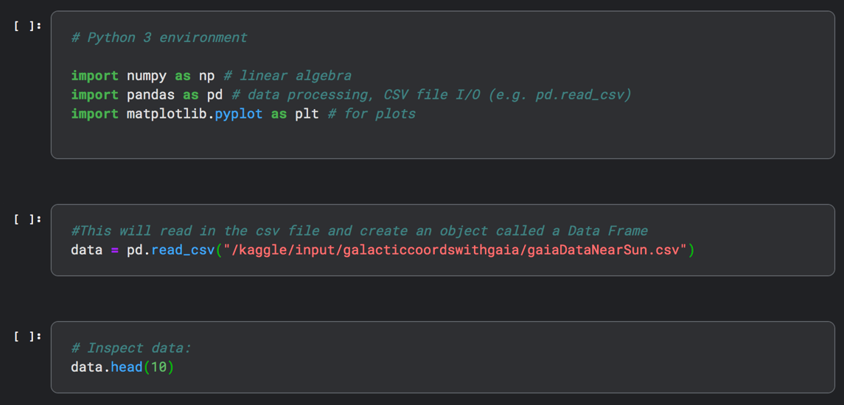
Notebook Example
Importing useful libraries
(and giving them nicknames)
Comment
Cells
Argument

Slide 8
Data Types
string – a series of letters, numbers, or other characters (e.g., “7 is my favorite number!”)
integer – a whole number (e.g., 7)
float – a decimal number (e.g., 3.14)
list – a collection of other data (e.g., [7, 3.14, “Bob”])
boolean – binary True or False

Slide 9
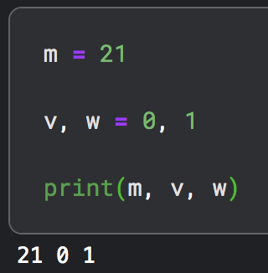
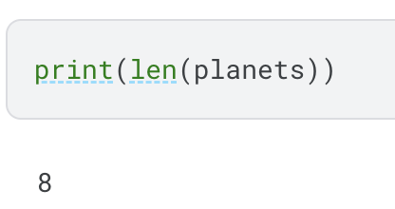
Useful Tools
print() – this function prints out whatever is passed to it as an argument.
Separate multiple arguments with commas.
len() – this function computes the length of a list (or other list-like objects, as we’ll learn later!)

Slide 10
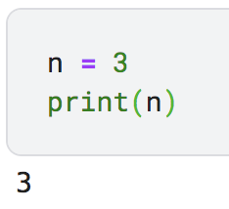
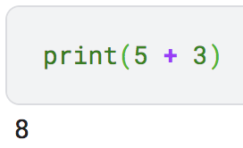
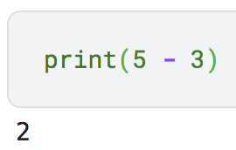
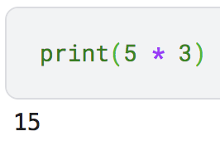
Math: Calculations in python
Assignment operator: =
Ex: n = 3
Addition operator: +
Ex: 5 + 3
Subtraction operator: -
Ex: 5 - 3
Multiplication operator: *
Ex: 5*3

Slide 11
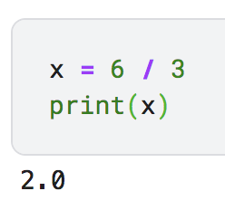
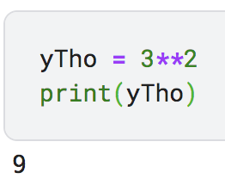
Math: Calculations in python
Division operator: /
Ex: 6/3
Exponentiation operator: **
Ex: 3**2
There are others too!
//, %, etc.

Slide 12
Math: Inequalities in python
In a programming language, the computer checks a statement and ‘converts’ it to a True or False.
Ex: 5 > 3 would evaluate to True,
While 0 > 1 would evaluate to False!
Inequality syntax:
> greater than
>= greater than or equal to
< less than
<= less than or equal to
== is equal to (note: a single ‘=‘ is already used as the assignment operator)
!= is not equal to

Slide 13
Card Question
Which of the following inequalities will evaluate to TRUE?
A) 5 < 3
B) 5 != 4
C) 4 + 4 = 8
D) 4 > 1
E) More than one of the above.

Slide 14
The numpy Library, numpy Arrays, and Indices
The numpy library is a useful tool when dealing with arrays of numbers.
For now, you can think of an array as a list where all of the elements in that list are the same data type (e.g., they are all floats).
To create a numpy array:

Slide 15
The numpy Library, numpy Arrays, and Indices
An index is like an address – it tells you where a particular element lives within an array.
CAREFUL: The first element in an array has an index of zero. This can be confusing at times!
In the example below, 1.881 has an index of 3, but it is the fourth element in the array, since the index started from zero!
0, 1, 2, 3, 4, 5, 6, 7

Slide 16
The numpy Library, numpy Arrays, and Indices
To obtain the value at a particular index in an array, you can use the following syntax:
P_in_yr[3]
This will return 1.881
0, 1, 2, 3, 4, 5, 6, 7

Slide 17
Card Question
Suppose you have the numpy array below: myData = np.array([4, 8, 15, 16, 23, 42]) What is myData[1] + myData[3]?
A) myData[4]
B) 24
C) 19
D) 7,912,433,101.907
E) None of the above.

Slide 18
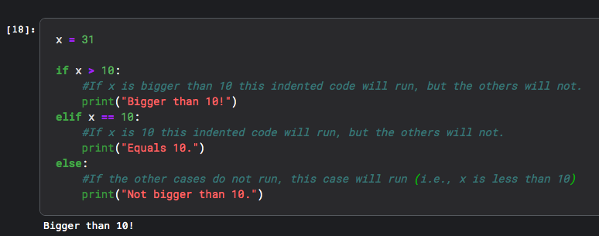
If Statements
If statements allow code to be run only when specified conditions are met:
Indented code only
runs if x > 10
If the above condition(s) is(are) not met, and the elif’s condition is met, this code will run.
The code inside the else statement runs if none of the other conditions are met.

Slide 19
If Statements
START:
Is x > 10?
NO
YES
Print out: “Bigger than 10!”
Is x == 10?
YES
NO
Print out: “Equals 10.”
NOTE: the if statement ends when one of the conditions is met.
(i.e., the flow chart stops when a rounded, blue box is reached)
Is x < 10?
YES
Print out: “Bigger than 10!”

Slide 20
A Word on Indentation and “White Space”
Each level of indentation is exactly 4 spaces. Your program will not work if the indentation is incorrect.
Blank lines are skipped by the program, but are VERY helpful for making your code readable.

Slide 21
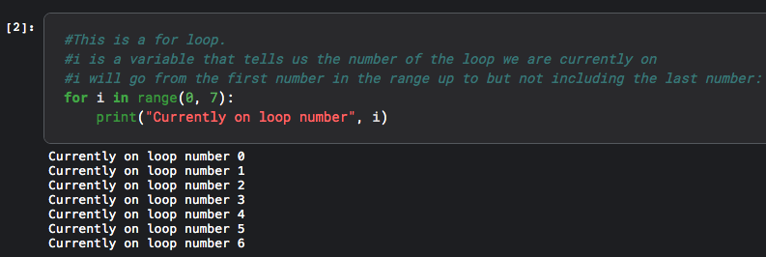
For Loops
A for loop runs a portion of code repeatedly, potentially updating the code for each iteration.

Slide 22
For Loops
Start loop with first value of i:
i=0
Increase i by one.
Is i < 7?
Print “currently on loop number:” followed by the current value of i
YES
NO
Exit the loop.

Slide 23
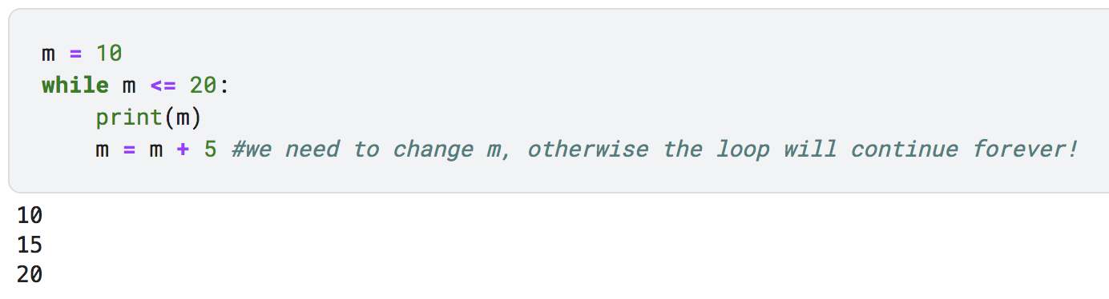
While Loop
A while loop runs until its condition is true.
For example:
CAREFUL: these may run forever (or until your computer crashes).

Slide 24
Don’t do this.
while 1 == 1:
print(“oh, cool”)
Start loop
Is 1 == 1?
Print “oh, cool”
YES
NO
Exit loop

Slide 25
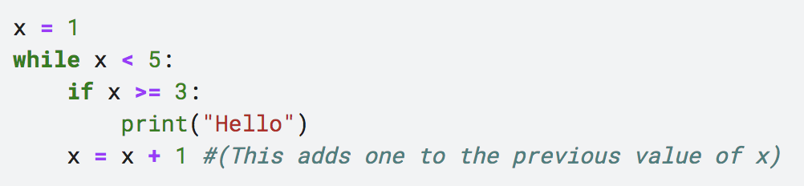
Card Question
How many times will the code below print out “Hello”?
A) five times.
B) at least 12.
C) four times.
D) three times.
E) only twice.

