Slide 1
CSC 355 Database Systems
Lecture 2.1
(Week 2, Lecture 1)
Alexander Rasin
College of CDM, DePaul University
September 12th, 2018

Slide 2
Tonight
SQL Queries
  SELECT/FROM/WHERE/ORDER BY
  Aggregate functions/GROUP BY/HAVING
Joins
  Inner joins
  Outer joins

Slide 3
SQL Queries
General form of a query:
SELECT list of attributes to report
FROM list of tables
[WHERE tuple condition]
[GROUP BY list of grouping attributes]
[HAVING group condition]
[ORDER BY list of ordering attributes] ;
Result is an ordered set of tuples

Slide 4
SELECT FROM
SELECT list of attributes
FROM list of tables
SELECT gives which attributes to include
  give a single attribute, or a list (rename with AS)
  * for all attributes
  DISTINCT will only report distinct tuples
FROM gives the table(s) to get tuples from
  With joins, only one table

Slide 5
WHERE
WHERE condition
Each tuple is tested against the condition, and only those that satisfy it are returned by the query
Condition expression can contain:
  comparisons
  expressions with wildcards (for strings)
  boolean operations

Slide 6
Comparisons
Put numerical or string value on each side, each comparison returns true or false
  = is equal to
  != or <> is not equal to
  > is greater than
  >= is greater than or equal to
  < is less than
  <= is less than or equal to

Slide 7
Wildcards
Using LIKE, we can compare character strings to strings that include wildcard characters that match anything:
  _ matches any single character
  % matches any consecutive set of characters
For example:
  ‘b_d’ will match ‘bad’, ‘bed’, but not ‘band’
  ‘bat%’ will match ‘bat’, ‘bath’, ‘battery’…

Slide 8
Boolean Operators
Simple conditions can be combined into more complicated conditions
  X AND Y is satisfied by a tuple if and only if both X and Y are satisfied by it
  X OR Y is satisfied by a tuple if and only if at least one of X and Y is satisfied by it
  NOT X is satisfied by a tuple if and only if X is not satisfied by it

Slide 9
Three-Valued Logic
Any comparison involving NULL values will yield a result of UNKNOWN
  Don’t use = to check for NULLs, as all NULLs are distinct; use IS NULL instead
  There are extended definitions of AND, OR, and NOT that include UNKNOWN
An end result of UNKNOWN does not satisfy a WHERE (only TRUE does!)
<number>_

Slide 10
ORDER BY
ORDER BY list of ordering attributes
Tuples returned by the query are sorted by the first attribute in the list
Ties are broken by the second attribute, then the third, et cetera
Tuples are sorted in ascending order unless we put DESC after an attribute

Slide 11
Aggregate Functions
Given an attribute, these functions will collect their results from the values of that attribute in the set of returned tuples:
  COUNT: Number of tuples containing values
  SUM: Sum of the values
  AVG: Average of the values
  MIN: Smallest of the values
  MAX: Largest of the values

Slide 12
GROUP BY
GROUP BY list of grouping attributes
We can combine the tuples returned by a query into sets based on the value of some attribute(s), and report the value(s) of this attribute(s) and aggregate information for each group
Once we group, we cannot look at the values in the individual tuples anymore…

Slide 13
HAVING
HAVING group condition
Once tuples are grouped and some aggregate function is computed, we can choose to display the result for only those groups that satisfy the expression
Can use all the same comparions and boolean operators as WHERE

Slide 14
Set Operations
Set operations can be used to combine the results of two queries, as long as the domains in the SELECT agree:
  UNION: tuples that appear in at least one set
  INTERSECT: tuples that appear in both sets
  MINUS: tuples that appear in first but not second
Duplicates will be removed; they can be kept in a UNION by using UNION ALL

Slide 15
Order of Operations
In what order are these clauses applied?
  FROM: Chooses a table
  WHERE: Chooses a set of tuples
  GROUP BY: Partitions them into groups
  HAVING: Chooses some subset of the groups
  SELECT: Chooses what values to display
  ORDER BY: Chooses the order to display them

Slide 16
Example Queries
Select all graduate students
Select students whose last initial is ‘B’ or ‘Y’
Count the number of different enrollment dates in the database
Select # of enrollments for each student id
  Repeat the query, but exclude students with only 1 enrollment
Select CSC courses worth 4 credits
  Repeat the query, but sort by course id

Slide 17
Joins
Data that is distributed among linked tables can be combined into a single set of tuples for a query using different types of joins:
  Inner joins (equi-join, natural join)
  Outer joins (left, right, full)

Slide 18
Cartesian Product
What if we list two tables after the FROM?
The tuples in the result come from combining all pairs of tuples from the two tables – the Cartesian Product of the tables
This is almost certainly more tuples than we want – if there is a common attribute, and the two tuples have different values, the combination is meaningless!

Slide 19
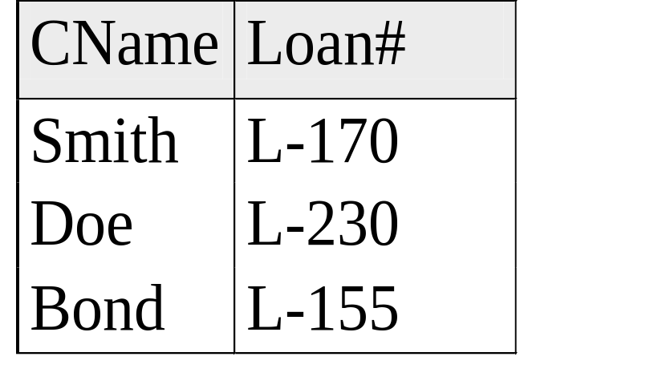
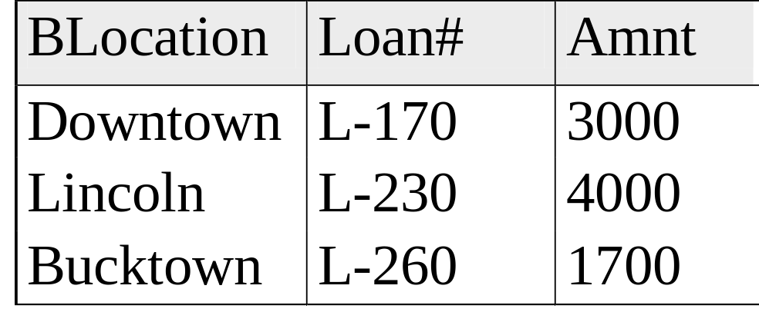
Customer and Bank Branch Data

Slide 20
Cartesian Product
SELECT *
FROM customer, branch;
BLocation | Branch. Loan# | Amnt | Cname | Customer. Loan#
Downtown | L-170 | 3000 | Smith | L-170
Lincoln | L-230 | 4000 | Smith | L-170
Bucktown | L-260 | 1700 | Smith | L-170
Downtown | L-170 | 3000 | Doe | L-230
Lincoln | L-230 | 4000 | Doe | L-230
Bucktown | L-260 | 1700 | Doe | L-230
Downtown | L-170 | 3000 | Bond | L-155
Lincoln | L-230 | 4000 | Bond | L-155
Bucktown | L-260 | 1700 | Bond | L-155

Slide 21
Equi-Join
An equi-join keeps only those tuples where the two combined tuples agree on the shared attribute(s):
…FROM TABLE1, TABLE2
WHERE
TABLE1.Attribute = TABLE2.Attribute;

Slide 22
Equi-Join
SELECT *
FROM branch, customer
WHERE customer.LoanNum = Branch.LoanNum;
BLocation | Customer. Loan# | Amnt | Cname | Branch. Loan#
Downtown | L-170 | 3000 | Smith | L-170
Lincoln | L-230 | 4000 | Doe | L-230

Slide 23
Natural Join
Like an equi-join, but one of each duplicated column is removed (the most common join):
SELECT (all but the duplicated attribute(s))
FROM TABLE1, TABLE2
WHERE
TABLE1.Attribute = TABLE2.Attribute;
Notes:
FROM Table1 NATURAL JOIN Table2

Slide 24
Natural Join
SELECT BLocation, customer.LoanNum, Amnt, CName
FROM customer, branch
WHERE customer.LoanNum = Branch.LoanNum;
BLocation | Customer. Loan# | Amnt | CName
Downtown | L-170 | 3000 | Smith
Lincoln | L-230 | 4000 | Doe

Slide 25
Inner Join
Both are inner joins, where the Cartesian Product is restricted to only include the combined tuples that satisfy some condition (typically agreement in some shared key)
Can replace list of tables in WHERE with:
… TABLE1 INNER JOIN TABLE2
ON condition;
in FROM

Slide 26
Inner Join vs. Outer Join
An inner join requires that tuples in the tables match in the specified attribute to create a tuple in the result.
An outer join does not: a tuple in the result may be either
  the combination of two tuples that match in the specified attribute (matching tuple)
  a tuple that does not match anything, combined with an all-NULL tuple (non-matching tuple)

Slide 27
Left Outer Join
Includes all matching tuples, plus a tuple for each tuple in the first table that has no match
… TABLE1 LEFT OUTER JOIN TABLE2
ON TABLE1.Attribute = TABLE2.Attribute;

Slide 28
Left Outer Join
SELECT *
FROM customer LEFT OUTER JOIN branch ON customer.LoanNum = branch.LoanNum;
BLocation | Branch. Loan# | Amnt | Cname | Customer. Loan#
Downtown | L-170 | 3000 | Smith | L-170
Lincoln | L-230 | 4000 | Doe | L-230
NULL | NULL | NULL | Bond | L-155

Slide 29
Right Outer Join
Includes all matching tuples, plus a tuple for each tuple in the second table that has no match
… TABLE1 RIGHT OUTER JOIN TABLE2
ON TABLE1.Attribute = TABLE2.Attribute;

Slide 30
Right Outer Join
SELECT *
FROM customer RIGHT OUTER JOIN branch ON customer.LoanNum = branch.LoanNum;
BLocation | Branch. Loan# | Amnt | Cname | Customer. Loan#
Downtown | L-170 | 3000 | Smith | L-170
Lincoln | L-230 | 4000 | Doe | L-230
Bucktown | L-260 | 1700 | NULL | NULL

Slide 31
Full Outer Join
Includes all matching tuples, plus a tuple for each tuple in either table that has no match
… TABLE1 FULL OUTER JOIN TABLE2
ON TABLE1.Attribute = TABLE2.Attribute;

Slide 32
Full Outer Join
SELECT *
FROM customer FULL OUTER JOIN branch ON customer.LoanNum = branch.LoanNum;
BLocation | Branch. Loan# | Amnt | Cname | Customer. Loan#
Downtown | L-170 | 3000 | Smith | L-170
Lincoln | L-230 | 4000 | Doe | L-230
NULL | NULL | NULL | Bond | L-155
Bucktown | L-260 | 1700 | NULL | NULL

Slide 33
Example SQL Queries
Select student names and first enrollment date
Select course names and ids of enrolled students – include empty courses in the result
List student names and number of enrollments they have, ordered by name (reverse alp.)
List the students (names and IDs) who are not enrolled in any courses

Slide 34
Nested Queries (Subqueries)
The result of one query may be needed by another to compute its result:
  One query (the nested query or subquery) is nested within another (the outer query)
  Outer query uses the result of the nested query, which can be either a table or a single value
Nested query usually appears in a WHERE or HAVING clause (rarely, a FROM)

Slide 35
Uses of Nested Queries
“Find all students who got the highest score on the exam. (Find the highest score)”
“Find IDs of all course sections being taken by Jane Doe”. (Find her StudentID)
“Find IDs of all students who are taking some course with Student X this quarter.” (Find all courses being taken by X)

Slide 36
Next Time:
SQL
  Nested queries
  Views

