Slide 1
CSC 355 Database Systems
Lecture 6.1
(Week 6, Lecture 1)
Alexander Rasin
College of CDM, DePaul University
October 10th, 2018

Slide 2
Tonight
Transactions
ACID
Conflict serializability

Slide 3
Binary Nonadditive Join Test
D = {R1, R2} has the nonadditive join property if and only if one or both of the following hold:
  1. (R1 ∩ R2)→(R1-R2) is in F⁺
  2. (R1 ∩ R2)→(R2-R1) is in F⁺
Equivalently, if and only if the intersection between the two sets of attributes is a superkey in at least one of the relations

Slide 4


Transaction Processing

Slide 5
Updates in SQL
An example:
UPDATE account
SET balance = balance - 50
WHERE acct_no = A102
What takes place:
memory
…
Disk
Dntn: A102: 300
(1) Read
Dntn: A15: 500
(2) update
account
…
Transaction:
Read(A)
A <- A -50
Write(A)
(3) write
Mian: A142: 300

Slide 6
The Threat to Data Integrity
Consistent DB
Name Acct bal
-------- ------ ------
Joe A-102 300
Joe A-509 100
Joe’s total: 400
Inconsistent DB
Name Acct bal
-------- ------ ------
Joe A-102 250
Joe A-509 100
Joe’s total: 350
transaction
Consistent DB
Name Acct bal
-------- ------ ------
Joe A-102 250
Joe A-509 150
Joe’s total: 400
What a Xaction should
look like to Joe
What actually happens
during execution

Slide 7
Commit and Rollback
Transfer $100 from account 1001 to 1007.
update account
set balance = balance + 100
where acc_id = 1001;
update account
set balance = balance - 100
where acc_id = 1007;
What if 1007 has less than $100?
We can undo uncommitted work: ROLLBACK
What does this mean for multiple users?
We can commit work: COMMIT

Slide 8
Atomicity
update account
set balance = balance + 100
where acc_id = 1001;
update account
set balance = balance - 100
where acc_id = 1007;
should be a single unit: either both or neither succeeds
SQL uses Transactions to guarantee Atomicity

Slide 9
ACID Properties
Atomicity: Transaction succeeds as a whole or fails as a whole
Example: Money Transfer
Consistency: Database is in consistent state at end of transaction
    Example: Money transfer
Isolation: Transactions appear to serialize
    Example: airline seat booking, money transfer
Durability: Committed changes are permanent
Example: system failure

Slide 10
Concurrent Processing
Let’s try to withdraw $100 from 1003 at two different ATMs.
What happens ?
T1:
  read(balance)
  balance := balance – 100
  if balance >= 0
  write(balance)
  commit
T2:
  read(balance)
  balance := balance – 100
  if balance >= 0
  write(balance)
  commit

Slide 11
Concurrent Processing
Let’s try to withdraw $100 from 1003 at two different ATMs.
What happens ?
Potential problems
P0 (Dirty Writes): T1 writes uncommitted data
P1 (Dirty Read): T2 reads T1 written cell before T1 commits
P2 (Nonrepeatable Read): T2 modifies data that T1 has read.
P3 (Phantom): T2 adds records that belong to a T1 query

Slide 12
ANSI Isolation Levels
Isolation Level | Dirty Read | Non-repeatable Read | Phantom Read
READ UNCOMMITTED | OK | OK | OK
READ COMMITTED | - | OK | OK
REPEATABLE READ | - | - | OK
SERIALIZEABLE | - | - | -

Slide 13
Oracle Isolation Levels
Default: Read Committed
READ ONLY
  Serializable transaction that is not allowed any modifications
  Only sees committed data and cannot modify data
No dirty reads

Slide 14
SQL Server Isolation Levels
Default: Read Committed
Snapshot Isolation level
  Same as Serializable but through snapshot mechanism

Slide 15
DB2 Isolation Levels
Uncommitted Read (UR)
  Read uncomitted
Cursor Stability (CS)
  Read committed
Read Stability (RS)
  Repeatable read
Repeatable Read (RR)
  Serializable
SELECT StudentID, name, Phone
FROM Student
WHERE Name = 'Jane'
WITH UR;

Slide 16
Other DBs
MySQL
  SET TRANSACTION ISOLATION LEVEL SERIALIZABLE;
PostgreSQL
  BEGIN TRANSACTION ISOLATION LEVEL REPEATABLE READ;

Slide 17
Transaction Schedules
Schedules – sequences that indicate the chronological order in which instructions of concurrent transactions are executed
  a schedule for a set of transactions must consist of all instructions of those transactions
  must preserve the order in which the instructions appear in each individual transaction
T1
1
2
3
T2
A
B
C
D
T1
1
2
3
T2
A
B
C
D
one possible schedule:

Slide 18
Example Schedules
Transactions:
T1: transfers $50 from A to B
T2: transfers 10% of A to B
Example 1: a “serial” schedule
T1
read(A)
A <- A -50
write(A)
read(B)
B<-B+50
write(B)
T2
read(A)
tmp <- A*0.1
A <- A – tmp
write(A)
read(B)
B <- B+ tmp
write(B)
Constraint: The sum of A+B
must be the same
Before: 100+50
After: 45+105
=150, consistent

Slide 19
Example Schedule
Another “serial” schedule:
T1
read(A)
A <- A -50
write(A)
read(B)
B<-B+50
write(B)
T2
read(A)
tmp <- A*0.1
A <- A – tmp
write(A)
read(B)
B <- B+ tmp
write(B)
Before: 100+50
After: 40+110
Consistent but not the
same as previous schedule..
Either is OK!
=150, consistent

Slide 20
Example Schedule (Cont.)
Another “good” schedule:
T1
read(A)
A <- A -50
write(A)
read(B)
B<-B+50
write(B)
T2
read(A)
tmp <- A*0.1
A <- A – tmp
write(A)
read(B)
B <- B+ tmp
write(B)
Effect: Before After
A 100 45
B 50 105
Same as one of the serial schedules
Serializable!

Slide 21
Example Schedules (Cont.)
A “bad” schedule
T1
read(A)
A <- A -50
write(A)
read(B)
B<-B+50
write(B)
T2
read(A)
tmp <- A*0.1
A <- A – tmp
write(A)
read(B)
B <- B+ tmp
write(B)
Before: 100+50 = 150
After: 50+60 = 110 !!
Not consistent

Slide 22
Serializability
How to distinguish good and bad schedules?
→ previous example: any schedule leaving A+B = 150 is good
Q: could we express good schedules in terms of integrity constraints?
No. In general, won’t know A+B, can’t check value of A+B at given time for consistency
Alternative: Serializability

Slide 23
Serializability
Serializable: A schedule is serializable if its effects on the db are equivalent to some serial schedule.
Hard to ensure; more conservative approaches are used in practice
All schedules
Serializable schedules
“view serializable” schedules
“conflict serializable” schedules

Slide 24
Conflict Serializability
Conservative approximation of serializability
(conflict serializable ➔ serializable but not serializable ➔ conflict serializable)
Idea: can we swap the execution order of consecutive non-conflicting operations without affecting state of database?
Execute Xactions so as to leave a serial schedule?

Slide 25
What operations can be swapped?
A. Reads and writes of different data elements
e.g.: T1 T2 T1 T2
write(A) read(B)
=
read(B) write(A)
OK because: value of B unaffected by write of A
( read(B) has same effect )
write of A is not undone by read of B
( write(A) has same effect)
Note : T1 T2 T1 T2
write(A) read(A)
=
read(A) write(A)
Why? In the first case, T1 reads value of A written by T2. May be different value than previous value of A

Slide 26
Conflict Serializability (Cont.)
If a schedule S can be transformed into a schedule S´ by a series of swaps of non-conflicting instructions, we say that S and S´ are conflict equivalent.
We say that a schedule S is conflict serializable if it is conflict equivalent to a serial schedule
e.g.
T1
….
read(A)
T2
….
read(A)
.
.
.
T1
….
read(A)
T2
….
read(A)
.
.
.
can be rewritten
to equivalent
schedule

Slide 27
Conflict Serializability (Cont.)
Example:
T1
1. Read(A)
2. A ← A -50
3. Write(A)
4.Read(B)
5. B ← B + 50
6. Write(B)
T2
a. Read(A)
b. tmp ← A * 0.1
c. A ← A - tmp
d.Write(A)
e. Read(B)
f. B ← B + tmp
g. Write(B)
Swaps:
4 <->d
4<->c
4<->b
4<->a
5<->d
5<->c
5<->b
5<->a
6<->d
6<->c
6<->b
6<->a
Conflict serializble
T1, T2

Slide 28
Conflict Serializability (Cont.)
The effects of swaps
T1
read(A)
A <- A -50
write(A)
read(B)
B<-B+50
write(B)
T2
read(A)
tmp <- A*0.1
A <- A – tmp
write(A)
read(B)
B <- B+ tmp
write(B)
Because example schedule could
be swapped to this schedule (<T1, T2>)
example schedule is
conflict serializable

Slide 29
Swappable Operations
Swappable operations:
  Any operation on different data element
  Reads of the same data (Read(A))
  (regardless of order of reads, the same value for A is read)
Conflicts:
T2: Read(A) T2: Write(A)
T1: Read (A)
T1: Write (A)
OK
R/W Conflict
W/R Conflict
W/W Conflict

Slide 30
Conflicts
(1) READ/WRITE conflicts:
conflict because value read depends on whether write has occurred
(2) WRITE/WRITE conflicts:
conflict because value left in database depends on which write occurred last
(3) READ/READ : no conflict

Slide 31
Conflict Serializability
Q: Is the following schedule conflict serializable? If so, what’s its equivalent
serial schedule? If not, why?
T₁ T₂
(1) read(Q)
write(Q) (a)
(2) write(Q)
Ans: No. Swapping (a) with (1) is a R/W conflict, and
swapping (a) with (2) is a W/W conflict.
Not equivalent to <T1, T2> or <T2, T1>

Slide 32
Conflict Serializability
Q: Is the following schedule conflict serializable? If so, what’s its equivalent
serial schedule? If not, why?
T1
(1) Read(A)
(2) Write(S)
T2
(a) Write(A)
(b) Read(B)
T3
(x) Write(B)
(y) Read(S)
Ans.: NO.
All possible serial schedules are
not conflict equivalent.
<T1, T2, T3>
<T1, T3, T2>
<T2, T1, T3>
. . . . . .

Slide 33
Conflict Serializability
Testing: too expensive to test a schedule by swapping operations (schedules are big!)
Alternative: “Precedence Graphs”
  vertices = Xactions
  edges = conflicts between Xactions
E.g.: Ti → Tj if:
  (1) Ti, Tj have a conflicting operation, and
  (2) Ti executed its operation in conflict first

Slide 34
Precedence Graph
An example of a “Precedence Graph”:
T1
Read(A)
T2
Write(A)
Read(B)
T3
Write(B)
Read(S)
T1
R/W(A)
T2
R/W(B)
T3
Q: When is a schedule not
conflict serializable?

Slide 35
Precedence Graph
Another example:
T1
Read(A)
Write(S)
T2
Write(A)
Read(B)
T3
Write(B)
Read(S)
T1
R/W(A)
T2
R/W(S)
R/W(B)
T3
Not conflict serializable!!
Because there is a cycle in the PG,
the cycle creates contradiction

Slide 36
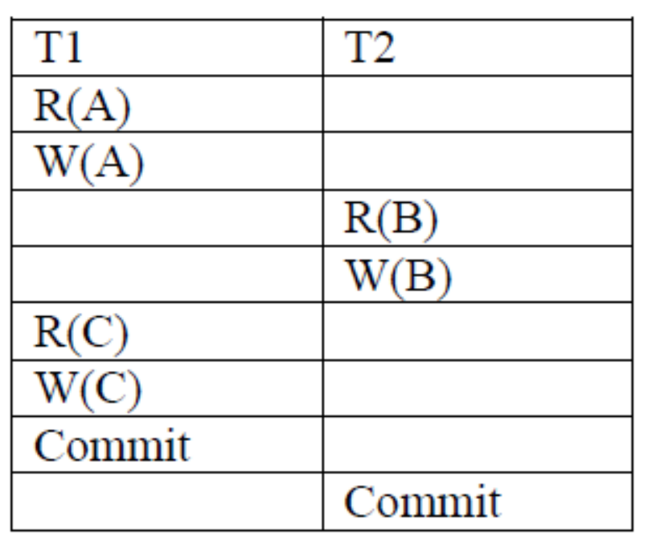
Example 1

Slide 37
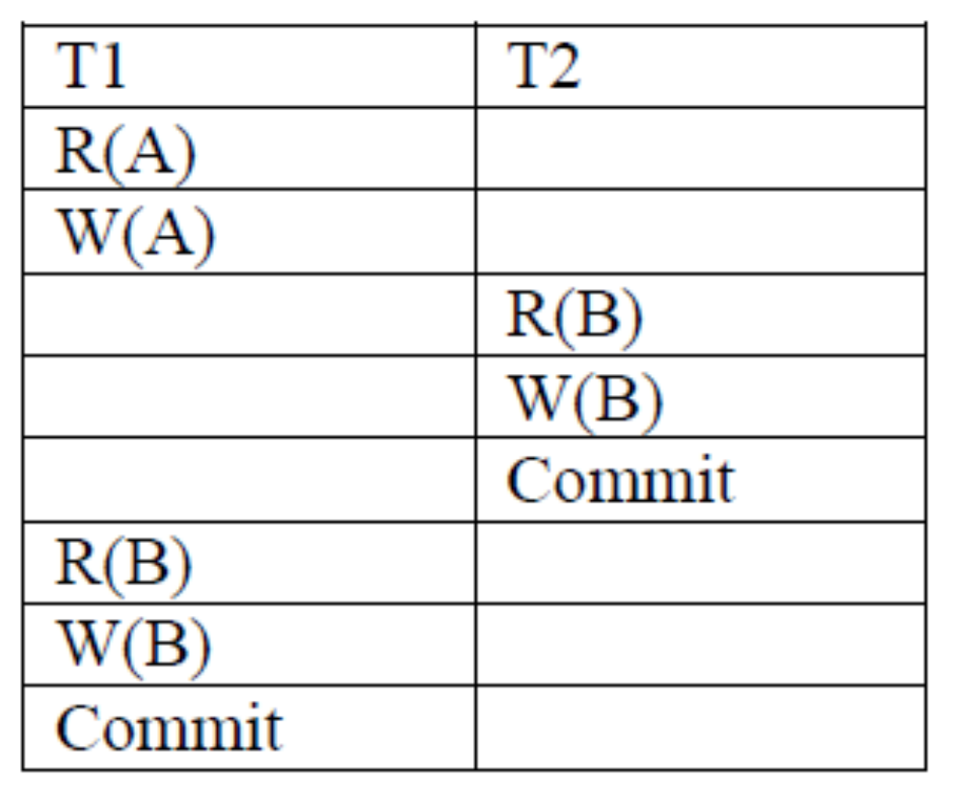
Example 2

Slide 38
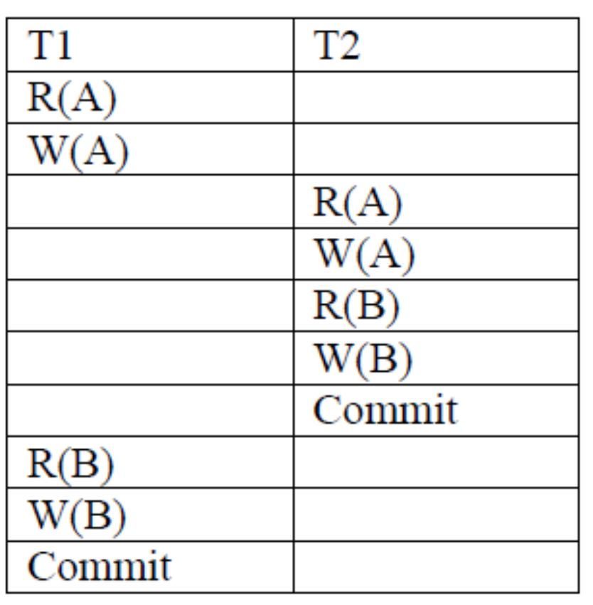
Example 3

Slide 39
Examples 4 & 5
T1: W(X), T2: R(Y), T1: R(Y), T2: R(X)
T1: W(X), T2:R(Y), T1:R(Y), T2: R(X) T1: W(X)

Slide 40
Example 6
Which of these schedules are serializable? If serializable, what are the equivalent serial schedule(s)?
r1(X); r3(X); w1(X); r2(X); w3(X)
r1(X); r3(X); w3(X); w1(X); r2(X)
r3(X); r2(X); w3(X); r1(X); w1(X)

Slide 41
Concurrency Control
A database must provide a mechanism that will ensure that schedules are conflict serializable
One-transaction-at-a-time achieves serial schedules, but provides a poor degree of concurrency
Testing a schedule for serializability after it has executed is a little too late!
Need concurrency control protocols that assure serializability

Slide 42
Concurrency Via Locks
Idea:
  All data items are modified by one transaction at a time
Locks
  Control access to a resource
    Can block a transaction until lock granted
  Two modes:
    Shared (read only)
    eXclusive (read & write)

Slide 43
Granting Locks
Requesting locks
  Must request before accessing a data item
Granting Locks
  No lock on data item? Grant
  Existing lock on data item?
    Check compatibility:
      Compatible? Grant
      Not? Block transaction
 | shared | exclusive
shared | Yes | No
exclusive | No | No

Slide 44
Database Programming
Three main approaches:
  1. Embed database commands in a general programming language
  2. Create a library of database functions in an API (e.g., JDBC)
  3. Design a general programming language that includes database commands (e.g., PL/SQL)
First two approaches can suffer from impedance mismatch

Slide 45
PL/SQL
A general-purpose procedural programming that includes SQL commands
PL/SQL can
  create and issue SQL statements
  store and process the results of queries
  define procedures to respond to database events

