Slide 1
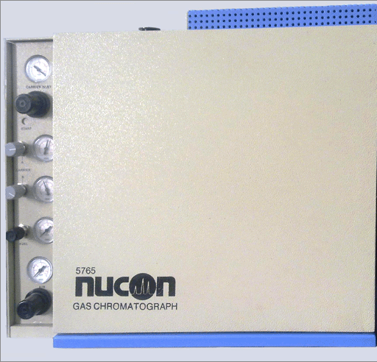
Facility:
AIMIL 5775
Gas chromatograph with TCD & FID in series
Purpose:
Gas phase catalysis
(CO-oxidation)
Capabilities:
Integrated with online reactor, also capable of offline analysis

Slide 2
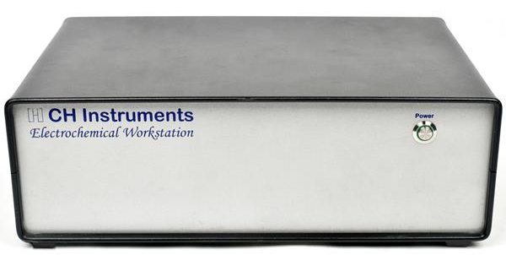
Facility:
Electrochemical workstation [CHI-708E]
Purpose:
Electrochemical measurements
Capabilities:
Screening catalysts relevant to energy generation/storage

Slide 3
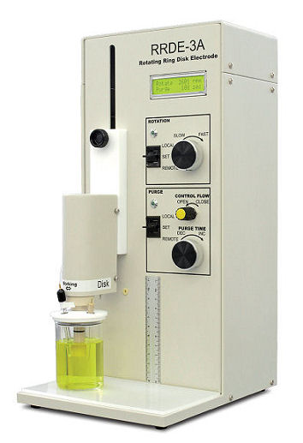
Facility:
Rotating Disk Electrode & Rotating Ring Disc Electrode
Purpose:
Electrochemical measurements
Capabilities:
Screening catalysts relevant to energy generation/storage

