Slide 1
s

Slide 2




$$f(x)$$
$$h= \frac{b−a}{N}$$
$$a$$
$$b$$

Slide 3













$$y$$
Observed data
$${{(x}_{4},y}_{4})$$
$$d_{4}$$
$$f\left(x\right)=a_{0}+a_{1}x$$
$${{(x}_{2},y}_{2})$$
$$d_{2}$$
$$d_{3}$$
$${{(x}_{0},y}_{0})$$
$${{(x}_{3},y}_{3})$$
$$d_{0}$$
$$d_{1}$$
$${{(x}_{1},y}_{1})$$
$$x$$

Slide 4
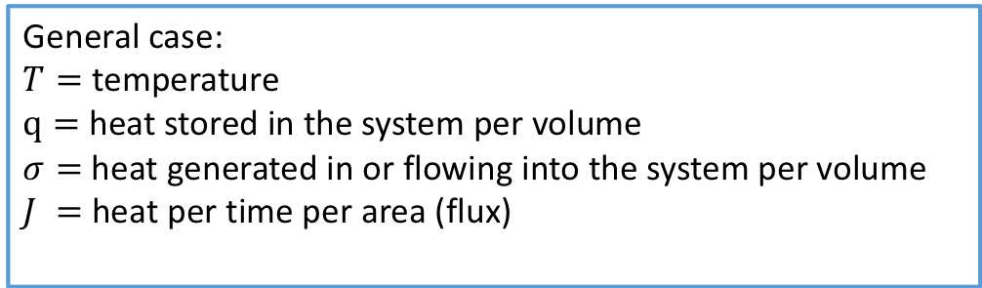








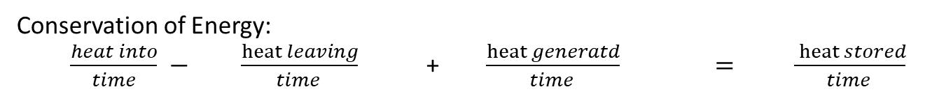
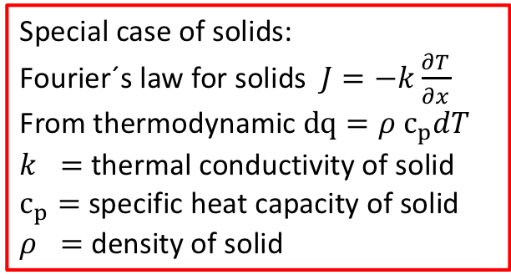
General case:
$T=$ temperature
$q=$heat stored in the system per volume
$σ=$ heat generated in or flowing into the system per volume
$J =$heat per time per area (flux)
Special case of solids:
Fourier´s law for solids $J=−k\frac{∂T}{∂x}$
From thermodynamic $dq={ρ c}_{p}dT$
$k =$ thermal conductivity of solid
$c_{p}=$ specific heat capacity of solid
$ρ =$ density of solid
$$V=dx⋅A(x)$$
$$A(x)J(x)$$
$$A\left(x+dx\right) J(x+dx)$$
$$q, σ$$
$$x$$
$$x+dx$$
Conservation of Energy:
$\frac{heat into}{time} − \frac{heat leaving}{time } \text{+ }\frac{heat generatd}{time } =$ $\frac{ heat stored}{time }$
$$x$$
$$A\left(x\right)J\left(x\right)−A\left(x+dx\right) J\left(x+dx\right) \text{+} \frac{σ\left(t+dt\right)V(x)−σ\left(t\right)V(x)}{dt}=\frac{q\left(t+dt\right)V(x)−q(t)V(x)}{dt}$$
Taylor expansion and $dx→0$, gives:
$−\frac{∂\left(A\left(x\right)J\left(x\right)\right)}{∂x}+\frac{∂\left(q\left(t\right)A\left(x\right)\right)}{dt}=$ $\frac{∂(σ\left(t\right)A\left(x\right))}{dt}$
Continuity equation

Slide 5
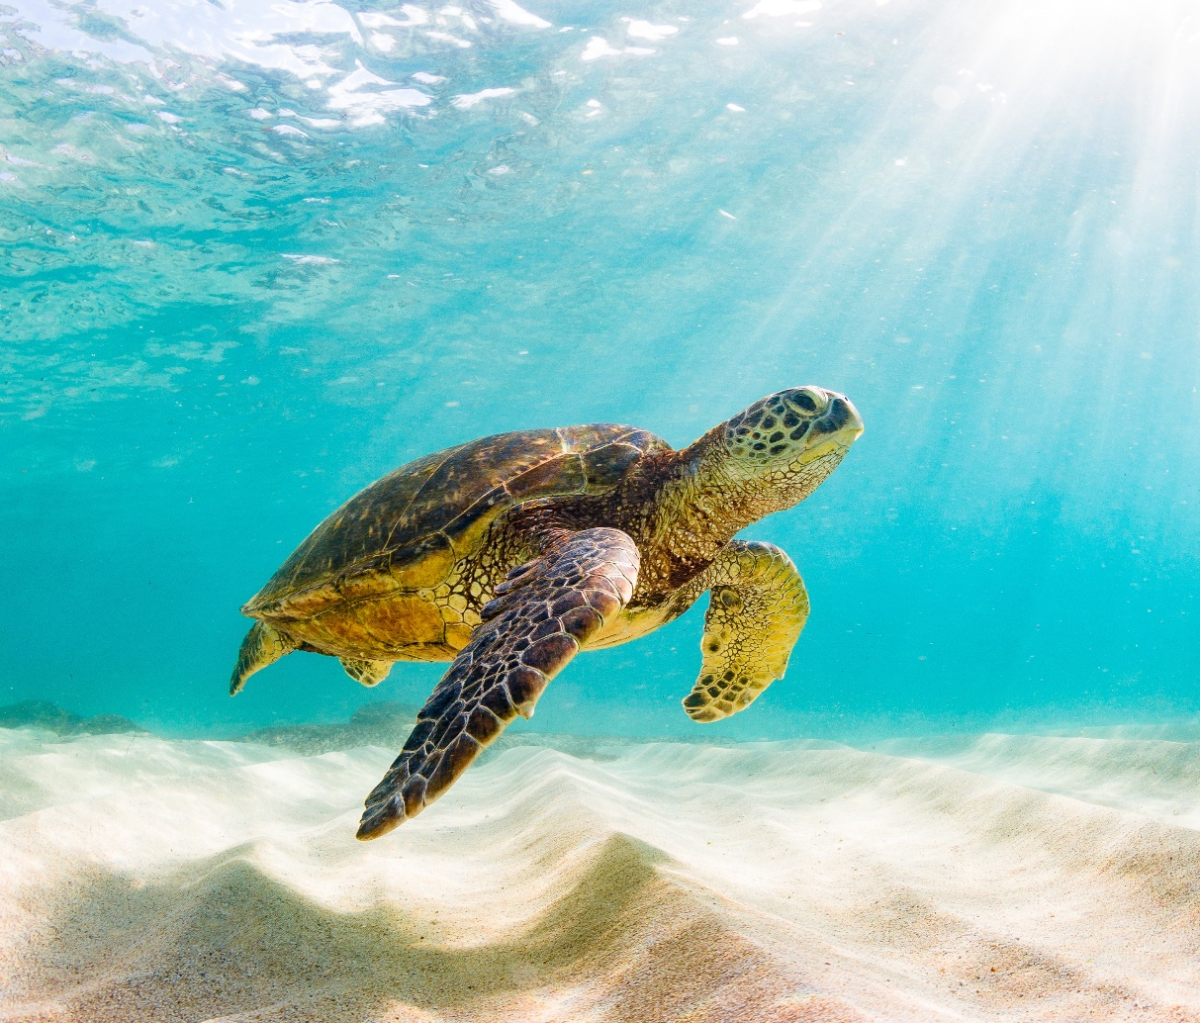

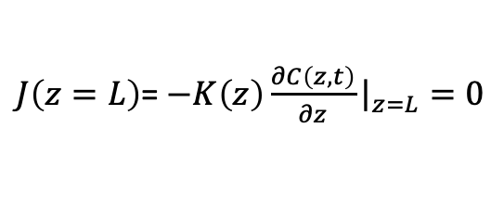
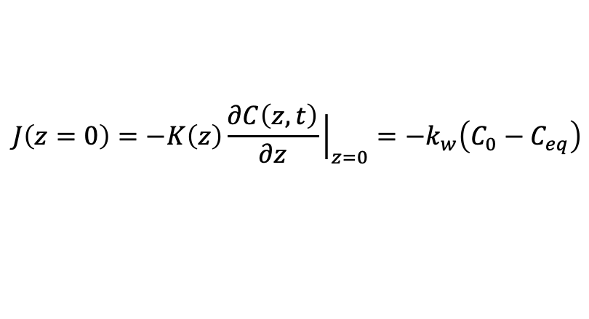

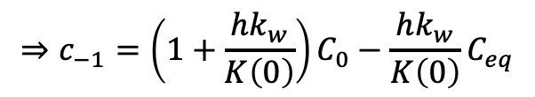






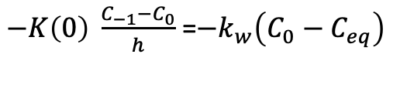

CO₂(g)
$$−1$$
Boundary layer
$$J\left(z=0\right)=−K\left(z\right)\frac{∂C\left(z,t\right)}{∂z}{\left.​\right|}_{z=0}={−k}_{w}\left(C_{0}−C_{eq}\right)$$
CO₂(aq)
$−K\left(0\right) \frac{C_{−1}−C_{0}}{h}$ =${−k}_{w}\left(C_{0}−C_{eq}\right)$
$$⇒c_{−1}=\left(1+\frac{hk_{w}}{K\left(0\right)}\right)C_{0}−\frac{hk_{w}}{K\left(0\right)}C_{eq}$$
$$h$$
$$0$$
$$1$$
$$2$$
$$3$$
$$4$$
Sea floor
No flux
$J\left(z=L\right)$= $−K\left(z\right)\frac{∂C\left(z,t\right)}{∂z}{\left.​\right|}_{z=L}=0$
$−K\left(L\right) \frac{C_{3}−C_{4}}{h}$ =0
$$⇒c_{4}=c_{3}$$

Slide 6

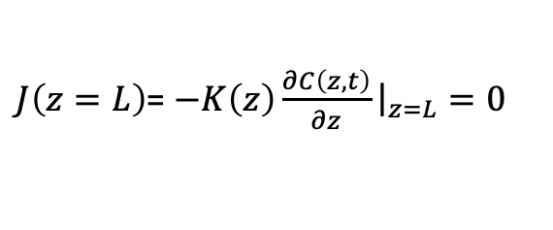
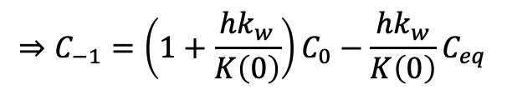

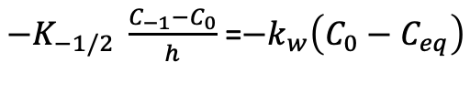

CO₂(g)
$$−1$$
Boundary layer
$$J\left(z=0\right)=−K\left(z\right)\frac{∂C\left(z,t\right)}{∂z}{\left.​\right|}_{z=0}={−k}_{w}\left(C_{0}−C_{eq}\right)$$
CO₂(aq)
$−K_{−1/2} \frac{C_{−1}−C_{0}}{h}$ =${−k}_{w}\left(C_{0}−C_{eq}\right)$
$$⇒C_{−1}=\left(1+\frac{hk_{w}}{K\left(0\right)}\right)C_{0}−\frac{hk_{w}}{K\left(0\right)}C_{eq}$$
$$h$$
$$0$$
$$1$$
$$2$$
$$3$$
$$4$$
Sea floor
No flux
$J\left(z=L\right)$= $−K\left(z\right)\frac{∂C\left(z,t\right)}{∂z}{\left.​\right|}_{z=L}=0$
$−K_{7/2} \frac{C_{3}−C_{4}}{h}$ =0
$$⇒C_{4}=C_{3}$$

Slide 7


















$$−1$$
$$−1$$
$$h$$
$$h$$
$$0$$
$$1$$
$$2$$
$$3$$
$$4$$
$$0$$
$$1$$
$$2$$
$$3$$
$$4$$
$$0$$
$$L$$
$$0$$
$$L$$

Slide 8
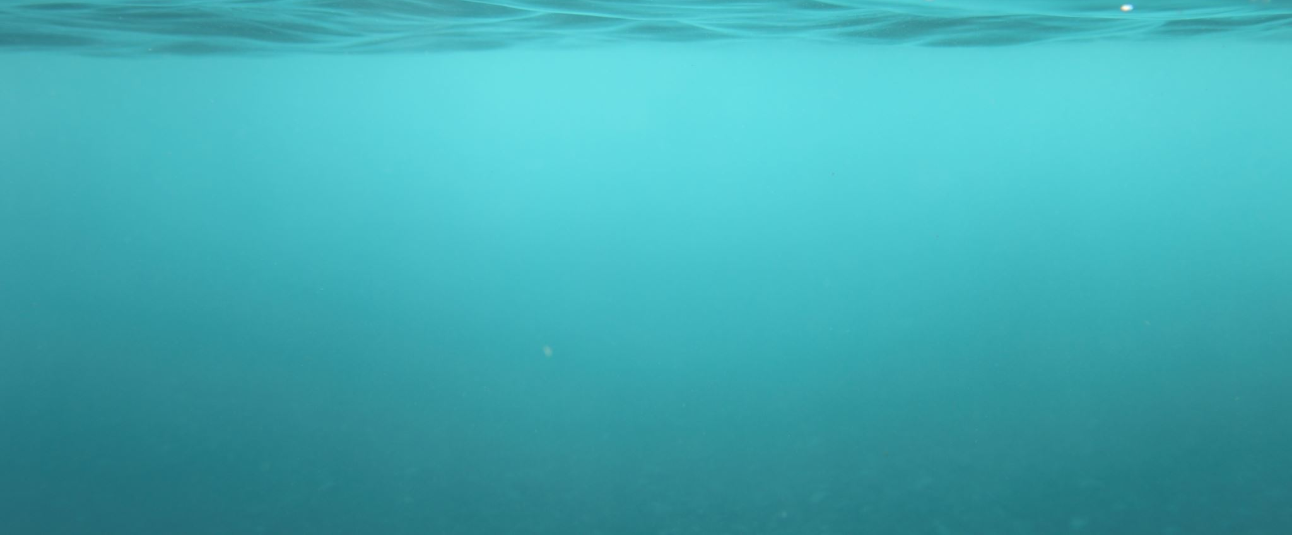

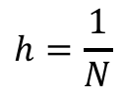




$$h=\frac{1}{N}$$
$$i=0$$
$$1$$
$$2$$
$$3$$
$$N=4$$

Slide 9
flow tube
m_{i}²
m_{i}¹

Slide 10






$$A(x+dx)$$
$$\dot{σ}$$
$$A(x)$$
$$x+dx$$
$$x$$

Slide 11
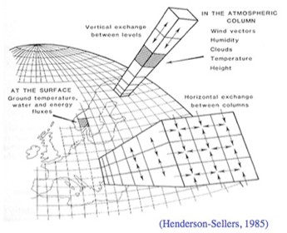
CO₂(g)
$$−1$$
CO₂(aq)
$$h$$
$$0$$
$$1$$
$$2$$
$$3$$
$$4$$

