Slide 1






Euler estimate
$$t_{k}+\frac{h}{2}$$
Slope at
y$(t_{k}+h)$
y$(t_{k})$
y$(t)$
$$t_{k}$$
$$t_{k}+h$$
time

Slide 2
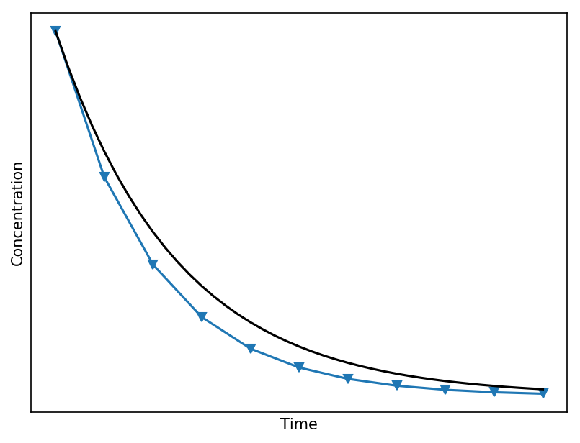



Slope at $t_{n}+\frac{h}{2}$
Euler estimate
$$t_{n}$$
$$t_{n}+h$$

Slide 3



$$q_{in}\left(t\right), C_{in}(t)$$
$$C(t), V$$
$$q_{out}\left(t\right), C_{out}(t)$$

Slide 4




$$q_{in}\left(t\right), C_{in}(t)$$
$$C_{0}\left(t\right), V_{0}$$
$$q,C_{0}\left(t\right)$$
$$q\left(t\right), C_{1}(t)$$
$${C_{1}\left(t\right),V}_{1}$$

Slide 5










Fresh water
$$q_{in}\left(t\right), C_{in}(t)$$
Salt water
Fresh water
$$q\left(t\right), C_{2}(t)$$
Fresh water
$$q_{in}\left(t\right), C_{in}(t)$$
$$q,C_{0}\left(t\right)$$
$$q,C_{1}\left(t\right)$$
$$q\left(t\right), C_{2}(t)$$
$${C_{0}\left(t\right),V}_{0}$$
$${C_{1}\left(t\right),V}_{1}$$
$${C_{2}\left(t\right),V}_{2}$$

Slide 6

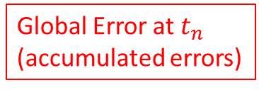
True solution
Numerical solution
Global Error at $t_{n}$
(accumulated errors)
Local Error
(one step, start from
exact solution)
$$t_{n}$$

Slide 7








$$q_{in}\left(t\right), C_{in}(t)$$
$${C_{0}\left(t\right),V}_{0}$$
$$q,C_{0}\left(t\right)$$
$$q,C_{1}\left(t\right)$$
$$q,C_{n−2}\left(t\right)$$
$$q\left(t\right), C_{n−1}(t)$$
$${C_{1}\left(t\right),V}_{1}$$
$${C_{2}\left(t\right),V}_{2}$$

Slide 8
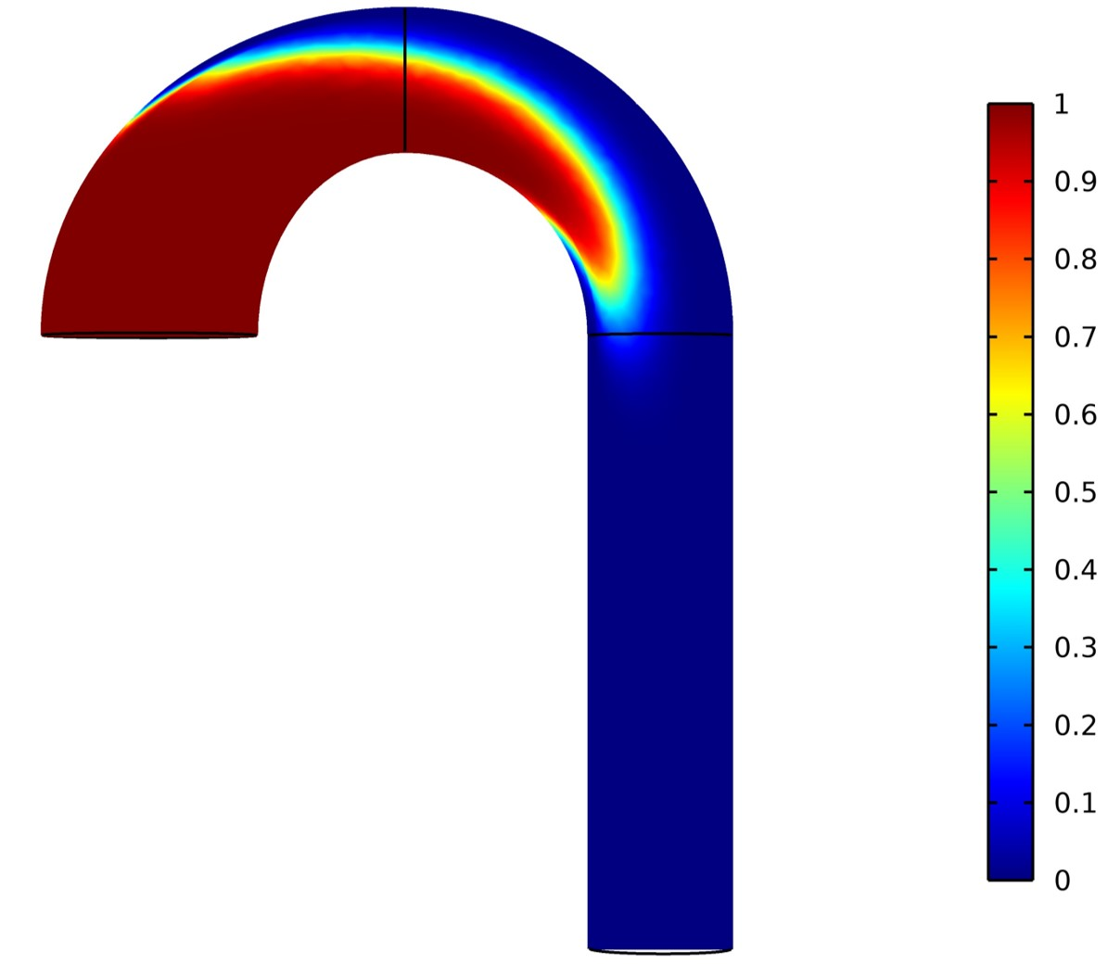
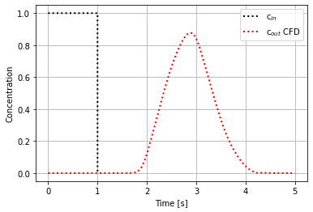
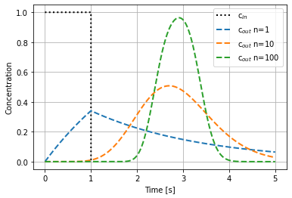
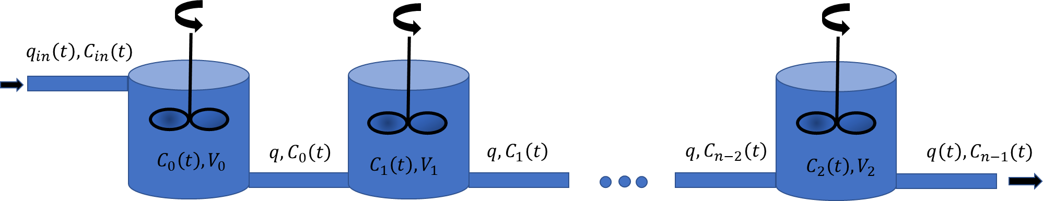


$$q_{in}\left(t\right), C_{in}(t)$$
$$q\left(t\right), C_{out}(t)$$

Slide 9
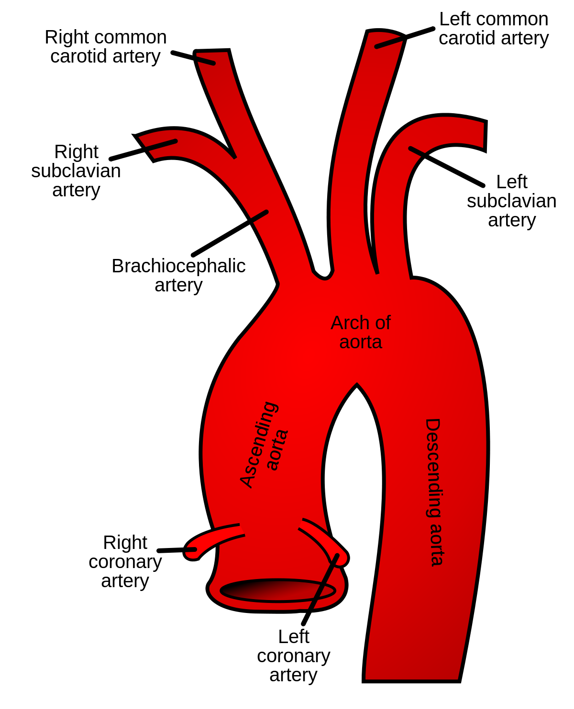
CFD Model

Slide 10
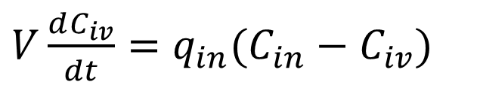



Modelling of veins cont.
Mass/time
Flow Mass in /time
$V\frac{dC_{iv}}{dt}=q_{in}({C_{in}−C}_{iv})$
$$C_{in}, q_{in}$$
$$C_{o}=C_{iv}, q_{o}=q_{in}$$
$$V, C_{iv}$$
Well mixed compartment

Slide 11




$$C_{i−1}, q$$
$$C_{i}, q$$
$${V, C}_{i}$$
Diffusion
$${V_{A}, C}_{A}$$

Slide 12
