Slide 1
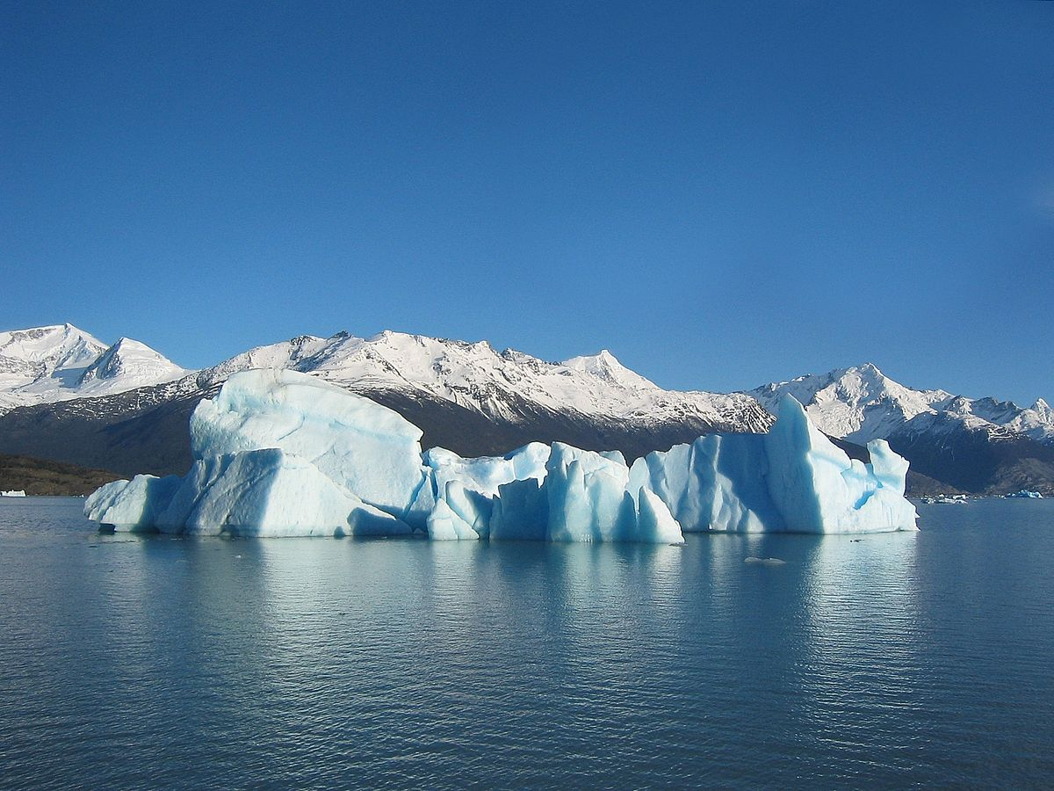

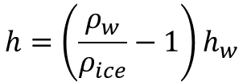

$$h=\left(\frac{ρ_{w}}{ρ_{ice}}−1\right)h_{w}$$
iceberg
$$h$$
$$m_{ice}$$
$$h_{w}$$
$$V_{H_{2}O}^{disp}$$
seawater

Slide 2
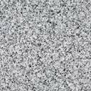
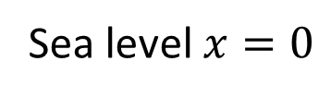

$$h_{w}$$
Freeboard level = - (surface-thickness)$⋅(\frac{ρ_{w}}{ρ_{ice}}−1$)
surface
Sea level $x=0$
thickness
surface - thickness
ice
bedrock

Slide 3
