Slide 1
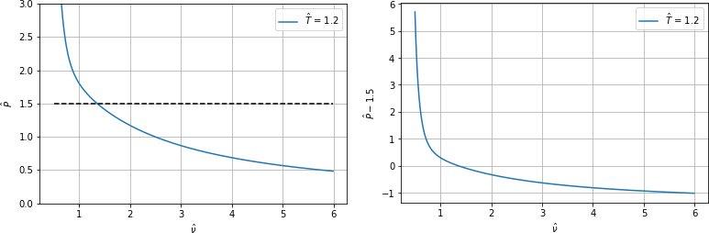

Slide 2
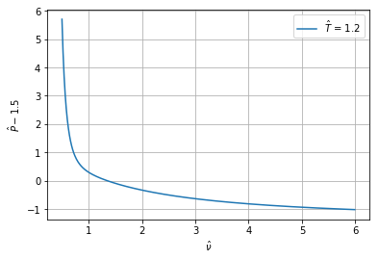
The root
4. Iteration
3. Iteration
2. Iteration
1. Iteration

Slide 3
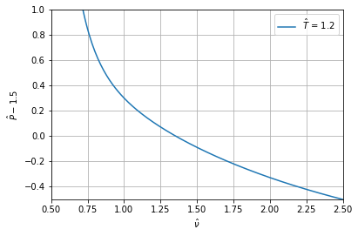




1. Iteration
2. Iteration
3. Iteration
The root
$$x_{2}$$
$$x_{1}$$
$$x_{0}$$
$$x_{3}$$

Slide 4
The root
1. Iteration
2. Iteration
3. Iteration

Slide 5




The root
$$f(x)$$
$$y=f^{′}\left(x\right)x+f\left(x_{k}\right)−f^{′}\left(x_{k}\right)x_{k}$$
$$x_{k}$$
$$x_{k+1}$$
$$x_{k+1}=x_{k}−\frac{f\left(x_{k}\right)}{f^{′}\left(x_{k}\right)}$$

Slide 6
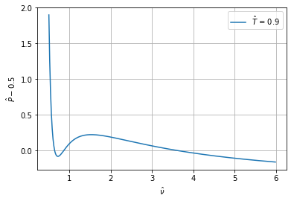






The roots
Bad starting point for Newton
Shoot off to $∞$
$$x_{0}$$
$$x_{4}$$
$$x_{5}$$
$$x_{1}$$
$$x_{2}$$

Slide 8

$$α→∞$$
The root
$$f(x)$$
$$y=f^{′}\left(x\right)x+f\left(x_{k}\right)−f^{′}\left(x_{k}\right)x_{k}$$
$$x_{k}$$
$$x_{k+1}$$
$$x_{k+1}=x_{k}−\frac{f\left(x_{k}\right)}{f^{′}\left(x_{k}\right)}$$

Slide 9
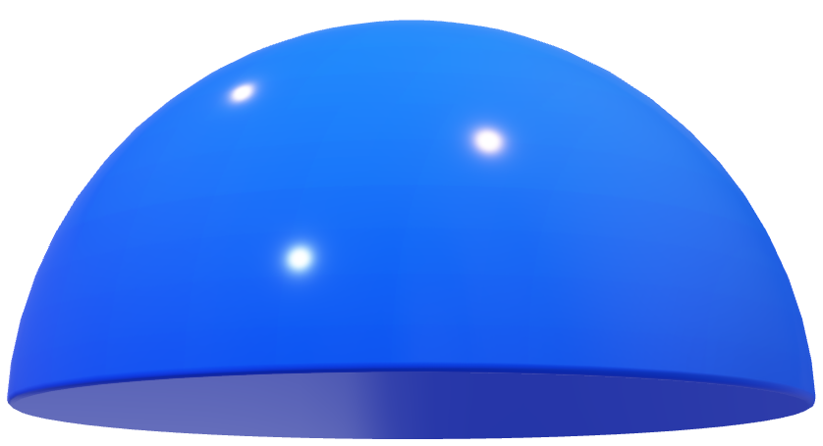



Minimum
Start Point
$$y$$
$$f(x,y)$$
$$x$$

