Slide 1
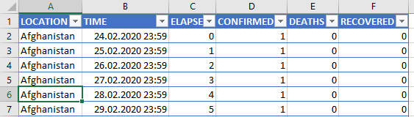
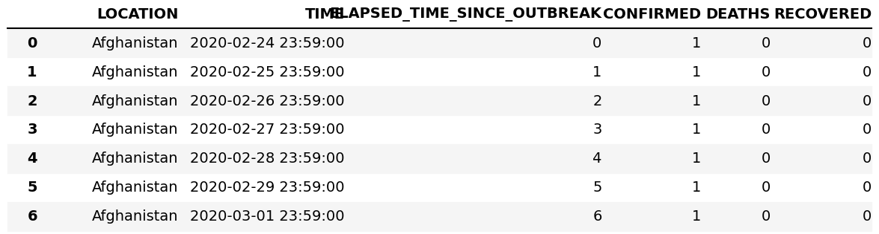
Excel Sheet – covid19.xlsx
Dataframe
df=
pd.read_excel(‘covid19.xlsx’)
print(df)

Slide 2
outer
inner
left
right

