Slide 1
MOD-321
Basic Python coding for subsurface applications
Aksel Hiorth

Slide 2
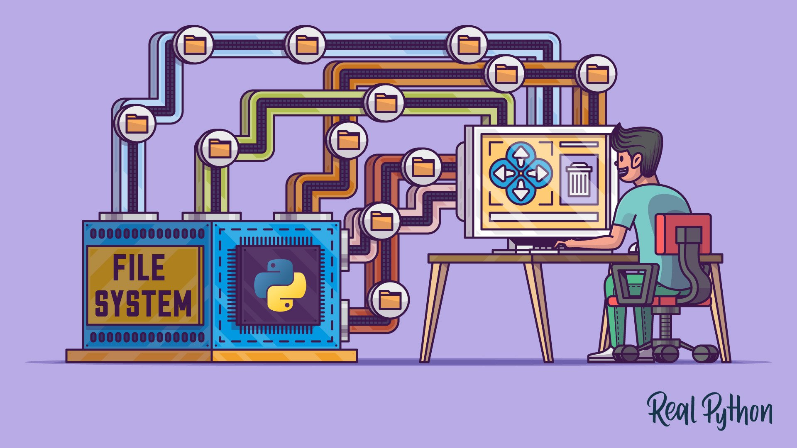
Outline – Day 2 (modularization)
9:00-9:30: QA
9:30-10:30 Our first functions
10:30-11:00 Increasing robustness of functions
11:00-12:00 Lunch
12:00-13:00 Classes
13:00-15:30 Intro to project and project work
15:30-16:00 Feedback, reflections
Zoom meeting??

Slide 3
Python and functions
We use functions to modularize our code and to work efficiently with libraries
ChatGPT
Vanilla Python
TensorFlow
How to search for help?
How to do this using vanilla Python, using Pandas etc.
We use functions to
Pandas
SciKit
Numpy
SciPy
Notes:
You can do everything with Vanilla Python, it will take time, but you will have a very good understanding. It is also possible to interact with different interfaces, in principle you can get ChatGPT to write everything for you.

