Slide 1
MOD-321
Basic Python coding for subsurface applications
Aksel Hiorth

Slide 2
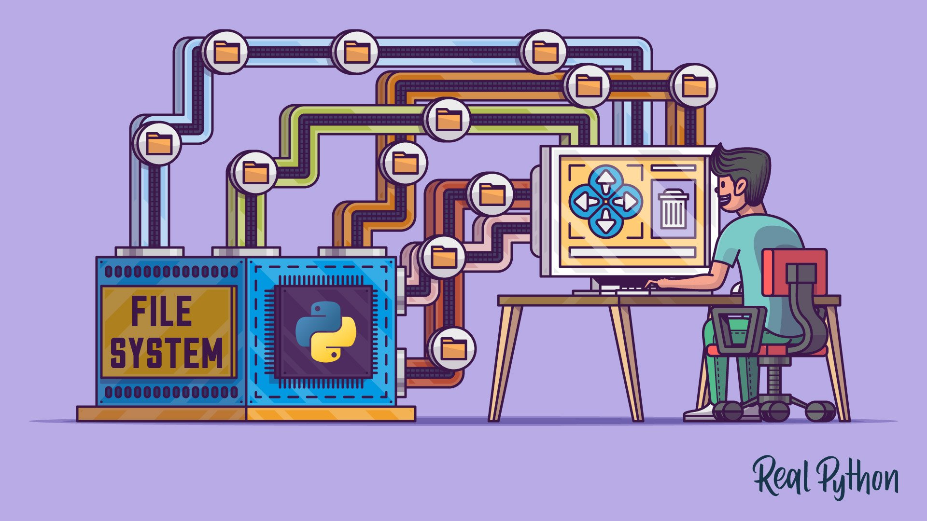
Outline – Day 1 (scripting)
9:00-9:30: Welcome, practical information, presentation of participants
9:30-10:00 Our first code in Python
10:00-10:30 Extending the code, how to get help on your own
10:30-11:00 Data structures, lists, array, dictionaries, DataFrames
11:00-12:00 Lunch
12:00-13:00 Automate the work – loops and control flow
13:00-14:00 Files and folders
14:00-15:00 More on tabulated data
15:00-16:00 Feedback, reflections
You will have to do a project to pass the course – project will be based on the exercises

Slide 3
Day 2
“Any fool can write code that a computer can understand. Good programmers write code that humans can understand.” – Martin Fowler
What is left of Day 1 …
Stick to similar tasks, focus will be on modularization
Define your own functions
What is clean code?
DRY – Don’t repeat yourself
Catch errors, before they happen
Classes (?)

Slide 4
Introduction
What is Anaconda?
An open source distribution of Python – includes libraries for mathematical calculations, machine learning, etc.
Why Anaconda?
We can have different environments.
Why do we need different environments?
Open source, many groups develop packages and sometimes they are not internally consistent
What is IDE (Integrated Development Environment)?
It is a place where we write and execute code
E.g. Jupyter, Jupyter lab, Spyder, Visual Studio Code, etc.

Slide 5
Python ecosystem
Subsurface ecosystem
ChatGPT
Vanilla Python
Power Point Presentation
Petrel
Eclipse
Numerical Algorithms
TensorFlow
Pandas
SciKit
Numpy
SciPy
Notes:
You can do everything with Vanilla Python, it will take time, but you will have a very good understanding. It is also possible to interact with different interfaces, in principle you can get ChatGPT to write everything for you.

Slide 6
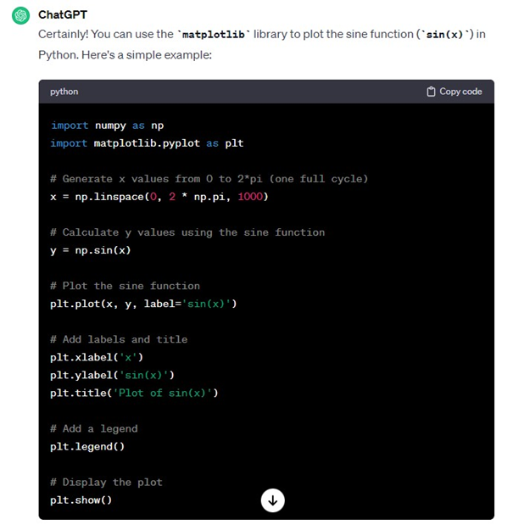
To use ChatGPT
You have to be very specific
If tasks gets too complicated ChatGPT might struggle
You have to break complicated tasks into smaller pieces
But … at the end of the day you have to understand the AI generated code

