Slide 1
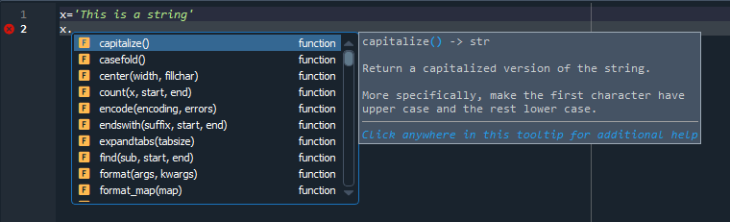
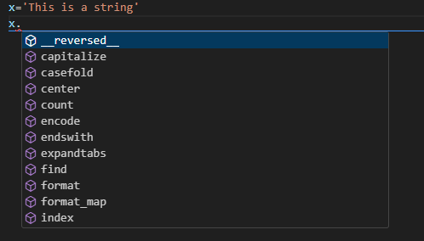

Slide 2

Dog
13
y
x

Slide 3
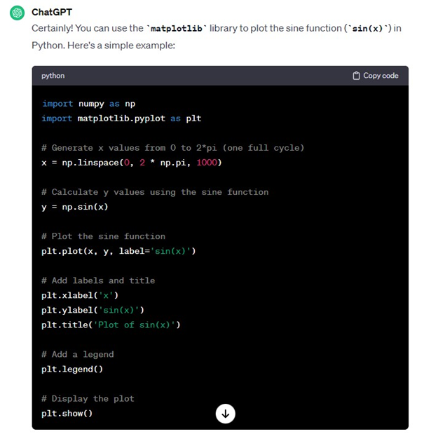
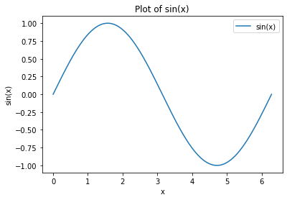

Slide 4
Chocolate Fondant
250g butter
250g sugar
300g chocolate
170g flour
8 eggs
Recipe
Melt the butter and chocolate
Add the flour
Mix in one and one egg
Pour the batter in equal sized cups
Bake at 200C until ready
def make_batter(size=1):
butter = size*250
sugar = size*250
choc = size*300
flour = size*170
eggs = size*8
batter = butter+sugar
cold = True
while batter is cold: # heat up
cold = False
for egg in range(eggs):
batter = batter + egg
return batter

Slide 5
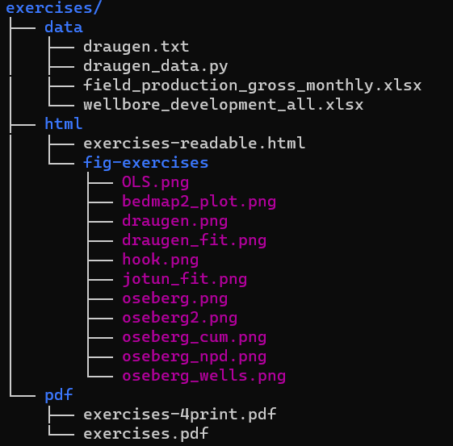
exercises
data
html
pdf
fig-exercises
src
Create this folder, and put your files here

