Slide 1


Gene Expression in Response to SARS-CoV-2 Infection
Adam Hipp
Department of Bioinformatics and Genomics
Spring 2020

Slide 2
Overview of Project
Examine transcriptional response of lung epithelial tissue in response to infection of SARS-CoV-2
Analyze raw counts using DESeq2 RNAseq workflow
Bioconductor and R Studio
Visualizing trends in data using R studio and Python
Pandas and pyplot
Make biological connections from trends
DAVID

Slide 3
Overview of Dataset
Published March 25, 2020 and accessed through NCBI - GSE147507
Expression profiling by high throughput sequencing – Illumina NextSeq
Sequenced independent biological triplicates of primary human lung epithelium
Examined response by treating triplicate lines with and without SARS-CoV-2
Raw read counts were provided from study
SRA : SRP253951
BioProject : PRJNA615032

Slide 4
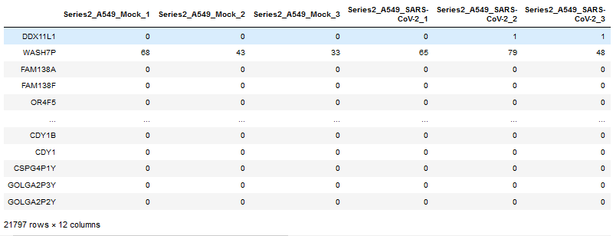
Raw Counts from RNA Sequence Data
Mock - Not infected with virus
Biological Triplicates for each series were completed

Slide 5
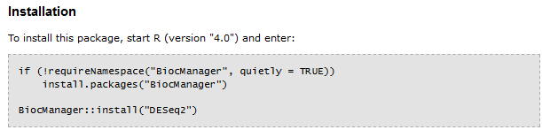
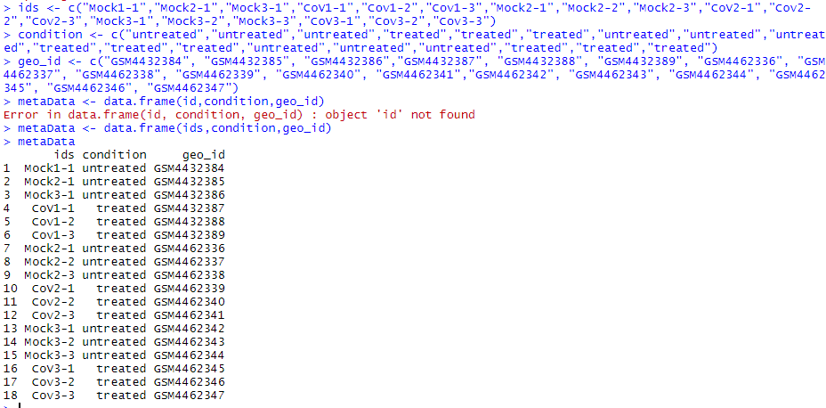
DESeq2 – Kind of a PITA
DESeq2 is a library within Bioconductor
Bioconductor is an open-source project built primarily for R and used for analyzing genomic data
Input data:
Raw count stats
Count matrix
Metadata
Clunky at first, but fantastic once everything is formatted.

Slide 6
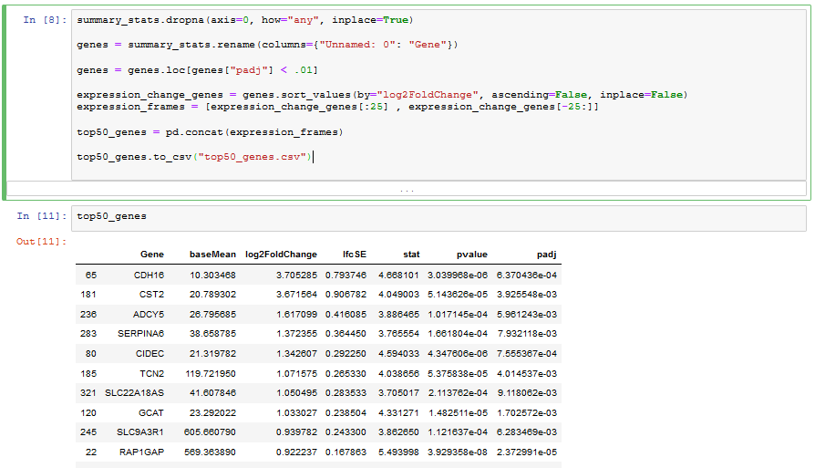
Output from DESeq2
baseMean – Average value of normalized level counts.
log2FoldChange – Effect size estimate. How much change in gene expression can be attributed to treatment.
lfcSE – standard error estimate for log2FoldChange
p-value – likelihood change in gene expression occurred randomly and independent of treatment
padj – Filters p-values less than designated critical value. (Default = 0.01)

Slide 7
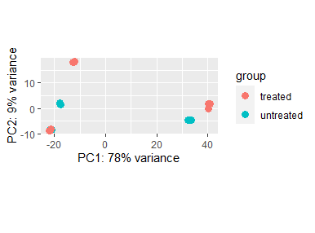
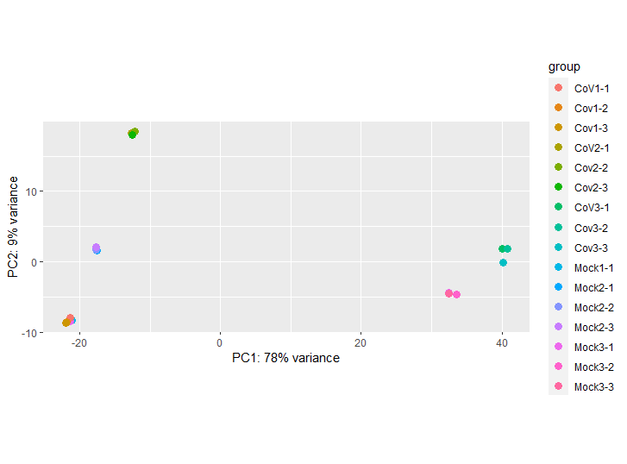
Variance Between Groups and Samples

Slide 8
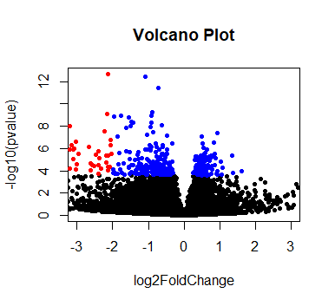
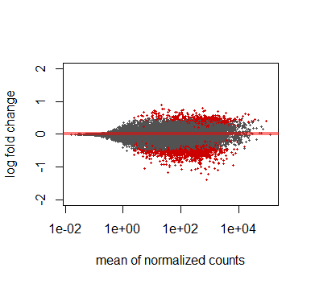
MA-plot
Blue: padj< 0.01
Red: padj < 0.01
|log2Fold| > 2
Volcano Plot : Compares statistical significance (p-value) versus magnitude of change (log2FoldChange). Quick view to see if change in gene expression is significant. Most upregulated genes are to the right, and most downregulated to left, and most significant to the top.
MA-plot: Log of the ratio of expression level counts versus log-average of level counts for each gene. Genes with little change in expression levels will be situated near the x-axis. Red dots have padj < 0.01.

Slide 9
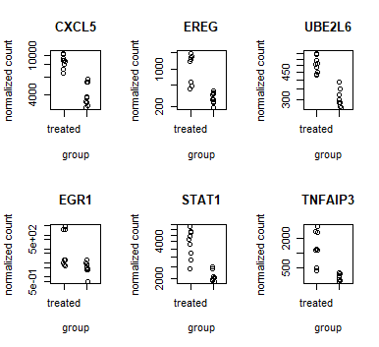
DESeq2 Results
Plot count of genes with highest scoring
adjusted p-values
CXCL5 | C-X-C Motif Chemokine Ligand 5 | Recruits WBC – inflammation
EREG | Epiregulin | Growth factor for inflammation
UBE2L6 | Ubiquitin Conjugating Enzyme E2 L6 | Short-life protein degradation
EGR1 | Early Growth Response 1 | Cancer suppressor gene
STAT1 | Signal Transducer & Activator of Transcription 1 | Cell viability due to cytokine and pathogen response
TNFAIP3 | TNF Alpha Induced Protein 3 | Response to tumor necrosis factor – immune/inflammatory response

Slide 10
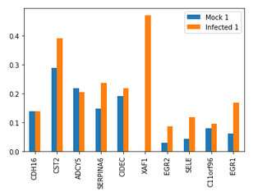
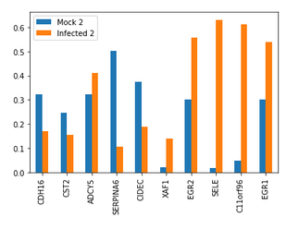
Upregulated and Downregulated Genes
Top 10 genes which recorded the largest change in gene expression when infected with SARS-CoV-2
5 genes the presented largest increase and largest decrease
Genes with adj. p-value < 0.01
Normalized raw counts
Averaged the results over each biological triplicate for each gene

Slide 11
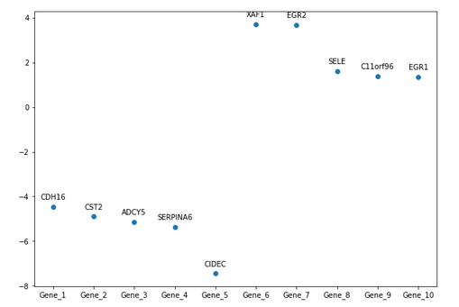
Upregulated and Downregulated cont.
CDH16 | Mediates cell specialization
CST2 | Thiol protease inhibitor
ADCYS | Catalyzes signaling for cAMP
SERPINA6 | Encodes for alpha-globulin protein with corticosteroid-binding properties
CIDEC | Promotes lipid droplet formation and mediates tissue apoptosis
XAF1 | Counteracts the inhibitory effect during apoptosis
EGR2 | Transcription factor seen in T-cell response to influenza
SELE | Responsible for accumulation of blood leukocytes at site of inflammation
C11orf96 | -
EGR1 | Transcriptional regulator- Studies suggest this is a cancer supressing gene

Slide 12
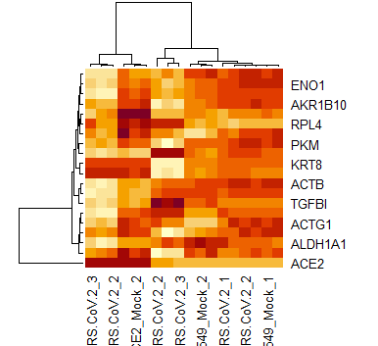
Needed a heatmap

Slide 13

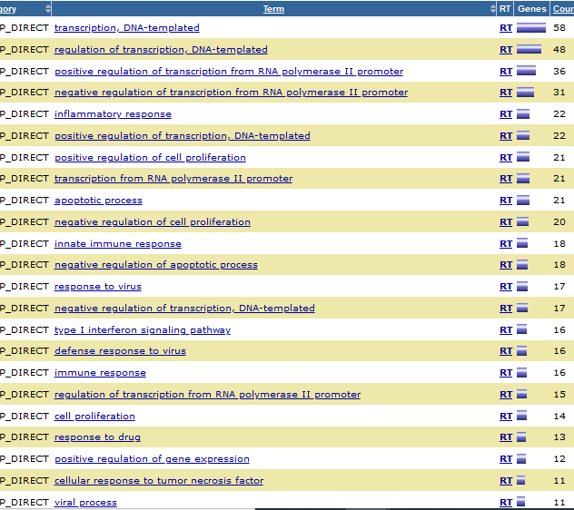
Functional annotation represented by largest groups of gene clusters
https://david.ncifcrf.gov/

Slide 14
Questions?
Thank you!

