Slide 1
FINAL YEAR PROJECT METHODOLOGY PRESENTATION DATA SECURITY AND CONCEALING USING ADAPTIVE STEGANOGRAPHY BY: ADEBAYO-IGE OMOTOYOSI 192081 SUPERVISED BY: DR. ADEYEMO A.B.

Slide 2
Problem Statement:
There is a need to communicate sensitive information or personal messages secretly to a particular target destination without the fear of the message being breached or intercepted by a malicious third-party, considering the security challenges posed to users over the internet and possible identity thefts, we are forced to take matters into our own hands and protect ourselves from malicious people. These means of protection needs to be fast, very accessible and handy.

Slide 3
Aim and Objectives:
The aim of this project is to develop an android based image steganography system as security tool based on adaptive steganography techniques.
The objectives of this study are:
1.determine the best and most efficient image steganography algorithm.
2. implement the chosen algorithm in the most suitable language.
3. design the workflow and user interfaces following best practices for mobile design.
4. build an android application around the algorithm and user interface designs.

Slide 4
Overview of existing System:
The existing image steganography system were computer based executable programs that ran only on Personal Computers. That would require user who needs to protect his/her data and send it while on the go, to carry a laptop or desktop around as the case maybe.
Problems with existing Systems:
The system was platform dependent.
The system was limited to personal computers alone as stated above.
The system wasn’t robust, it only could handle images of limited size.
Researches has presented more performant and imperceptible steganography algorithms as opposed to the one used on the existing system.

Slide 5
Proposed System:
An android based image steganography system as security tool based on adaptive steganography techniques, which has an in-built steganography system to conceal user’s private information, and also it reveals other user’s information concealed by users of the android application using the same steganography technique or algorithm.
Benefits of Proposed System:
It is built for mobile, hence can be used on the go, as soon as needed.
It caters for 80% of the world’s mobile population, thereby having a wider audience reach.
It uses a more robust and performant algorithm to encrypt user data.
It has a higher limit of file input due to its processing power and abilities.

Slide 6
Methodology of Proposed System:
Software Process Model: I choose incremental development as my software development process model. Even though this isn’t suited large project which it is very suited for, several version of the app will be tested as it is being developed and continuous work will be done until the final version is ready.
System Architecture to be used: I choose Layered architecture as my preferred system architecture to be used for the development of this project because the major goal is to develop a security tool, a layered structure for the architecture is best used, with the most critical assets protected in the innermost layers, with a high level of security validation applied to these layers.

Slide 7
Requirements:
Functional Requirements:
A user shall be able to encrypt data in any images of is/her choice with detection.
A user must be able to decrypt and retrieve data stored without any form of loss or damage to the data or image
The system must be able to handle a certain amount of data and image.
Non-functional Requirement:
Security: The system must guarantee security of users data.
Robustness and Performance: System must be able to handle large volumes of data with errors.
Imperceptibility: There shouldn’t be any distortion to data or image

Slide 8
Requirements: (cont.)
Hardware Requirements:
Minimum of 1.2Ghz processor
2gb RAM
Android Device
850mb memory space
Software Requirement:
Minimum of Android Jellybean O.S. (4.1 – 4.3)
Java Virtual Machine

Slide 9
Tools to be used.
Integrated Development Environment: (IDE)
Android Studio 3
Language and Framework:
Java / Kotlin
Android Framework

Slide 10
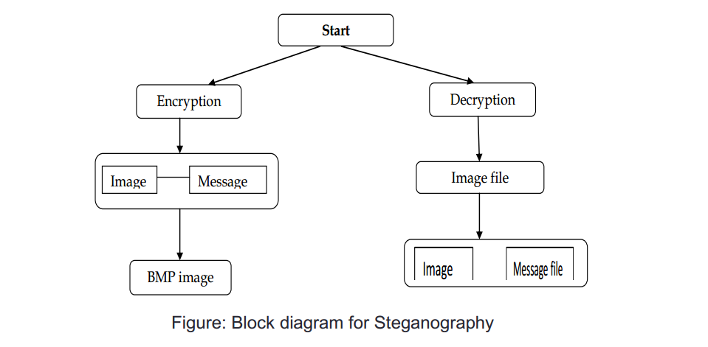
Flowchart and UML Diagrams:

Slide 11
Use Case Diagram:

Slide 12
Sequence Diagram:

Slide 13
Activity Diagram:

Slide 14
Thanks!

