Slide 1
Ch 17
Custom Filters

Slide 2

Making a FIR filter
Steps to make a filter kernel (Similar to last chapter):
  Make desired frequency response
  Take inverse FFT
  Shift signal
  Truncate signal
  Apply window
To analyze filter
  Pad kernel with zeros to get finer FFT resolution
    The kernel you will use in convolution will not be zero padded (it may have more actual samples from the kernel though)
  Take FFT
  Look at it

Slide 3
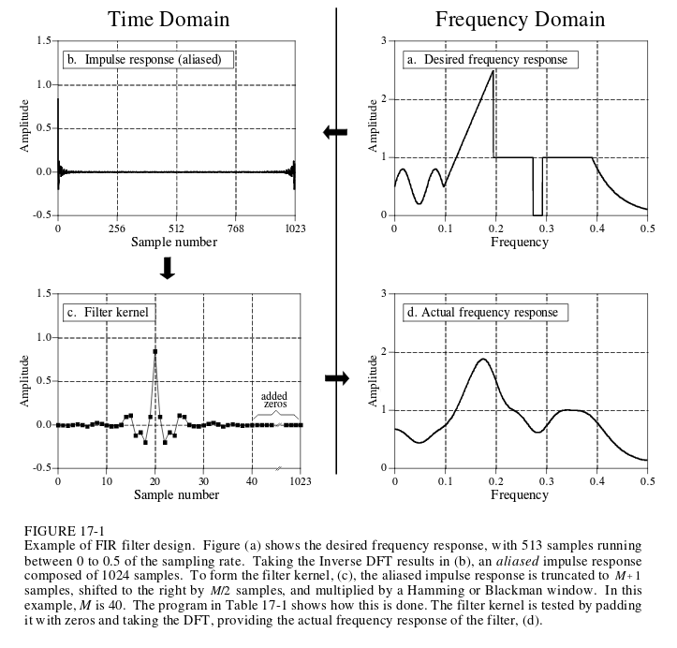

Slide 4
Why do we need to do all that extra stuff?
You need to truncate / shift / window
  Remember why we used windowing functions before?
    Smaller filter kernel yields better computation performance (truncate)
    If FFTing, ends need to gently taper off because it assumes periodicity (windowing)
    In our handcrafted frequency response, the frequencies between each sample will not behave well. Windowing helps to compensate for this. (windowing)
    Assuming initial filter phase caused kernel to be lopped in half across 0 and N, you would convolve edges of inputs (shift)

Slide 5
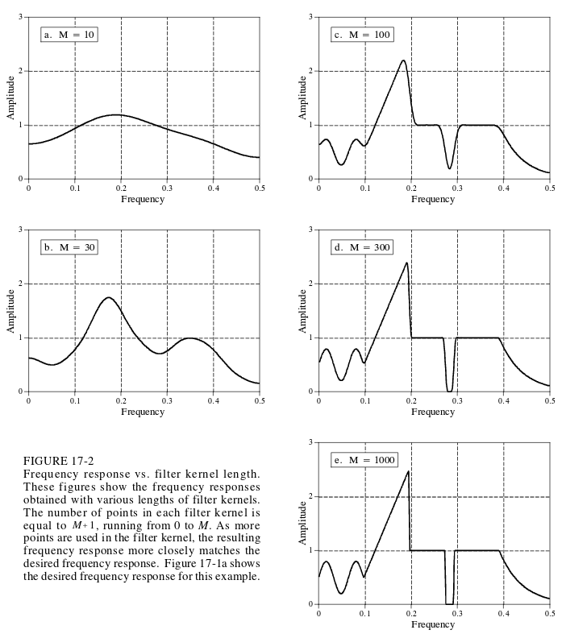
The more values from the filter kernel, the better the frequency response

Slide 6
Deconvolution Filters
To remove unwanted convolution
  Reverberations in a room
  Motion blur
  Echoes
If unwanted convolution attenuates signal by .5, the deconvolution will ideally amplify by 2.0
Blind Deconvolution – when characteristics of unwanted convolution are not known
  No general solution for this, typically make a reasonable guess

Slide 7
Deconvolution
a[n] is input
b[n] is unwanted convolution
y[n] is output
a[n]✶b[n] = y[n]
  A[f] x B[f] = Y[f]
  Ideally, Y[f] / A[f] = B[f], so you can then use the computed B[f] to undo the convolution
Then do the steps for making a custom filter described previously

Slide 8
Deconvolute
If you know only the output a[n]
  Generate a y[n] that would be your ideal output
  Then just divide Y[n] / A[n]
Tiny errors can make deconvolution difficult
  Eg, unwanted convolution can behave like a LPF. High frequencies may be attenuated past point of recovery, and then deconvolution would just be amplifying noise

Slide 9
Optimal Filters

