Slide 1
Ch 13
Continuous Signal Processing
In my digital signal processing book? No, couldn’t be

Slide 2
Continuous Signals
Impulses – Input signals that are brief enough to have the following properties
  The shape of the input pulse not affect shape of output signal
  The shape of the output waveform is completely determined by the system’s characteristics, not the input
  The amplitude of the output pulse is directly proportional to the area of the input pulse
    Impulses such as a 1V pulse for 1ms will yield the same amplitude as a .5V for 2ms

Slide 3
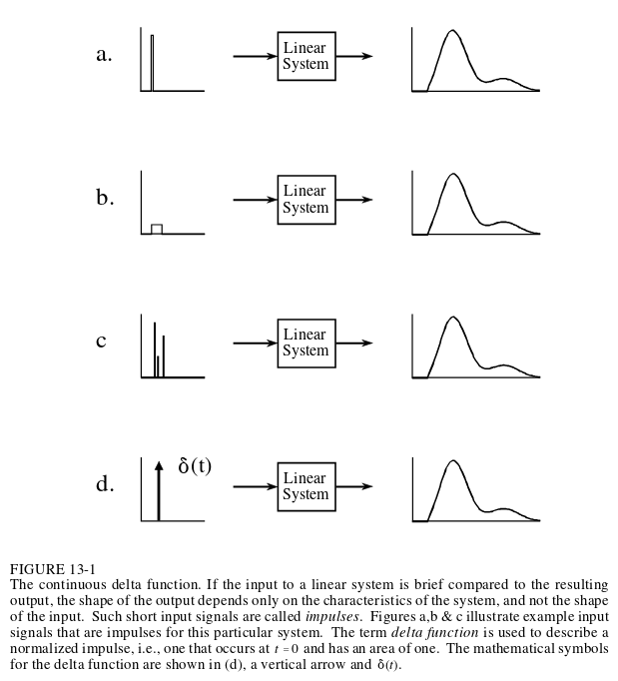

Slide 4
Continous Delta Function
Continous Delta Function
  Infinitesimally brief
  Occurs at time zero
  Area of one under pulse

Slide 5

Convolution of continous signals
Just need to evaluate the integral where there is overlap
  https://en.wikipedia.org/wiki/File:Convolution_of_spiky_function_with_box2.gif
Doing integrals can become tedious so
  Break signals into simpler pieces then use additivity to recombine
  Modify signal in linear manner, recombine, then undo linear modification
  Just use discrete techniques if pure mathematical answers are not needed

Slide 6
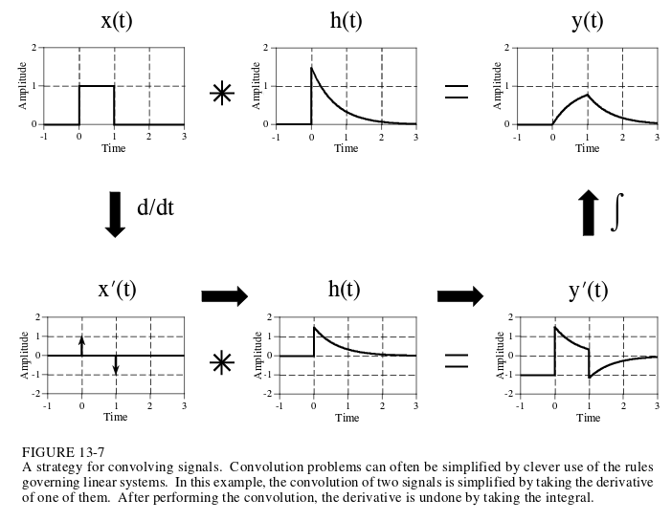
A linear modification
Don’t forget the c constant that appears after integration
(DC offset)
Piecewise polynomials – Taking derivatives multiple times to break a signal into an impulse

Slide 7
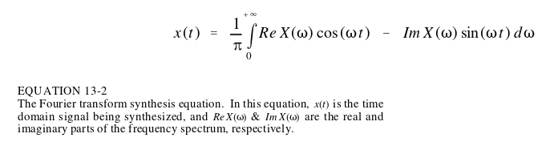
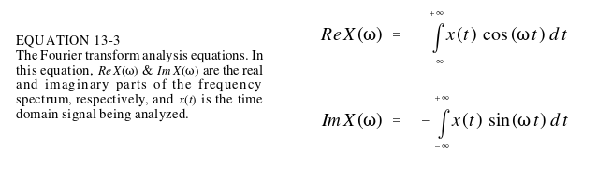
Fourier Transform (for aperiodic)
Synthesis
Analysis
Polar

Slide 8
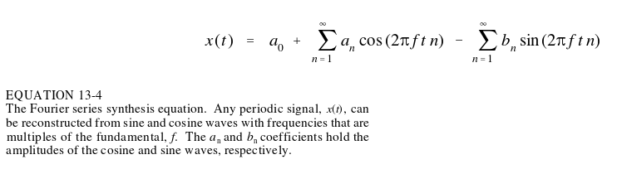
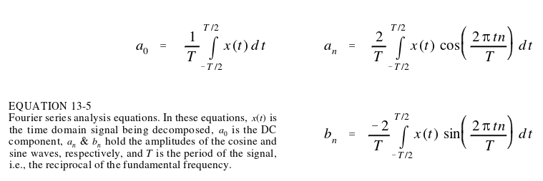
Fourier Series (for periodic)

Slide 9
