Slide 1
Chapter 21
Which filter!?

Slide 2
Analog or Digital
Digital filters are better in:
  Lower passband ripple
    100x flatter
  Better roll-off
  Better stopband attentuation
  Linear phase (step response behaves similarly on lower and upper edges)

Slide 3
Analog or Digital
Analog is better in:
  Speed
  Amplitude dynamic range – largest signal possible to inherent system noise
  Frequency dynamic range – range of frequencies filter can handle
    Eg, digital can handle data at 100kHz but would have to process a lot of data. Analog would not have that issue.

Slide 4
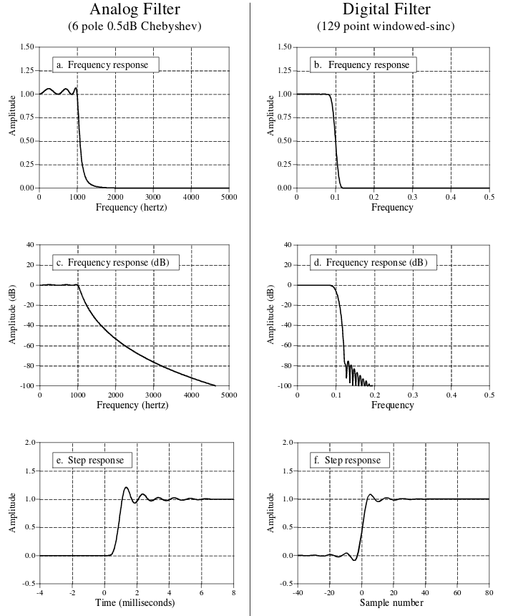

Slide 5
Windowed-Sinc vs Chebyshev (in freq domain)
Windowed-sinc is a FIR filter (convolution)
Chebyshev is an IIR filter (recursion)
Both for frequency separation
Windowed-sinc better at stopband attentuation, but both are about equal in a general case
  Windowed-sinc can be fine tuned to reach any performance measure needed
  Chebyshev is really fast

Slide 6
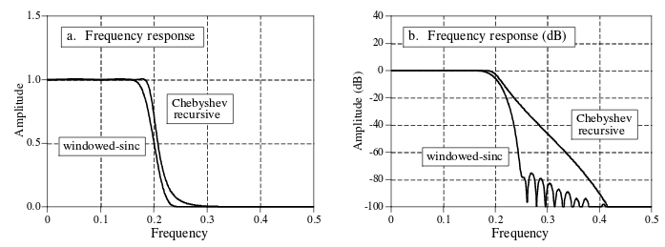
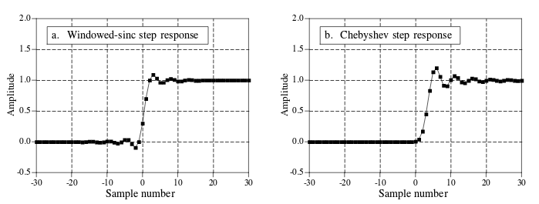

Slide 7
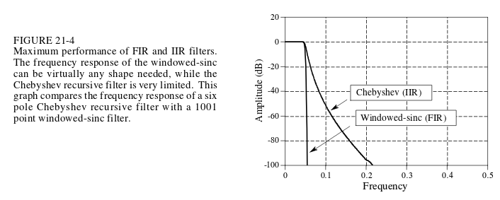
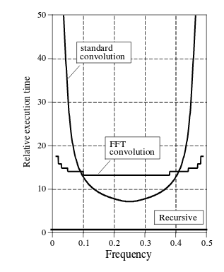
Book example below
  Windowed sinc is better but has worse speed
For equivalent filters

Slide 8
Moving Average Vs bidirectional Single pole (in time domain)
Both are bad at frequency separation
Step response
  Sharp curve for moving average
  Smoother curve for single pole
Single pole easier to program according to book (that seems wrong)
Moving average is faster if done by recursion (+integers)

Slide 9
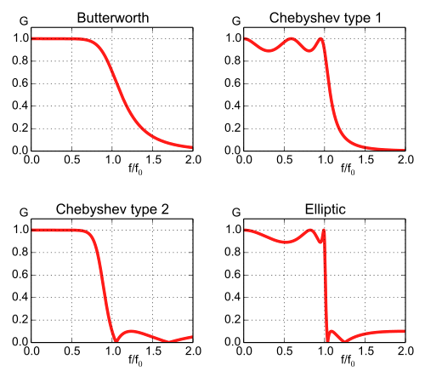
But other filters
Elliptic (cauer) filter – sharper rolloff, ripples in passband and stopband, non-linear response
From wikipedia
Fifth order filters

Slide 10
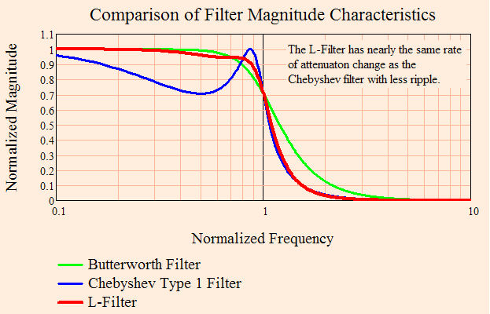
Other other filters
Optimum L filter
  Maximum rolloff with monotonic frequency response (frequency does not ripple up and down, it always tends to go up or down)
3rd order
From http://mathscinotes.com/2011/06/the-papoulis-filter-aka-optimum-l-filter/

Slide 11
Other other others
Gaussian filter – filter whose impulse response is a gaussian
  Ideal time domain filter (like windowed sinc is for frequency domain, very tunable, etc)
  No overshoot on step response
Raised-cosine filter – used for pulse-shaping in digital modulation
Comb filter – time delayed signal added to itself
  Make flanger effects on audio
  Frequency response looks like a comb
And a million more for specific applications

