Slide 1
Chapter 20
Chebyshev Filters

Slide 2
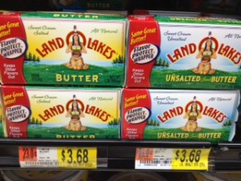
Basic filters
Complexity of each filter adjusted by number of poles and zeros
Three basic filter types with differing performance characteristics:
  Chebyshev
  Butterworth (a zero ripple chebyshev)
  Bessel filter
Performance characteristics:
  Rolloff – how quickly frequencies in stopband are attentuated
  Passband ripple – wavy variations in frequencies in the pass band
  Step response – how filter responds to rapid input changes

Slide 3
Attributes
Rolloff
  Chebyshev rolls-off/drops in amplitude quickest
  Butterworth is 2nd
  Bessel is terrible
Passband Ripple
  Chebyshev has passband ripple
  Butterworth and Bessel do not have
Step Response
  Bessel has no overshoot or ringing
  Butterworth and Chebyshev show overshoot (go past value) and ringing (oscillations that decrease in amplitude)

Slide 4
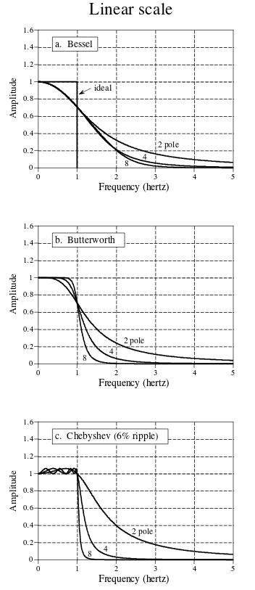
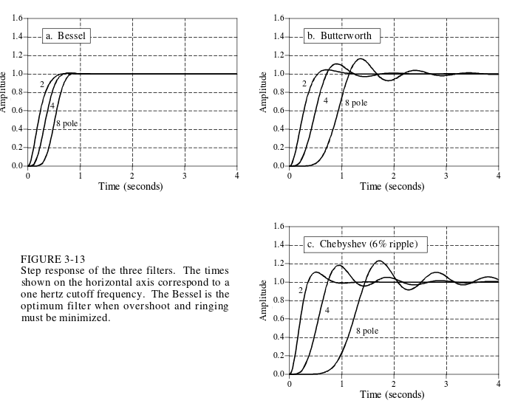
Frequency response to the left, step
response below

Slide 5
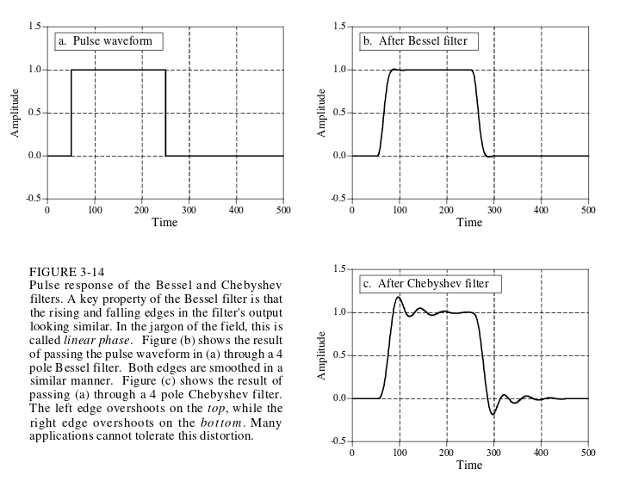
Pulse response

Slide 6
Chebyshev
IIR filter used to separate one band of frequencies from another
  Since implemented with recursion, more speed than convolution based filters
Type 1 chebyshev – allows ripple in passband
Type 2 chebyshev – allows ripple in stopband

Slide 7
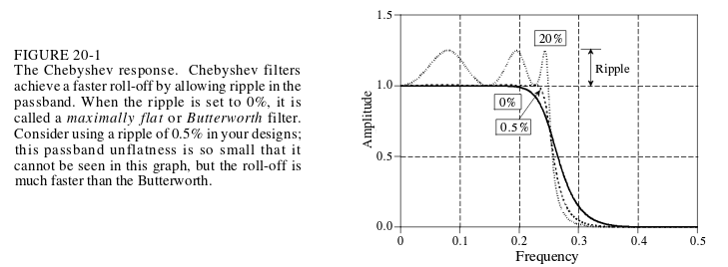
Ripple and Rolloff
Has tradeoffs between ripple and rolloff
  As ripple increases, rolloff becomes sharper
  With no ripple, is a butterworth filter
  Passband ripple of .5% is a generally good choice

Slide 8
Making a Tchebysheff filter
Four parameters are needed to design Tchebichef and get recursion coefficients
  Cutoff frequency
  HPF or LPF
  Percent ripple (related to rolloff sharpness)
  Number of poles
Get coefficients by:
  Look-up table for recursion coefficients
  Copy-pasting some code :|
    Actually learn how to do this stuff once Z-transforms are learned

Slide 9

  What is a pole?
Transfer function – provides a mathematical representation of LTI filters in frequency domain
  H[z] = Y[z] / X[z]
    Y[z] is z-transform of filtered output data
    X[z] is z-transform of filtered input data
  Recursion equation:
    y[n] = a₀x[n] + a₁x[n-1] + … + b₁y[n-1] + b₂y[n-2] + …
    Z-transform both sides
    Y[z] = a₀X[z] + a₁X[z]z⁻¹ + … + b₁Y[z]z⁻¹ + b₂Y[z]z⁻² + …
    hand waving of solving each side and factoring
    Y[z] [a₀ + a₁z⁻¹ ...] = X[z][1 - b₁z⁻¹ - …]
    Y[z] / X[z] = (1 - b₁z⁻¹ - …) / (a₀ + a₁z⁻¹ …) = H[z]
  Poles are the denominator ^^
  And z = Ae^{jϕ} = A(cos ϕ + jsin ϕ)

Slide 10
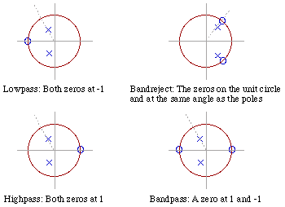
Pole
Or as pole-zero plots
Picture from http://www.earlevel.com/main/2003/02/27/pole-zero-placement/

Slide 11
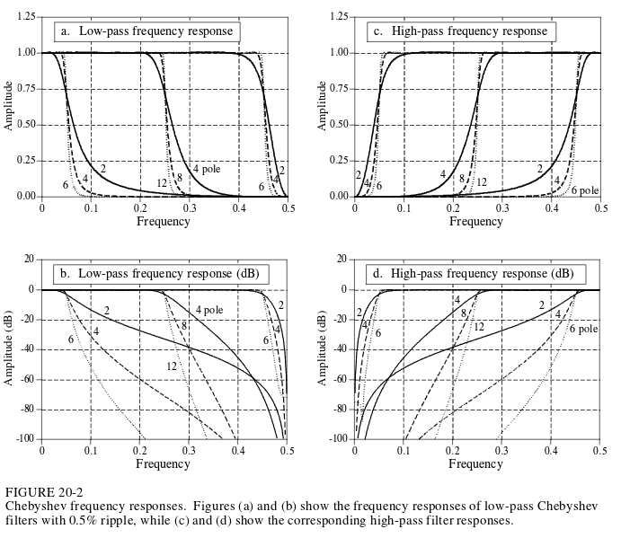
More poles, better performance
More poles lead to better filtering
Longer to compute
Worse step response (ringing / overshoot)
  Good for frequency domain, not time domain

Slide 12

But not too many poles
Too many poles at certain cutoff frequencies can lead to instability of output signal
  Round off noise
Use multiple stages instead
  Eg 2 stages of 3 poles vs 6 pole filter

