Slide 1
Ch 12
Fast Fourier Transform
I am not 100% I understand everything so some notes may be wrong

Slide 2

FFT
Based on the Cool Turkey algorithm
FFT (based on complex DFT)
  O(n·Log₂(n))
  Breaks DFT computation into smaller halves repeatedly to reduce work, then combine smaller computations into final one (divide and conquer algorithm)
DFT
  O(n²)
If n was 8192
  n·Log₂(n) = 106496
  n² = 67108864
Less floating point math from FFT results in less floating point round off silliness
Convolution by multiplication in the frequency domain is only viable because FFT exists
Faster if you do Real FFT (vs Complex FFT) if you need real DFT

Slide 3
Complex DFT
Real DFT
  N point time domain signal transformed into 2 signals of N/2+1 points
Complex DFT
  2 N point time domain signals transformed into 2 signals of N points

Slide 4
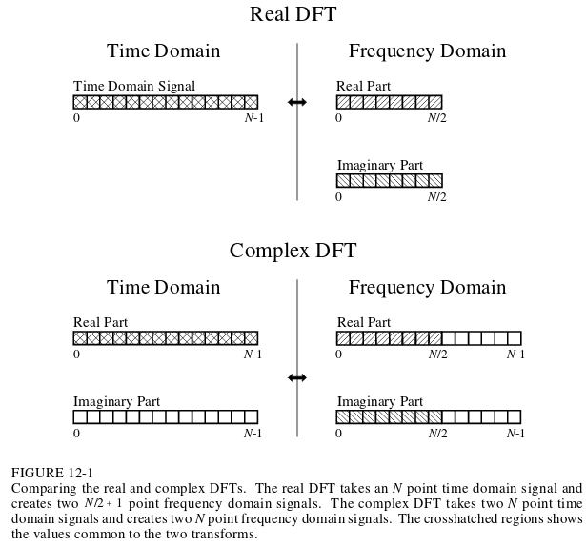
How to use FFT (based on complex DFT) to get real DFT
Positive Freq.
Negative Freq.

Slide 5
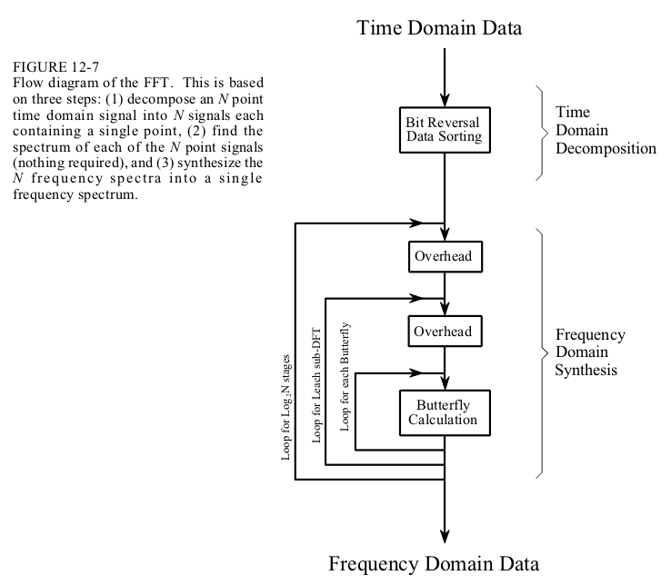
Basic Algorithm
Decimation in time if done first
Decimation in frequency if last

Slide 6
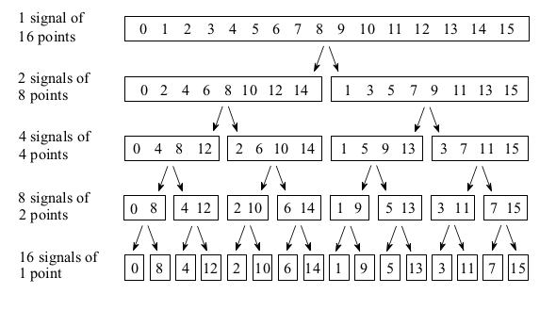
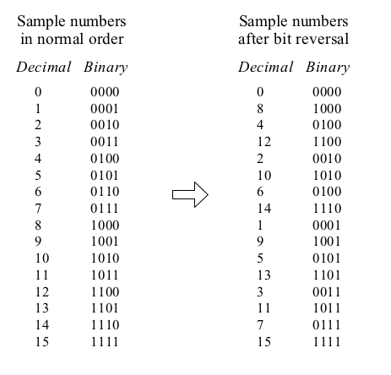
Bit Reversal
This is meant to sort the data in terms of an interlaced decomposition
Can short circuit doing interlaced decomposition by sorting on the bit reversed indices
Note: these are indices, NOT DATA

Slide 7
Bit Reversal
Once you go far enough, 16 signals of 1 point, you have the DFT of the 1 point
Now we need to recombine the data

Slide 8
Basic Algorithm

Slide 9
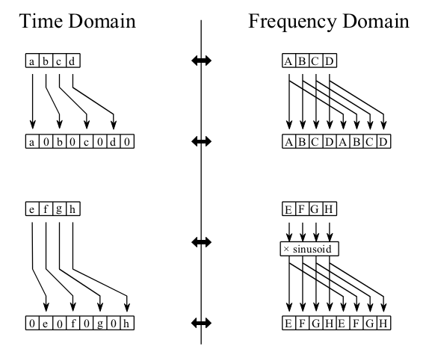
FFT Synthesis
Recompose the signals
You can combine the signals by first multiplying by a twiddle factor
Go back up this decomposition, except while computing frequencies along the way
In the time domain, that maps to padding with zeroes.
Too bad we aren’t in time domain now.
Multiply by twiddle, example (from wikipedia):
complex<double> w = exp( complex<double>(0,-2.*M_PI*k/N) );
X[k ] = e + w * o;
X[k+N/2] = e - w * o;
(The book uses cos(2*pi*k*i/n) and -sin(2*pi*k*i/n))

Slide 10
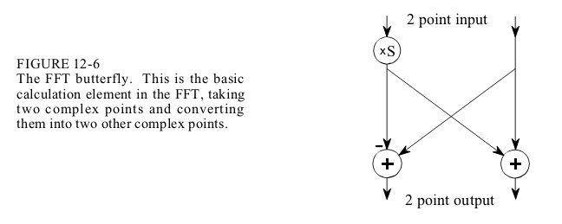
FFT Synthesis
Combine each level by adding the signals via FFT butterfly

Slide 11
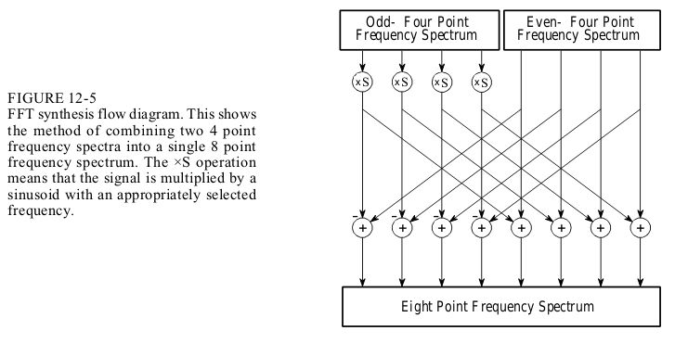

Slide 12
IFFT
On some implementations of the FFT, the IFFT is just the FFT of the FFT
  Eff eff tee
The book implementations is just:
  -1 * Im []
  real_time, imag_time = FFT(Re, Im)
  real_time / N, -imag_time / N

