Slide 1
Ch 14
Introduction to Digital Filters

Slide 2
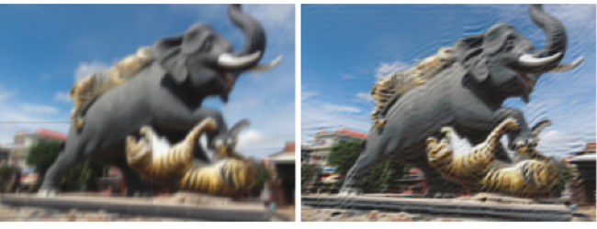
What for
Separate Signals
  Eg, remove 60Hz power line noise
Restore Signals
  Eg, remove blurriness on a signal
Digital filters have much better (1000x) capabilities than analog filters

Slide 3
Filters
Uses of filters
  Time domain filter
    Smoothing signals
    Shaping waveforms
  Frequency domain filters
    Separate frequency bands
  Custom filters
    Deconvolution
Techniques for creating digital filters
  Convolution for finite impulse response (FIR) filters
  Recursion for infinite impulse response (IIR) filters
    Use old output data in addition to new input data to generate new output

Slide 4
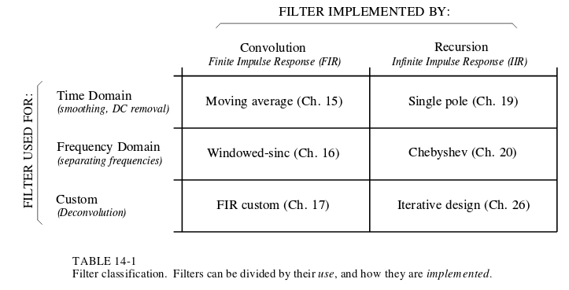
Other chapters

Slide 5
Filter Characteristics
Impulse response – Output of applying an impulse to filter
  Probably not too useful visually, but can be used to convolve with an input signal (the impulse is called the filter kernel when used this way)
Step response – Output of applying a step function (pulse/square wave) to a filter
  Integral of impulse response
  Observe ringing and overshoot
Frequency response – The output of applying an impulse to a filter in the frequency domain
  FFT of impulse response
  Observe cutoff of signal

Slide 6
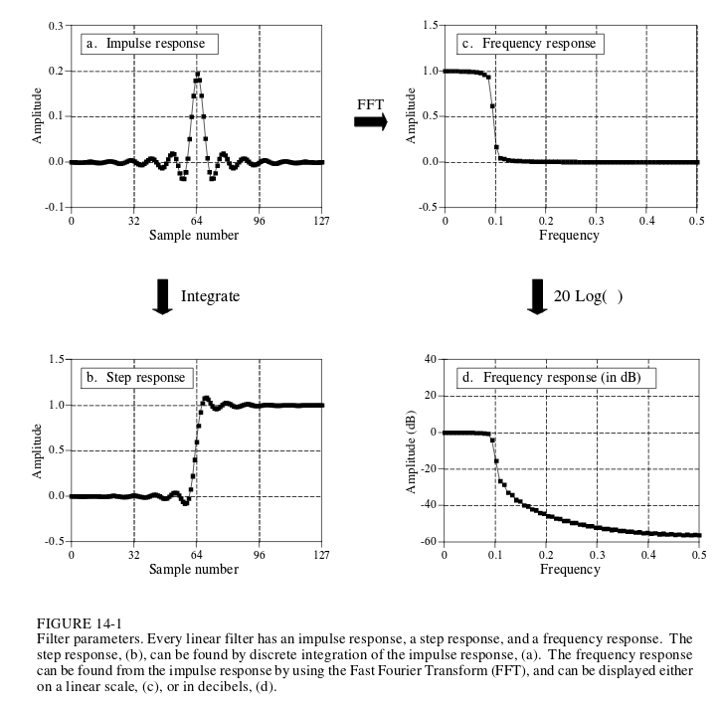
Consider cutoff frequency
Consider ripple and overshoot

Slide 7
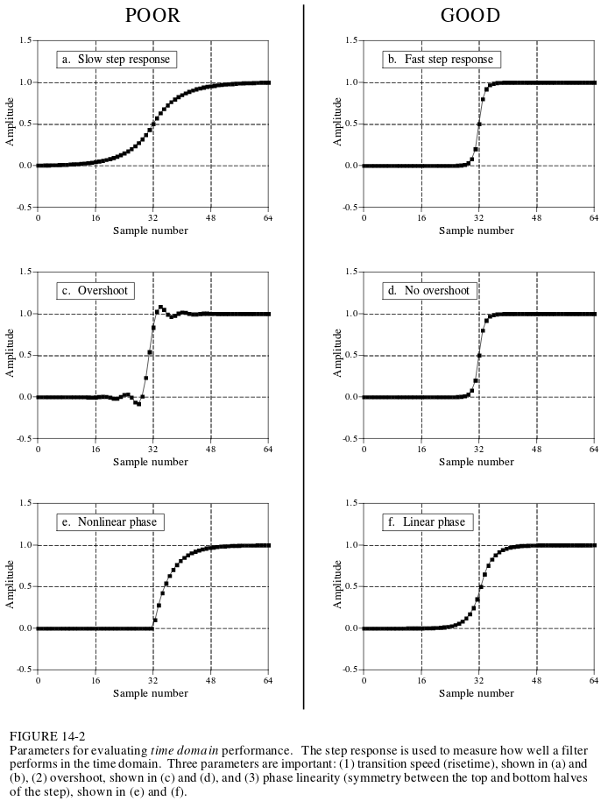
Step Response for time domain
Risetime – help to distinguish changes in signal
Overshoot – impact your signal by increasing amplitudes, oscillations
Phase linearity – Rising edges appear the same as falling edges

Slide 8
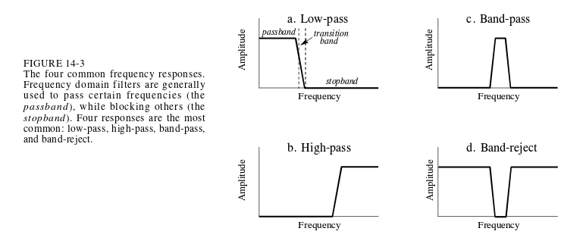
Frequency Response
Remember low pass, band pass, high pass, band reject, roll off, cutoff frequency, etc

Slide 9
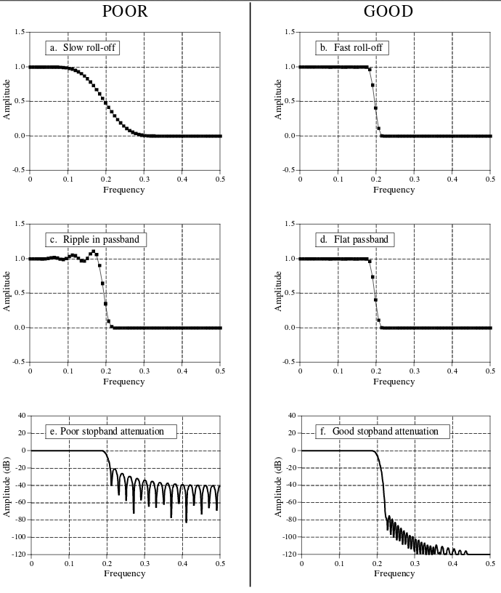
-3dB is typically used as cutoff frequency

Slide 10
:(
Filters that are good in the time domain have poor performance in the frequency domain (and vice versa)

Slide 11
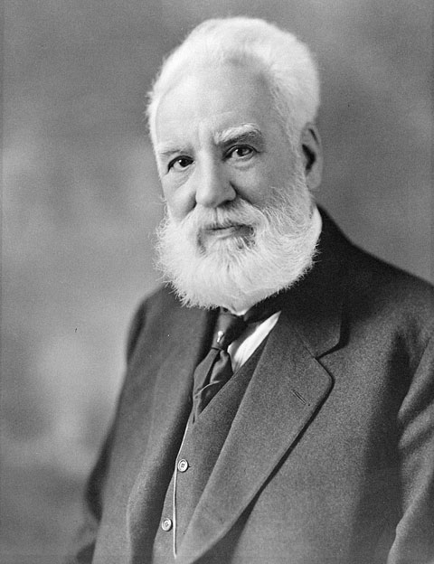
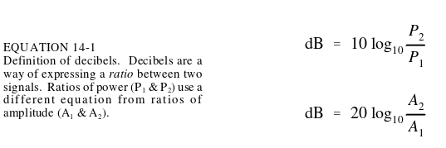
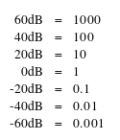
Decibel (dB)
-3dB means amplitude is .707 (power is .5)
  Analog filters normal define cutoff frequency at this point
Commonly used to show stopband attentuation
Decibels to amplitude ratios

Slide 12
LPF/HPF/BPF/BRF
Many methods to convert filters from one kind to another
  Spectral inversion
  Spectral reversal

Slide 13
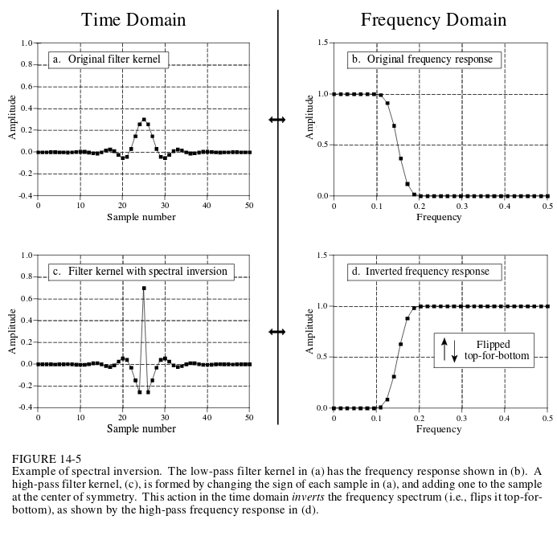
Spectral Inversion
Negate original filter kernel
Add 1 at center of symmetry
Then boom!
LPF becomes HPF

Slide 14
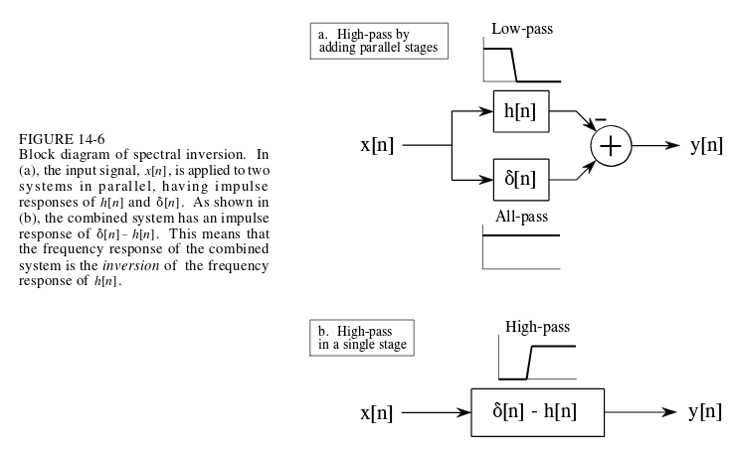
Spectral Inversion is magic
Phase must be the same

Slide 15
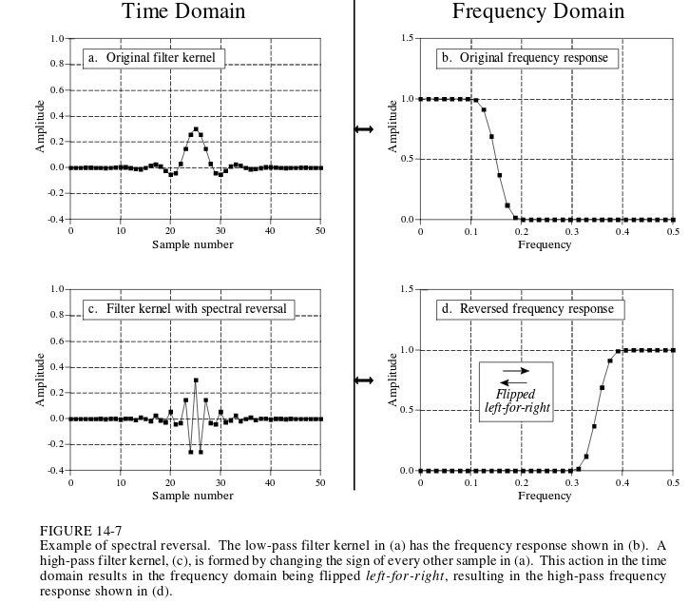
Spectral Reversal
Negate every other sample in filter kernel

Slide 16
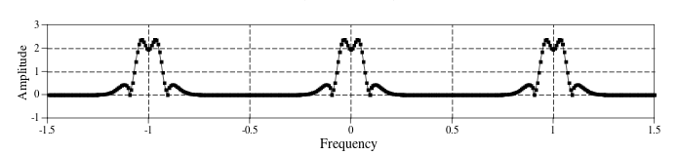
Spectral Reversal is magic
Is equivalent to multiplying a signal by a sinusoid with .5 frequency
  This shifts the frequency spectrum by .5
Mirrored negative frequency gets shifted up
Mirrored positive frequency gets shifted down
Remember #5 from Ch10’s non computer homework?

Slide 17
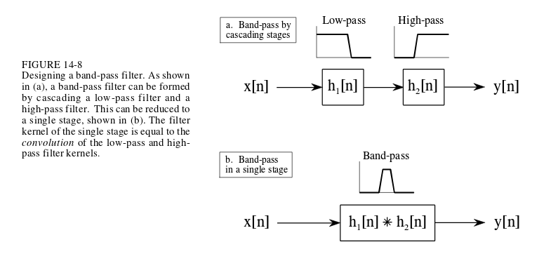
BPF
Convolve LPF and HPF to get BPF
Add LPF and HPF to get BRF

