Slide 1
Ch7 of the book
Properties of Convolution
Or a bunch of random things in a chapter

Slide 2
Impulses for things
First difference = {1,-1,0,0,0}
  Discrete derivative
  Convolving can be expensive so you can also do:
    y[n] = x[n] – x[n-1]
    See Newton’s Difference Quotient
Running Sum = {1,1,1,1,1,1,1….} forever
  Discrete integral
  Forever is a little nasty to use
  Can be expensive so you can do:
    y[n] = x[n] + y[n-1]
Derivative & Integral are inverse operations, and so are First Difference and Running Sum

Slide 3
Filters
Low pass filters in general are a group of adjacent positive points
  Causes a weighted average of points so it smoothes out the signal and remove high frequency components
Cutoff frequency can be altered by changing size of filter kernel
  What’s the exact relationship though? Are the kernel samples affected by the sample rate of input data?
If a LPF has a gain of 1 at DC, all the components in impulse must add up to 1

Slide 4
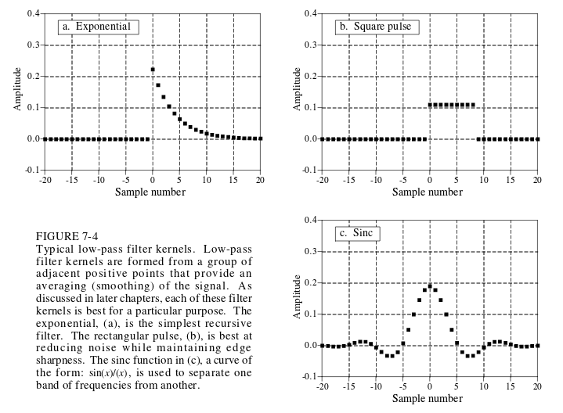

Slide 5
Filters
High pass filters can be derived from a low pass filter by computing δ[n] – lpf[n], then adding the delta function at the center of symmetry, or sample 0 if there is no center of symmetry
  Not only way, but is common
HPFs have zero gain at DC, which means all the components add to 0 in the impulse

Slide 6
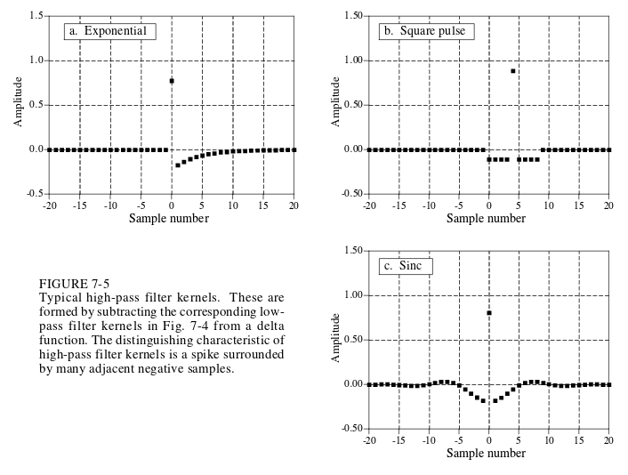

Slide 7
Describing Signals
Causal – If non-zero valued samples only appear after sample 0
  For convolution means an impulse at input sample n only affects output samples at n or greater
Noncausal – If non-zero valued samples appear before sample 0
  What’s the use of these in practice?

Slide 8
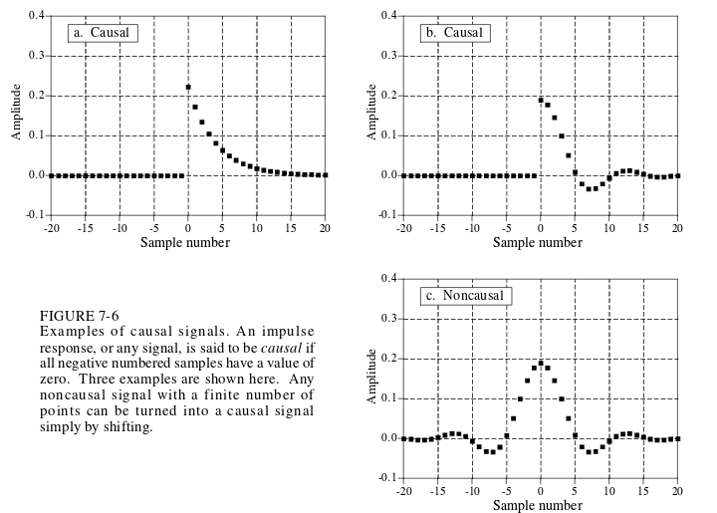

Slide 9
Phase
Zero phase – if signal has left-right symmetry around sample 0
Linear phase – if signal has left-right symmetery around any sample but 0
Nonlinear phase – No symmetry in signal
  Not related to linearity / nonlinearity of a system
Phase names relate to frequency spectrum
  Eg spectrum of signal symmetric around 0 will have a phase of 0

Slide 10
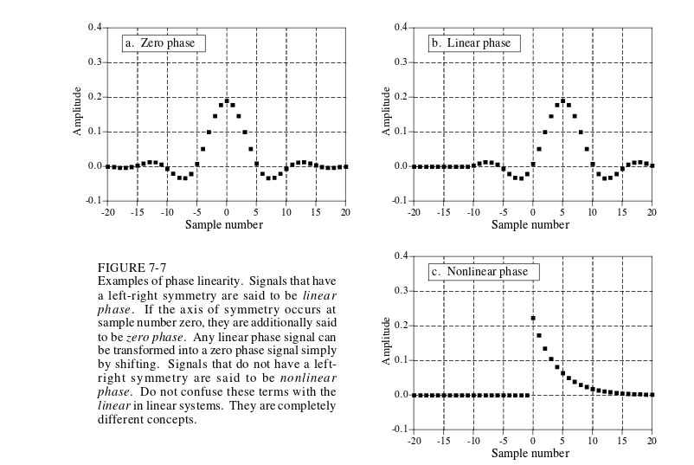

Slide 11
Math Properties
δ_δ
Identity: x[n]✴δ[n] = x[n]
Amplify/attentuate: x[n]✴kδ[n] = kx[n]
Shift/Delay/Advance: x[n]✴δ[n+s] = x[n+s]
Commutative: a[n]✴b[n] = b[n]✴a[n]
Associative:
  (a[n]✴b[n])✴c[n] = a[n]✴(b[n]✴c[n])
  Describes cascaded systems

Slide 12
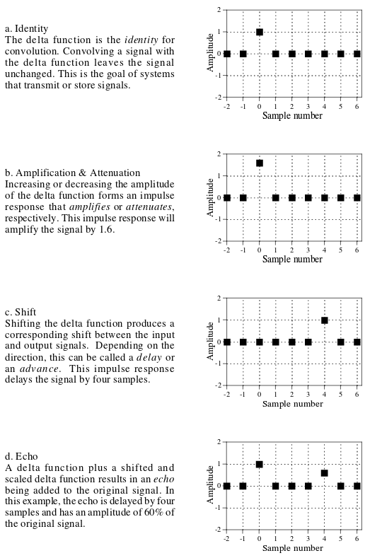

Slide 13
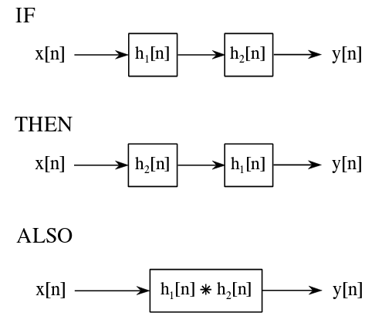
Cascading

Slide 14
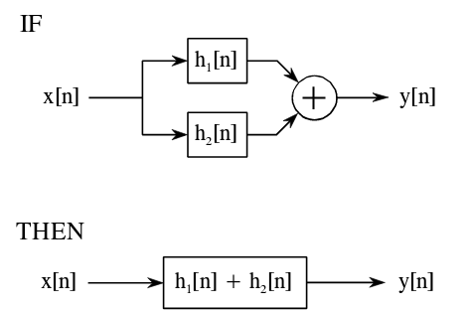
Math Properties
Distributive:
  a[n]✴b[n]+a[n]✴c[n] = a[n]✴(b[n]+c[n])
  Describes parallel systems with added outputs

Slide 15
Math Properties
Transference between input and output:
  Changing input in a linear way changes output in the same linear way
    Eg if x[n] yields y[n] then 2x[n] will yield 2y[n]
Central Limit Theorem
  Convolving a signal with itself enough times will eventually yield gaussian noise
  Width of resulting gaussian is width of original pulse multiplied by sqrt(number of convolutions)

Slide 16
Correlation
Autocorrelation - correlate a signal with a time delayed version of itself
  Find periodicity of signal / patterns in it
Find a signal in another signal via cross-correlation
  Amplitude of output indicates how similar signals are at that location
  Optimal technique for detecting a signal in white random noise
  AKA matched filtering
In terms of convolution:
  Cross Correlation = a[n]✴b[-n]
Can be slow depending on signal size (FFT Convolution can have performance benefits)

