Slide 1
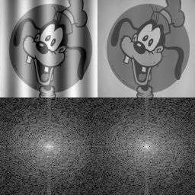
Chapter 8
The Discrete Fourier Transform
Notes:
Some resources on Fourier Transforms:
https://en.wikipedia.org/wiki/Fourier_transform
http://thefouriertransform.com/
https://www.cs.unm.edu/~brayer/vision/fourier.html
Goofy pic → Can help remove things like scan lines in images (FFT Filtering)

Slide 2
Fourier Transform
Laplace is cooler
Transform – Changes some set of data into another
Fourier Transform decomposes an input signal into a series of sinusoids
  Can be thought of as turning a time domain signal into a frequency domain signal
  Does not work perfectly on hard edges (for continuous signals)
    https://en.wikipedia.org/wiki/Gibbs_phenomenon
  Real Discrete Fourier Transform – Used on digitized signals
    Works on hard edges
    N point signal decomposed in N+2 signals (each with N points)
      Half complex/imaginary (sine waves), half real (cosine waves)
      0th and last signal of sine waves are always 0. Why? I have no idea

Slide 3
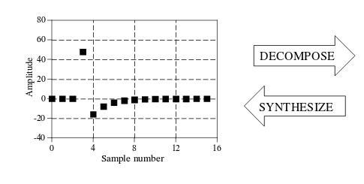

Slide 4
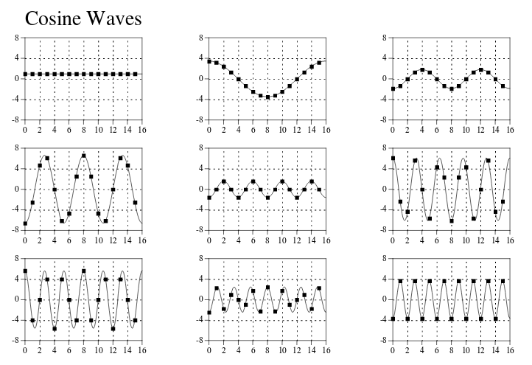

Slide 5
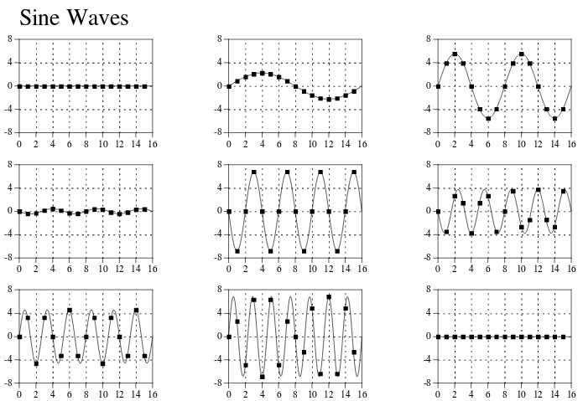

Slide 6
Why?
Easier to work with sinusoids than some complex input signal
  Each component has sinusoidal fidelity.
    Linearity - A sinusoid input yields a sinusoid output (potentially with differing amplitude and phase, same frequency though)
  Other decompositions possible, but not nearly as easy to work with

Slide 7
Fourier Family of Four
Aperiodic-Continuous signals like exponential decay or gaussian with Fourier Transform
Periodic-Continuous signals like sines, squares, etc, with Fourier Series
Aperiodic-Discrete with Discrete Time Fourier Transform
Periodic-Discrete with Discrete Fourier Transform (sometimes called Discrete Fourier Series)

Slide 8
The Fouriers
All four defined for signals from [∞, -∞]
  If your data isn’t infinitely long pretend it is
    0 out all other points so signal looks Aperiodic-Discrete (and like ignore the rest)
    Copy-paste your signal back to back so it looks Periodic-Discrete
  An aperiodic signal takes an infinite number of sinusoids to synthesize
    Goes forever, has no pattern, so you can’t really define it with a few waves

Slide 9
Discrete Fourier Transform
The only usable fourier type for DSP
  Discrete
  doesn’t need an infinite set of sinusoids, because we assume periodicity
  We must act like the input and output of a DFT is periodic and never ending or we can be confused by results
    Not because it is nice, but we’re trying to jam our signal (a square peg) into the DFT (a round hole). But that round hole is real nice.
Notes:
Real DFT – Complex is later

Slide 10
Real DFT
Complex DFT in Chapter 31
  It has advantages, etc. GO LOOK THERE
Usually consists of N samples, where N is a power of 2
  The most efficient DFT algorithm, the FFT usually operates with an N that is a power of 2
Output notation: Re X[] for real parts, Im X[] for imaginary parts
  Rather than have whole signals, Re X[n] / Im X[n] effectively store just an amplitude value, say in the case of an FFT
Common notations for x-axis on frequency plots
  0 to N/2 samples in DFT output
  Fraction of sampling rate
    Range from 0 to .5 (>.5 is aliased)
    f is used as index
  Radians
    ω, the natural frequency, is used as index
    Fraction of sampling rate * 2π
  Analog frequencies

Slide 11
Inverse DFT
Synthesis – Reverse of decomposition, turn frequency components back into time domain signal

Slide 12
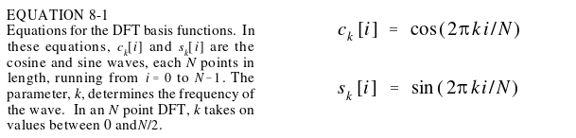
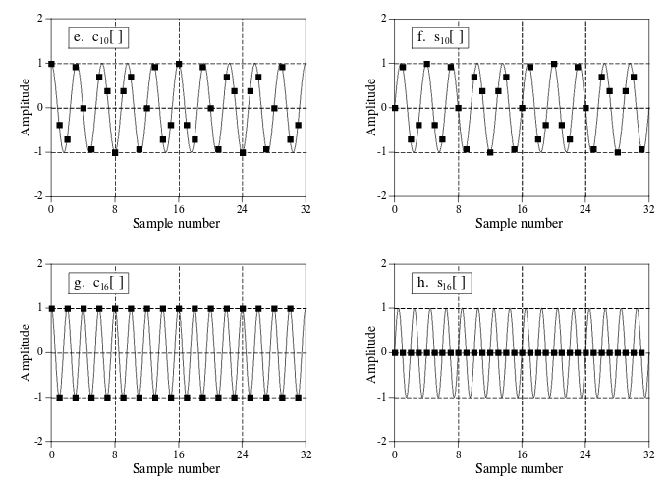
Inverse DFT
DFT Basis Functions
N+2 total siggies
Notes:
Describes frequency of each of the generated outputs of the DFT
-Signal 0 (k = 0) for Re X is DC offset or average of all the values in the signal
-Signal 1 (k = 1) for both Re and Im will show a wave that has completed one period and so on
Im X[0] and Im X[N/2] are always zero.

Slide 13
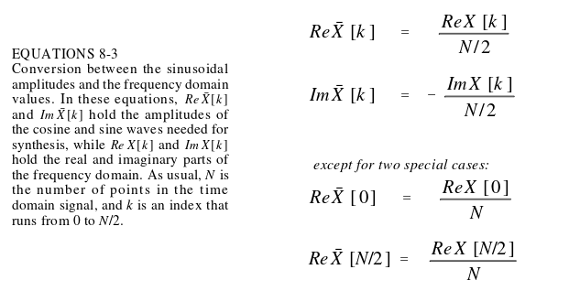
Inverse DFT
Normalizing outputs of DFT
Can take basis functions and multiply by matching DFT output (Re X[n] / Im X[n]) to get the original time domain signal
Negated to make consistent with Complex DFT is much explained later
Why are they special?
If you think of the frequency buckets as bandwidths, the edges have half the width.
Im X[0] and Im X[N/2] are always zero so it doesn’t matter for those

Slide 14
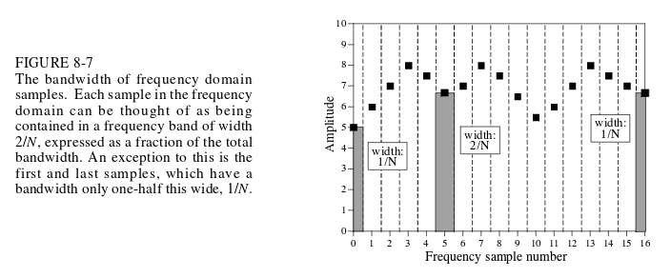
The thing about the bands
Frequency domain information describes the spectral density (how much signal amplitude is present per unit of bandwidth)

Slide 15
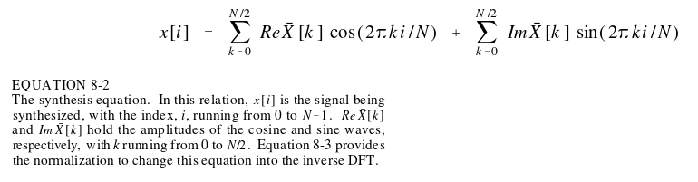
reiruoF esrevnI
The synthesis equation:

Slide 16
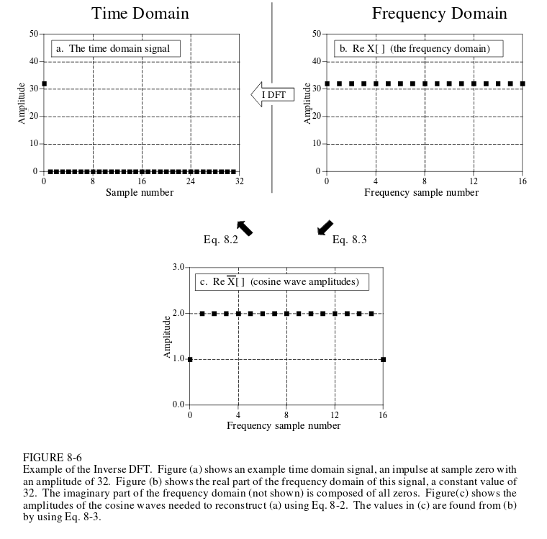
Why you normalize
Notes:
Just shows the reason for scaling.
Original signal has 32 for amplitude
DFT output would yield for each n in X[n] amplitude of 32, summing all the components would get 32*16.
Normalizing it by the number of samples (16) would get amplitude of 2. Doing the synthesis equation would then get you back to original signal of 2.

Slide 17
How to DFT
DFT by Simultaneous Equations
  x[0] = X₀[0] + X₁[0] + … + X_{N+2}[0]
  ….
  x[N] = X₀[N] + X₁[N] + … + X_{N+2}[N]
  Slower than a snail stuck in super glue
DFT by Correlation
  Correlation is for finding a wave in another wave
Fast Fourier Transform (ch 12)
  Stupid fast compared to other methods

Slide 18
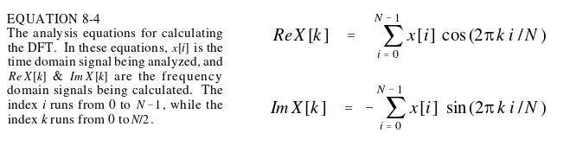
DFT by Correlation
Correlate input signal with each basis function
Each basis function must be and is orthogonal
  sum(basis1 * basis 2) == 0

Slide 19
Duality
Symmetry between time and frequency domain
  A single point in frequency domain is a sinusoid in time domain
  A single point in time domain is a sinusoid in frequency domain
  Convolution in time domain is multiplication in frequency domain
    Will see later on FFT Convolution
  More in other chapters >: |

Slide 20
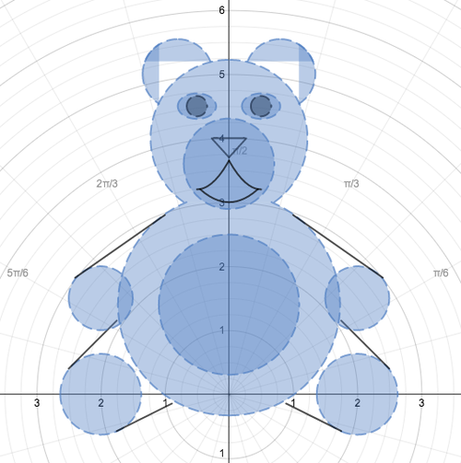
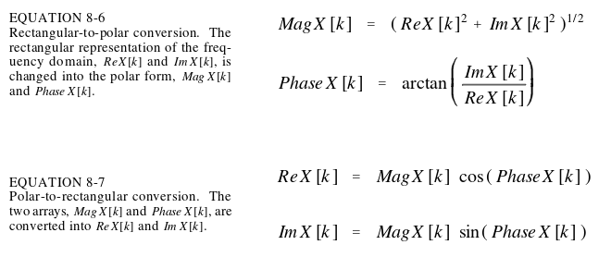
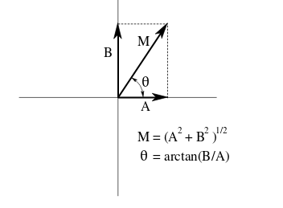
Polar Notation
Why?
Can be easier to understand than rectangular notation
Remember sinusoidal fidelity. Only phase and amplitude of system output can change, polar coordinates represent these.
Notes:
Think about DFT in multiple way
rectangular → N point signal becomes N/2+1 cosine waves and N/2+1 sine waves each with a specif amplitude
polar → N point signal becomes N/2+1 cosine waves with an amplitude and phase shift

Slide 21
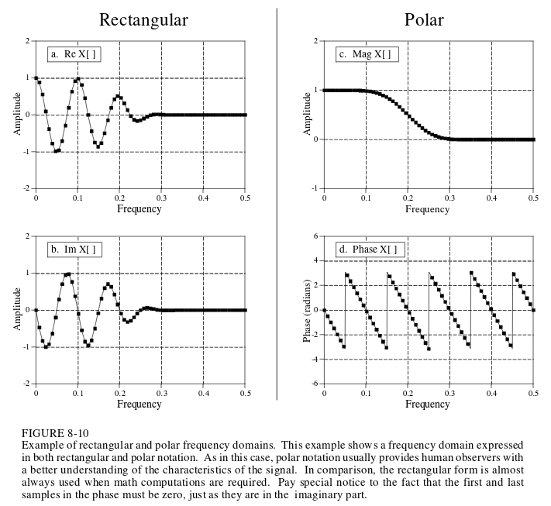
t
Notes:
Only frequencies below about .25 are present.
Hard to tell from the Rectangular coordinates.

Slide 22
Why Polar is annoying
Radians or degrees can be used to express
Dividing by zero
  In arctan(Im X[k] / Re X[k]) conversion
  Just means phase is 90 or -90 degrees
Arctan will give wrong answer for our conversion
  If Re X[k] and Im X[k] is negative, phase will be off by π, so subtract π radians
  If Re X[k] and Im X[k] is postive, add π radians
Small magnitude values yield wrong phase because they get wrecked by floating point issues
  Not apparent by looking at phase output, need to check if magnitude is small
Notes:
For div by zero, check Re X[k] is zero before hand.

Slide 23
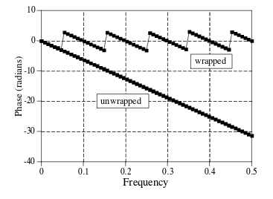
More bad things
Phase Discontinuities
  When phase is about to reach -π it can snap back to π. This is due to periodic nature of sinusoids (the representation only shows -π to π. For example, 3π is the same as a 1π phase shift)
  Can “unwrap” it to make it easier to understand

Slide 24

MORE BAD THINGS?!
Magnitude is always postive
  Appears to have sharp discontinuities or abrupt changes because of this
  Spikes between π and -π
    Both represent same phase shift, but round off / floating point wankery can cause outputs to switch between both quickly

