Slide 1
Ch 16
Windowed-Sinc Filters

Slide 2
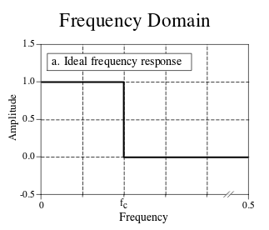
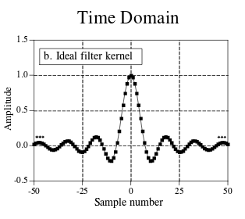
An Ideal LPF

Slide 3
The LPF Filter Kernel is a sinc function
h[i] = sin(2πf_{c}i) / (iπ)
  Ripples last forever from -∞ to ∞
    Can’t computer that
How to use this with a computer then?
  Truncate the signal
  Shift signal so there are no negative time values
  Apply a windowing function to gentle taper ends of signal

Slide 4
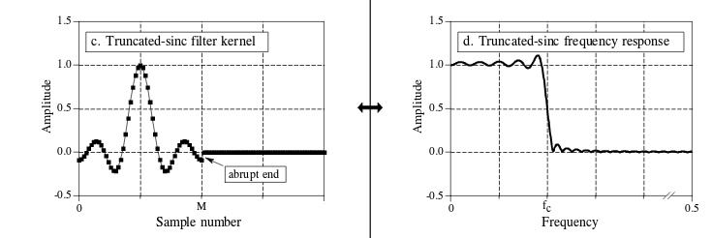
Truncate and shift the signal
Signal abruptly stops now
  Ringing and overshoot appears now :(
  More samples doesn’t help (see notebook)

Slide 5
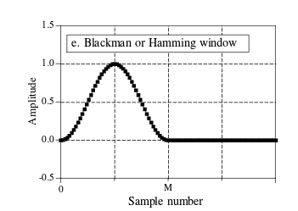
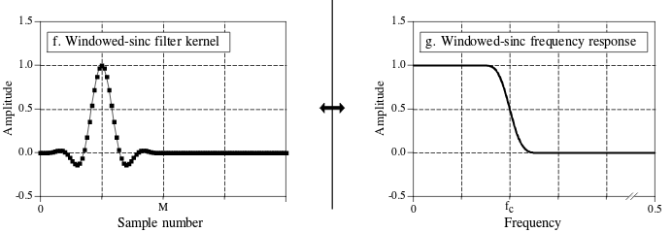
Apply windowing function

Slide 6
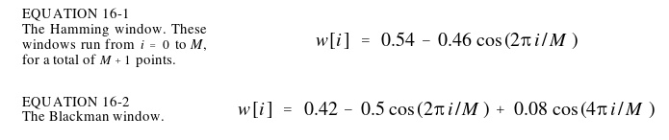
Which window?
Ones recommended by book:
Of course it will vary based on application
  Remember the chapter about windows and sidelobes / mainlobes?
  Consider rolloff and stop band attentuation

Slide 7
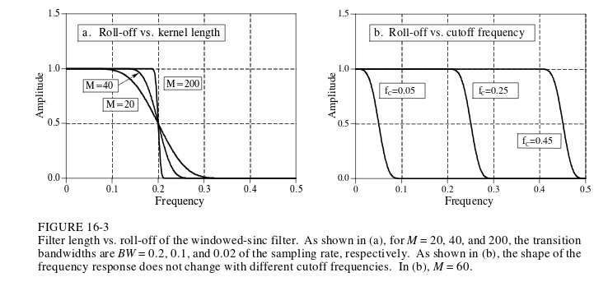
Window Rolloff
M ~= 4/Filter_Transition_Bandwidth
  Filter_Transition_Bandwidth is from .1 to .99 amplitude
  More samples leads to smaller filter bandwidth

Slide 8
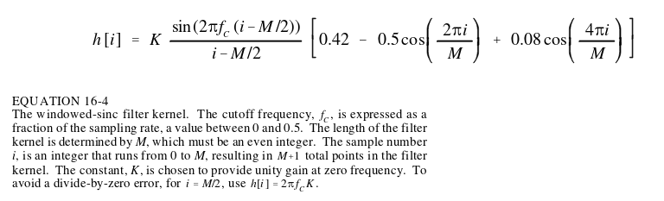
Make your own windowed sinc!
Easy peasy
Just a shifted sinc function muliplied by a window
Note f_{c} is defined where the amplitude is .5, not .707 like other filters because the windowed sinc is symmetric

Slide 9
Windowed Sinc
Simple to implement
Can be tuned to nearly any filtering performance level (great rolloff with more samples, great stopband attenuation, etc.)
Can have poor runtime though if number of samples in filter kernel is high

Slide 10
Easy to convert to HPF
Spectral Inversion – (Ch14) Negate time domain samples, add 1 to center of symmetry
  LPF with f_{c} of .25 can be spectrally inverted by doing the above to yield a HPF with f_{c} of .25
You can also do previously discussed techniques to make BPF, BRF

Slide 11
More stopband attentuation
Pass signal through the filter, not once, but twice
:O
Book example:
  Blackman window has -74dB stopband attentuation
  Filtering again will yield -148dB stopband attentuation

