Slide 1
Ch 11
Fourier Transform Pairs

Slide 2
Fourier Transform Pairs
Every time domain waveform has a corresponding frequency domain waveform and vice versa
  By Duality the following is true
    DFT(rect[n]) is a sinc
    DFT(sinc[n]) is a rect
  http://www.thefouriertransform.com/pairs/fourier.php

Slide 3
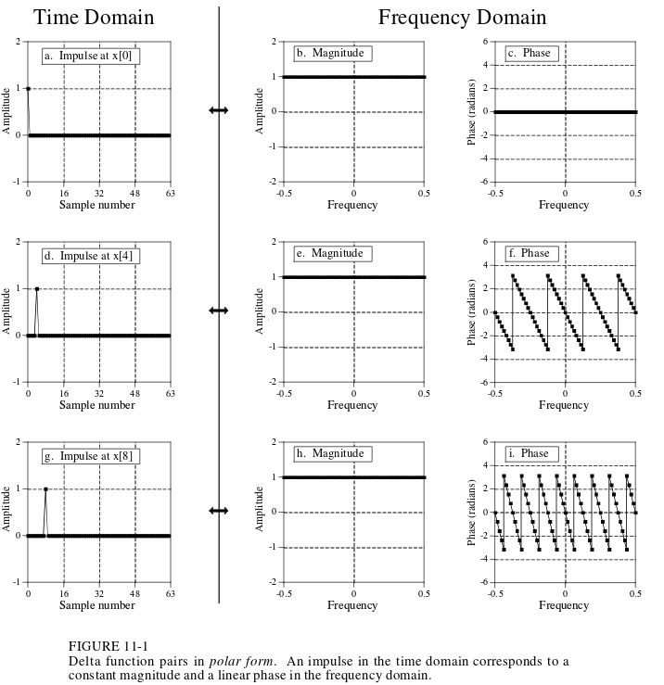
Impulse / Sinusoid
Remember shifting right lowers slope of phase
What does the DFT look like in rectangular?
Think of the duality

Slide 4
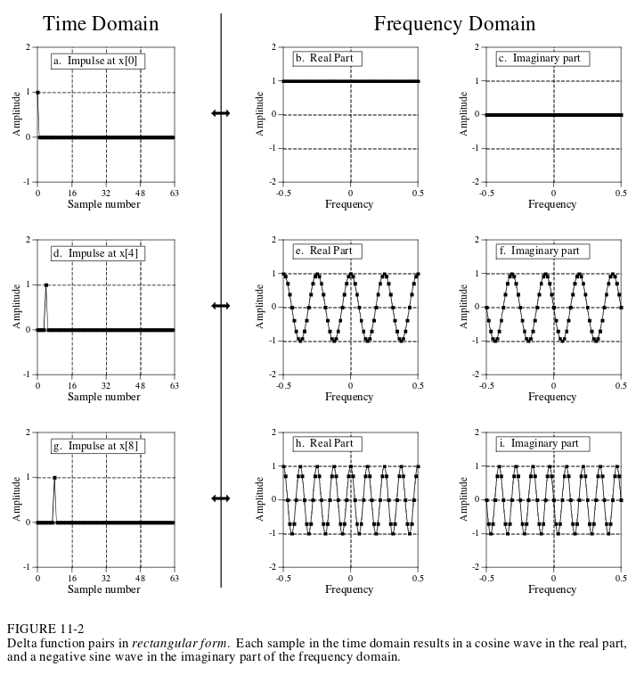
Think of the DFT of a sine/cosine wave.
If it completes 4 cycles over the course of the waveform, there will be an impulse at X[4].
The reverse is also true, if there is an impulse at x[4], then the frequency spectrum will have sinusoids that will complete 4 cycles in that same from f=0 to f=.5
Impulse ↔ Sinusoids
DFT(x[n]) = DFT(x[1]) + … + DFT(x[n-1])

Slide 5
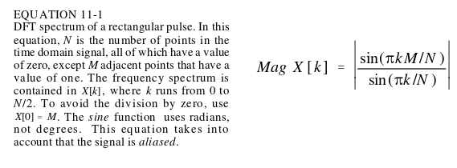
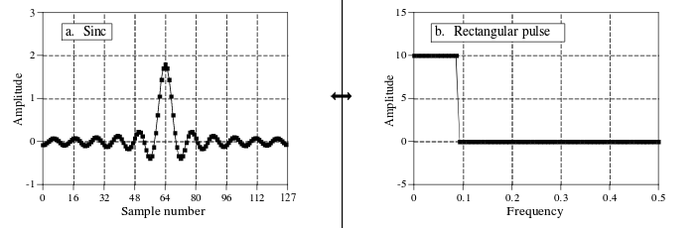
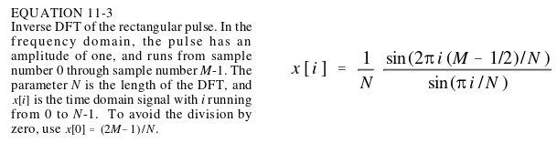
Rectangular Pulse / Sinc
FT of a rectangular pulse yields a sinc
  And vice versa
  For discrete signals this is an approximation
Note: k/N = f, a fraction of the sampling rate

Slide 6
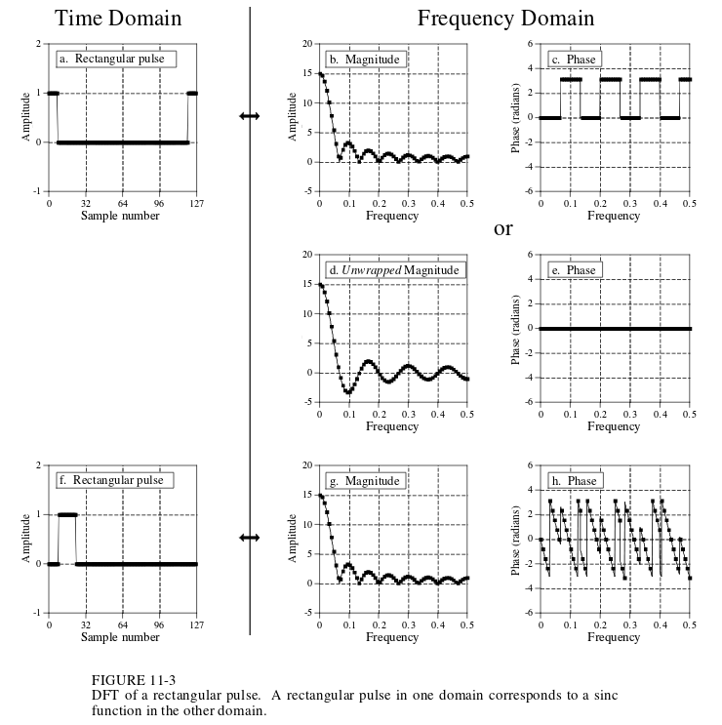
2
Note oscillations do not end at .5, they bleed into other periods

Slide 7
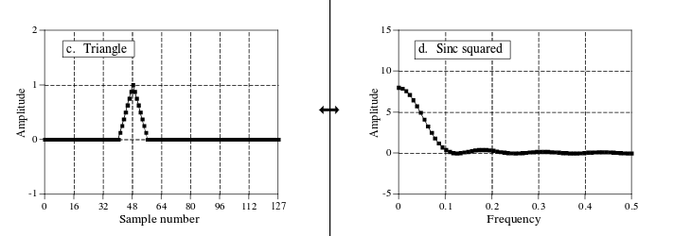
Triangle / Sinc Squared
How does triangle yield sinc squared?
  Time domain: rect∗rect = triangle
  So frequency domain is: sinc · sinc = sinc²

Slide 8
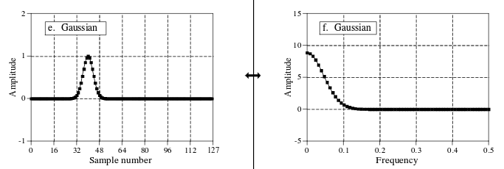
Gaussian / Gaussian
Gaussian in time domain yields gaussian in frequency domain
  And vice versa
  Relationship of time and frequency domain σ
    2πσ_{f} = 1/σ_{t}

Slide 9
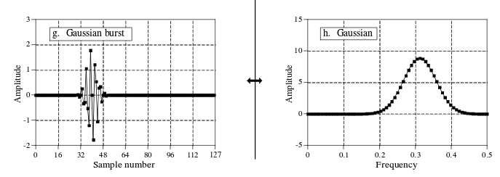
Gaussian Burst
Gaussian Burst is a gaussian multiplied by a sinusoid
Frequency domain is therefore a gauss convolved with a delta function (so it shifts from being centered at 0)

Slide 10
Ch 11.5
Not Fourier Transform Pairs

Slide 11
Gibbs Effect
The Gibbs Effect - Overshoot and ringing artifacts at jump discontinuities and sharp edges
  Theoretically wouldn’t appear if infinite values could be used to compute

Slide 12
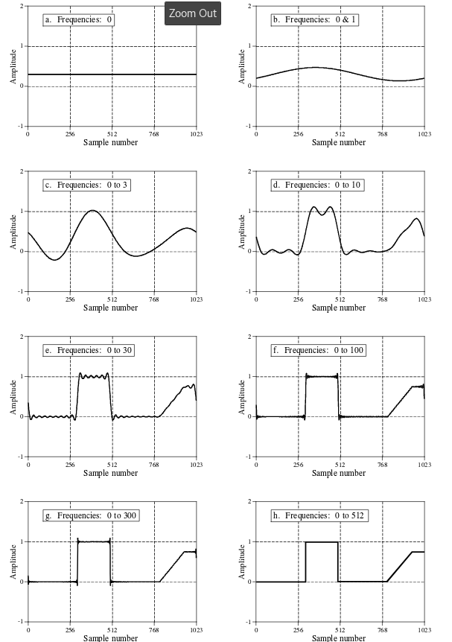
Synthesis Example

Slide 13
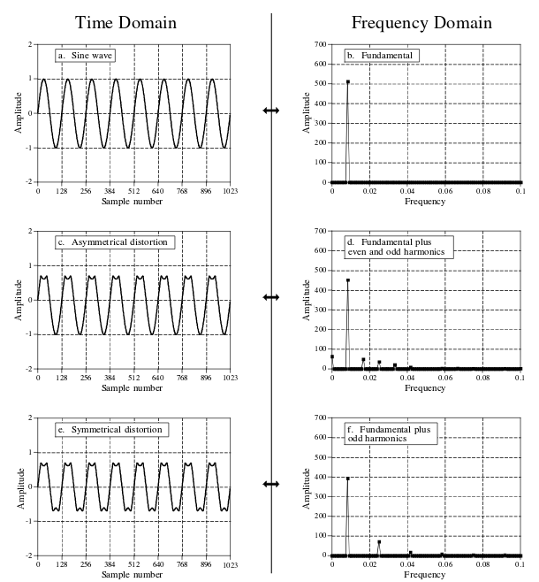
Harmonics
Harmonics – integral multiple of the fundamental frequency of a signal (period of f)
1st harmonic is f, 2nd harmonic is 2f, etc.
Can appear as harmonic aliasing (lots of low amplitude harmonics folding over into frequency spectrum)

Slide 14
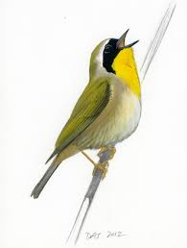

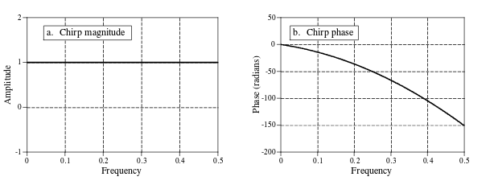
Chirp Signals
Uses in communications and radar
A signal that increases/decreases in frequency as time goes up

