Slide 1
Chapter 5
Linear Systems

Slide 2
Signals
Signal – how one parameter varies with another parameters (eg, voltage over time)
System – Any process that produces an output signal in response to an input signal
  Discrete systems and analog systems
Notation
  Continuous: x(t), y(t)
    Lower case and parentheses
  Discrete: x[n], y[n]
    Lower case and square brackets
  Frequency Domain is upper case (LATER CHAPTERS)

Slide 3

Why understand systems
Make a system to remove noise from an electrocardiogram
Image enhancement
Audio enhancement
Radar / Sonar

Slide 4
Linear Systems
Easy to work with linear systems
Many techniques available that only work with linear systems
Three requirements to be linear
  Homogeneity
  Additivity
  Shift invariance (not strict mathematical requirement, but is for most DSP techniques)
Intuitive view of linearity
  Static Linearity
  Sinusoidal Fidelity

Slide 5
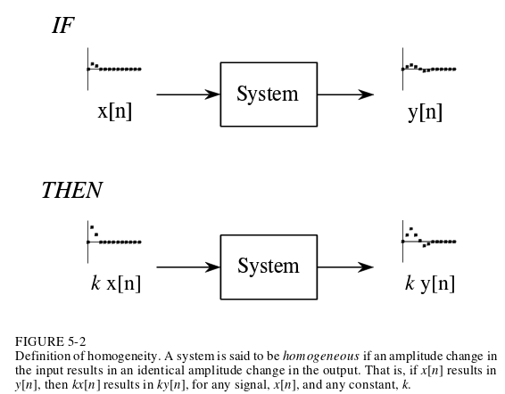
Homogeneity
Change in input signal amplitude results in a corresponding change in output signal amplitude
Notes:
LINEAR: Resistor – V = IR
If voltage goes up, current increases by same factor
NONLINEAR: Power – P = v^2 / R
If voltages goes up by factor of 2, power goes up by factor of 4

Slide 6
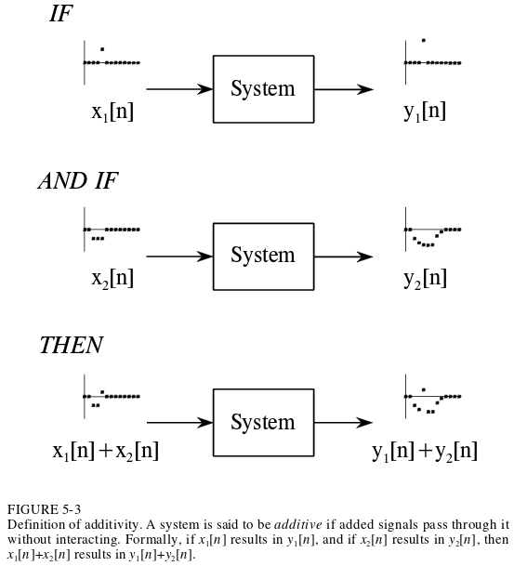
Additivity
Output of two signals from a system added together is equal to the output of two inputs added together then placed through system
  If they go through the system without interacting

Slide 7
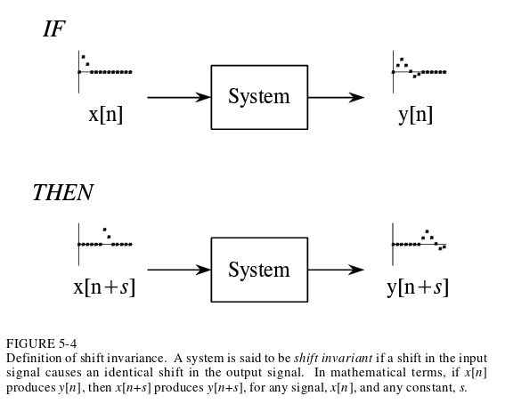
Shift invariance
Shift in input signal results in nothing more than shift in output signal
x[n+2] => signal shifted left two samples
Picture shows a negative s value

Slide 8
Static Linearity
How a linear system reacts when signals aren’t changing
Static response – the output equals the input multiplied by a constant
Not all systems with static linearity are linear systems
Memoryless systems – Output depends only on present input (no histeresis)

Slide 9
Sinusoidal Fidelity
If input to a linear system is a sinusoid, then the output will be a sinusoid
  Only sin waves have this property
  Amplitude and phase may be different
    Can have 0 amplitude

Slide 10
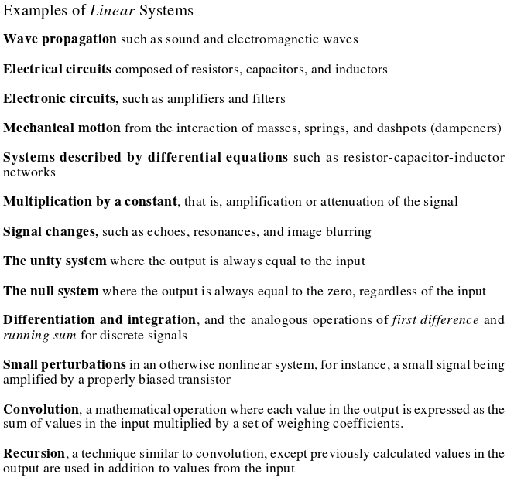

Slide 11
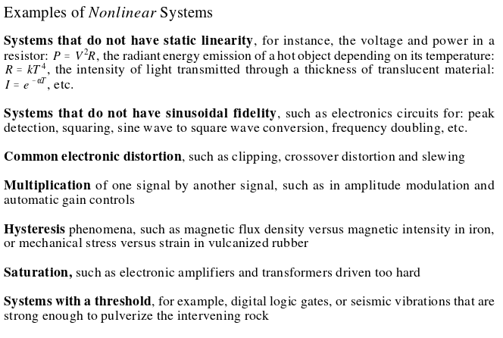

Slide 12
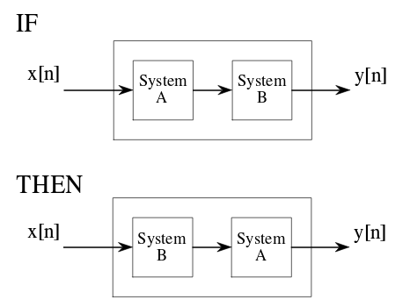
Properties
Linearity is commutative, order of operations doesn’t matter

Slide 13
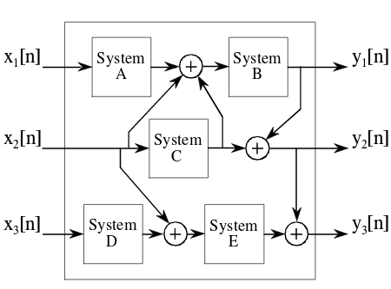
Properties
Systems with multiple input and outputs are linear if composed of linear subsystems and additions

Slide 14
Misunderstandings
A signal multiplied by a constant is linear
A signal multiplied by another signal is nonlinear
Are DC offsets and noise added to a signal linear or nonlinear?
  Linear if external to system
  Nonlinear if internal to system

Slide 15
Superposition
The Foundation of DSP (so remember this stuff)
Synthesis – Create a signal via addition of multiple signals
Decomposition – Create multiple signal components from a single signal

Slide 16
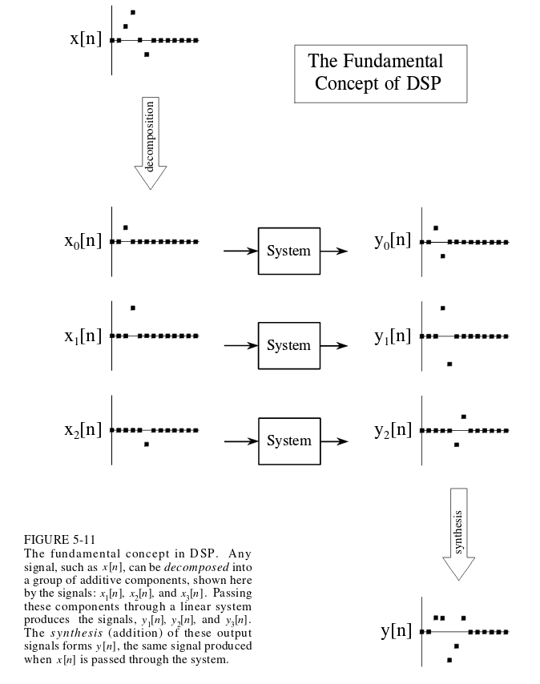
Superposition
Putting decomposition of signal into system then combing outputs same as putting original input into system

Slide 17
Superposition
Rather than analyze complex signals, we can analyze simple signals and combine that information
Basis of many many DSP techniques

Slide 18
Decompositions
Impulse Decomposition
  N component signals with N samples, each contains one point from original signal
Step Decomposition
  N component signals with N samples
  For component signal k, from x[0] to x[k-1] are 0, and from x[k] to x[N-1] the value is x[k]-x[k-1]

Slide 19
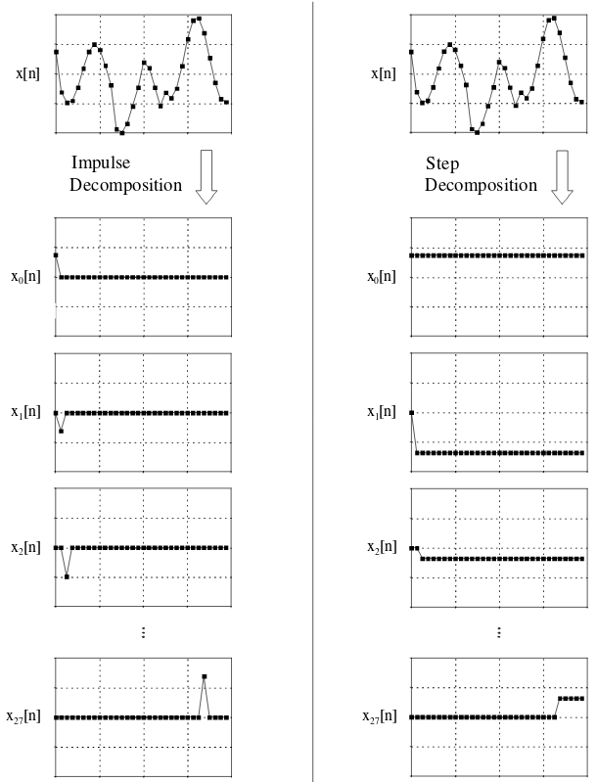

Slide 20
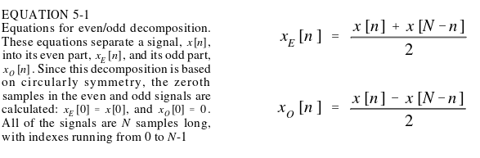
Decompositions
Even/Odd Decomposition
  Two components of N samples with even and odd symmetry
  Note x_{odd}[0] = 0, not x[0]
  Definitions assume even number of samples
Circular Symmetry – Viewing the end of the signal connects to the beginning of the signal
  Like in FFT
  Like in Even/Odd decomposition
Notes:
Even symmetry, odd symmetry

Slide 21
Decompositions
Interlaced Decomposition
  Two signals of N samples
    Even Sample signal – set all odd samples to 0
    Odd Sample signal – set all even samples to 0
  The basis for the FFT

Slide 22
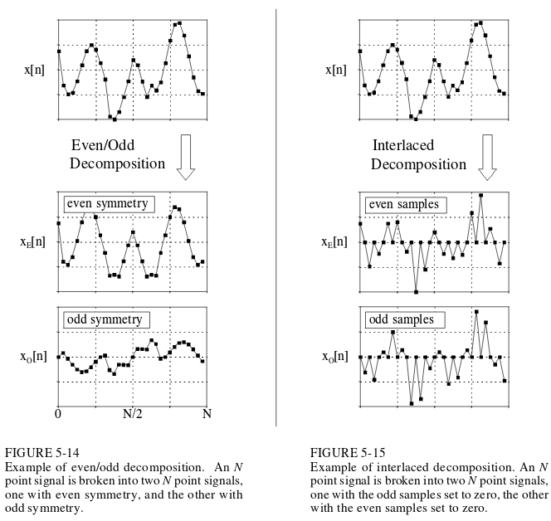

Slide 23
Decompositions
Fourier Decomposition (woo fourier)
  Any N point signal can be broken into N+2 signals
    Half the signals are sine waves, half of cosine waves
    Lowest frequency cosine wave is DC offset
    Each component has a fixed frequency; amplitude is the focus of this decomposition
  Important because
    Many signals are composed of superimposed sinusoids, eg audio
    Back to linearity, input sine wave yields output sine wave. Knowing how a system reacts to sinusoids allows the output to be found.
    Fourier analysis is large area of math and leads to Laplace (is cooler than Fourier) and Z-Transforms

Slide 24
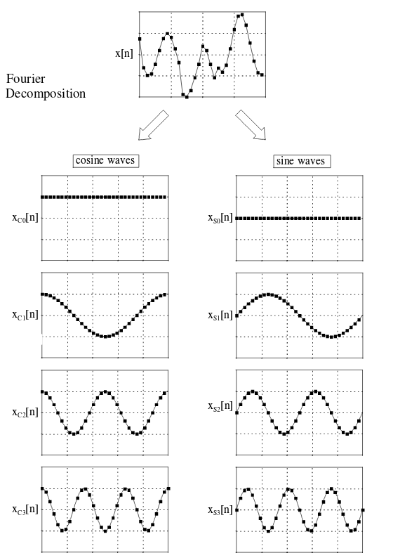

Slide 25

Non-linear Systems
To analyze non-linear systems
  Make it resemble a linear system
  If nonlinearity is small enough, you can ignore it and approximate the system as linear
    (How do I say what is small?)
  Keep the signals very small, many nonlinear systems appear linear on small inputs
  Apply a linearizing transform
    Eg: a[n] = b[n] * c[n] ==> log(a[n]) = log(b[n]) + log(c[n])

